Slide 1
















IT PARK BRIGADE IRV

Slide 2
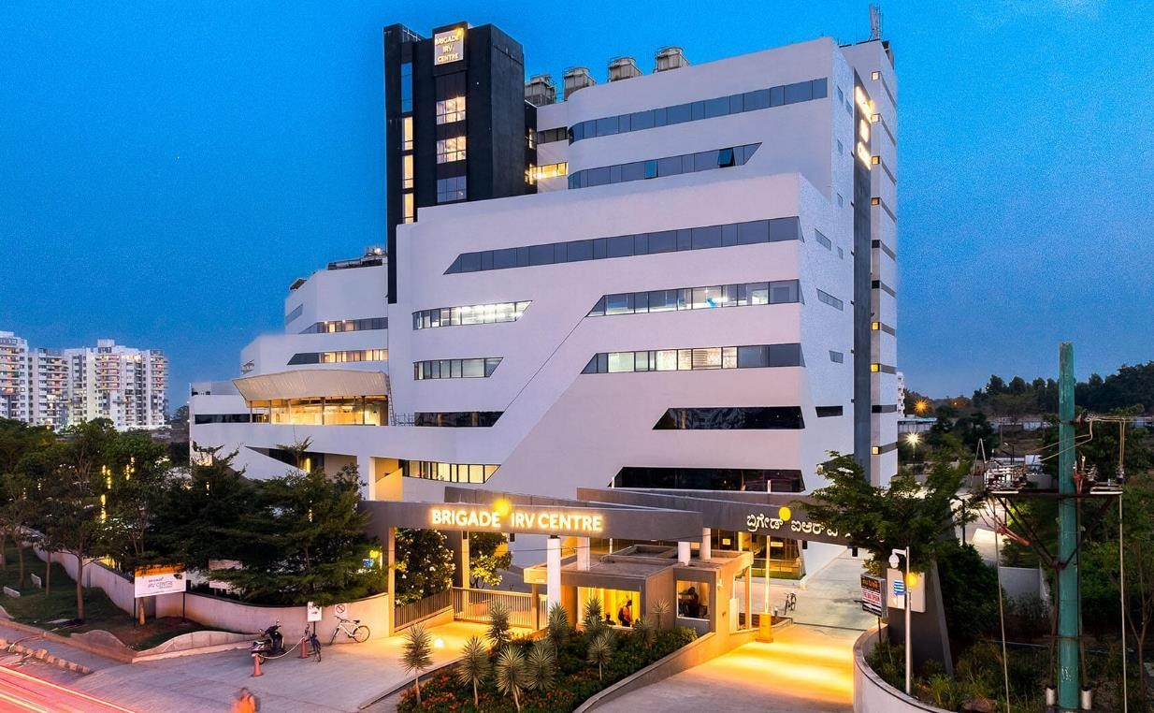








BRIGADE IRV

Slide 3




















BRIGADE IRV
White Field
1 Building Blocks
DOOH
Free Standing Unit
15,000 Employees
5,40,000 SFM

Slide 4
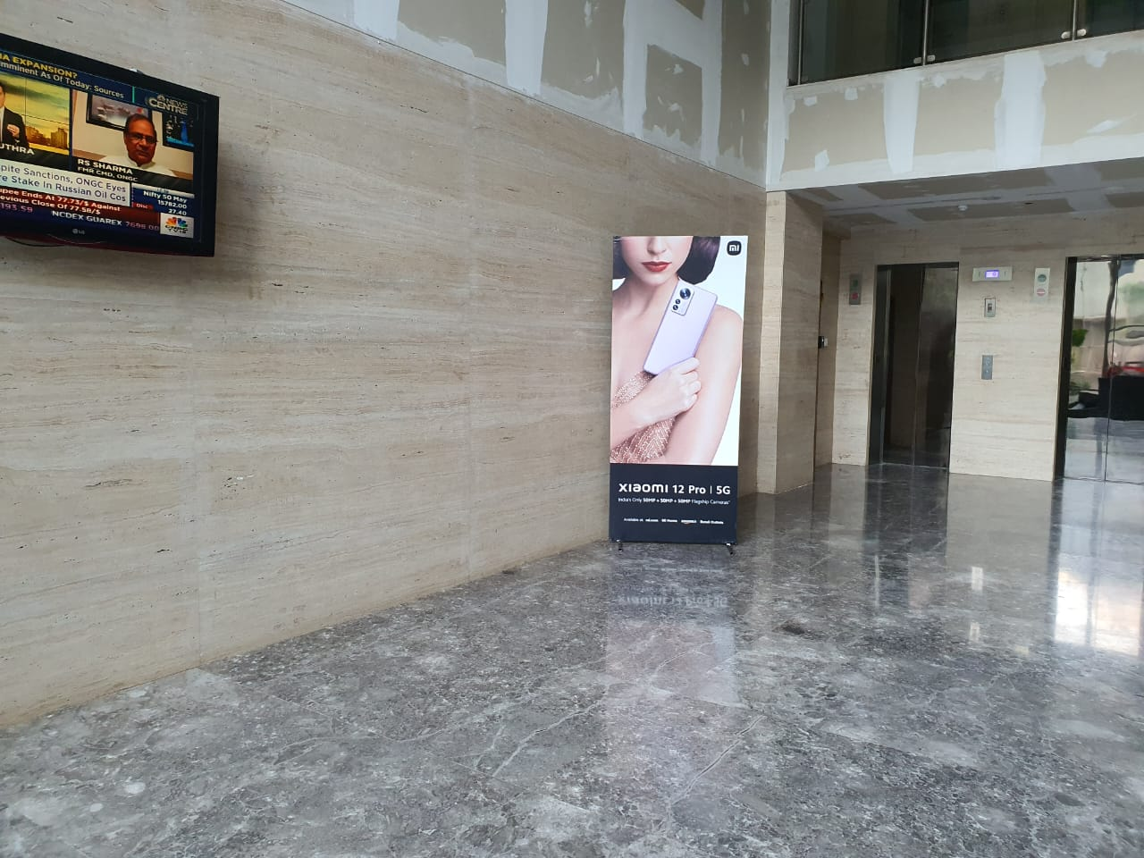
BRIGADE IRV
Type of the Media | Free Standing Unit
Media Location | Office Lobby/Elevator lobby
Total No. of Media | 4
Dimension - W X H (Feet) | 3*7

Slide 5
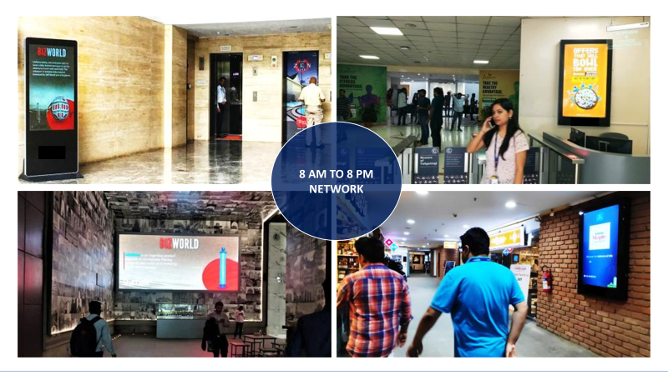

Slide 6


Slide 7


Slide 8


Slide 9
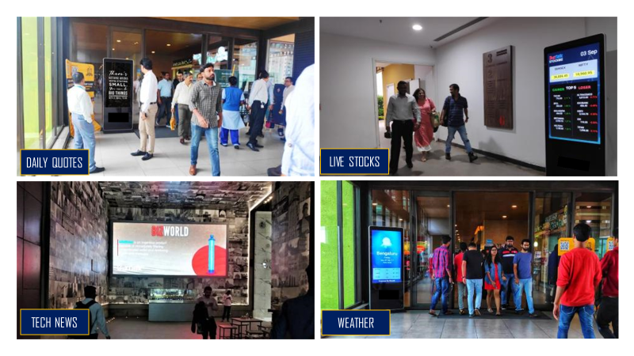

Slide 10
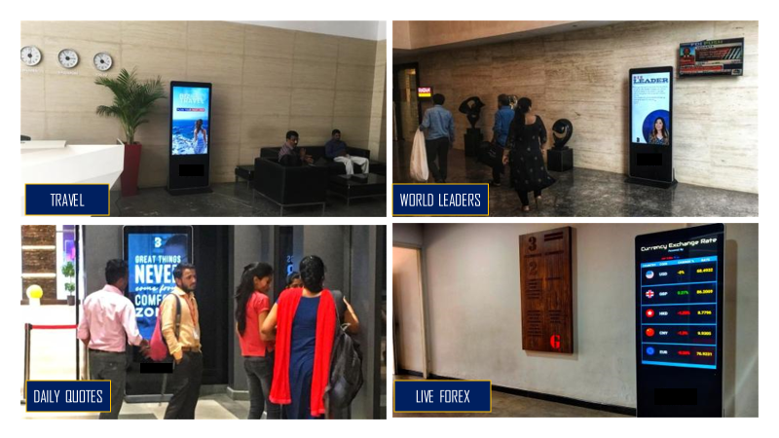

Slide 11


Slide 12











Thank You

