Slide 1
















Exora Business Park

Slide 2
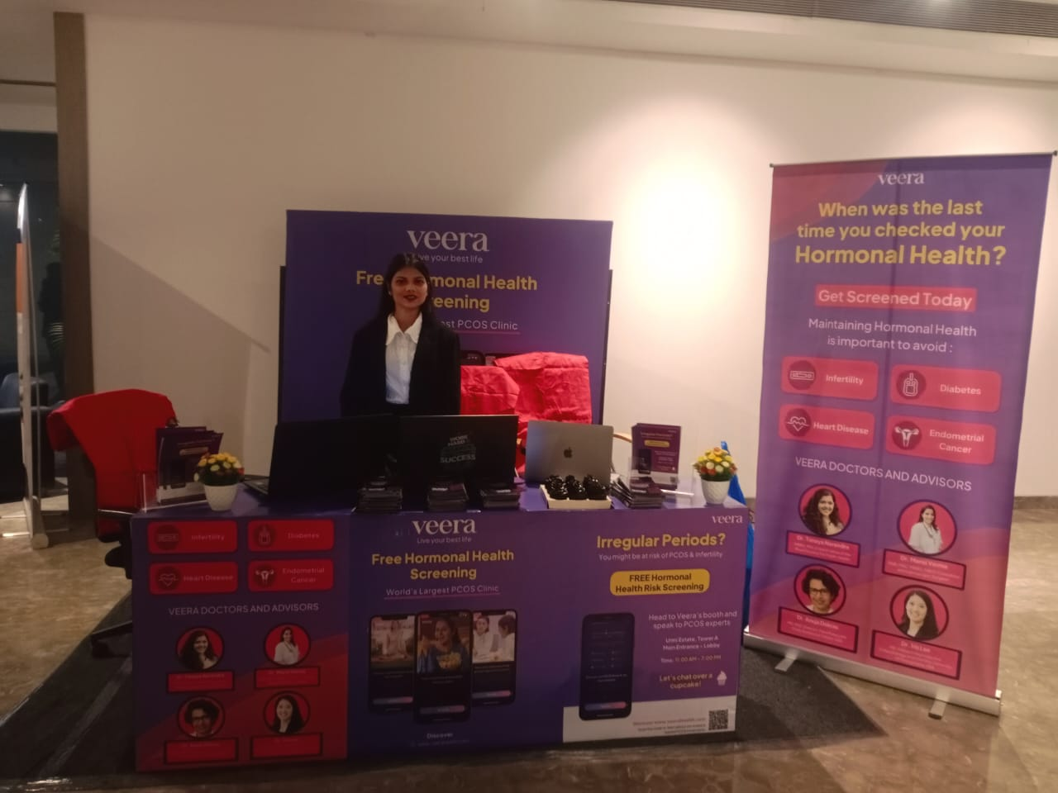
Kiosk Setup
Dimension: 10*10 (W x H).Ft
www.themediaant.com

Slide 3
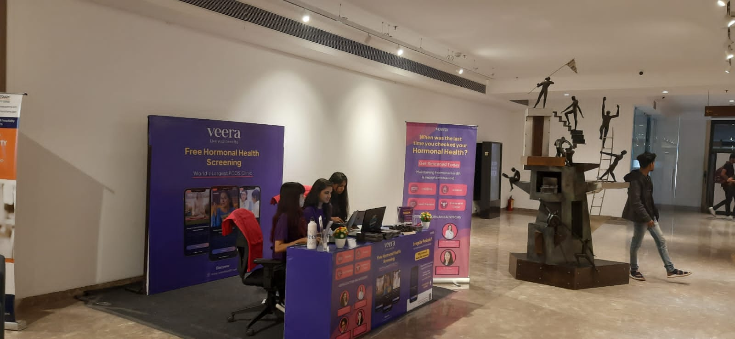
Kiosk Setup
Dimension: 10*10 (W x H).Ft
www.themediaant.com

Slide 4











Thank You

