Slide 1
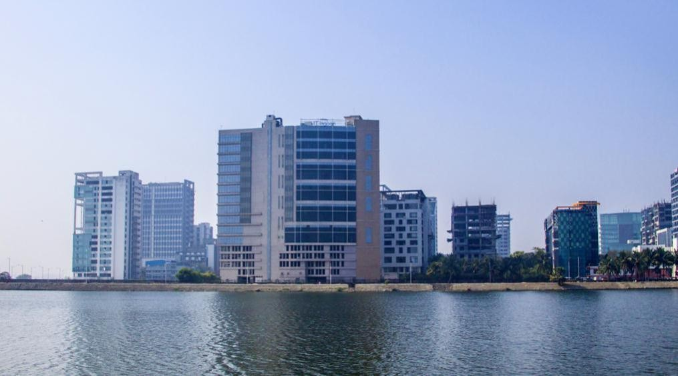
INFINITY IT LAGOON

Slide 2










INFINITY IT LAGOON
Salt Lake
1 Building Blocks
5,000 Employees
65,000 Sq.ft.
And more…

Slide 3
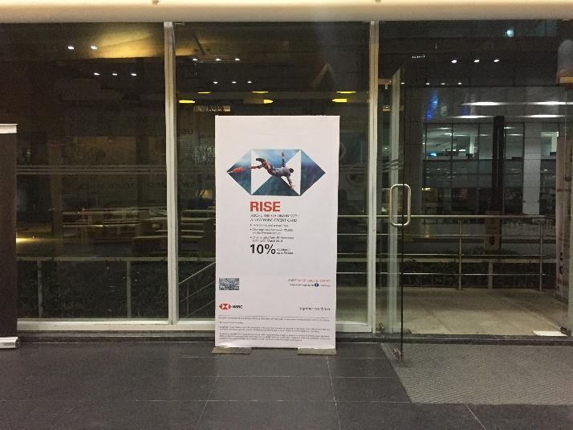

INFINITY IT LAGOON
Type of the Media | Free Standing Signage
Media Location | Office lobby
Total No. of Media | 6
Dimension - W X H (Feet) | 3 X 7

Slide 4
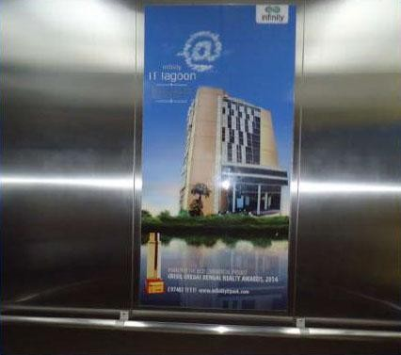
INFINITY IT LAGOON
Type of the Media | Snap Poster
Media Location | Inside Elevator
Total No. of Media | 15
Dimension - W X H (Feet) | 2 X 4

Slide 5


THANK YOU

