Slide 1
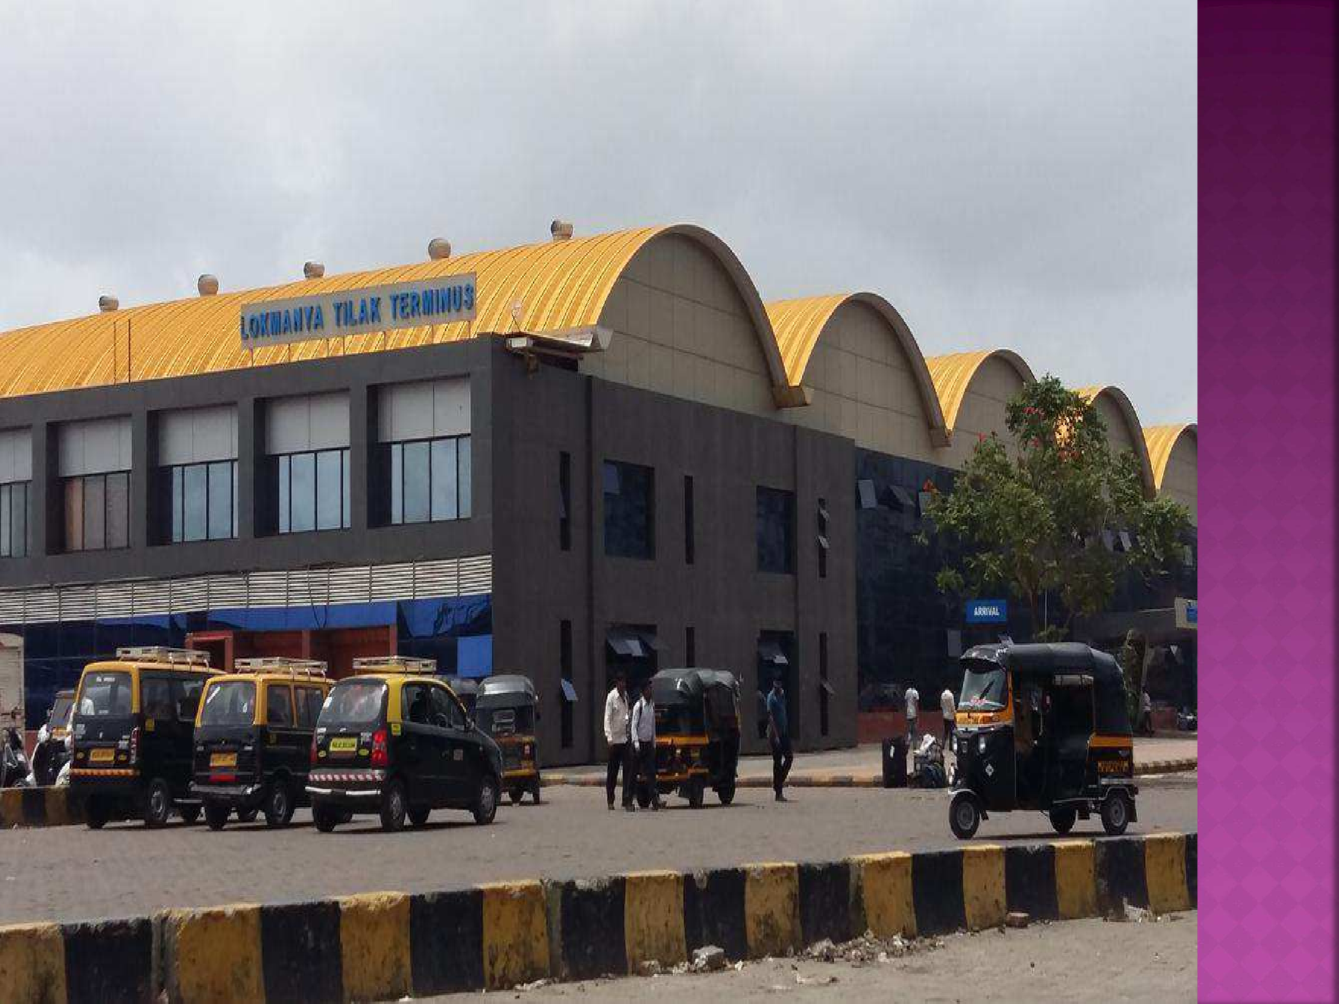

Slide 2
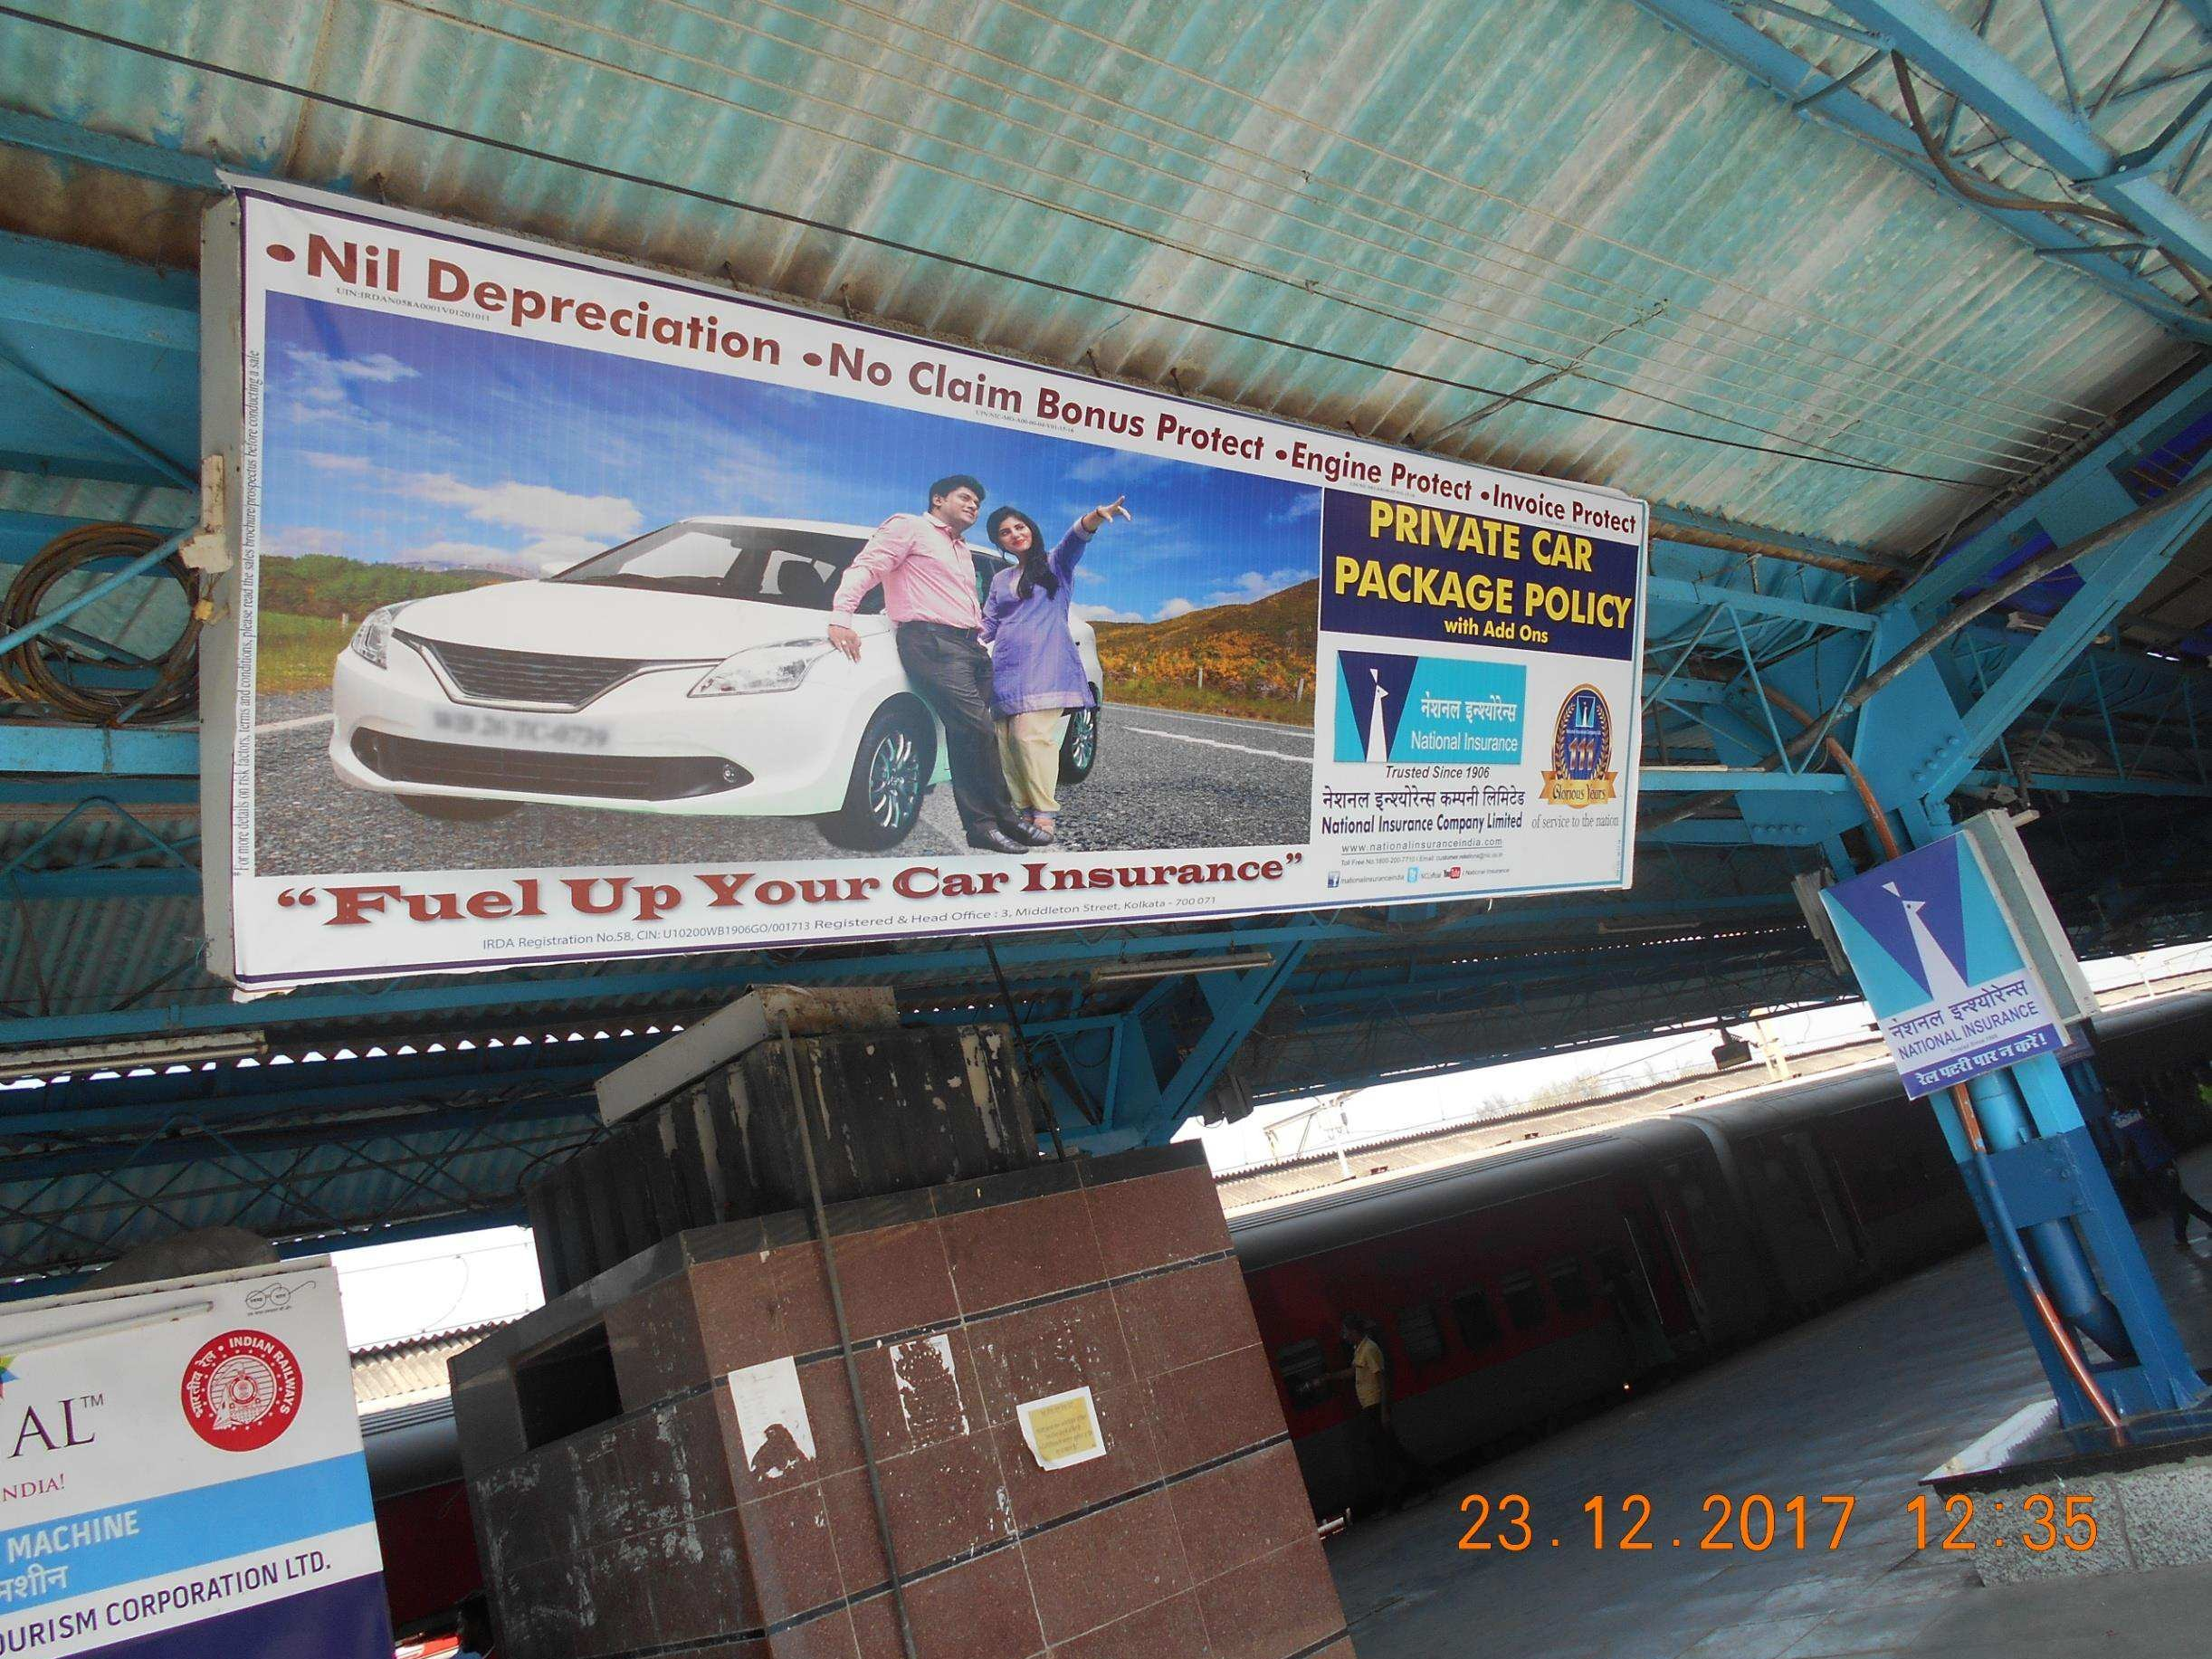

Slide 3
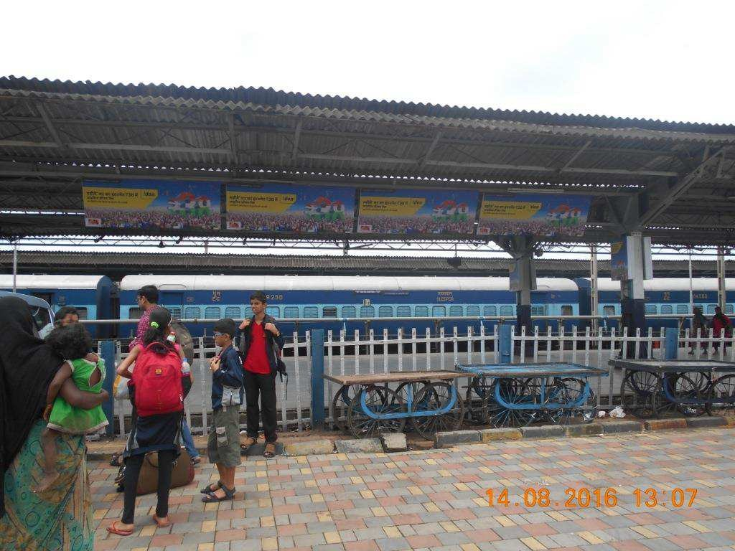

Slide 4


Slide 5
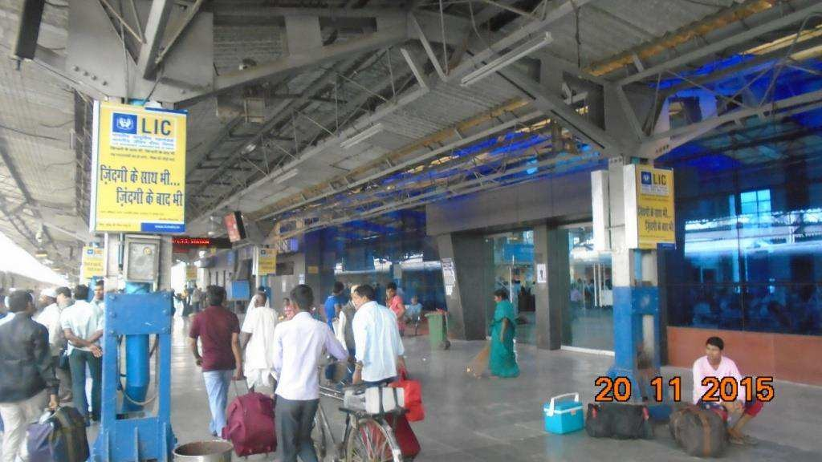

Slide 6
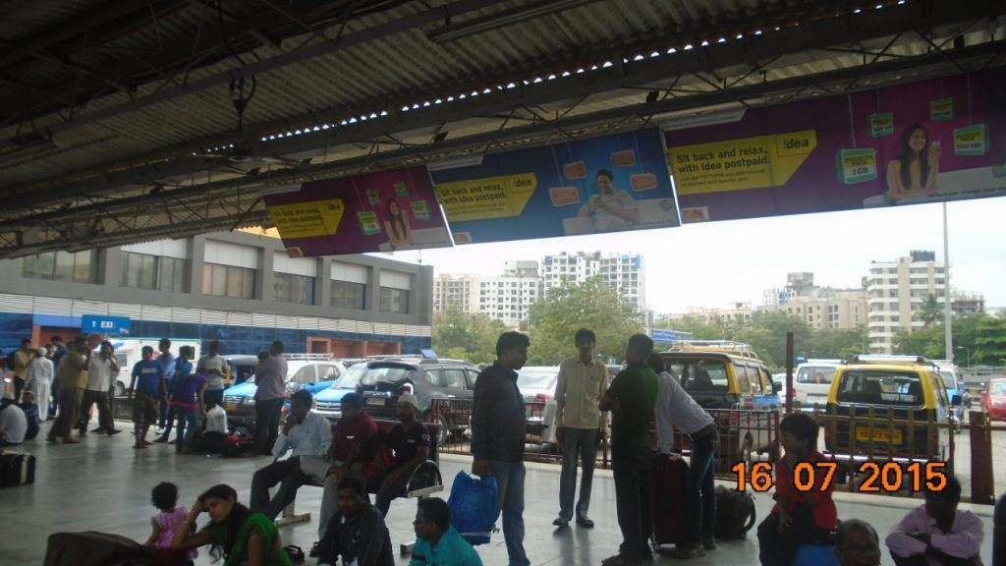

Slide 7
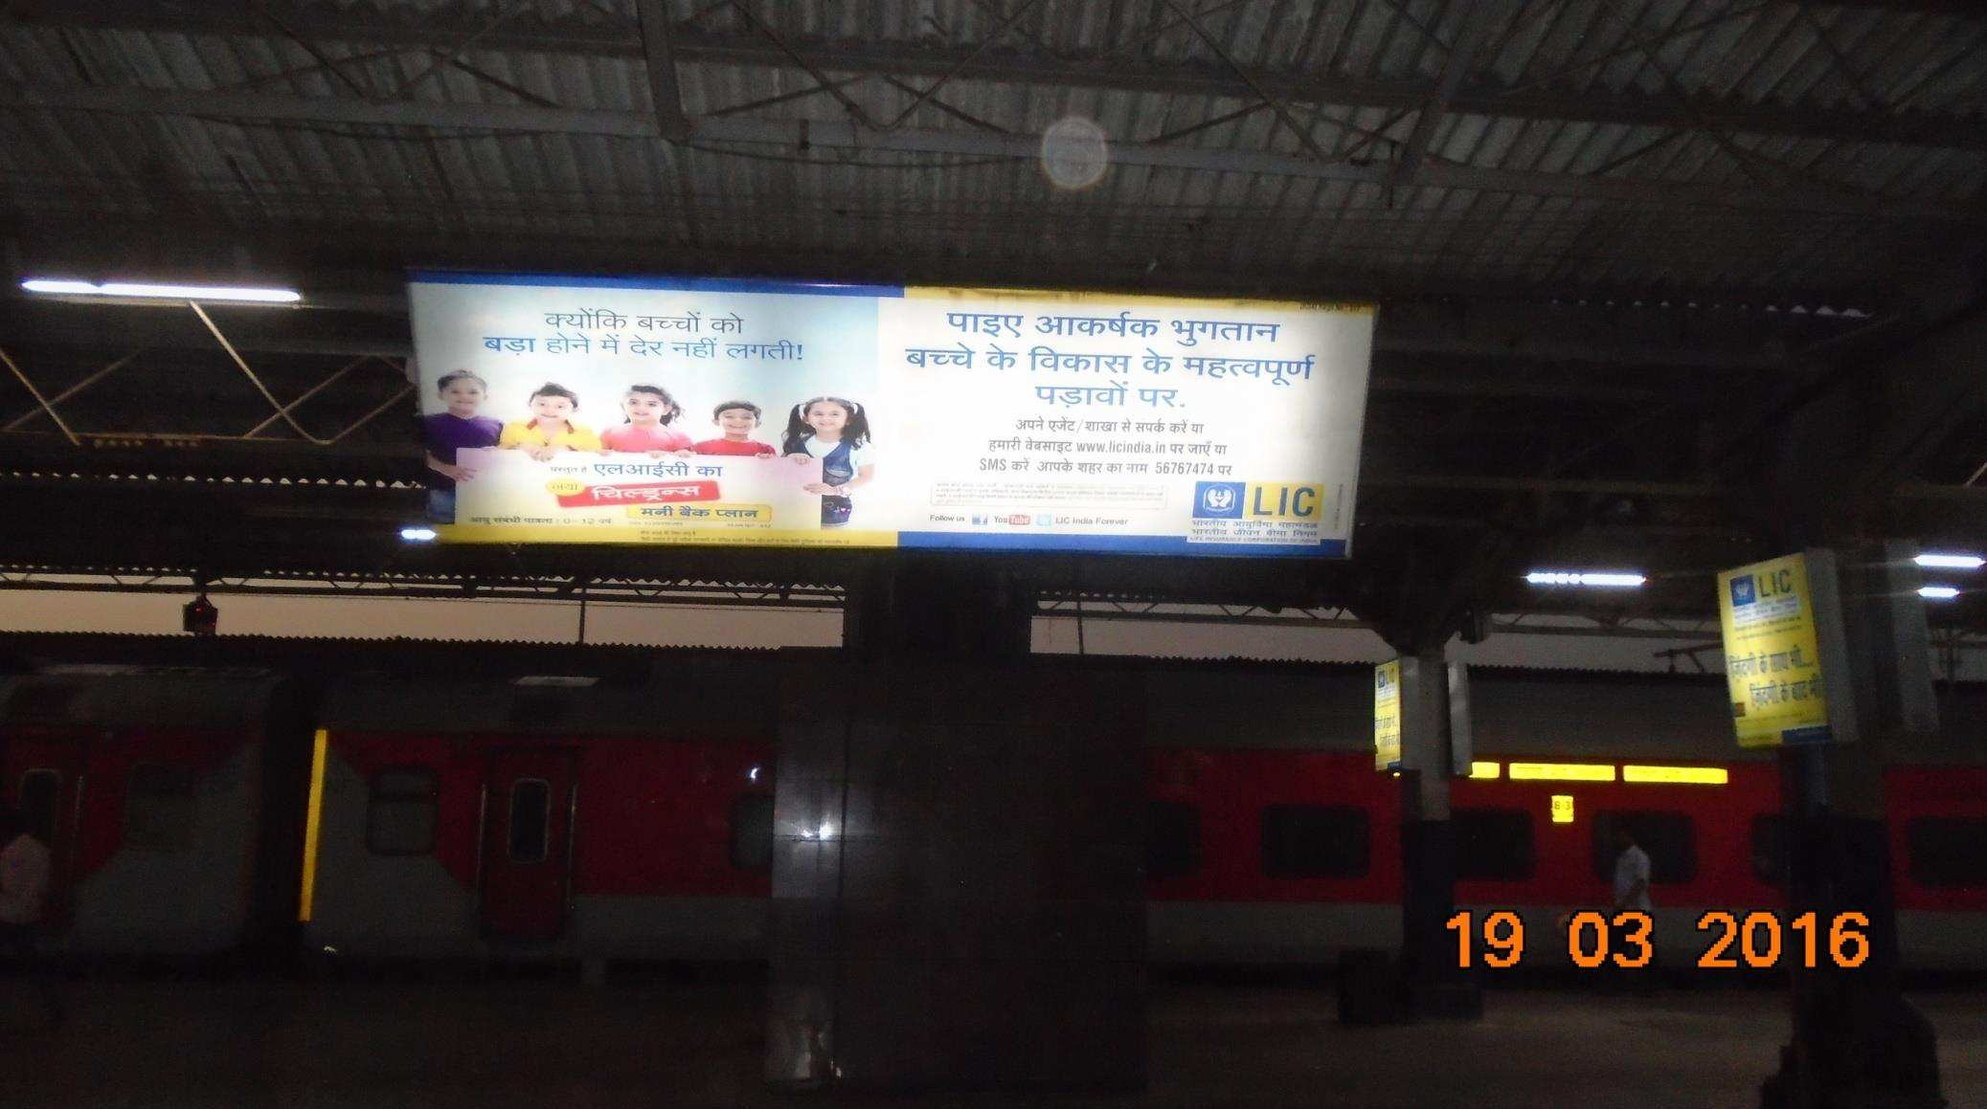

Slide 8
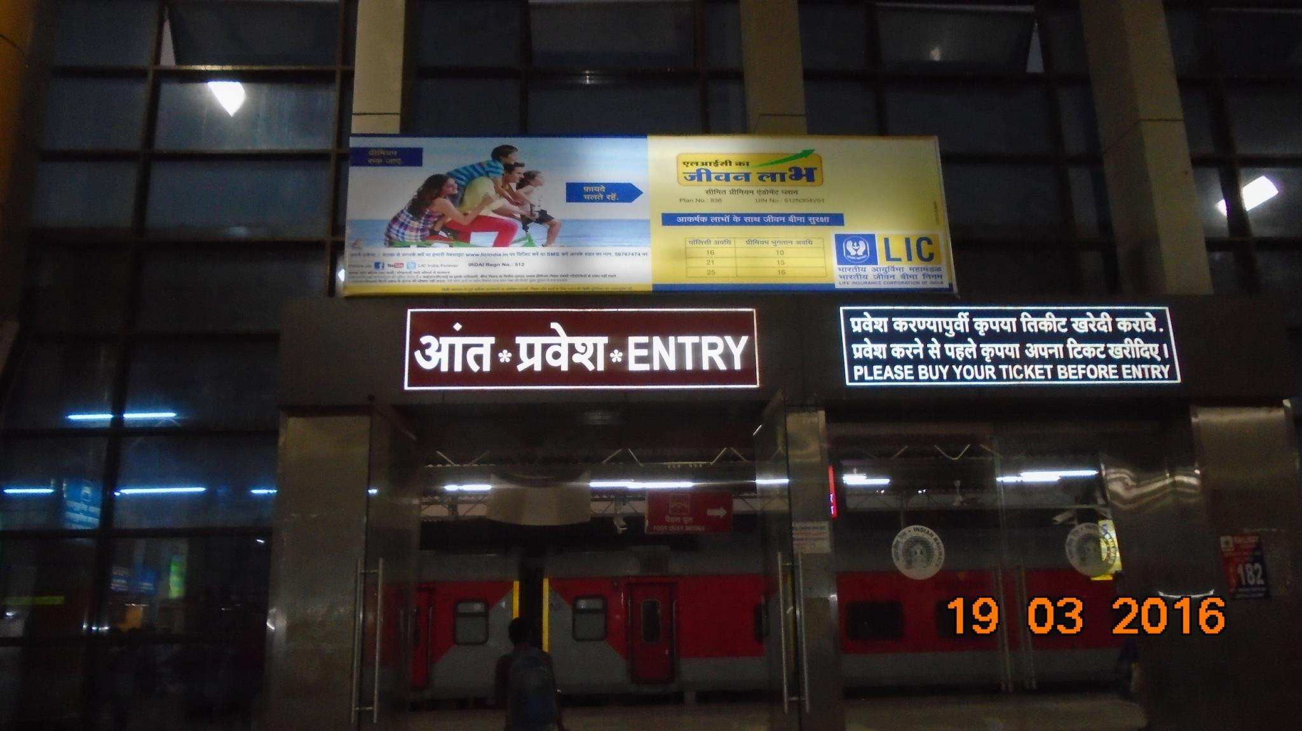

Slide 9
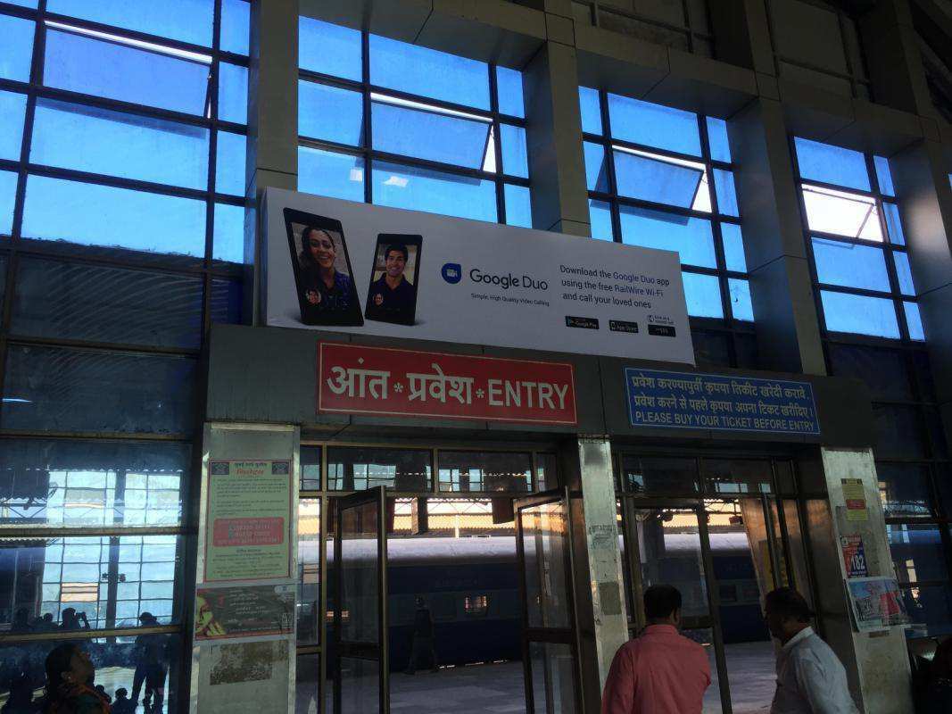

Slide 10

Type of Station: Terminus
Number of Platforms: 5
Number of Halting Trains: 0
Number of Originating Trains: 71
Number of Terminating Trains: 71

Slide 11
Board Size
Qty
Total Rent PM
2 X 3 GLOW SIGN
50
Rs.850000/-
8 X 3 Non Lit
40
14 x 4 GLOW SIGN
3

