Slide 1

H Y D E R A B A D
Static Advertising & Branding Media Proposal
Ofﬁcial Partner

Slide 2
METRO MEDIA – Impactful & Cost Effective
Reach & Engagement – L&T Metro has been consistently growing as the most preferred medium of commuting in Hyderabad. Avg. Footfalls of 1.5 Cr per month
Target Audience – A blend of all age, gender & income groups , varied professions and geographic specific targeting.
High Impact – A perfect medium to execute a powerful campaign offering standard & Closer visibility. Boards are full LED backlit and are Strategically located like Station Entry & Exit Points, Lifts & Escalators access points, Platform Levels with Head-on & eye level visibility.
Cost Effective – Metro Stations offer a compelling value proposition to execute a campaign with excellent coverage across Hyderabad.
Flexibility – From exclusive branding in a particular station to a wide spread across all stations. Various custom packages can be designed basis on the campaign objective, budget and requirements.
As an extension to Static Advertising , we can work on Product promotions, In Train Announcements etc .
Over 1,00,000 sft of high
impact Metro station media

Slide 3
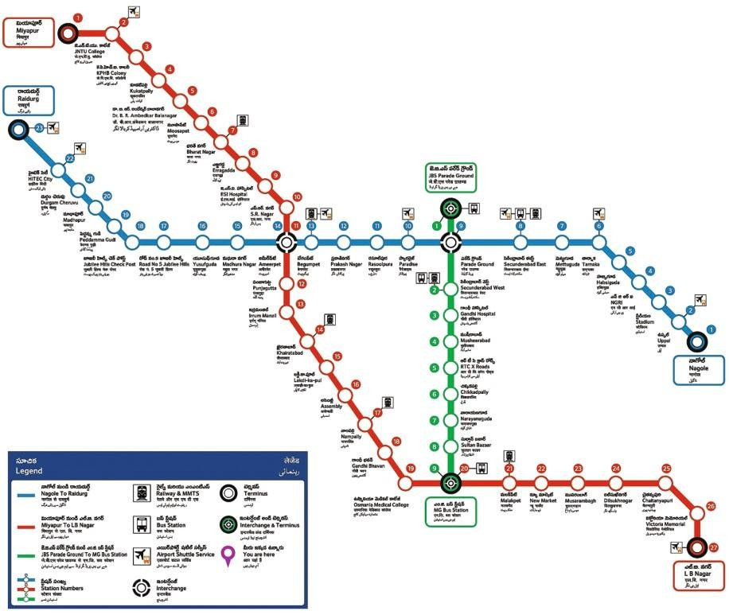
Metro Overview
Corridor Detail No.of Stations Length in KMs.
Corridor-I | Miyapur to L.B. Nagar | 27 | 29.2 KMs
Corridor-II | JBS to MGBS | 8 | 11 KMs
Corridor-III | Nagole to Raidurgam | 22 | 29 KMs
Total |  | 57 | 69.2 KMs

Slide 4
Stations
Types & Ridership
Stations
Miyapur JNTU KPHB
Kukatpally Balanagar Moosapet Bharath Nagar Erragadda
ESI
SR Nagar Ameerpet Panjagutta Irrum Manzil Khairathabad Lakdikapool Assembly
Nampally Gandhi Bhavan
Osmania Medical College Malakpet
New Market Musarambagh Dilsukhnagar Chaitanyapuri Victoria Memorial LB Nagar
Nagole Uppal Stadim NGRI
Habsiguda Tarnaka
Mettuguda Secunderabad East Parade Ground Paradise Rasoolpura Prakash Nagar Begumpet Madhuranagar Yousufguda
Jubilee Hills Road No.05 Jubilee Hills Check Post Peddamma Temple Madhapur
Durgamcheu Hitech City
INTERCHANGE STATIONS: 3
Ameerpet (Junction station 20,000 sft of retail space)
Parade Grounds (Connected to JBS interchange station)
MGBS (Junction station)
Special Stations: 4 (with extra mezzanine floor)
ErrumManzil (Connected to Mall & Multiplex with 4.14 lakhs sft Retail space)
Punjagutta (Connected to Mall & Multiplex with 3.25 lakhs sft Retail space)
Musarambagh (Connected to Mall & Multiplex with 2.25 lakhs sft Retail space)
Hi-TechCity (Connected to Mall & Multiplex with 2 lakhs sft Retail space)
Total No.of Stations: 47 (Including interchange, special and typical stations)
Ridership:
Over 1.5cr/month riders of Hyderabad Metro Rail

Slide 5
Types of branding available at Metro stations
10x5 Concourse level - Entry Arm or Entrance to Metro Station 10x5 Walkway - Entry to metro Station
5x5 Head on wall mount - at entry to metro station 2x6 Head on wall mount - at entry to metro station 5x6 Diagonal to the Ticket scanner entry point
6x6 Head On pillar board - After entering Concourse level Station 10x5 Head on board at the staircase/ Escalator to Platform level 5x5 Eye level board to Lift wall - Concourse level
Concourse level branding
Platform level Branding
8x4 8x4 8x4 5x5
Platform level - Passenger waiting point Platform level - Head on to Escalator
platform level - Headon while taking staircase to Concourse level Long visibility - Platform level
Over 1,00,000 sft of high
impact Metro station media

Slide 6
Concourse level branding options
Over 1,00,000 sft of high
impact Metro station media

Slide 7
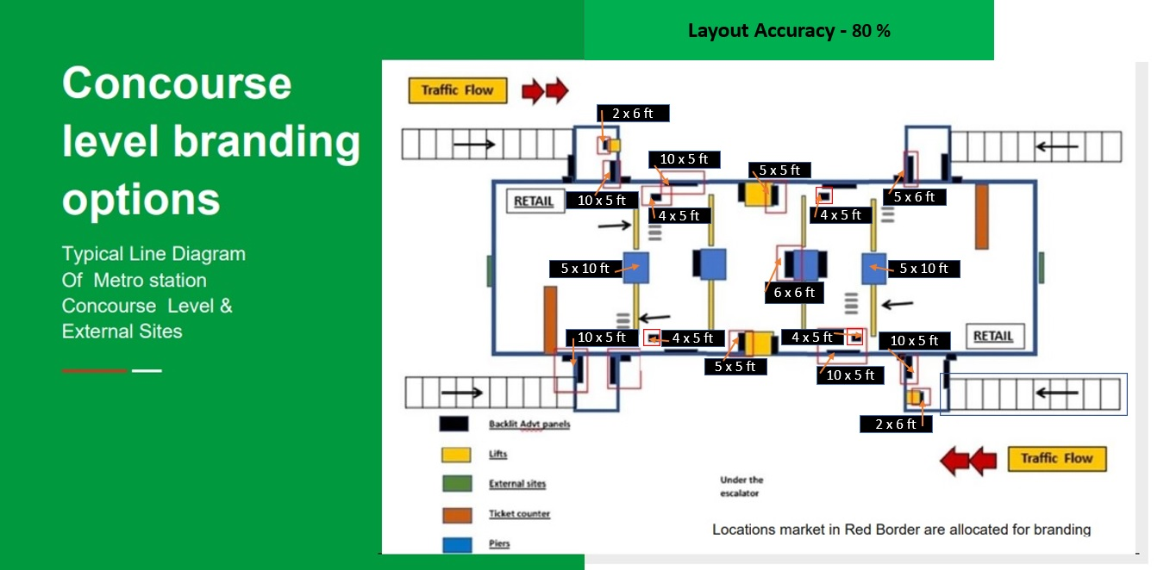
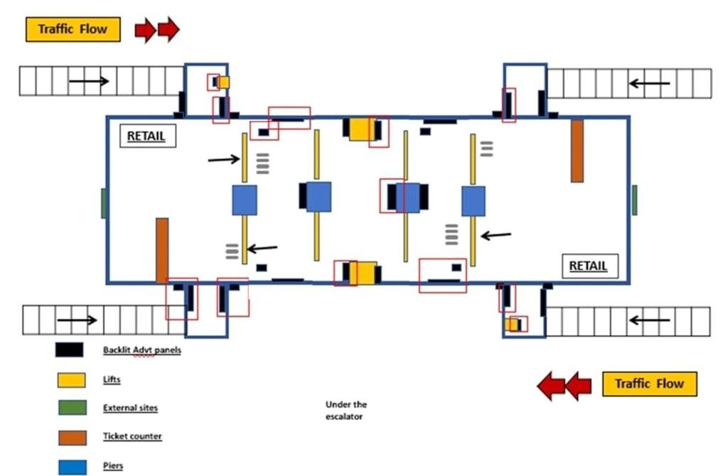
Concourse level branding options
Typical Line Diagram Of Metro station Concourse Level & External Sites
Locations market in Red Border are allocated for branding
Over 1,00,000 sft of high
impact Metro station media

Slide 8
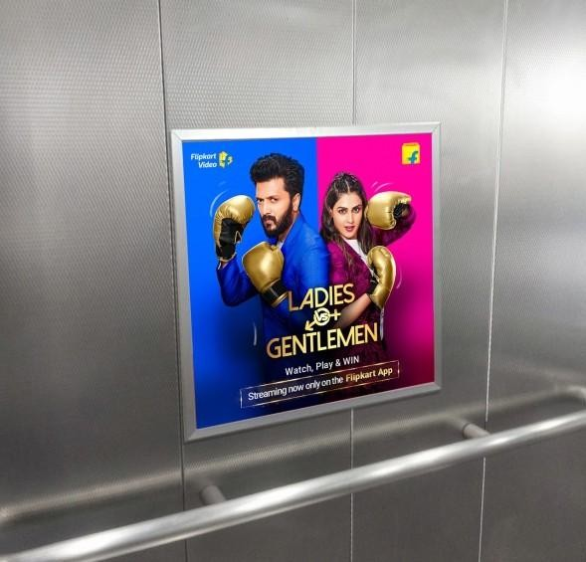
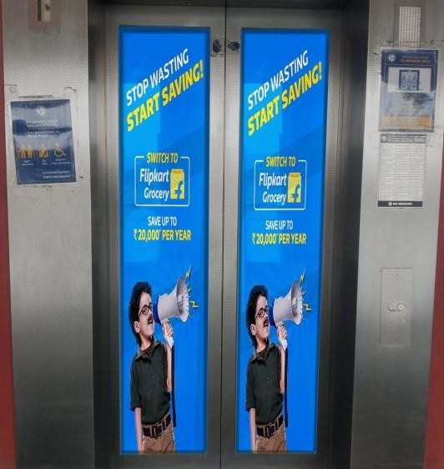
3x7 - Lift branding - at entry to metro station
3x7
Lift Glass Branding
3x3
Lift inner branding
Over 1,00,000 sft of high
impact Metro station media

Slide 9
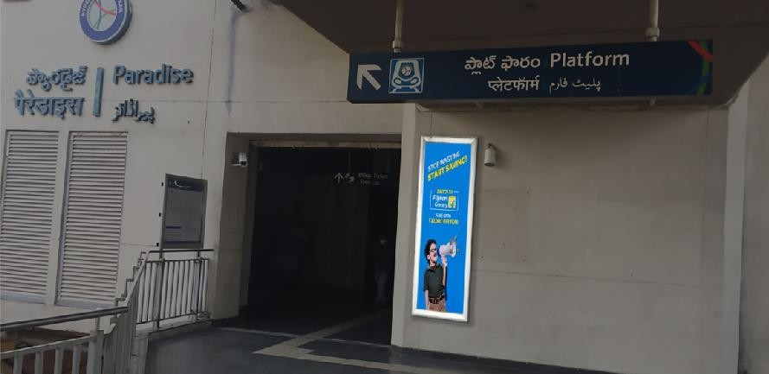
2x6 - Head on wall mount - at entry to metro station
2x6
Head on wall mount
Over 1,00,000 sft of high
impact Metro station media

Slide 10
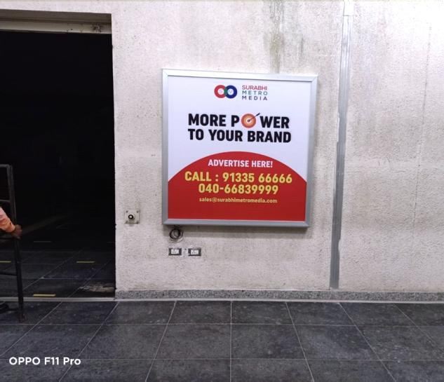
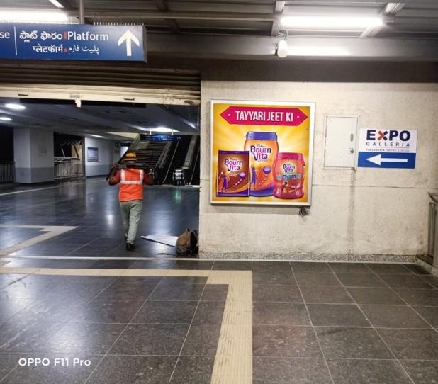
5x5 - Head on wall mount - at entry to metro station
Over 1,00,000 sft of high
impact Metro station media

Slide 11
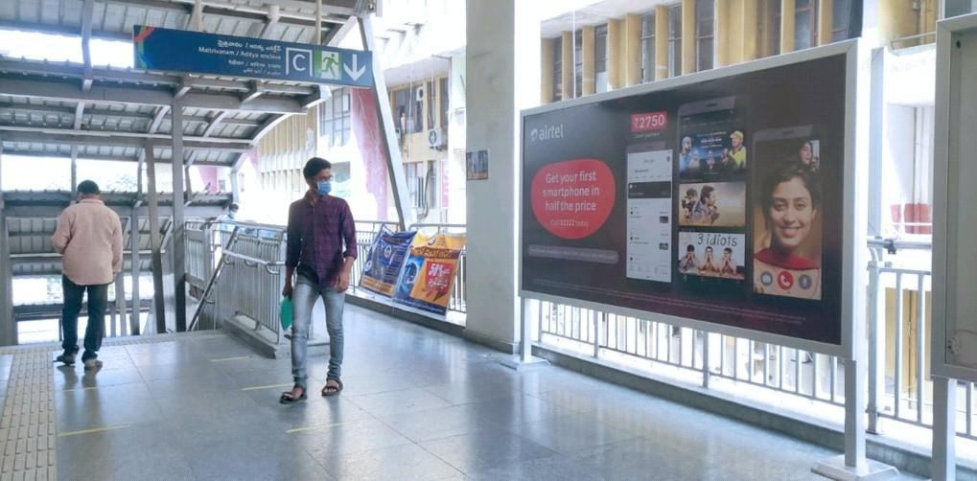
10x5 - Concourse level - Entry/Exit Arm to Metro Station
Over 1,00,000 sft of high
impact Metro station media

Slide 12
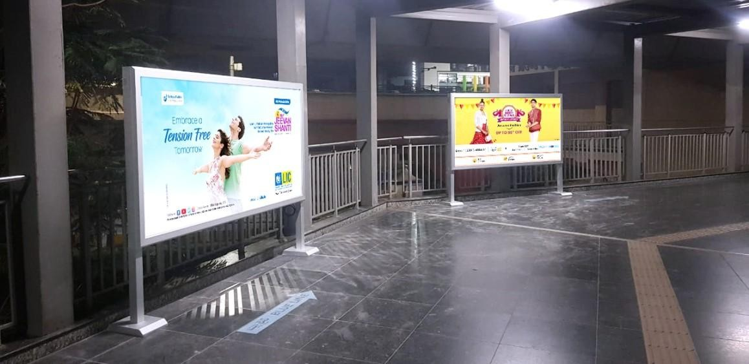
10x5 - W alkway - Entry to metro Station
Over 1,00,000 sft of high
impact Metro station media

Slide 13
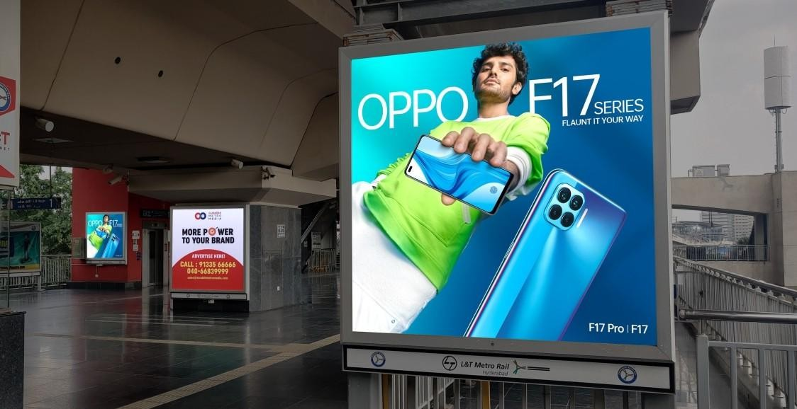
5x6 - Diagonal to the Ticket scanner entry point
5x6
staircase Head on landing
Over 1,00,000 sft of high
impact Metro station media

Slide 14
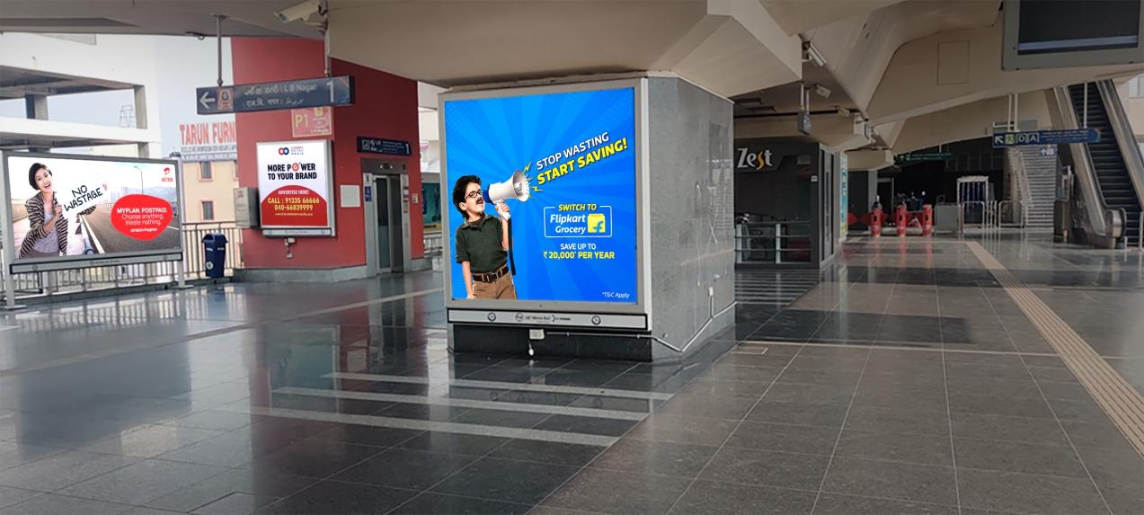
6x6 - Head On pillar board - After entering Concourse level Station
6x6
Pillar sides Branding
Over 1,00,000 sft of high
impact Metro station media

Slide 15
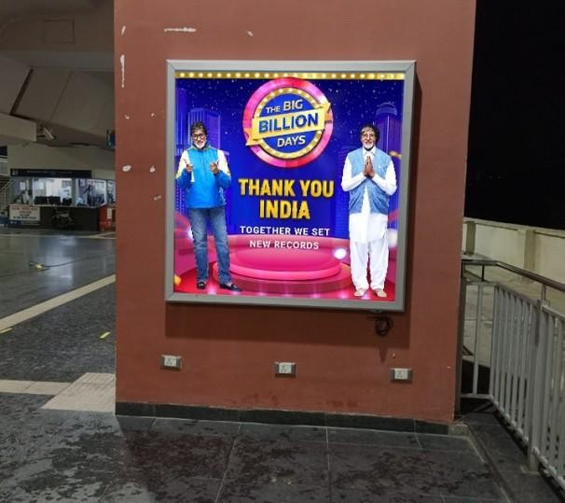
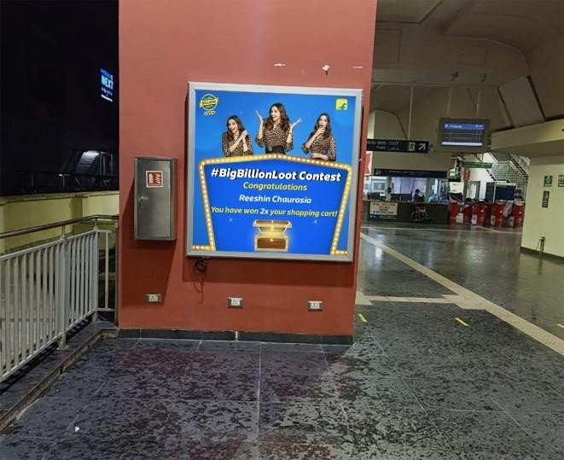
5x5 - Eye level board on Lift wall - Concourse level
Over 1,00,000 sft of high
impact Metro station media

Slide 16
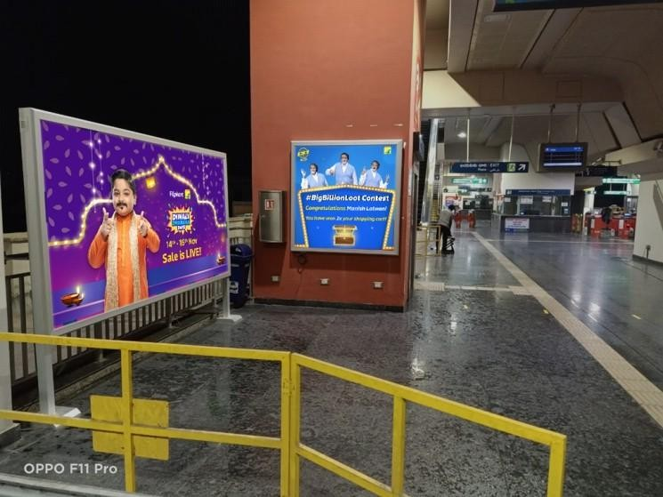
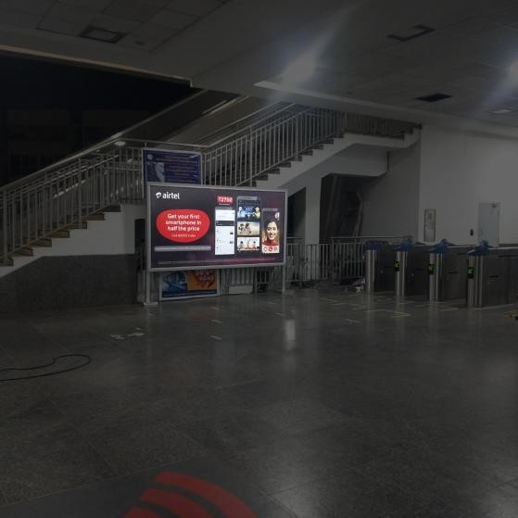
10x5 - Head on board at the staircase/ Escalator to Platform level
Over 1,00,000 sft of high
impact Metro station media

Slide 17
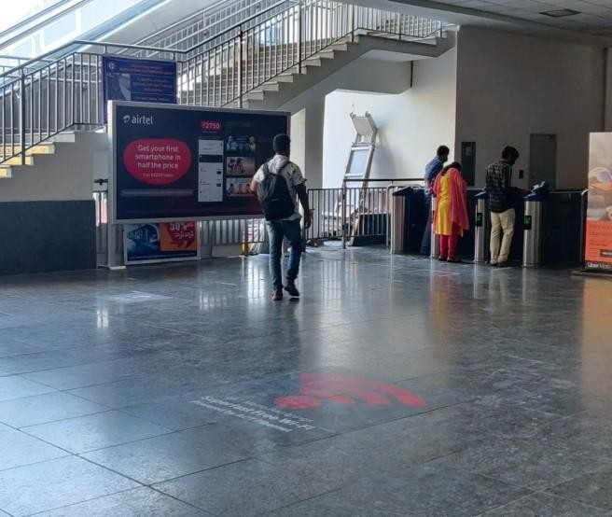
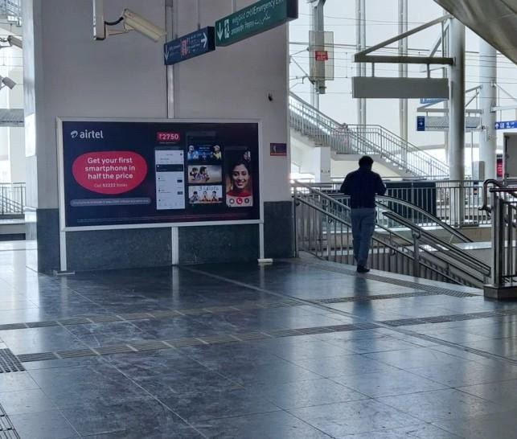
10x5 - Head on board at the staircase/ Escalator to Platform level
Over 1,00,000 sft of high
impact Metro station media

Slide 18
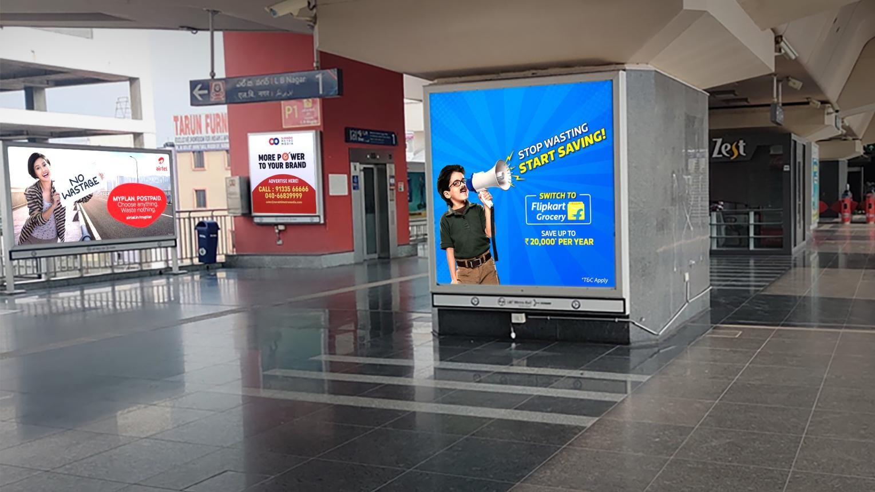
6x6
Pillar sides Branding
5x5
Lift Wall Branding
10x5
Concourse Branding

Slide 19
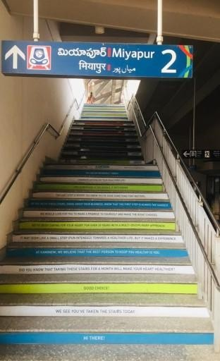
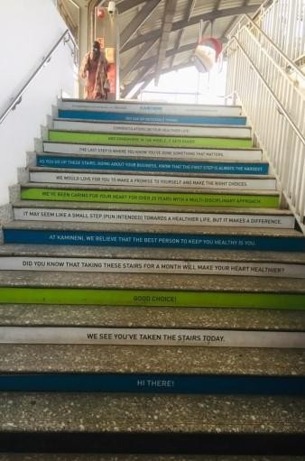
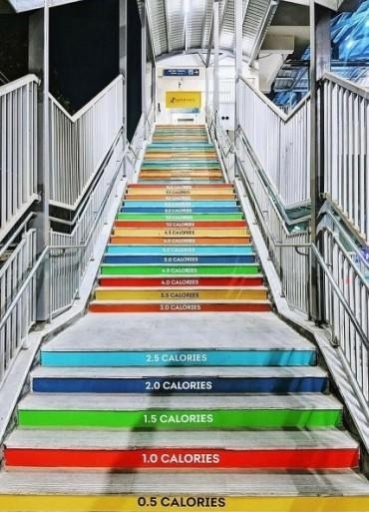
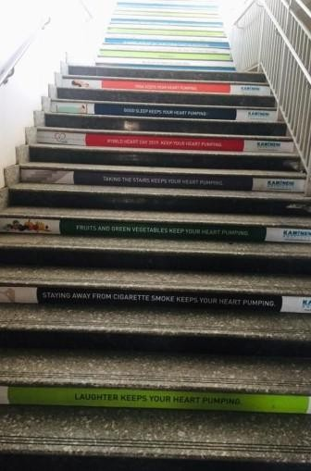
Staircase Branding Innovations
Over 1,00,000 sft of high
impact Metro station media

Slide 20
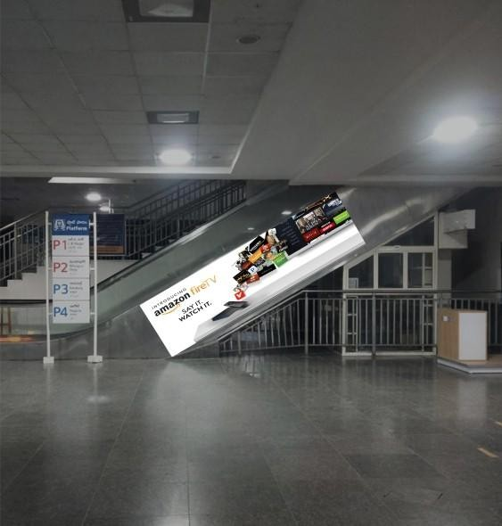
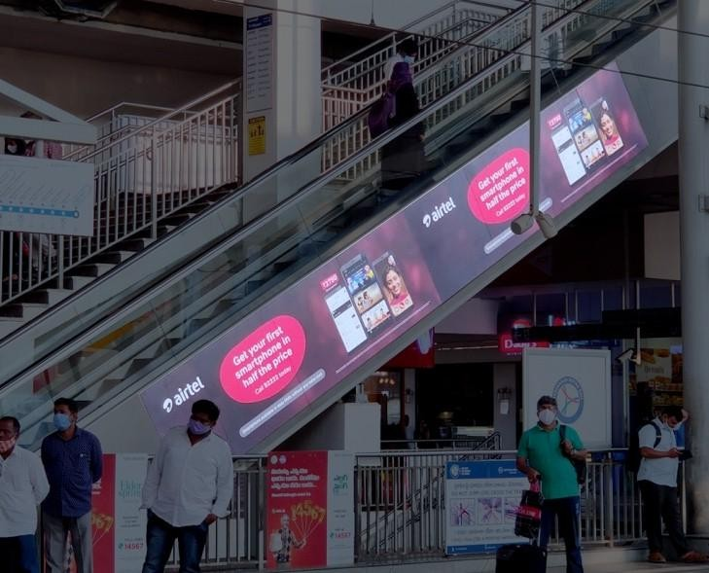
Escalator Branding Innovations
Over 1,00,000 sft of high
impact Metro station media

Slide 21
Platform level branding options
Over 1,00,000 sft of high
impact Metro station media

Slide 22
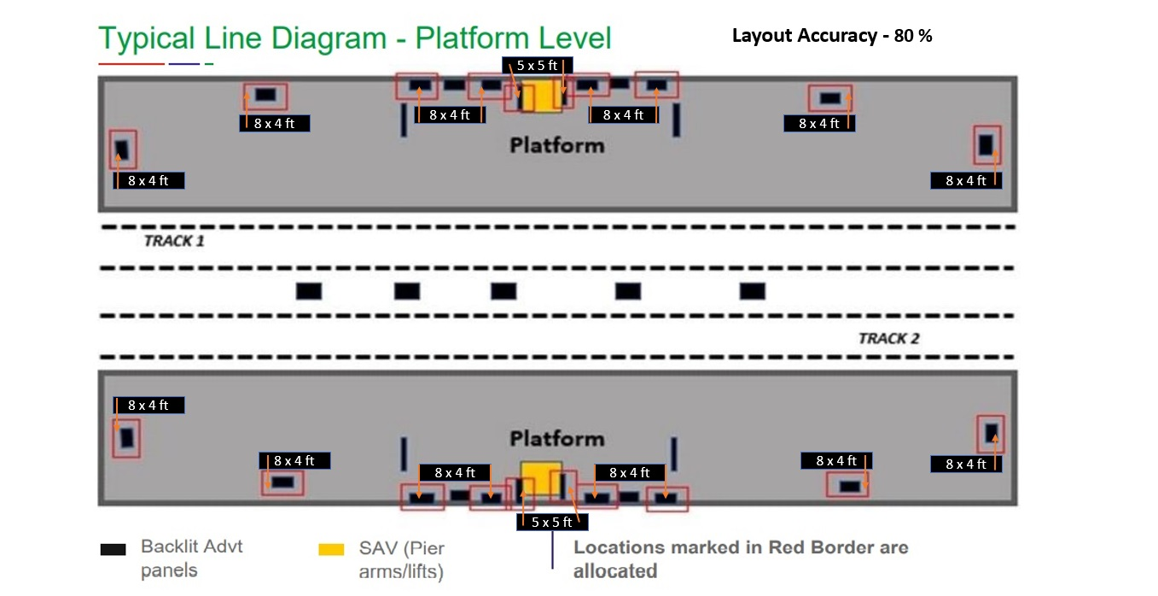
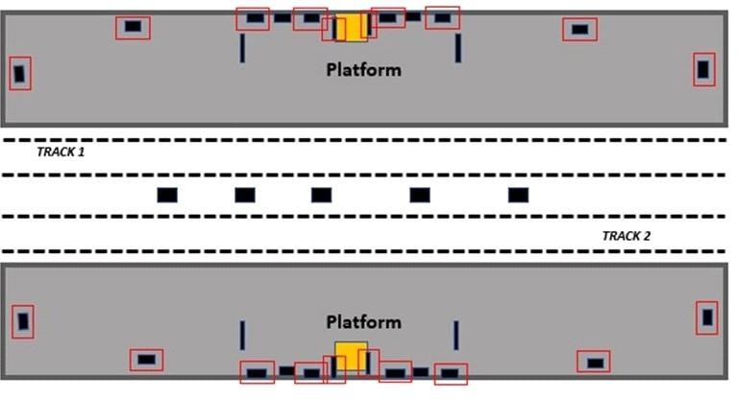
Typical Line Diagram - Platform Level
Backlit Advt
SAV (Pier
Locations marked in Red Border are
panels
arms/lifts)
allocated

Slide 23
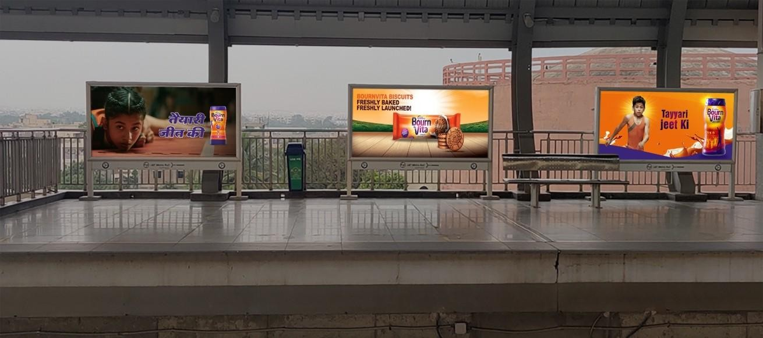
8x4 - Platform level - Passenger waiting point
Over 1,00,000 sft of high
impact Metro station media

Slide 24
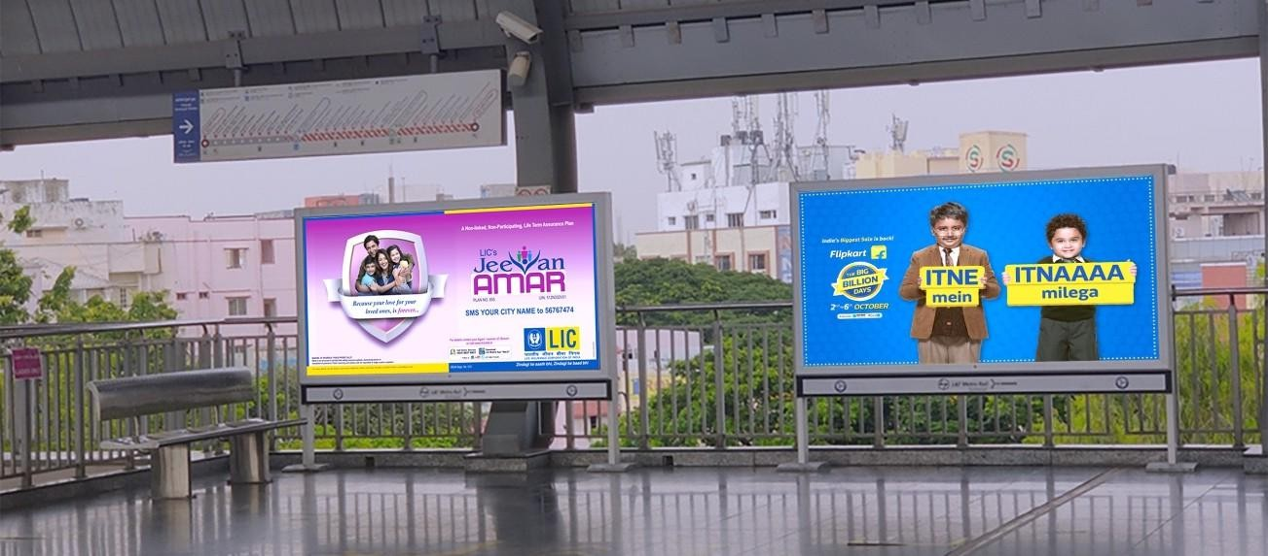
8x4 - Platform level - Passenger waiting point
Over 1,00,000 sft of high
impact Metro station media

Slide 25
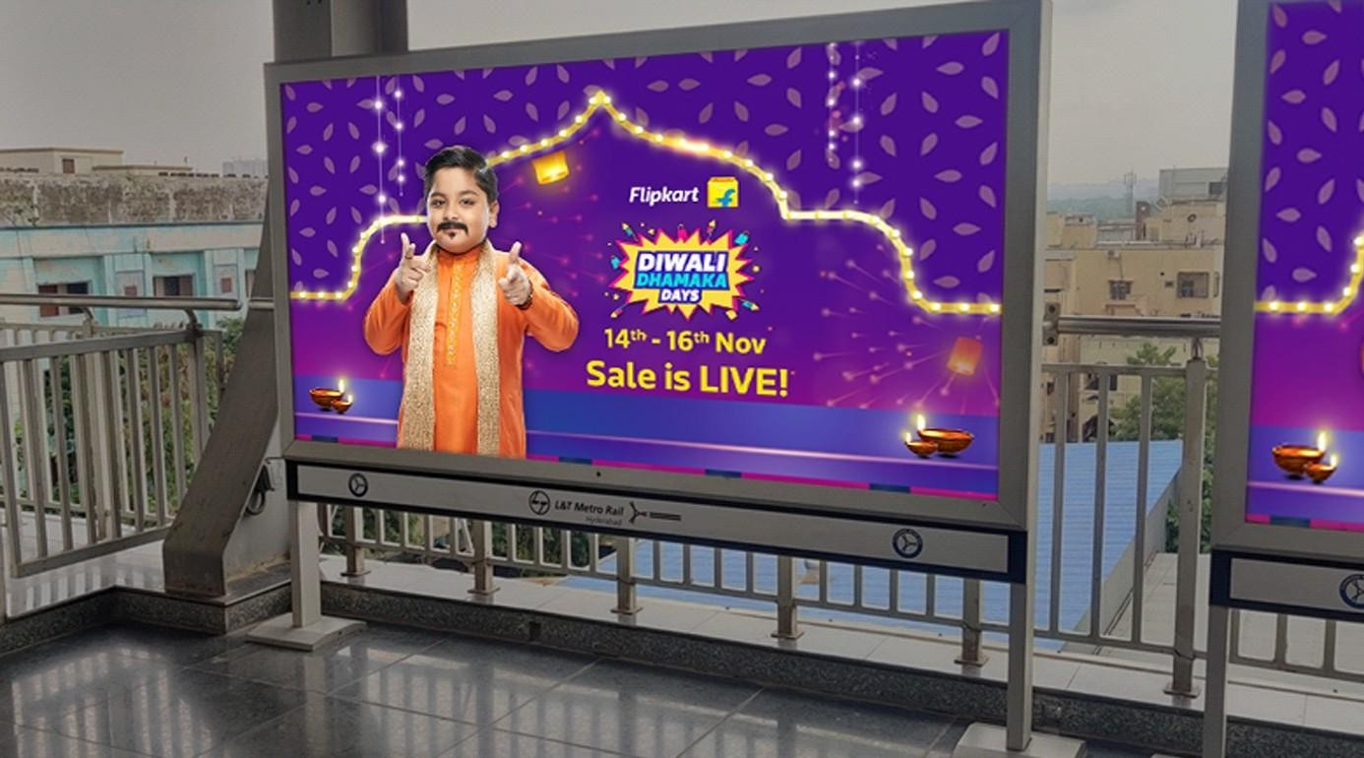

Slide 26
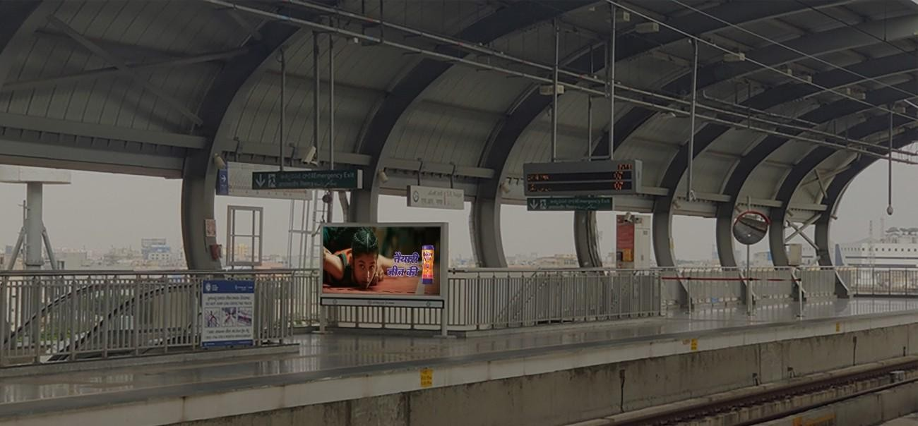
8x4 - Platform level - Head on to Escalator
Over 1,00,000 sft of high
impact Metro station media

Slide 27
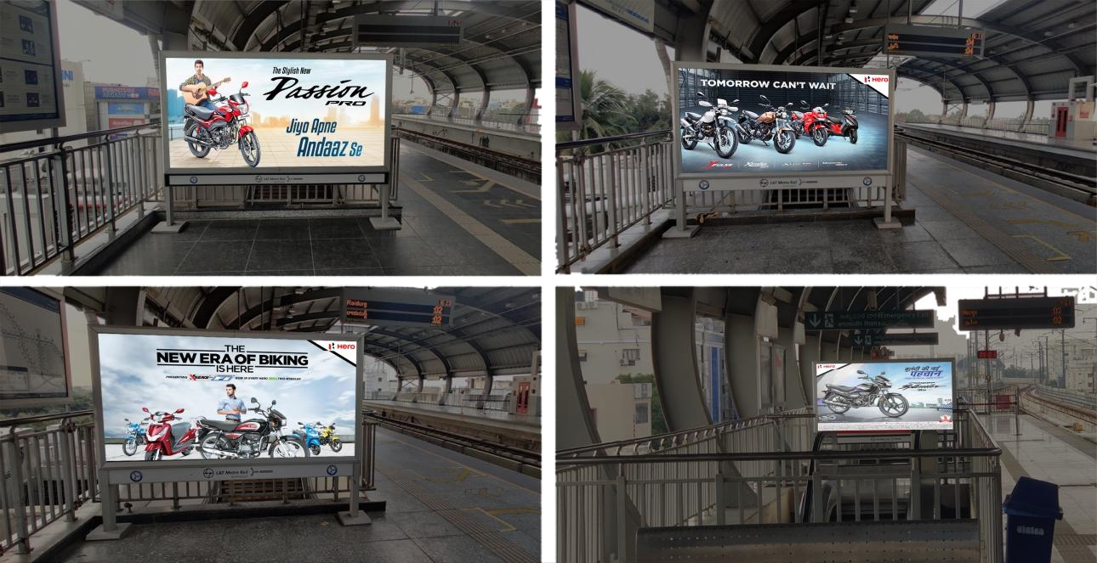
8x4 - Platform level - Headon while taking staircase to Concourse level

Slide 28
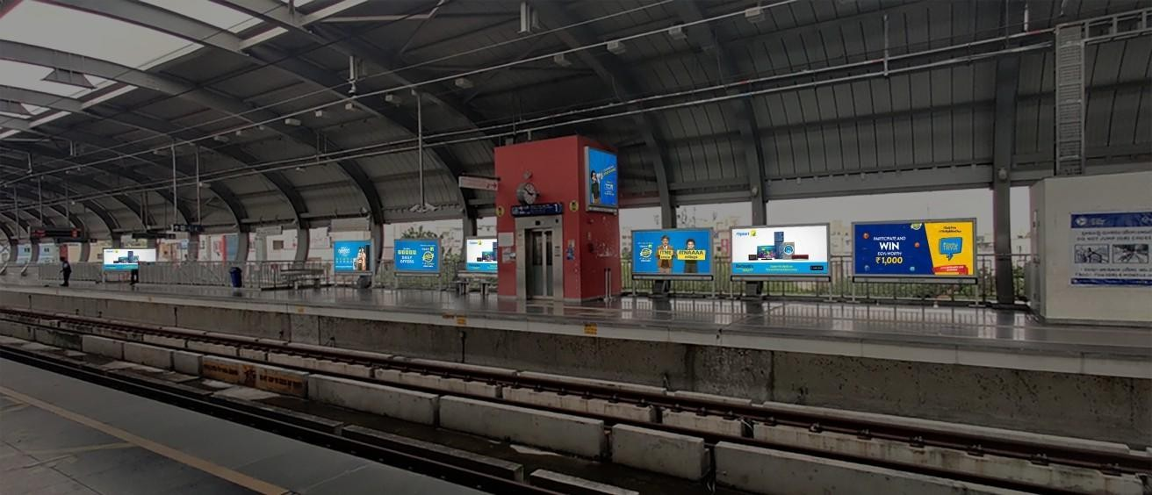
5x5 - Long visibility - Platform level
Over 1,00,000 sft of high
impact Metro station media

Slide 29
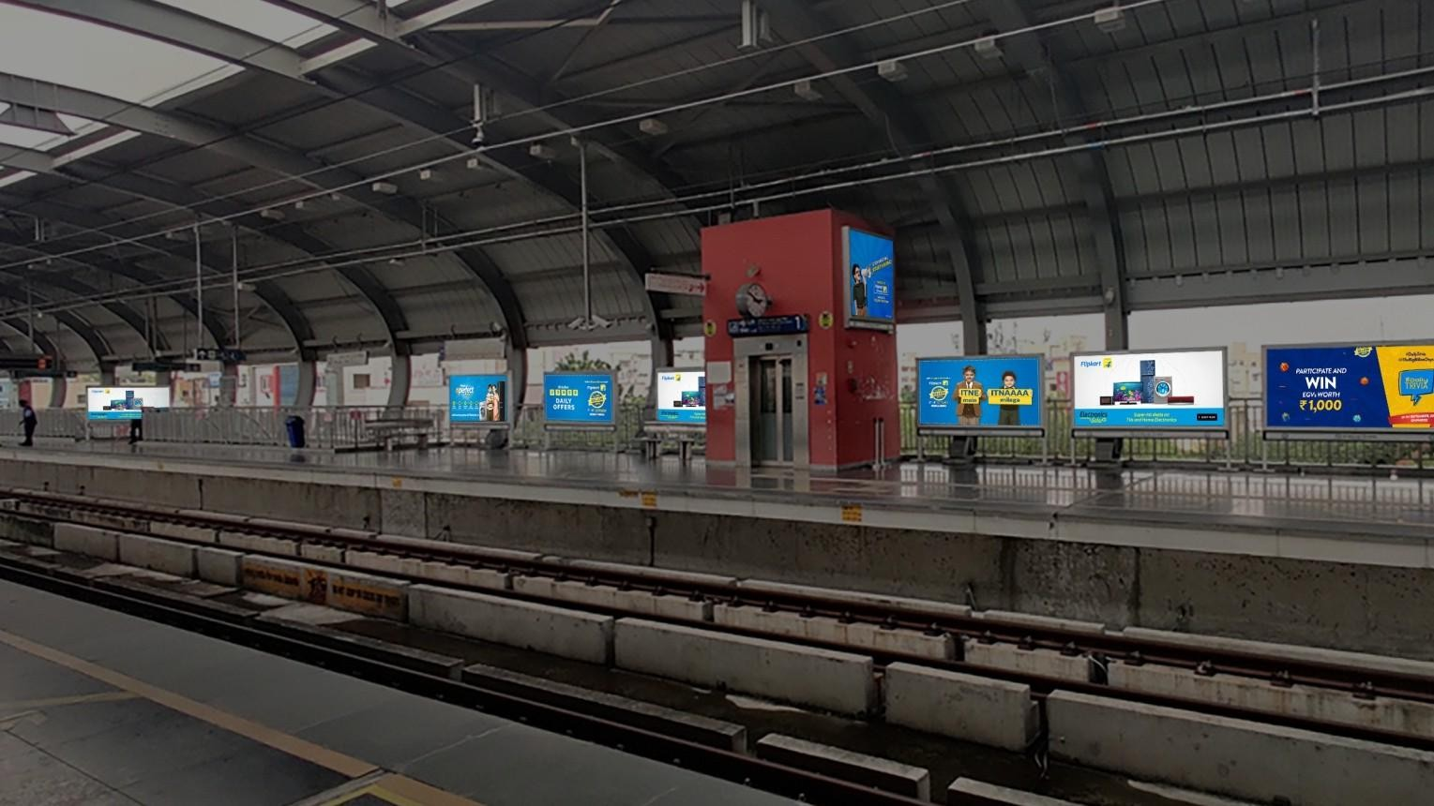
5x5
Pillar Branding
8x4
Head-on staircase branding
8x4
Standard Branding

Slide 30
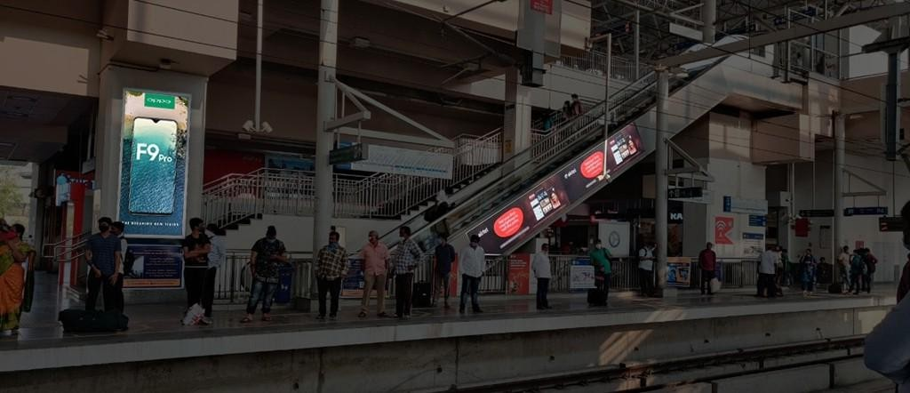

Escalator branding innovation
5x10
Vertical Station Branding
Escalotor Branding

Slide 31
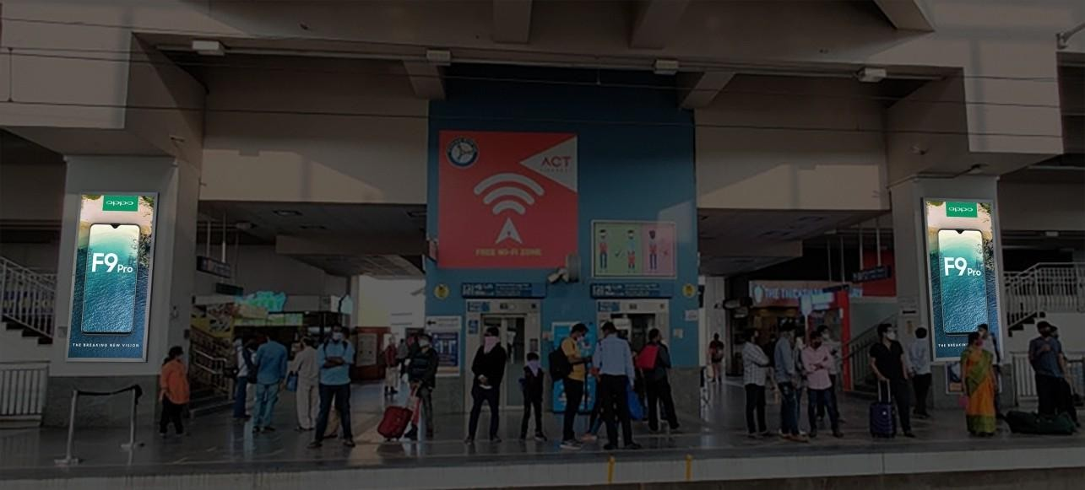
5x10 vertical station specific branding innovation
5x1
5x10
Vertical Station Branding
V₀ertical
Station
Branding

Slide 32
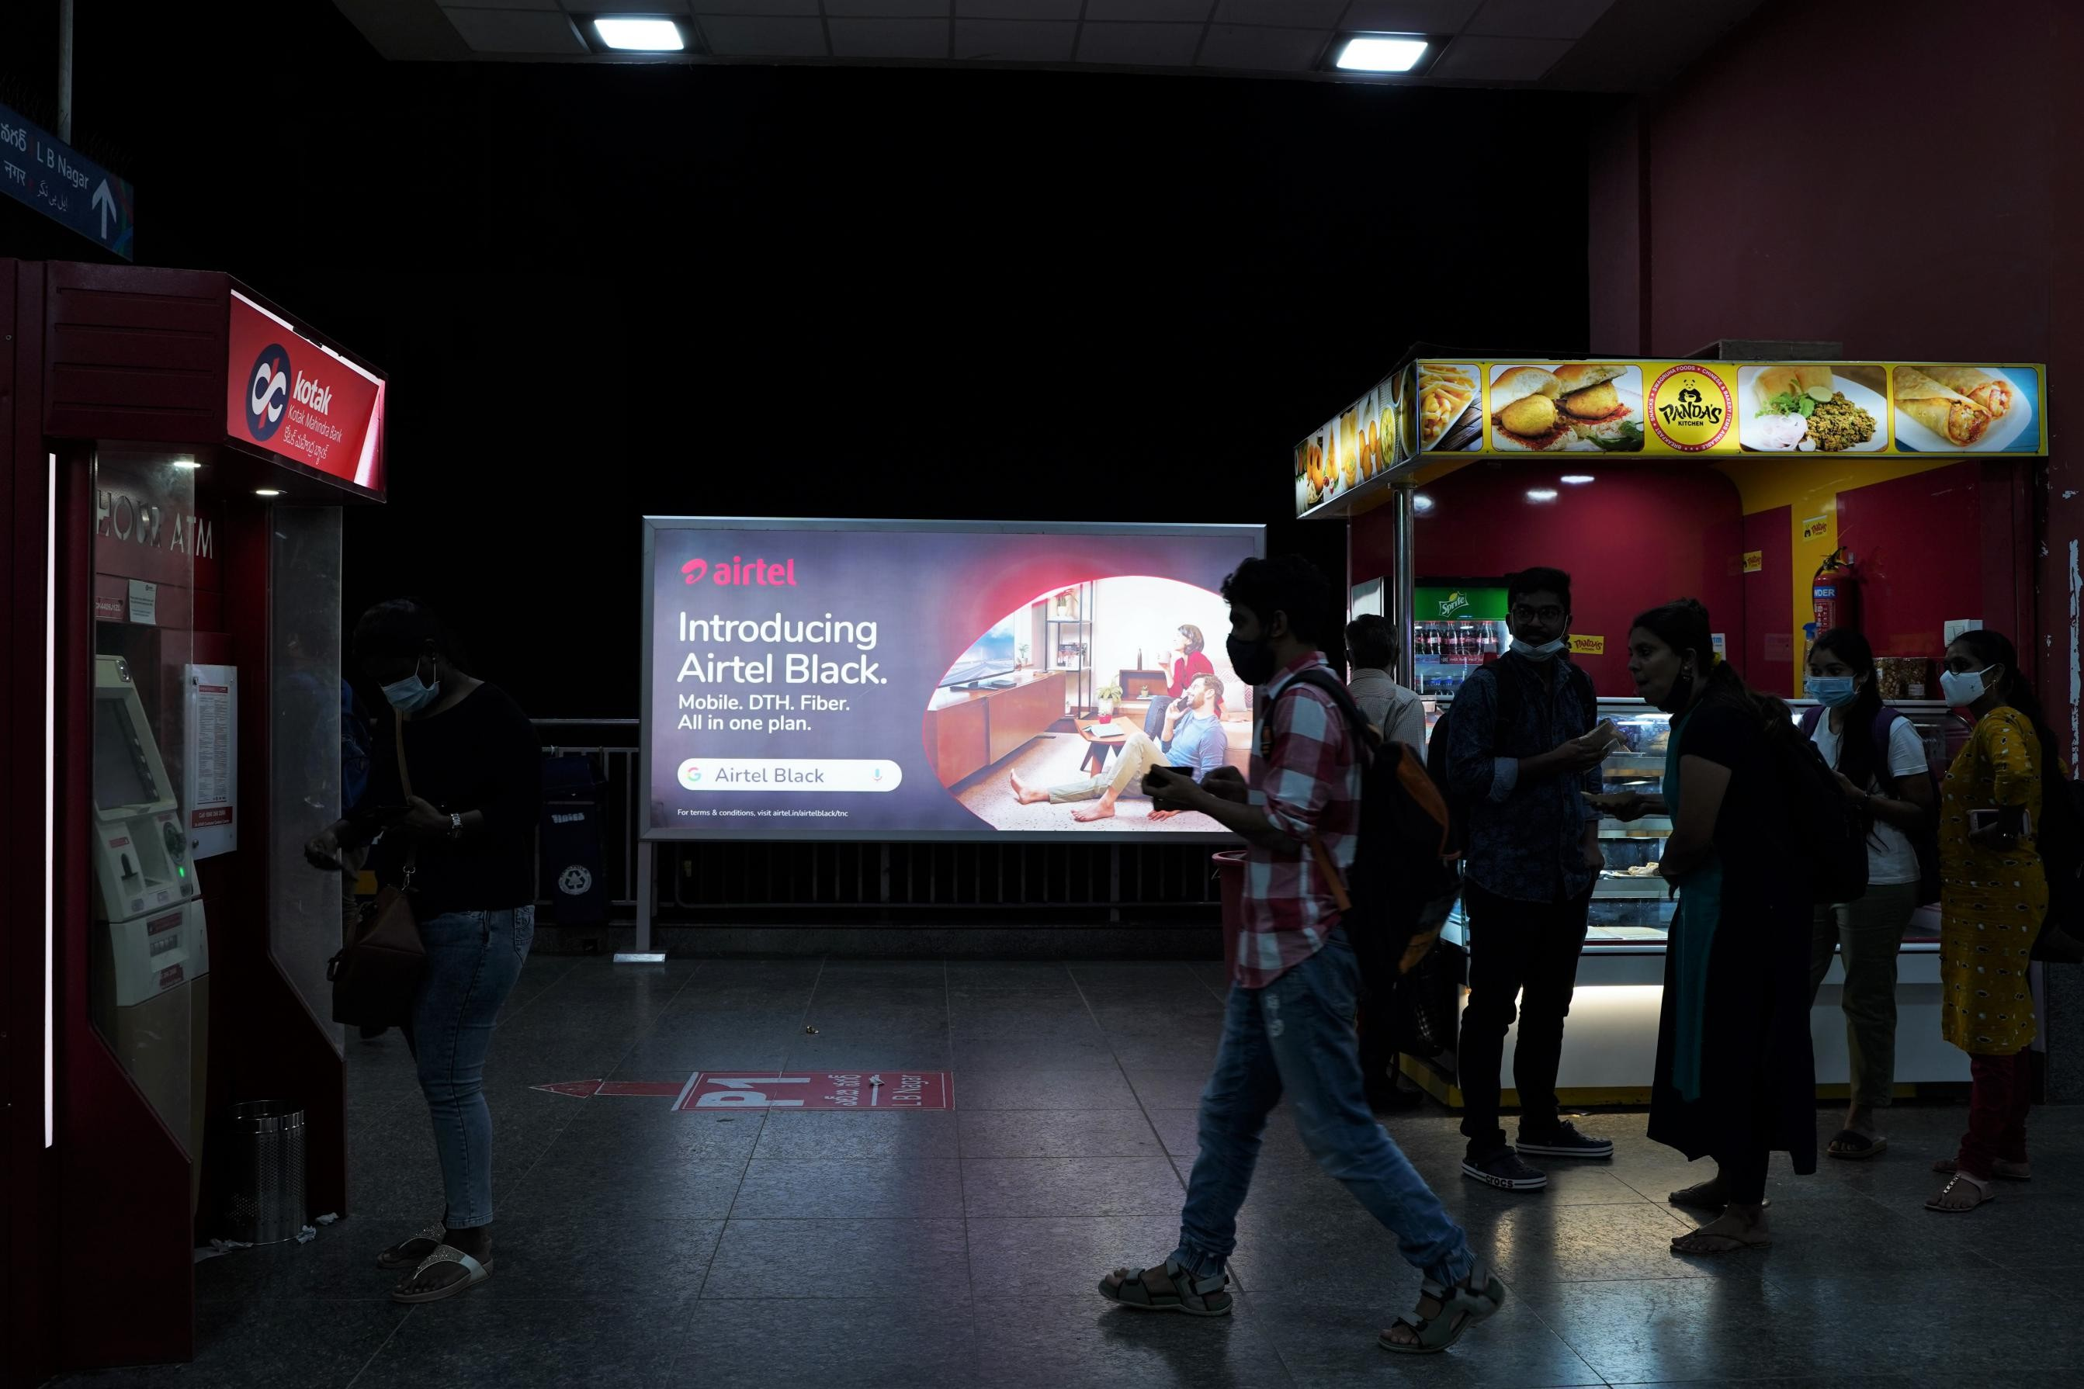
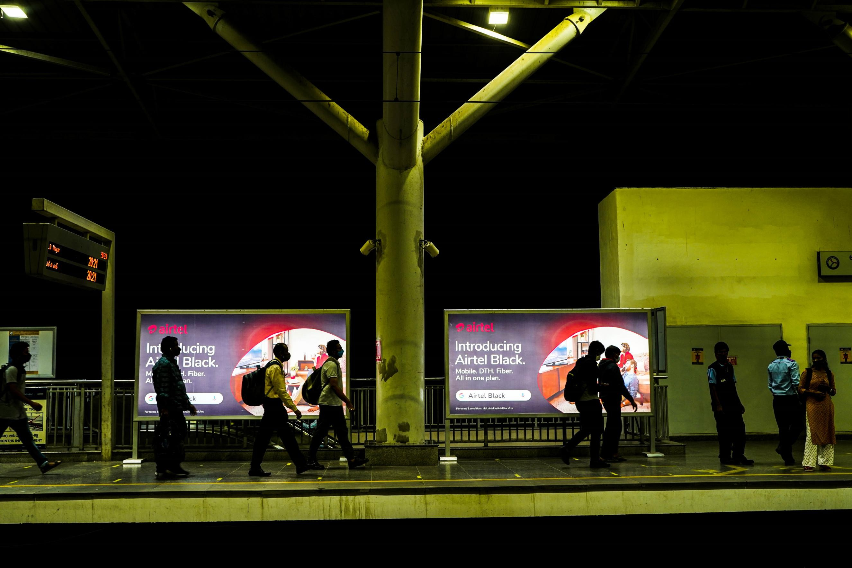
Pics of our Previous Campaigns
AIRTEL BLACK
5x1
5x10
Vertical Station Branding
V₀ertical
Station
Branding

Slide 33
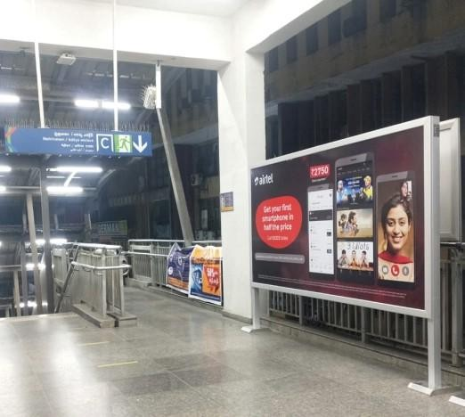
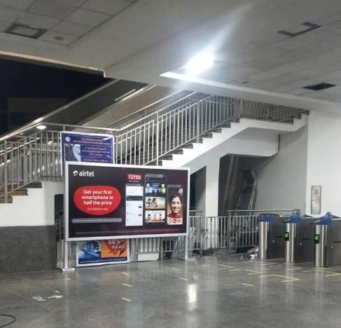
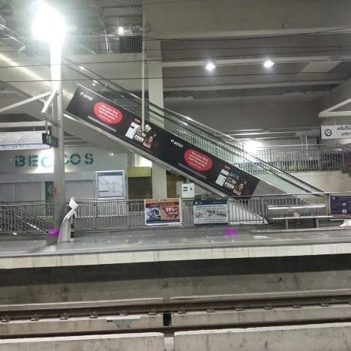
Over 1,00,000 sft of high impact Metro station media

Slide 34
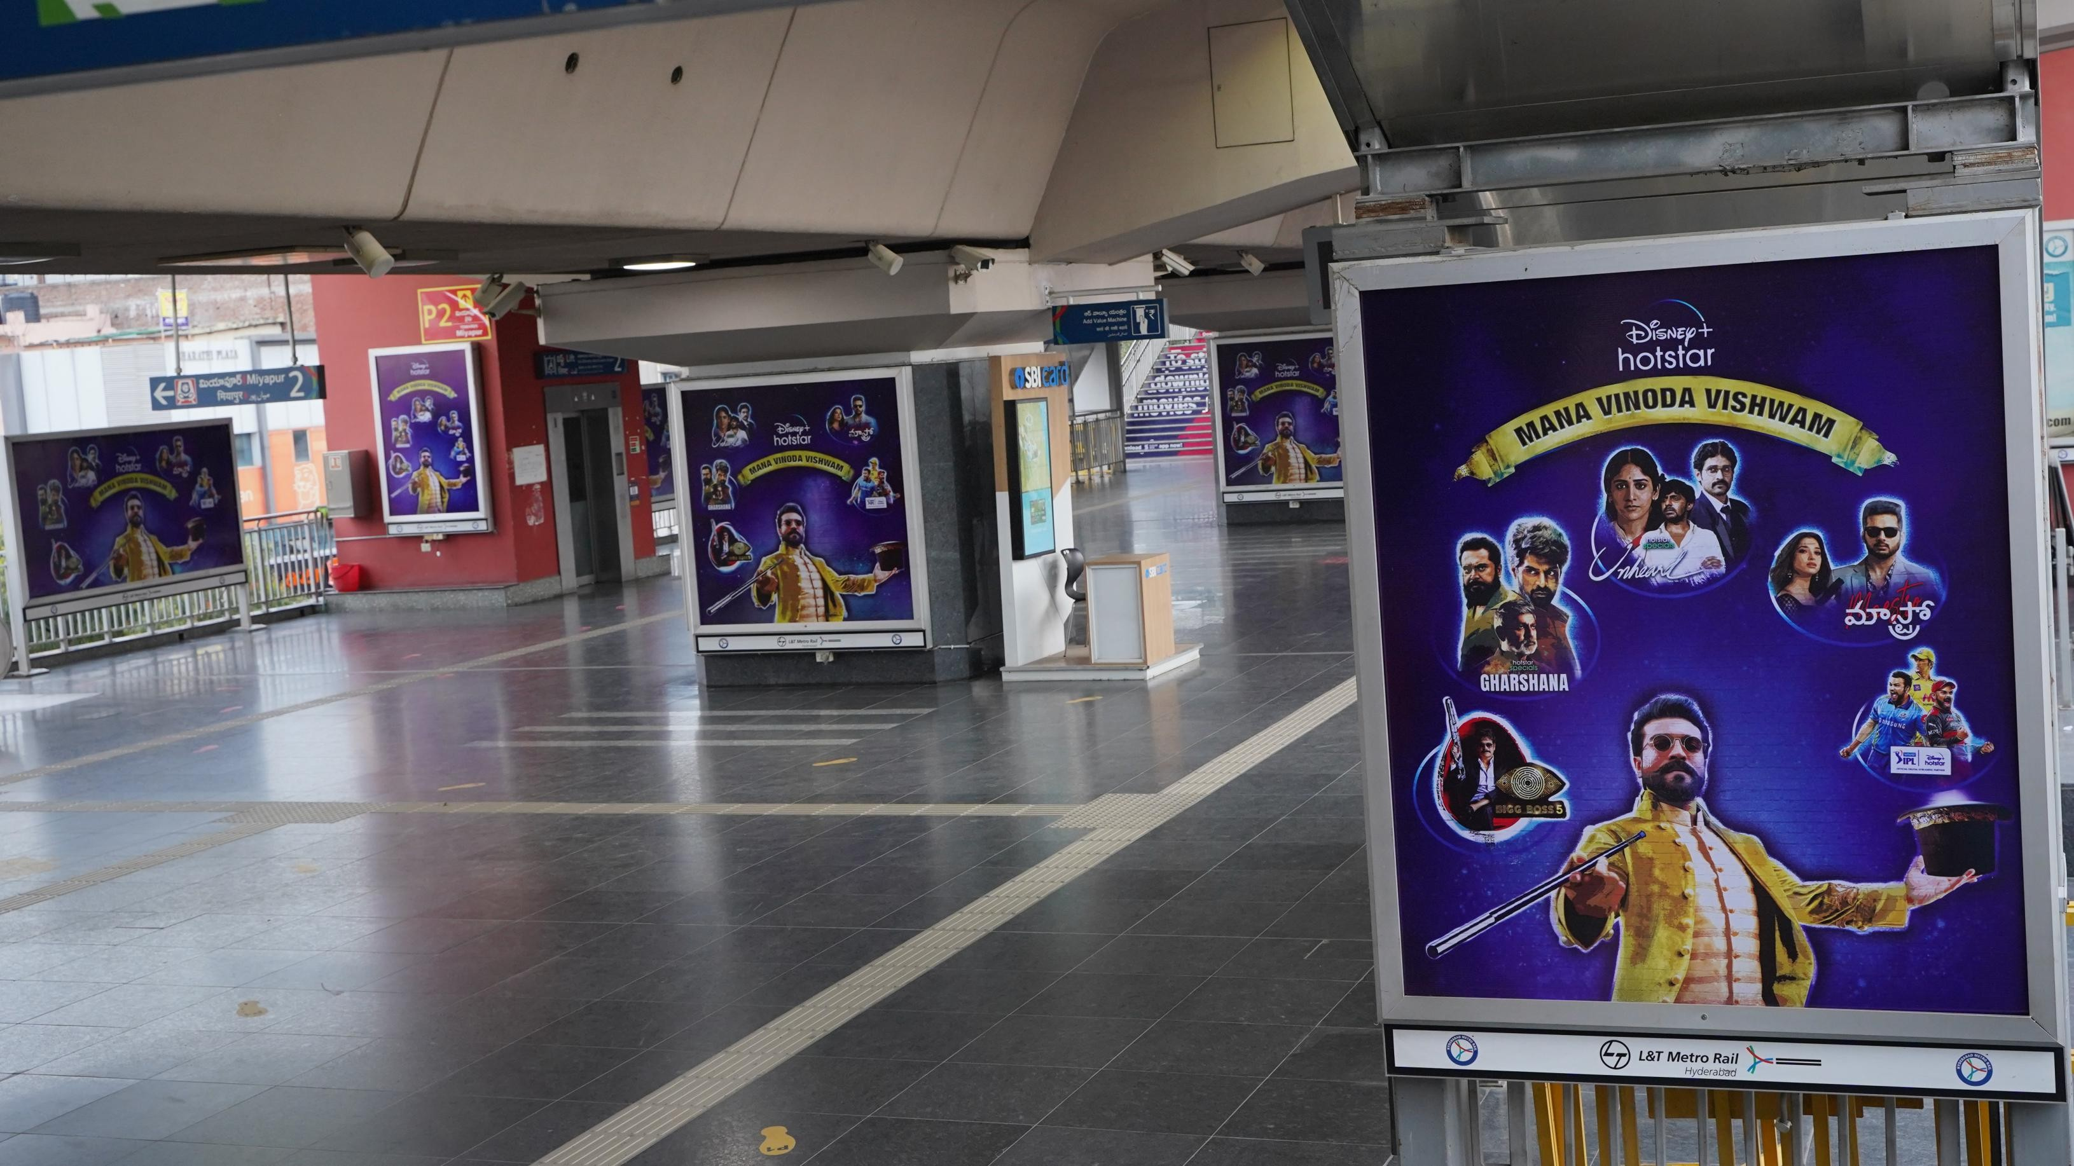
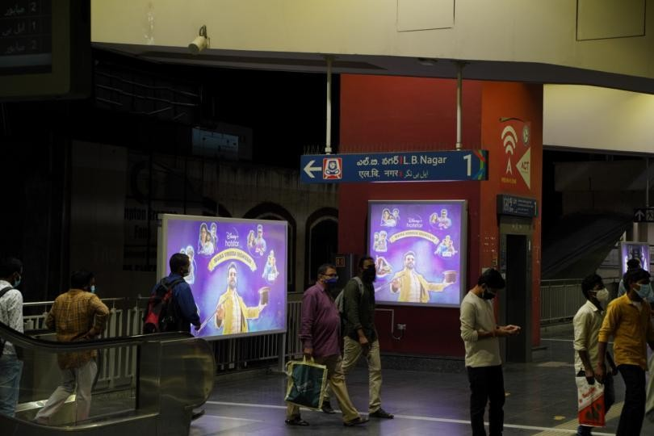
Pics of our Previous Campaigns
DISNEY HOTSTAR
5x1
5x10
Vertical Station Branding
V₀ertical
Station
Branding

Slide 35
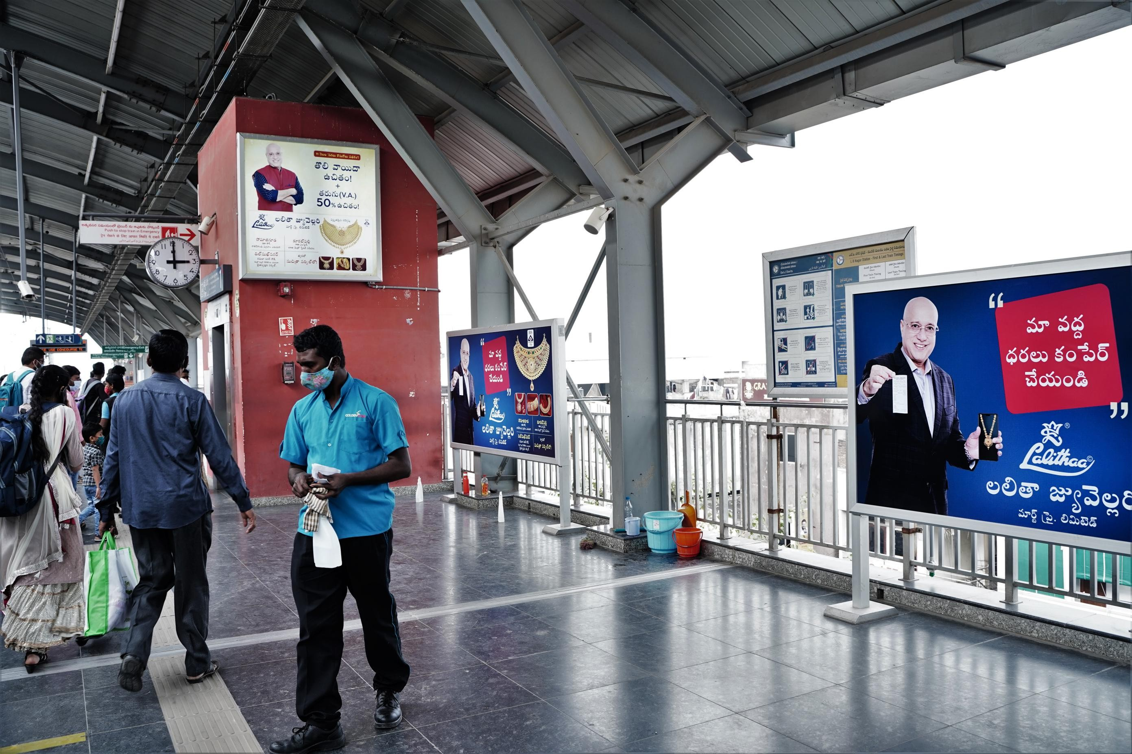
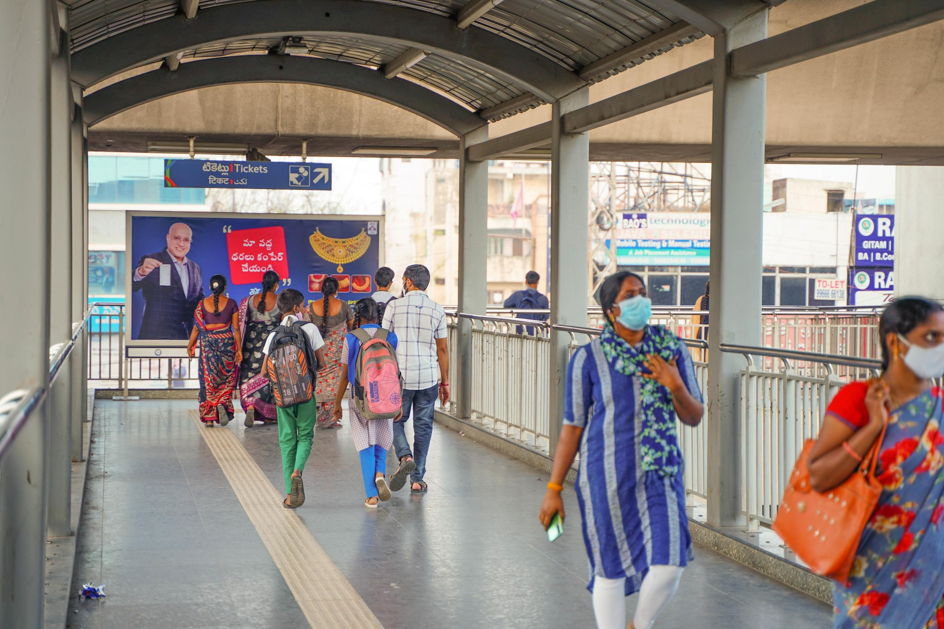
Pics of our Previous Campaigns
LALITHA JEWELLERY
5x1
5x10
Vertical Station Branding
V₀ertical
Station
Branding

Slide 36
H Y D E R A B A D
Get in touch
www.TheMediaAnt.com | Help@TheMediaAnt.com
+91 8067415510 | +91 6364145443

