Slide 1


WWW.SURFACESREPORTER.COM
A Power Combo of PRINT + DIGITAL
for targeting Specifiers, Architects & Designers

Slide 2

SURFACES REPORTER AT A GLANCE

Slide 3

READERSHIP
&
VIEWERSHIP

Slide 4

Pre/ Post COVID
SURFACES REPORTER AT A GLANCE
30,000+/
20-23000
4.5 Lacs+
Annual Readership
Print Copies
5,50,000
12/ 6
Mailers per month
Issues
45000/ 75000+
95,000+
Rise in E-mag readers
Database for Newsletter

Slide 5
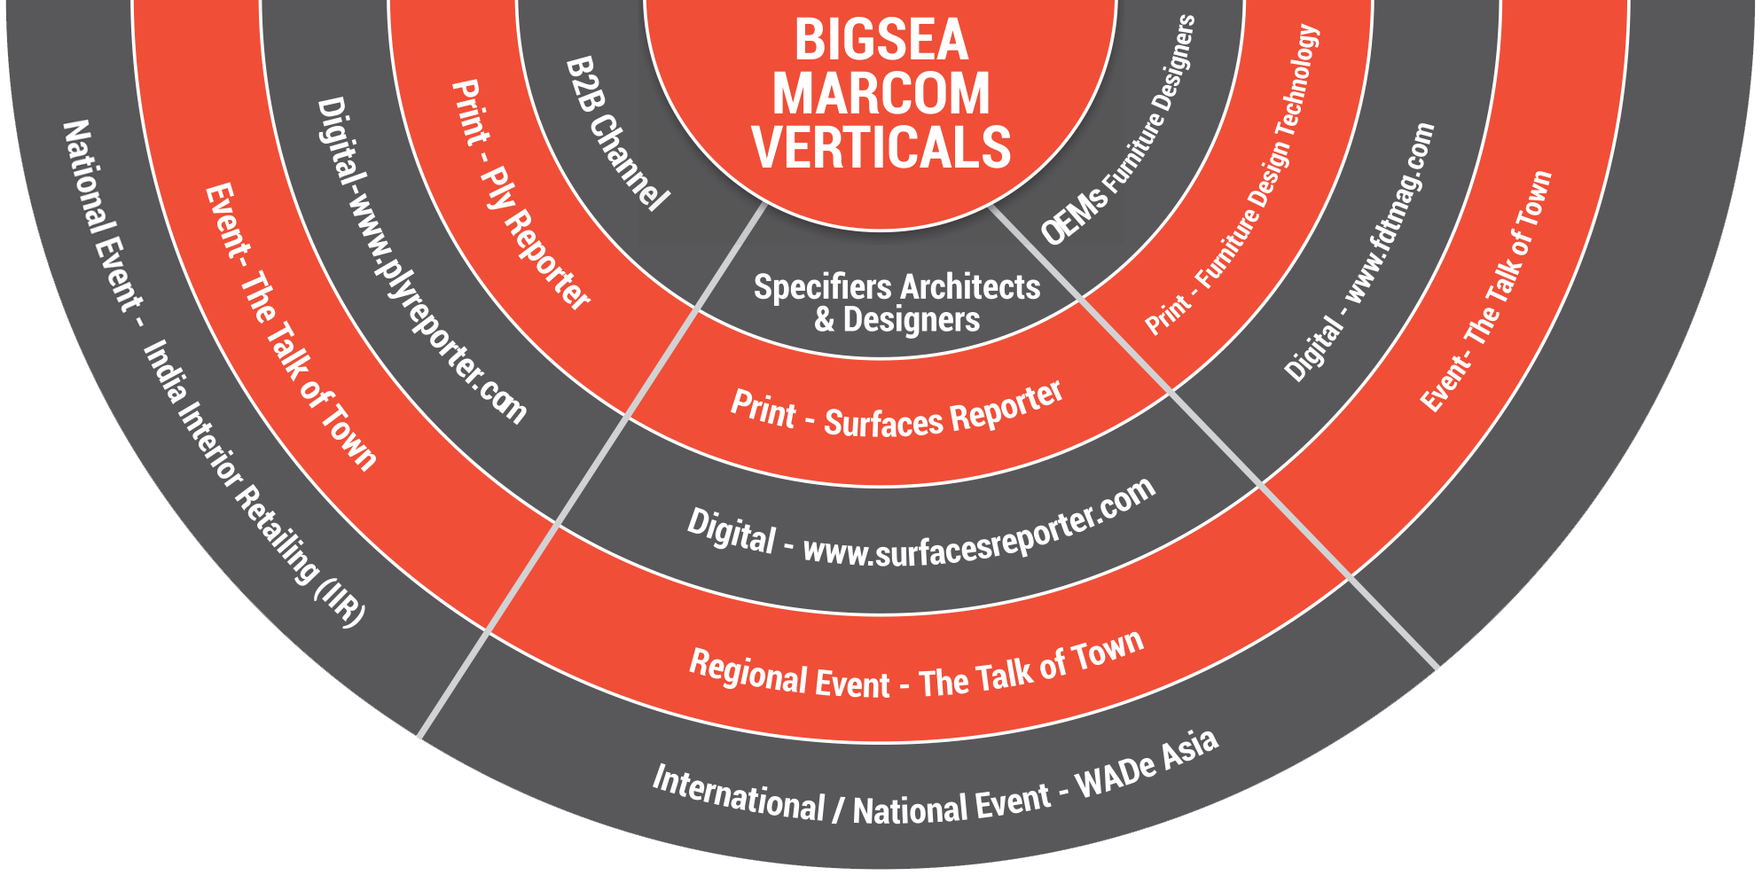

Bigsea Marcom (I) Pvt. Ltd.
A Specialist in the domain of promoting ‘Interior Products & Building Material’ Brands to reach Architects, Interior Designers, Contractors, Consultants and Builders through Specifiers vertical, while catering to Business Channels through B2B, and OEMs & Project Designers through Furniture wing.

Slide 6
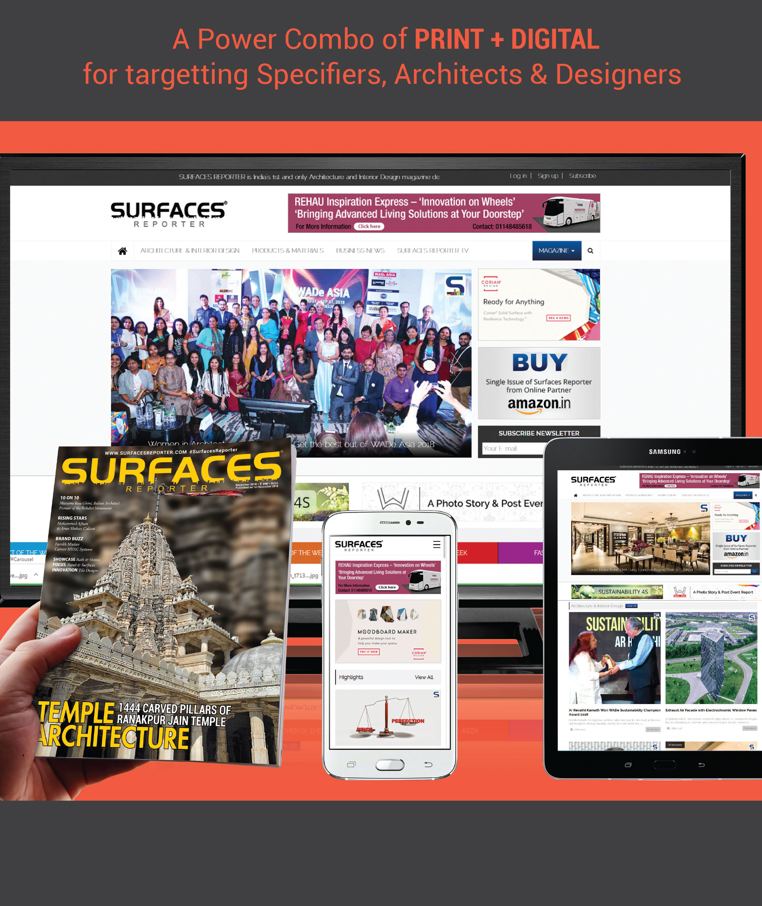
ABOUT SURFACES REPORTER
Frequency – Monthly
Language – English
USP - 1st magazine on Products & Materials for Interior & Building domain
Respected for - Content
Read by - Architects & Designers
Surfaces Reporter Print & Digital are media & content platforms for Leveraging & Increasing Reach and Business Opportunities for Brands in Architectural & Designing sectors.

Slide 7
Readership Distribution
By Business Category
42 % Architects, Builders, Interior Designers, Specifiers, Specialist PMCs, Project Managers for Hospitality, Health care, Residential, Commercial, Retail, and More
23 % B2C Consumers through stands & Bulk distribution in selected showrooms
03 % Foreign Architects/Designers
02 % Celebrities/page3 People, Artists, Hi-profile design enthusiasts
16 % Hi-end showrooms – mixed & single branded & Retail outlets owners & Visiting hi-profile consumers
09 % Manufacturers, Importers, exporter, Distributors, Dealers, Suppliers
05 % OEMS, Furniture Component makers, Furniture manufacturers

Slide 8
Readership Distribution
By Region
South Region
West Region
Andhra Pradesh
Karnataka
Kerala
Tamil Nadu
Telangana
Gujarat
Maharashtra
Goa
Rajasthan
21 %
31 %
09 %
North and Central Region
East Region
39 %
Himachal Pradesh
Punjab & Haryana
Uttarakhand
Delhi
Uttar Pradesh
Madhya Pradesh
West Bengal
Bihar
Jharkhand
Odisha

Slide 9

Readership Distribution
By Region
West Region
North & Central Region
Gujarat
Maharashtra
Goa
Rajasthan
Himachal Pradesh
Punjab & Haryana
Uttarakhand
Delhi
Uttar Pradesh
Madhya Pradesh
31%
39%
South Region
East Region
Andhra Pradesh
Karnataka
Kerala
Tamil Nadu
Telangana
West Bengal
Bihar
Jharkhand
Odisha
21%
09%

Slide 10
Readership Distribution
By Profession
Top Managements/ Decision Makers/ CEOs/
Owners of Businesses
Architects/ Designers/ Builders/ Artists/ Middle management
Product Specifiers
Hi-end Showrooms (Mixed,
Single branded, Company owned), B2B Distributors/ Dealers/ B2B network of important dealers & retailers, Showroom sales managers
B2C Consumers, design enthusiasts, through Subscriptions
throughout India
65%
23-25%
47%
18-21%

Slide 11
Readership Distribution
By Profession
47%
18-21%
65%
23-25%
Architects/ Designers/ Builders/ Artists/ Middle management
Product Specifiers
Hi-end Showrooms (Mixed,
Single branded, Company owned),
B2B Distributors/ Dealers/ B2B network of important dealers
& retailers, Showroom sales managers
Top Managements/ Decision Makers/ CEOs/
Owners of Businesses
B2C Consumers, design enthusiasts, through Subscriptions
throughout India

Slide 12
What They Say?

Slide 13

“See a niche that was not being fully covered by other publications, which Surfaces Reporter takes a close look at. Keep up the good work! For the readers of Surfaces Reporter, I would say this publication goes ‘below the surface’.
Keep reading Surfaces Reporter!“
Niranjan Hiranandani
Co Founder & CMD, Hiranandani Group
Mumbai

Slide 14

“In Surfaces Reporter there is strong emphasis on material and personalities. Much needed”
Legendary Architect Raj Rewal
Raj Rewal Associates
New Delhi

Slide 15

“Surfaces Reporter has improved manifold since its inception. The diverse range of projects and materials showcased in your magazine are extremely interesting!“
Ar. Sanjay Puri
Principal, Sanjay Puri Architects
Mumbai

Slide 16

“Surfaces Reporter is a wonderful magazine. I was just seeing the amount of national and international coverage. We all talk about the concepts, the ideas; but here you guys are trying to go down to the hardcore material palette and I think that’s a fantastic initiative.“
Ar Manish Gulati
MOFA
New Delhi

Slide 17

“I must add that the endeavours of your magazine towards the task you have taken at hand are surely working... my office has used the vendor of stone veneer recommended in your magazine very aptly.“
Ar Annkur Khosla
Founder, Annkur Khosla Design Studio
Mumbai

Slide 18



“I would like to suggest this magazine to every architect & designer. It is one of the finest magazines I have come through and strongly recommend it.“
“I think its fantastic that finally there is a magazine that looks at materials with a serious perspective instead of being an admag. Also the quality and layout are excellent.“
“Surfaces Reporter is a very good magazine for anybody who wants to place a hand on the nerve of interior, exterior designing and architecture.“
Ar. N Mahesh
Principal, Iyer & Mahesh Architects
Trivandrum
Malavika Tiwari
Actress & Entrepreneur
Malavika Tiwari Glass Arts
Natasha Suri
Miss India 2006

Slide 19

“Since your first copy, I've been reading SURFACES REPORTER. You people achieved tremendous growth in very short span of time. Undoubtedly you've delivered quality and well curated content to your readers, which I hardly find with other magazines.“
Vipul Mehta
Country Head, Elegant Marbles & Grani Industries Ltd.
Mumbai

Slide 20



“Nice magazine and extremely useful for every architect and interior designer for latest news about constructon & interior products.“
“Congratulations for increasing your reach and circulation in an extremely competitive market.“
“Surfaces Reporter is a great magazine and all architects and interior designer should read & refer it!“
Rahul Dev
Indian Actor & Entrepreneur
Mumbai
Dhiren Mehta
ARHAM DECO
Baroda
Kedar Devi
Design Connoisseurs
Nashik

Slide 21



“Surfaces Reporter is filling a void in architectural journalism by focusing on products and materials in the form of a magazine as opposed to a catalogue.“
“Wonderful details about the materials and great source of information to keep me updated. I am looking forward to long term association with Surfaces Reporter magazine.“
“I still remember the 1st copy of Surfaces Reporter! Growth has just been tremendous! Every issue is mind-blowing and keeps me awaited for more.“
Ar. Takbir Fatima
DesignAware
Hyderabad
Jyotika Nigam
Opus Design Studio
Bhopal
Ar Nishant
Chavda N&G Associates
Hyderabad

Slide 22
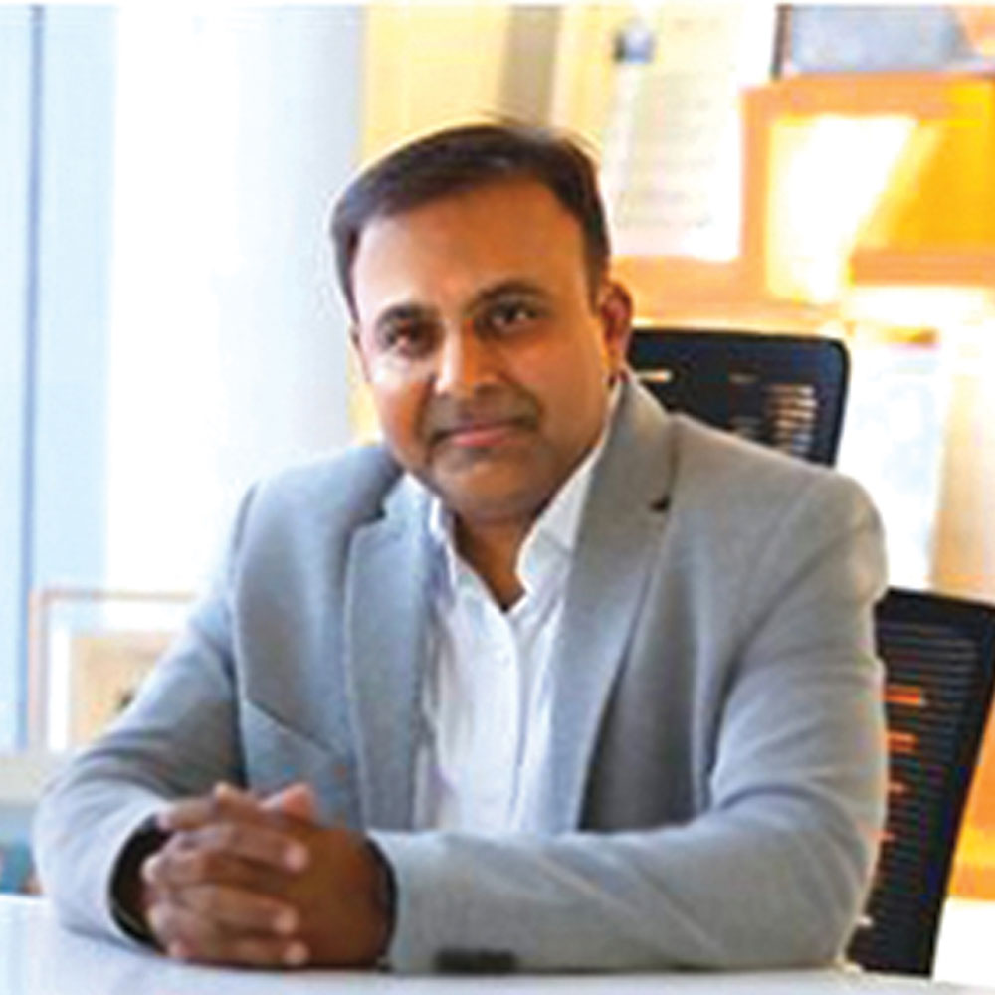
“I usually don’t read magazines but I ensure that whenever Surfaces Reporter reaches, it is circulated amongst the team. It has such a lot of information helpful for them and its very interesting.“
Ar Amit Porwal
IPIPL
Mumbai

Slide 23

“I in person am in awe of their thought process and result oriented magazine Surfaces Reporter. It was launched in May 2011. In short span of time it has become a household magazine not only for Architects and Interior Designers but also people who do up their own houses
without the help of professionals.
Best wishes Vertica & team!“
Ar Hoshedaar Eruch Carnac
Creative Director,
HEJC Architects Combine,
Mumbai

Slide 24

GROUP CLIENTS

Slide 25
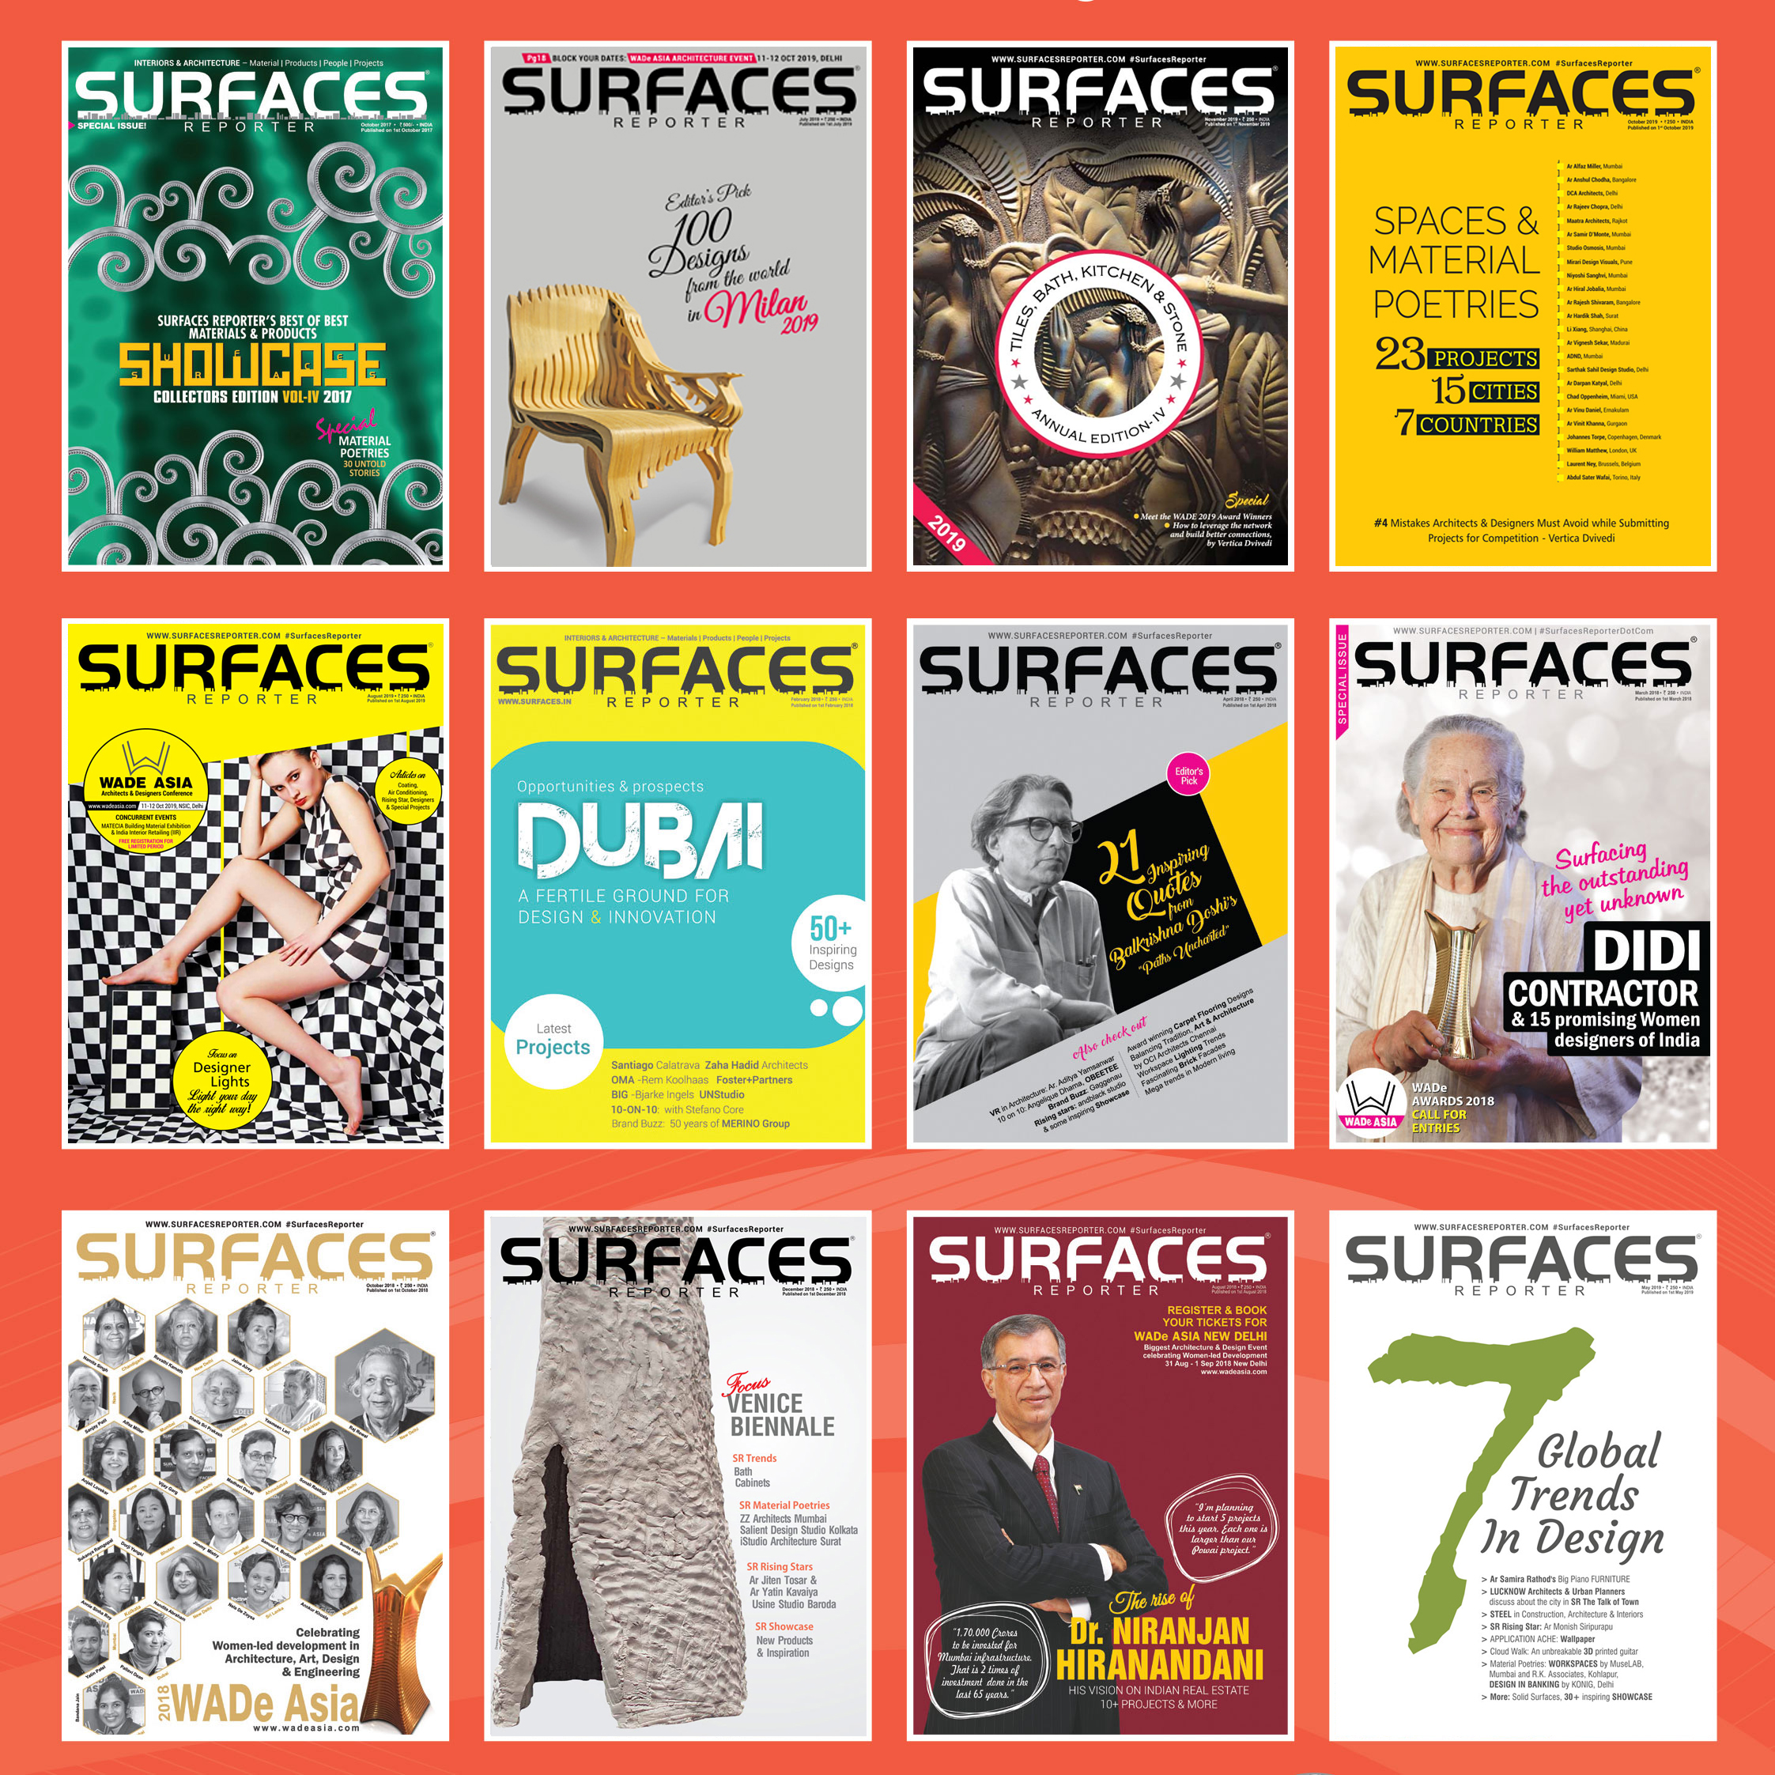
WE
DO NOT
HAVE A
BIG & STRONG
HISTORY
WE ARE /\ CREATING ONE!
definitely

