Slide 1
















Reference images

Slide 2
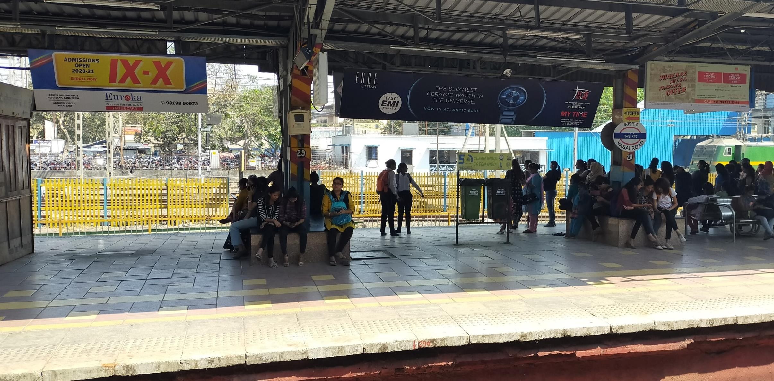
City - Vasai, Location - Vasai Station Board, Platform No. 3 , Size – 16 X 3 , Type - NL (Sample Picture)
http://www.themediaant.com/

Slide 3
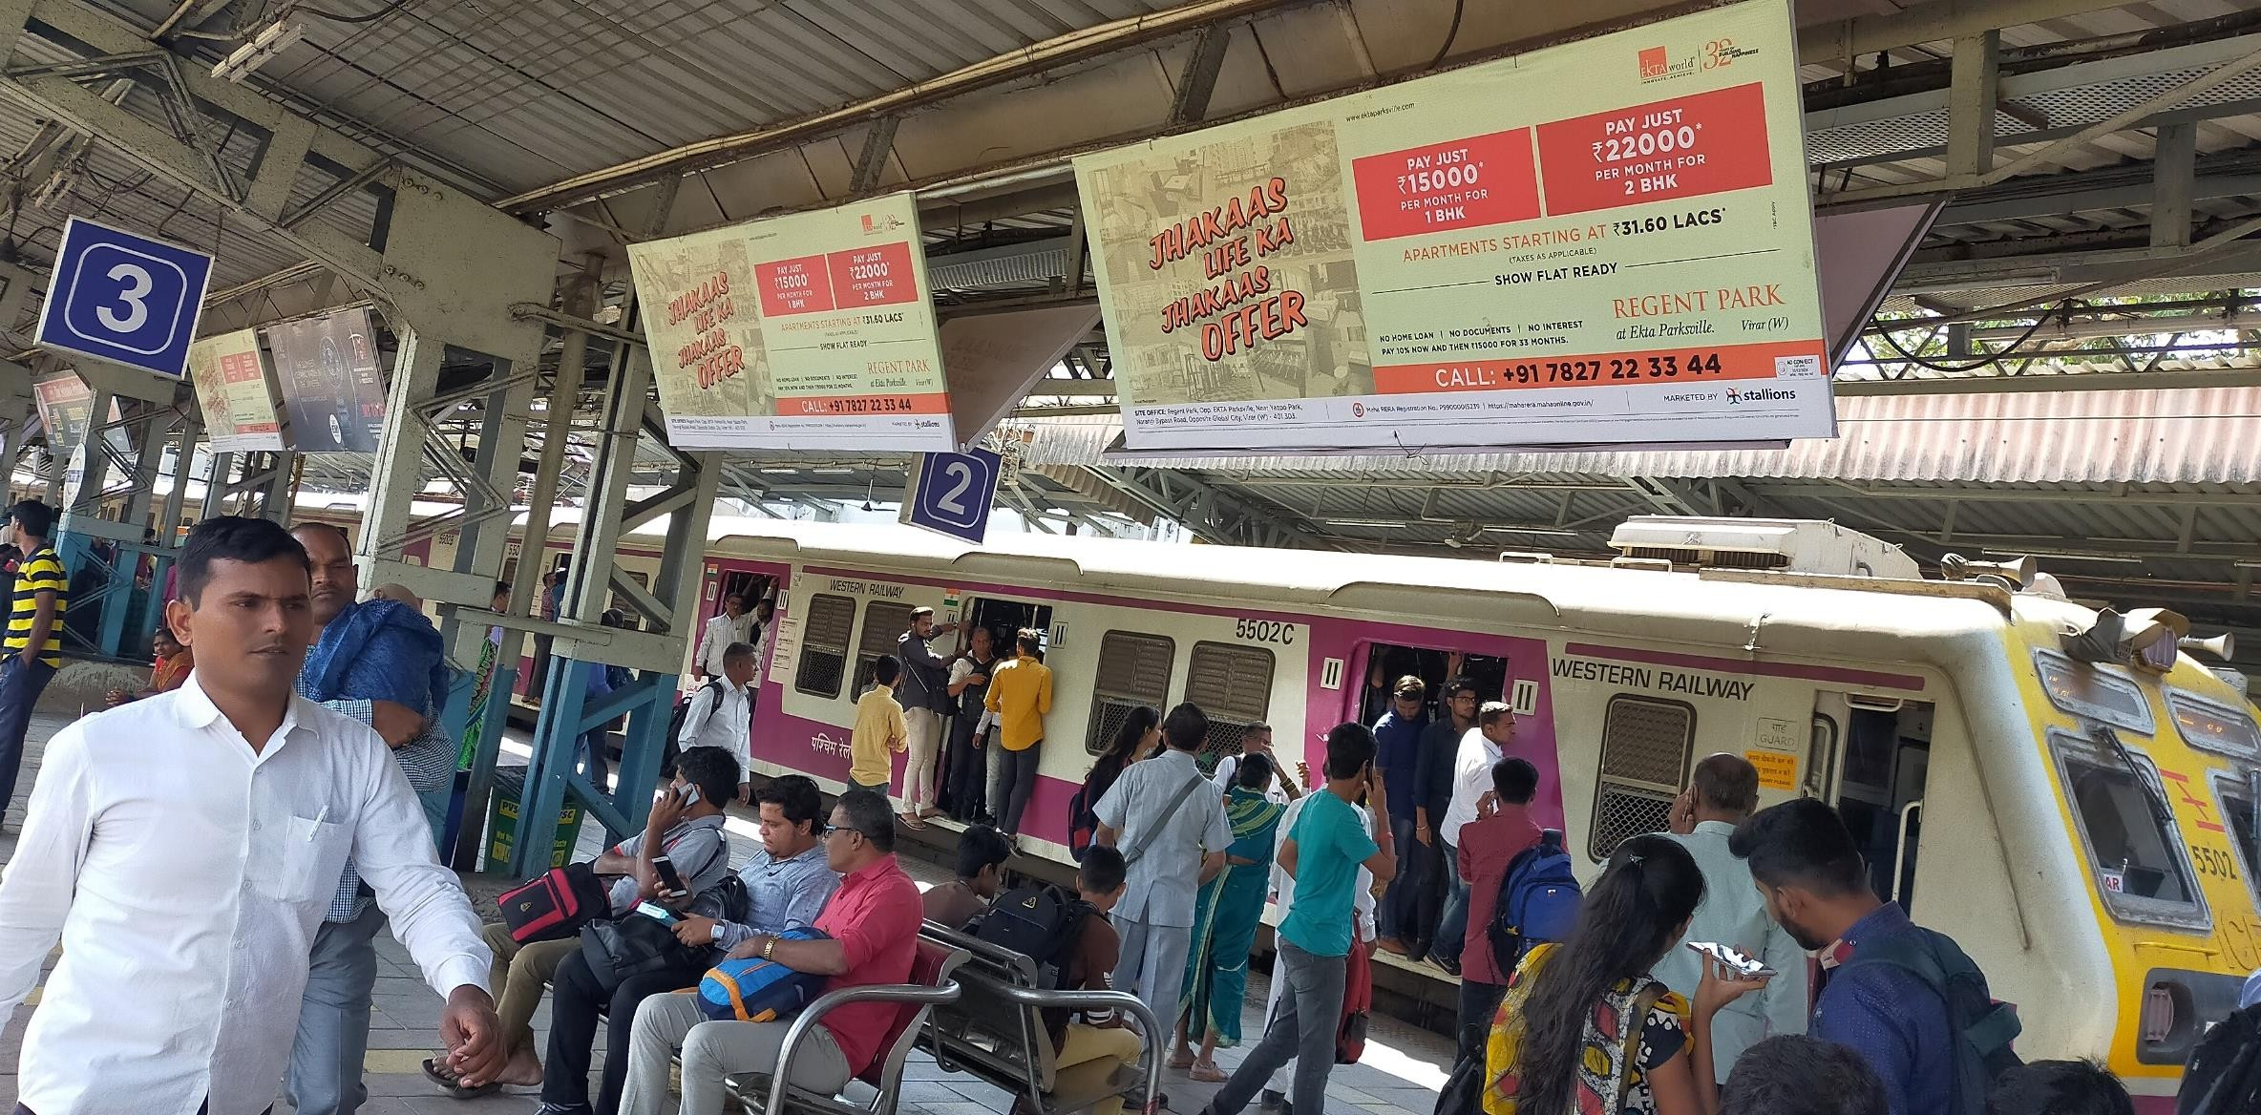
City - Vasai, Location - Vasai Station Board, Platform No. 3 , Size – 8 X 3 , Type - NL (Sample Picture)
http://www.themediaant.com/

Slide 4











Thank You

