Slide 1
















Reference images

Slide 2
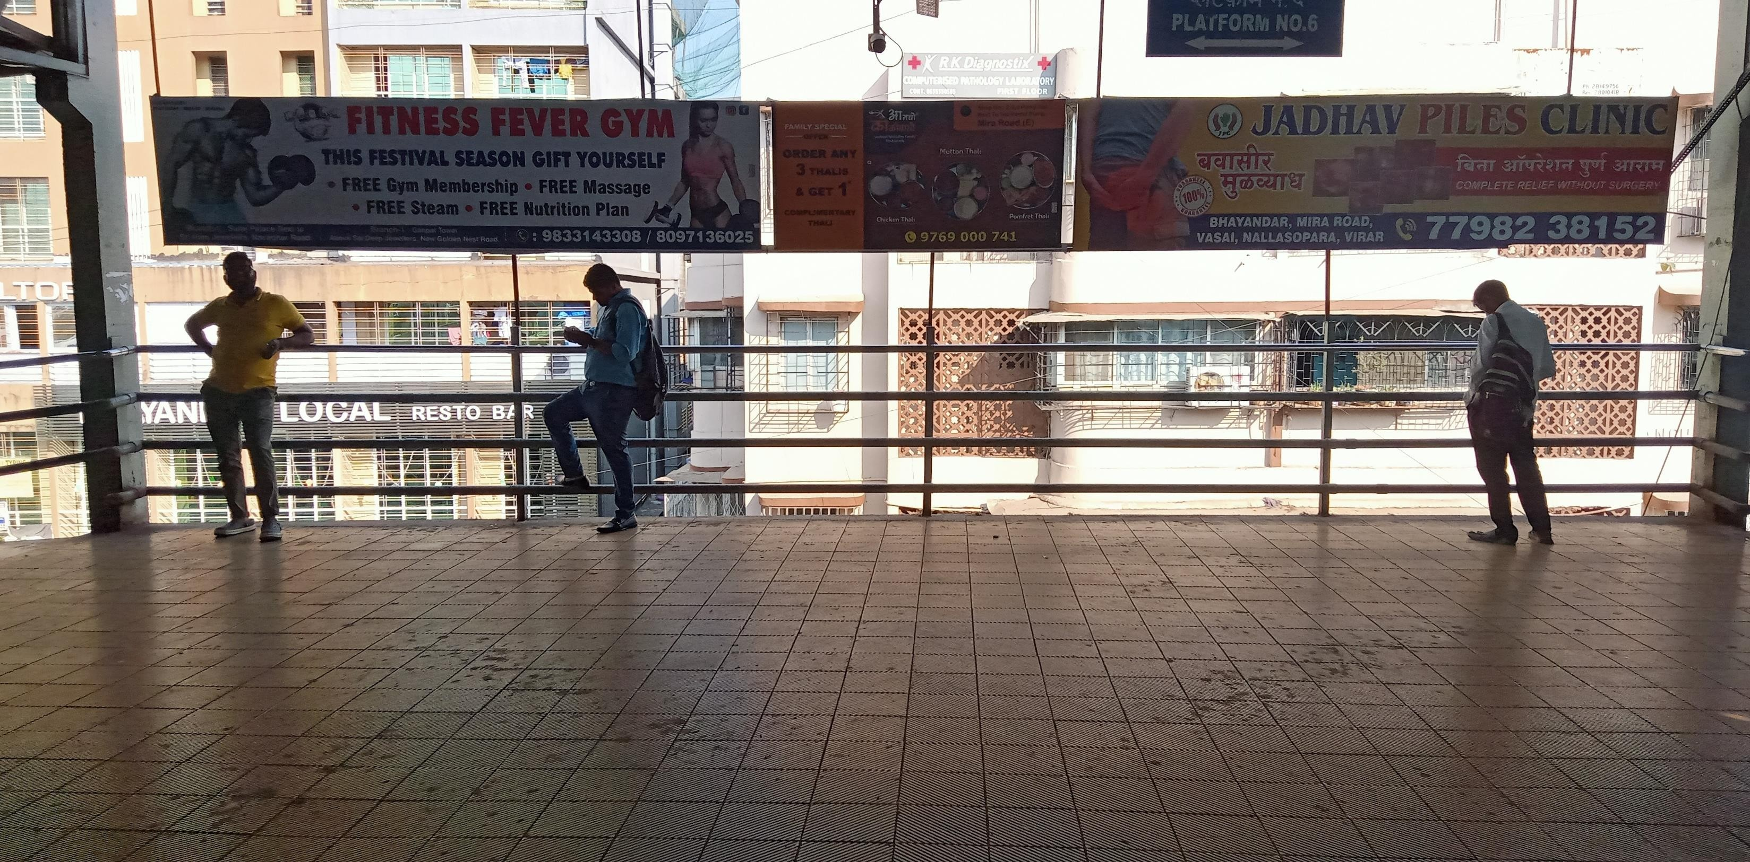
City - Bhayandar, Location – Bhayandar Railway Footover Bridge , Size – 12 X 3 , Type - NL
http://www.themediaant.com/

Slide 3
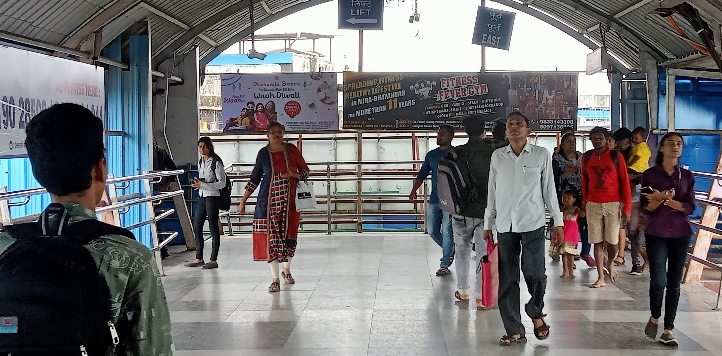
City - Bhayandar, Location – Bhayandar Railway Footover Bridge , Size – 6 X 3 , Type - NL
http://www.themediaant.com/

Slide 4
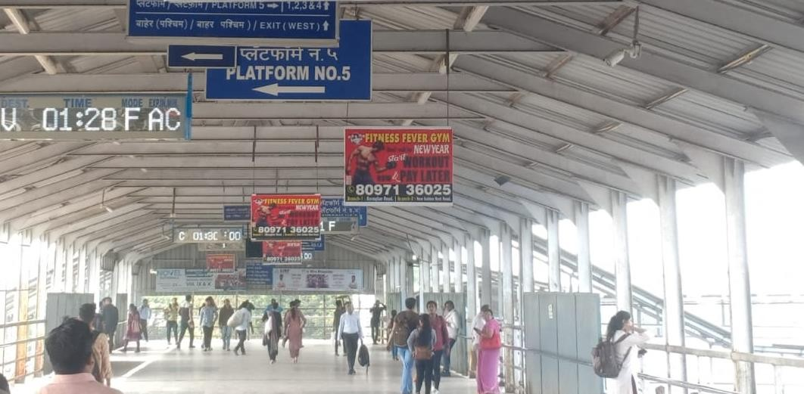
City - Bhayandar, Location – Bhayandar Railway Footover Bridge , Size – 3 X 2 (Back to Back) , Type - NL
http://www.themediaant.com/

Slide 5
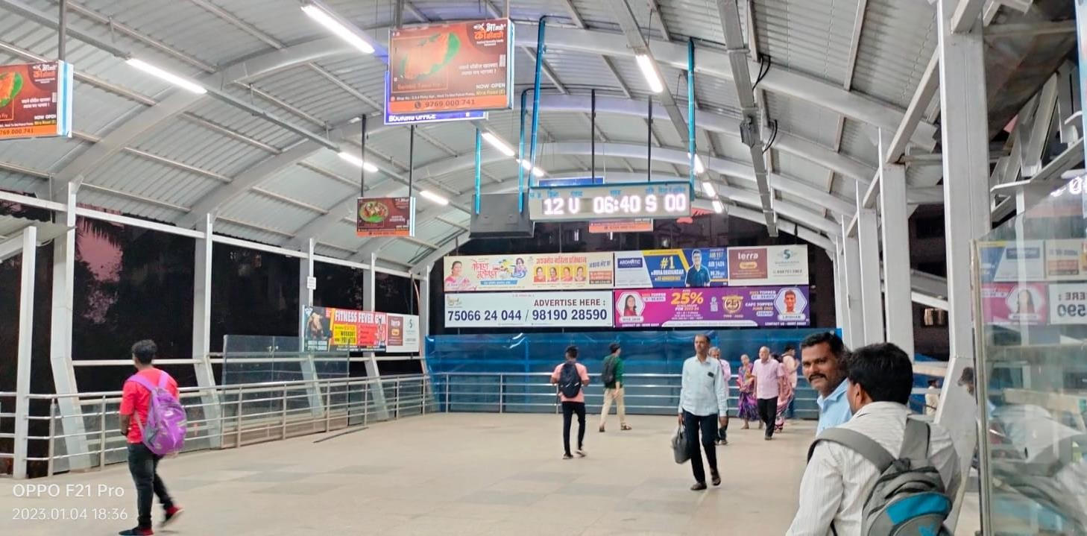
City - Bhayandar, Location – Bhayandar Railway Footover Bridge , Size – 15 X 3 , Type - NL
http://www.themediaant.com/

Slide 6
City - Bhayandar, Location – Bhayandar Railway Footover Bridge , Size – 18 X 3 , Type - NL
http://www.themediaant.com/

Slide 7
City - Bhayandar, Location – Bhayandar Railway Footover Bridge , Size – 20 X 3 , Type - NL
http://www.themediaant.com/

Slide 8
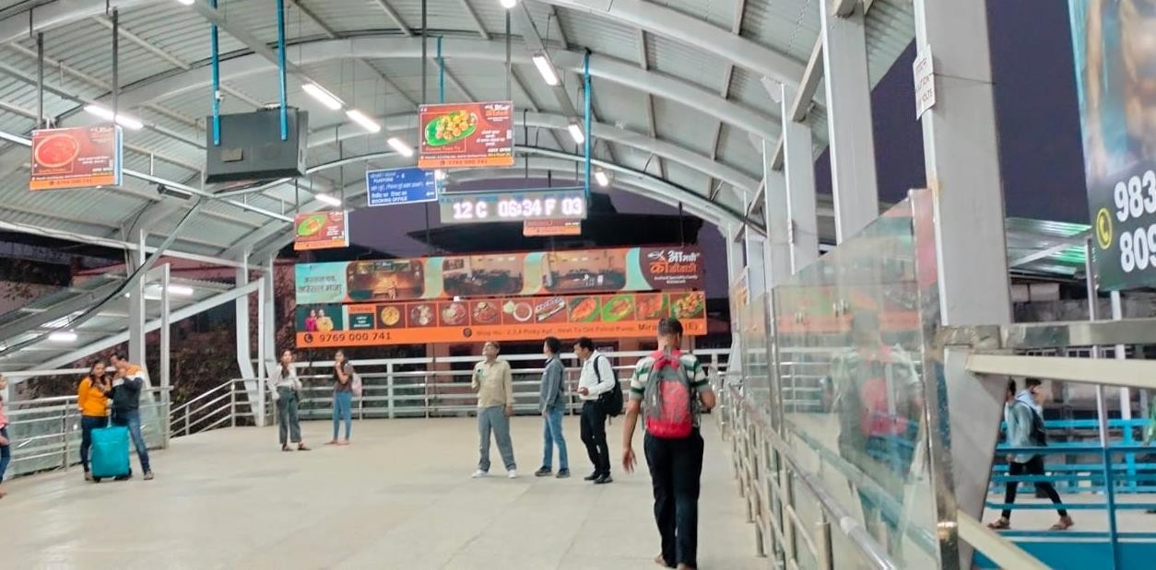
City - Bhayandar, Location – Bhayandar Railway Footover Bridge , Size – 30 X 3 , Type - NL
http://www.themediaant.com/

Slide 9











Thank You

