Slide 1
















Reference images

Slide 2
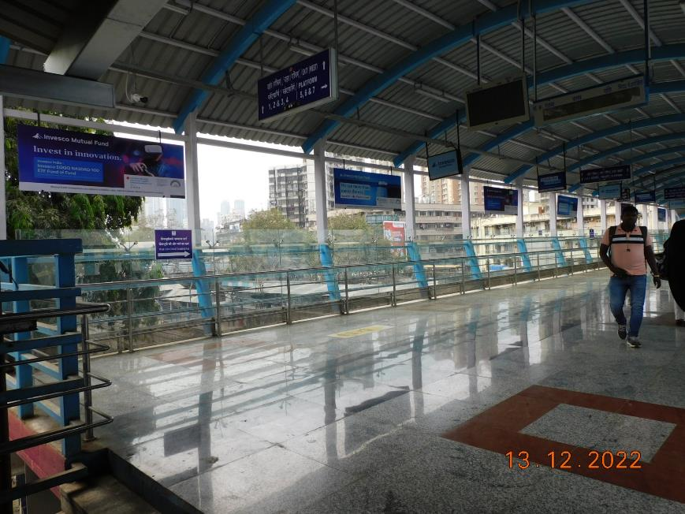
1st FOB from South i.e. C'gate towards Andheri - 8x3 - Board Ambi lit
http://www.themediaant.com/

Slide 3
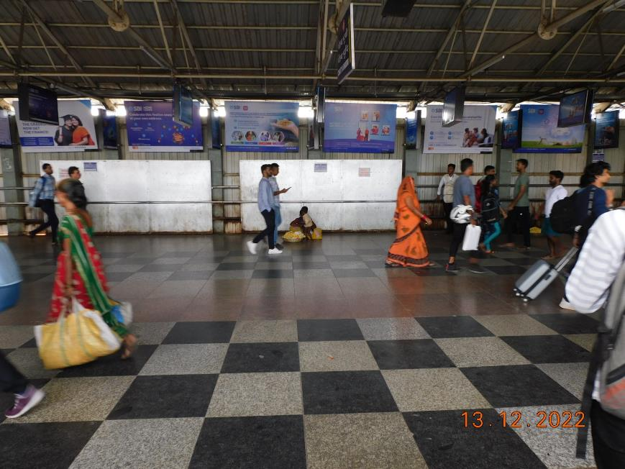
2nd FOB from south i.e.C'gate towards Andheri (middle)
- 8x3 - Board - Ambi lit
http://www.themediaant.com/

Slide 4
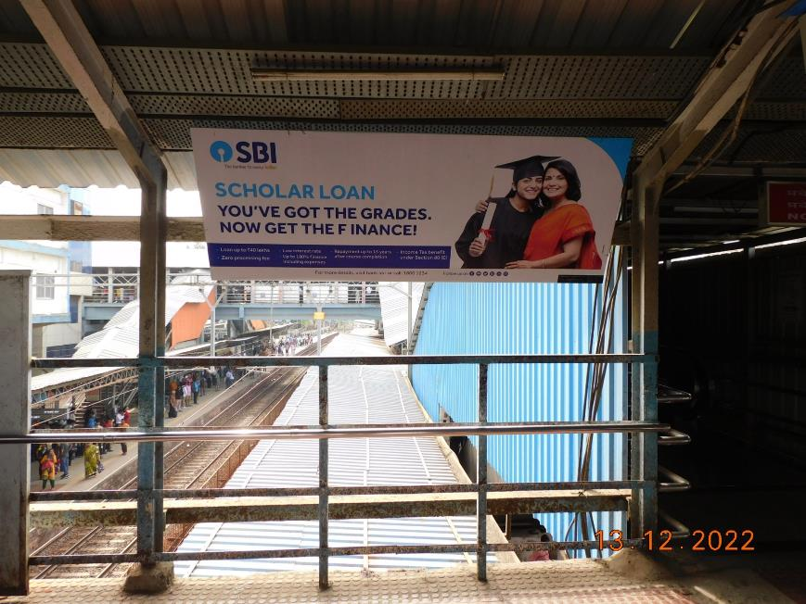
3rd FOB from south i.e. C'gate towards Andheri- 8x3 - Board - Ambi lit
http://www.themediaant.com/

Slide 5
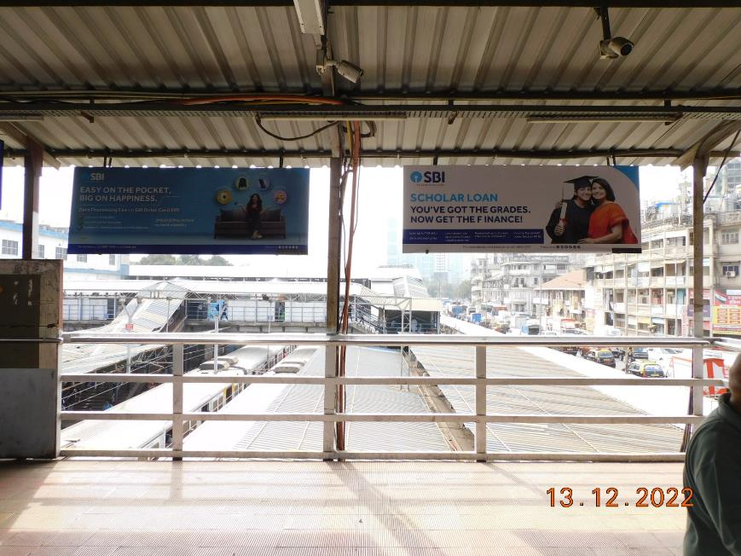
4th FOB from South i.e. C'gate towards Andheri - 8x3 - Board - Ambi lit
http://www.themediaant.com/

Slide 6
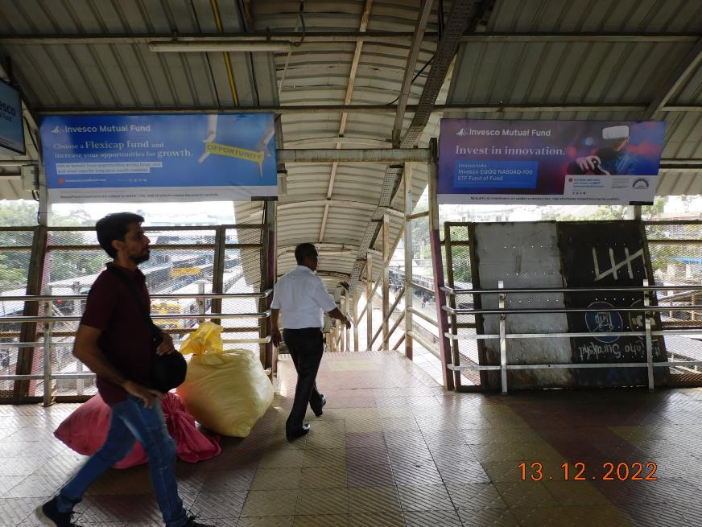
5th FOB From South i.e.C'gate towards Andheri – 8 x 3 – Board Ambi lit
http://www.themediaant.com/

Slide 7











Thank You

