Slide 1
















Reference images

Slide 2
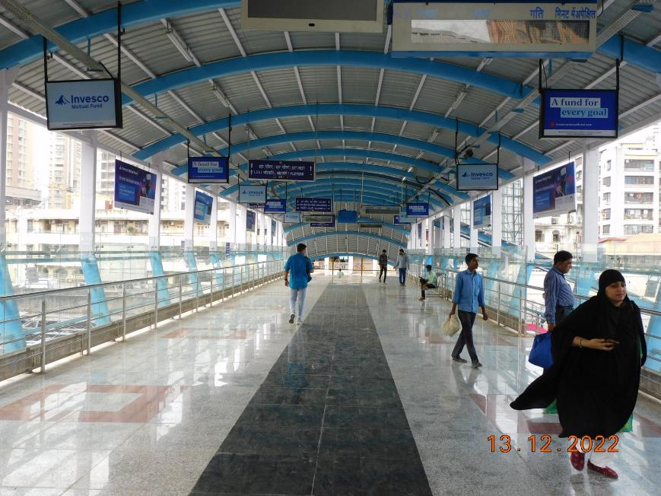
1st FOB from South i.e. C'gate towards Andheri - 3x2 – Glowsign Backlit
http://www.themediaant.com/

Slide 3
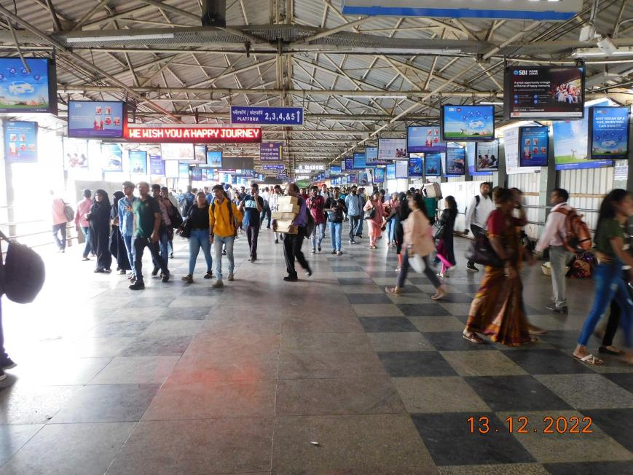
2nd FOB from south i.e.C'gate towards Andheri (middle) – 3 x 2 – Glowsign Backlit
http://www.themediaant.com/

Slide 4
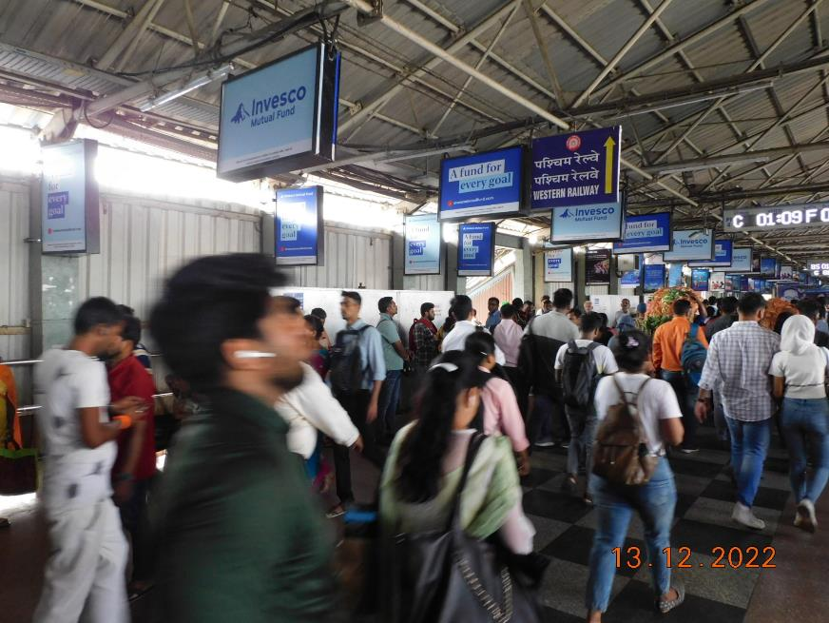
2nd FOB from south i.e.C'gate towards Andheri (middle) – 3 x 2 – Glowsign Backlit
http://www.themediaant.com/

Slide 5
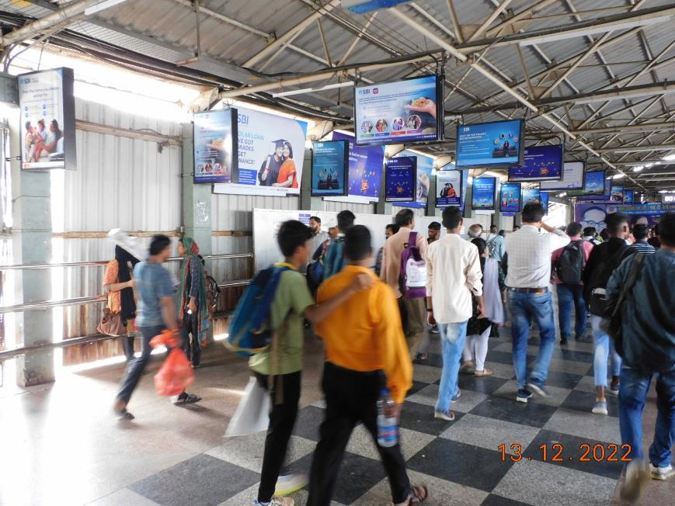
2nd FOB from south i.e.C'gate towards Andheri (middle) - 2x3 – Glowsign Backlit (Vertical Shape)
http://www.themediaant.com/

Slide 6
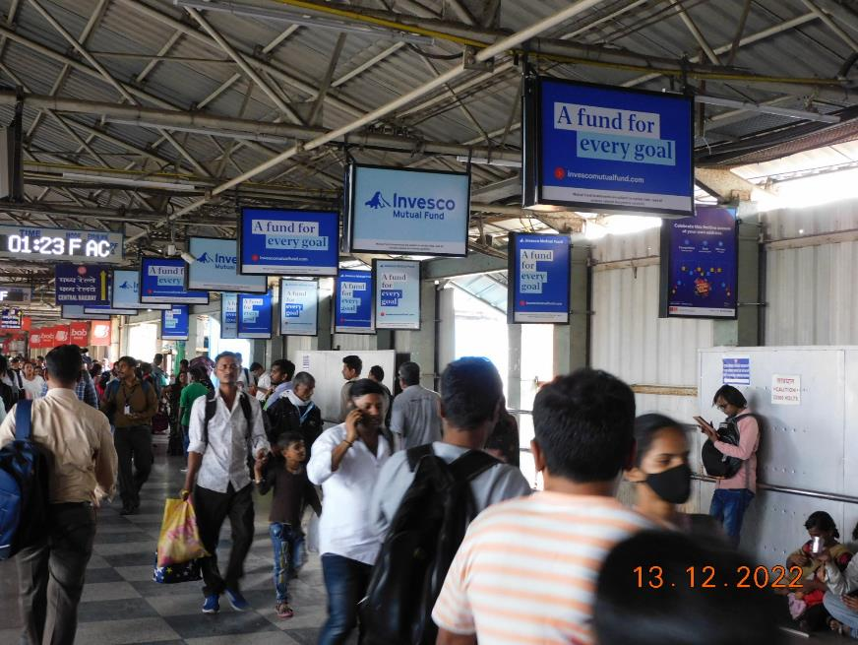
2nd FOB from south i.e.C'gate towards Andheri (middle) - 2x3 - Glowsign (Vertical Shape)
http://www.themediaant.com/

Slide 7
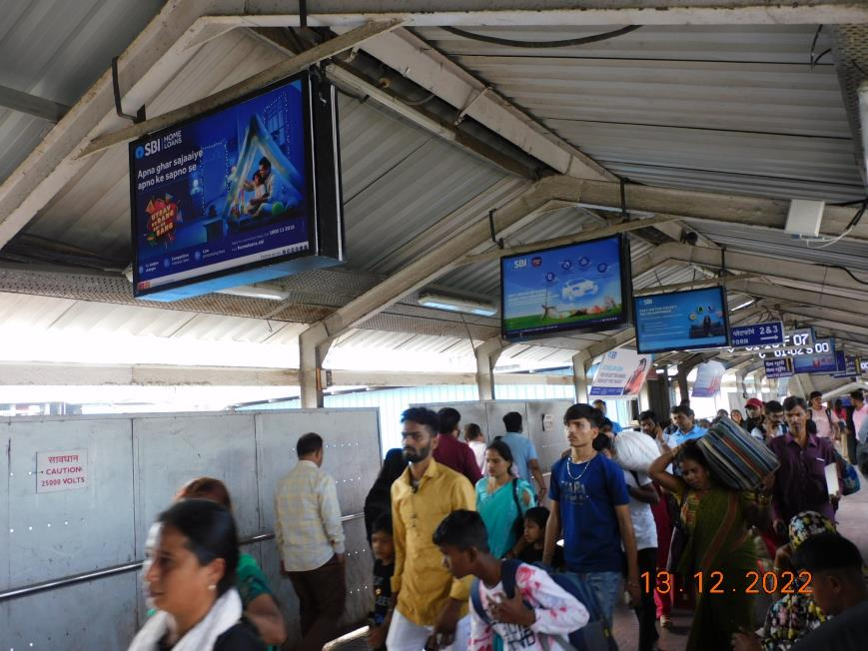
3rd FOB from south i.e. C'gate towards Andheri- 3x2 – Glowsign Backlit
http://www.themediaant.com/

Slide 8
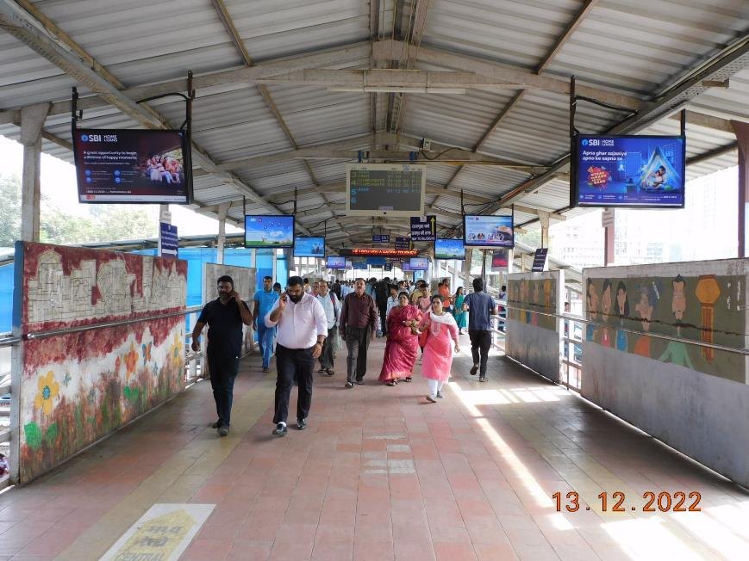
4th FOB from South i.e. C'gate towards Andheri- 3x2 – Glowsign Backlit
http://www.themediaant.com/

Slide 9
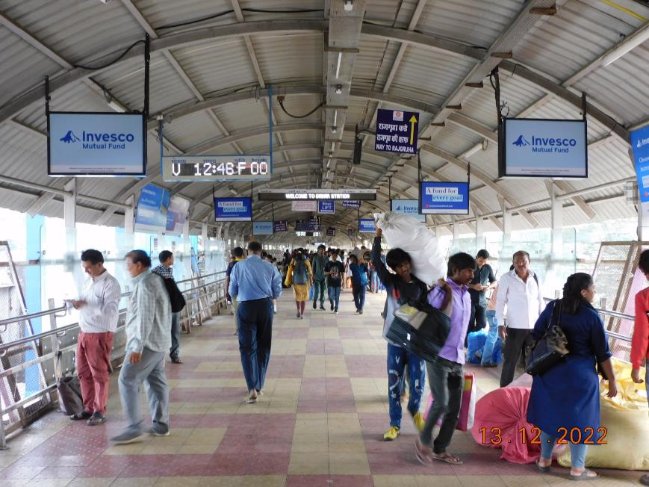
5th FOB From South i.e.C'gate towards Andheri - 3x2 - Glowsign Backlit
http://www.themediaant.com/

Slide 10











Thank You

