Slide 1
















Reference images

Slide 2
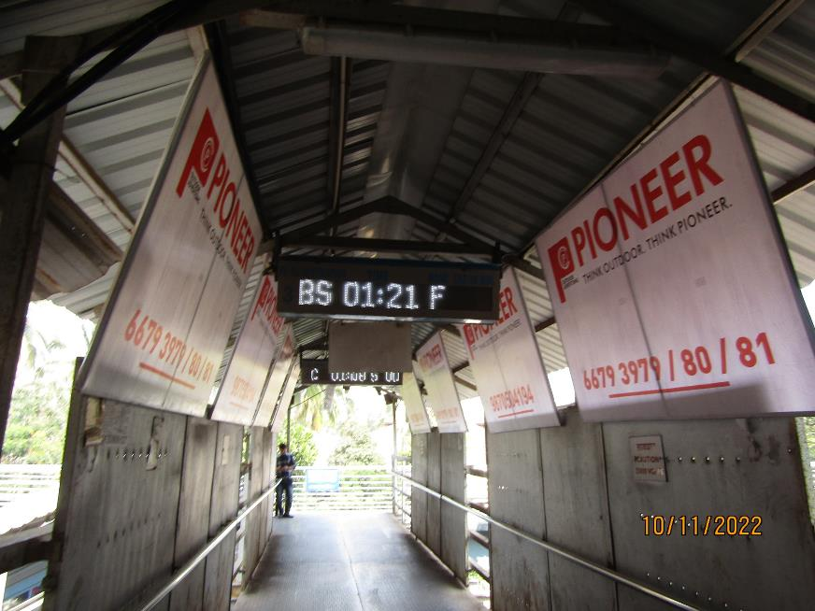
1st FOB from South i.e.C'gate towards Andheri - 6x4 - Board Ambi lit
http://www.themediaant.com/
http://www.themediaant.com/

Slide 3
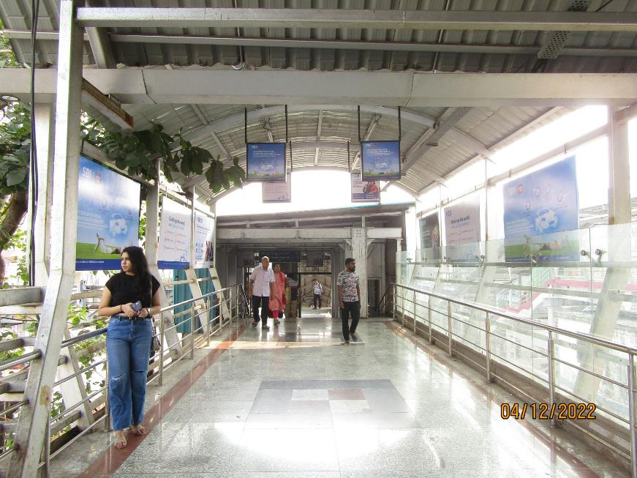
2nd FOB from South i.e. C'gate towards Andheri - 6x4 – Board Ambi lit
http://www.themediaant.com/

Slide 4
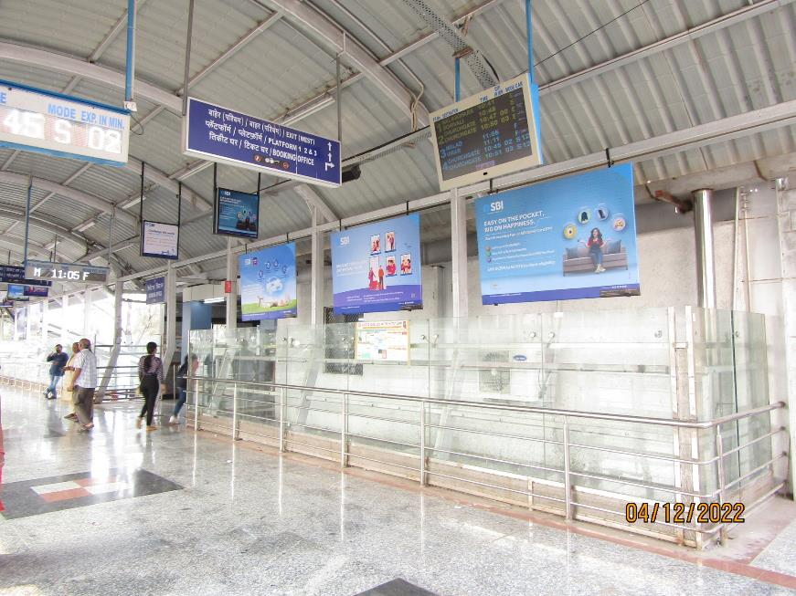
2nd FOB from South i.e. C'gate towards Andheri - 6x4 – Board Ambi lit
http://www.themediaant.com/

Slide 5
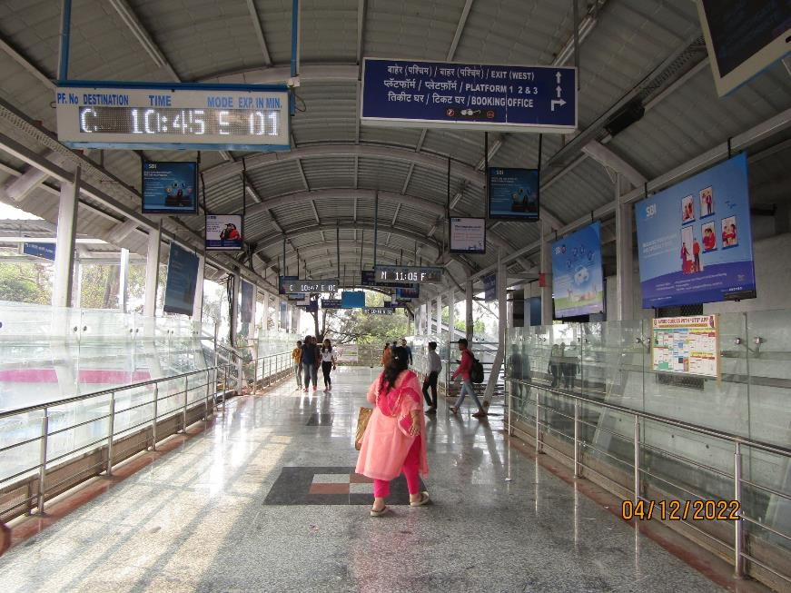
2nd FOB from South i.e. C'gate towards Andheri - 2x2 – Glowsign Backlit
http://www.themediaant.com/

Slide 6
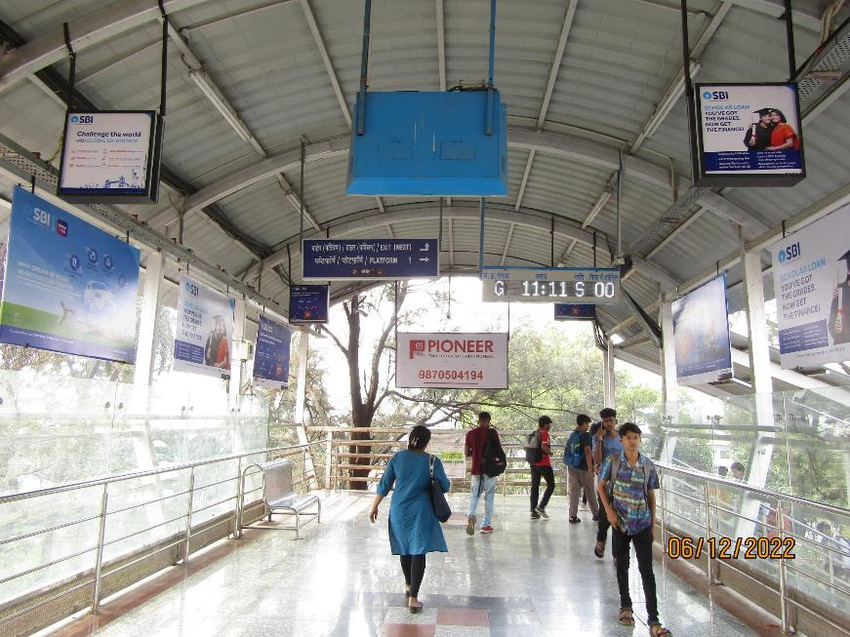
2nd FOB from South i.e. C'gate towards Andheri - 8x4 – Glowsign Backlit
http://www.themediaant.com/

Slide 7
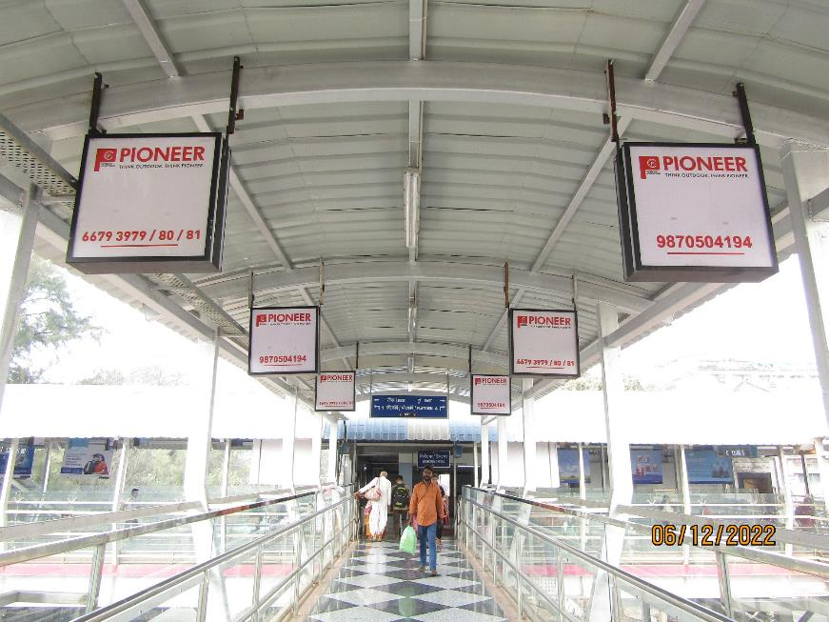
2nd FOB from South i.e. C'gate towards Andheri - 2x2 – Glowsign Backlit
http://www.themediaant.com/

Slide 8
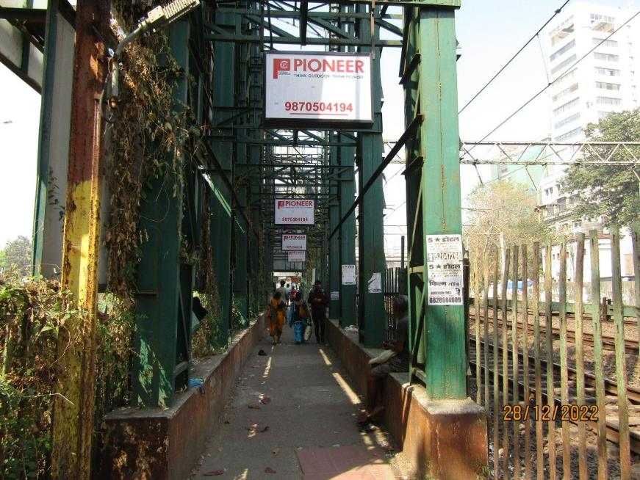
Pathway- (Entry/Exit from North Side) - 3x2 – Glowsign Backlit
http://www.themediaant.com/

Slide 9











Thank You

