Slide 1
















Reference images

Slide 2
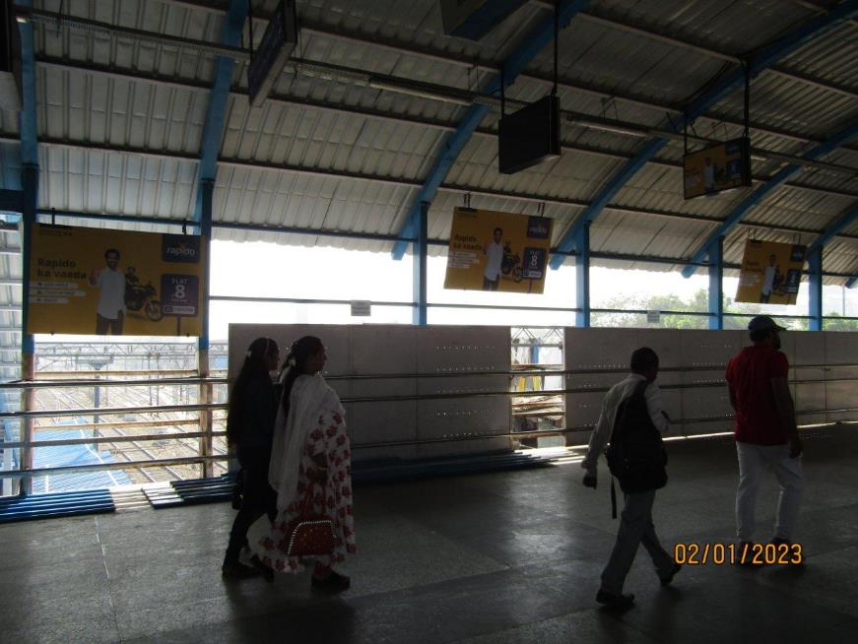
1st FOB from South i.e. C'gate towards Andheri – 6 x 4 Board – Ambi lit
http://www.themediaant.com/

Slide 3
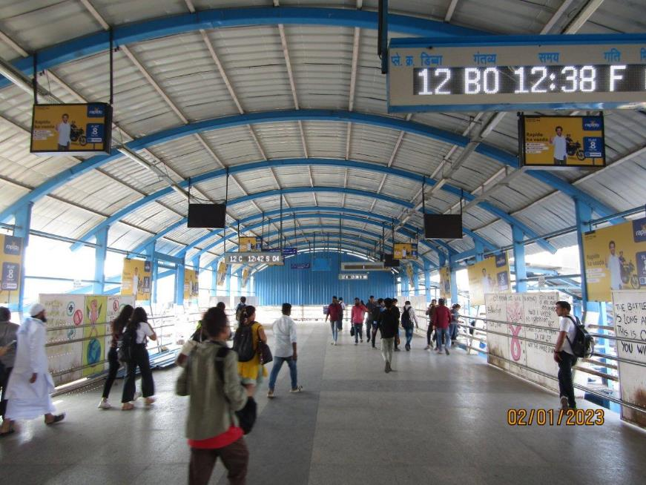
1st FOB from South i.e. C'gate towards Andheri - 3 x 2 – Glowsign Backlit
http://www.themediaant.com/

Slide 4
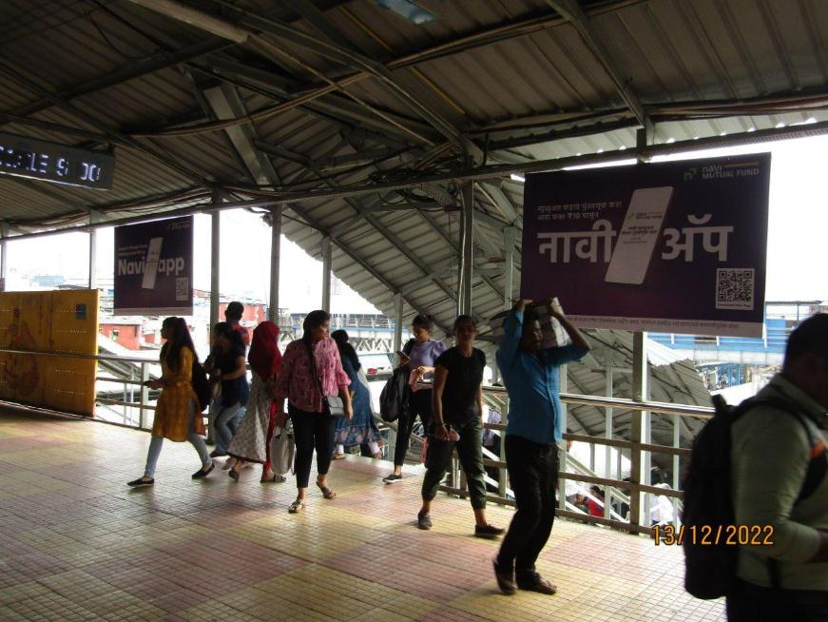
2nd FOB from South i.e. C'gate towards Andheri 6 x 4 – Board Ambi lit
http://www.themediaant.com/

Slide 5
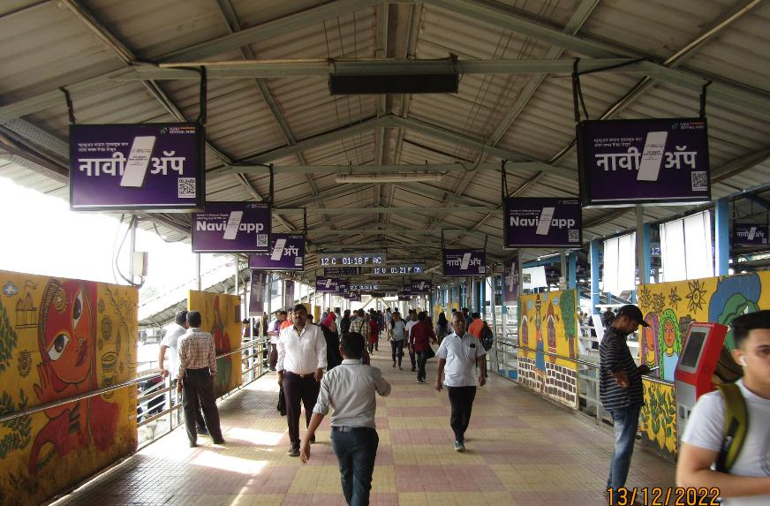
2nd FOB from South i.e. C'gate towards Andheri 3 x 2 – Glowsign Backlit
http://www.themediaant.com/

Slide 6
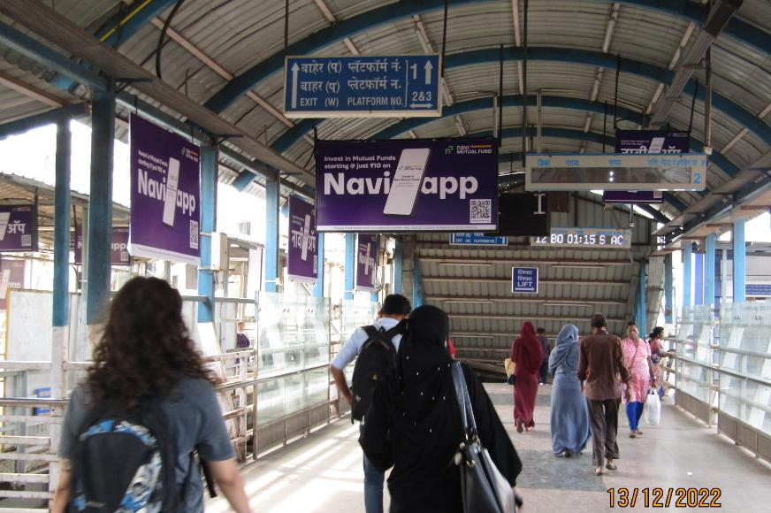
3rd FOB from South i.e. C'gate towards Andheri - 8x4 – Glowsign Backlit
http://www.themediaant.com/

Slide 7
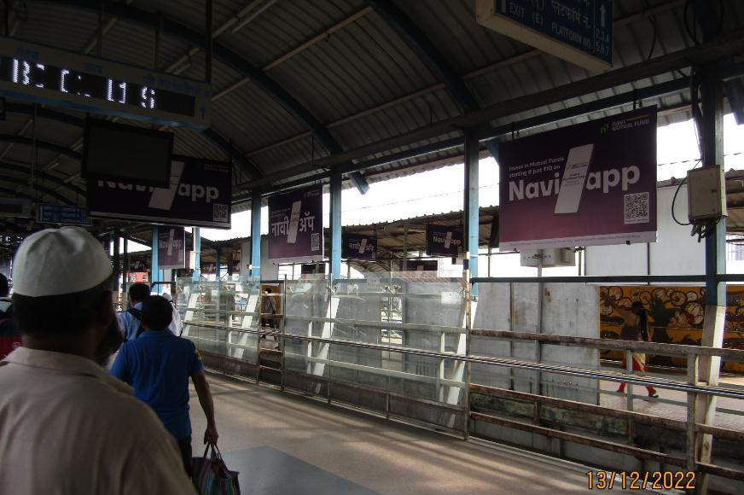
3rd FOB from South i.e. C'gate towards Andheri - 6x4 – Board Ambi lit
http://www.themediaant.com/

Slide 8
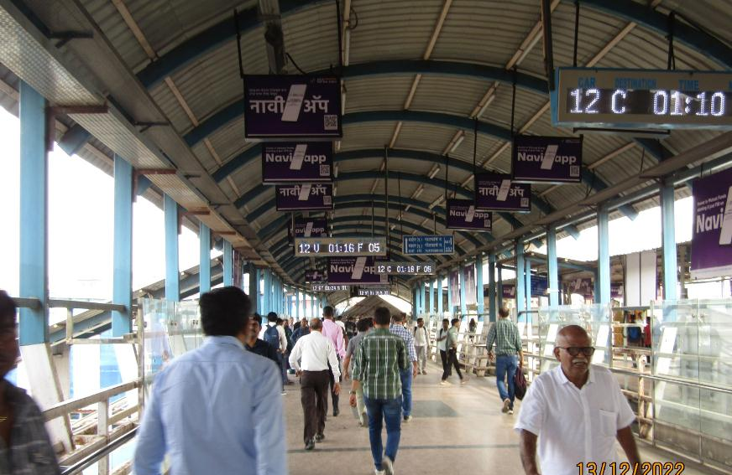
3rd FOB from South i.e. C'gate towards Andheri - 3x2 – Glowsign Backlit
http://www.themediaant.com/

Slide 9
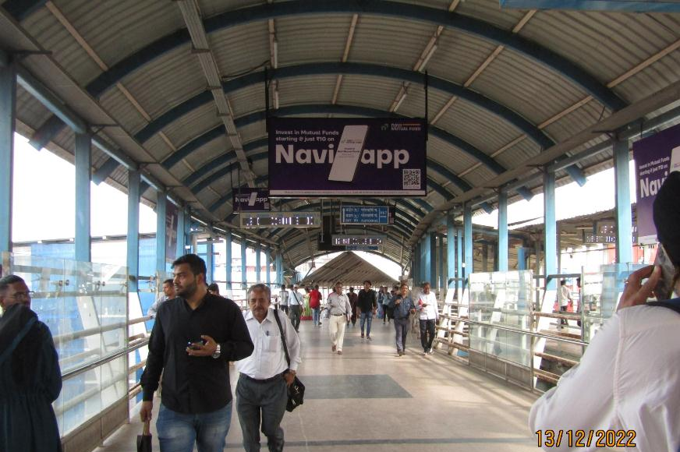
3rd FOB from South i.e. C'gate towards Andheri 8 x 4 – Glowsign Backlit
http://www.themediaant.com/

Slide 10
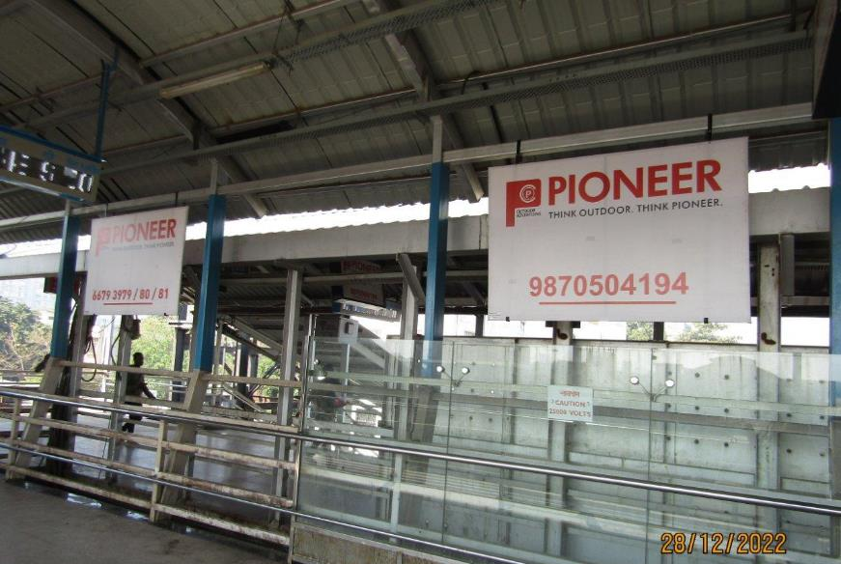
4th FOB from South i.e. C'gate towards Andheri – 6 x 4 –Board Ambi lit
http://www.themediaant.com/

Slide 11
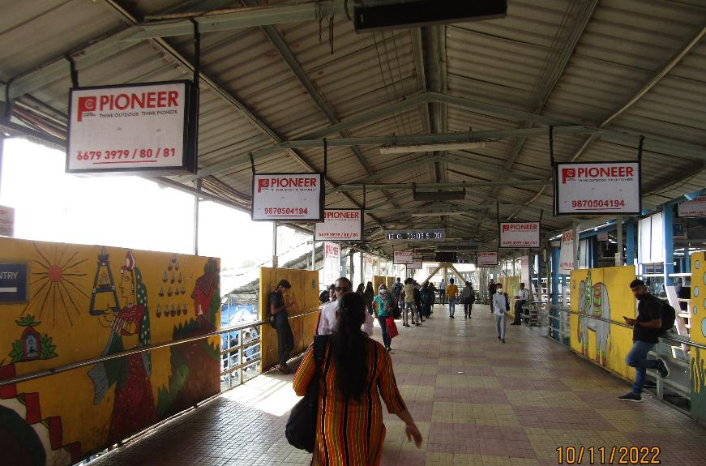
4th FOB from South i.e. C'gate towards Andheri - 3 x 2 –Glowsign Backlit
http://www.themediaant.com/

Slide 12











Thank You

