Slide 1
















Reference images

Slide 2
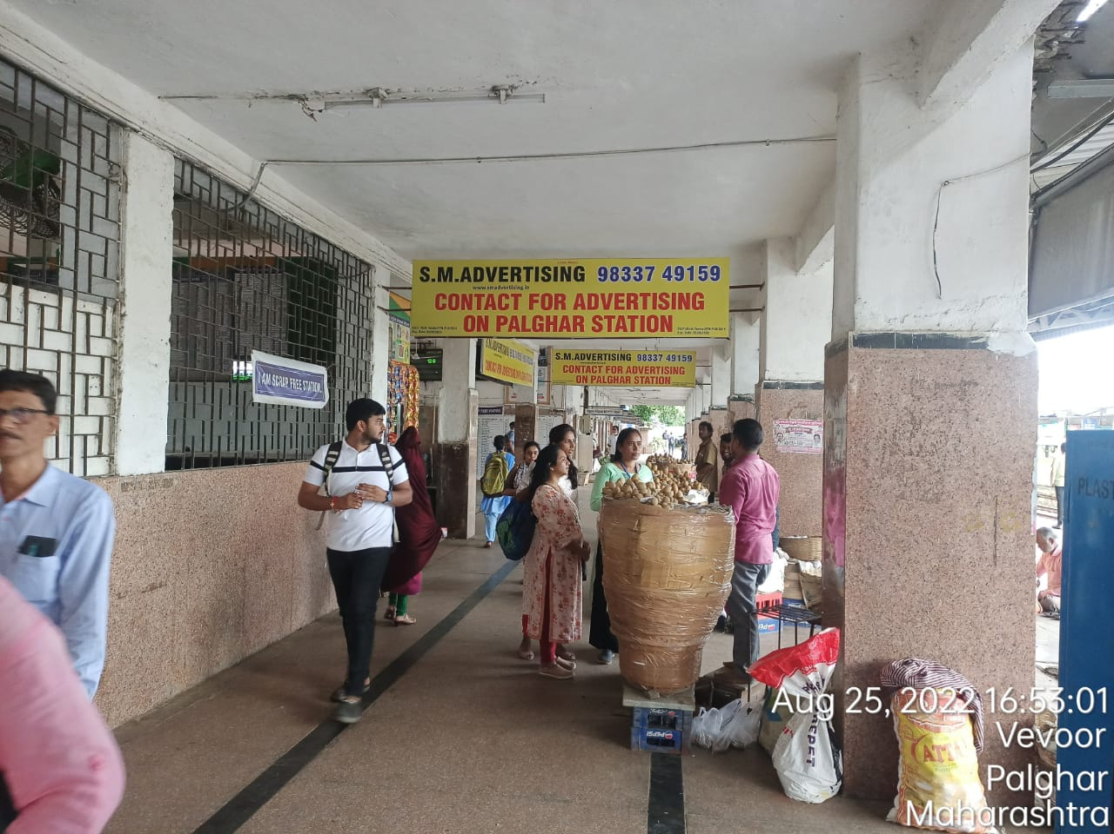
10ft x 2.5ft Frontback Display boards
http://www.themediaant.com/

Slide 3
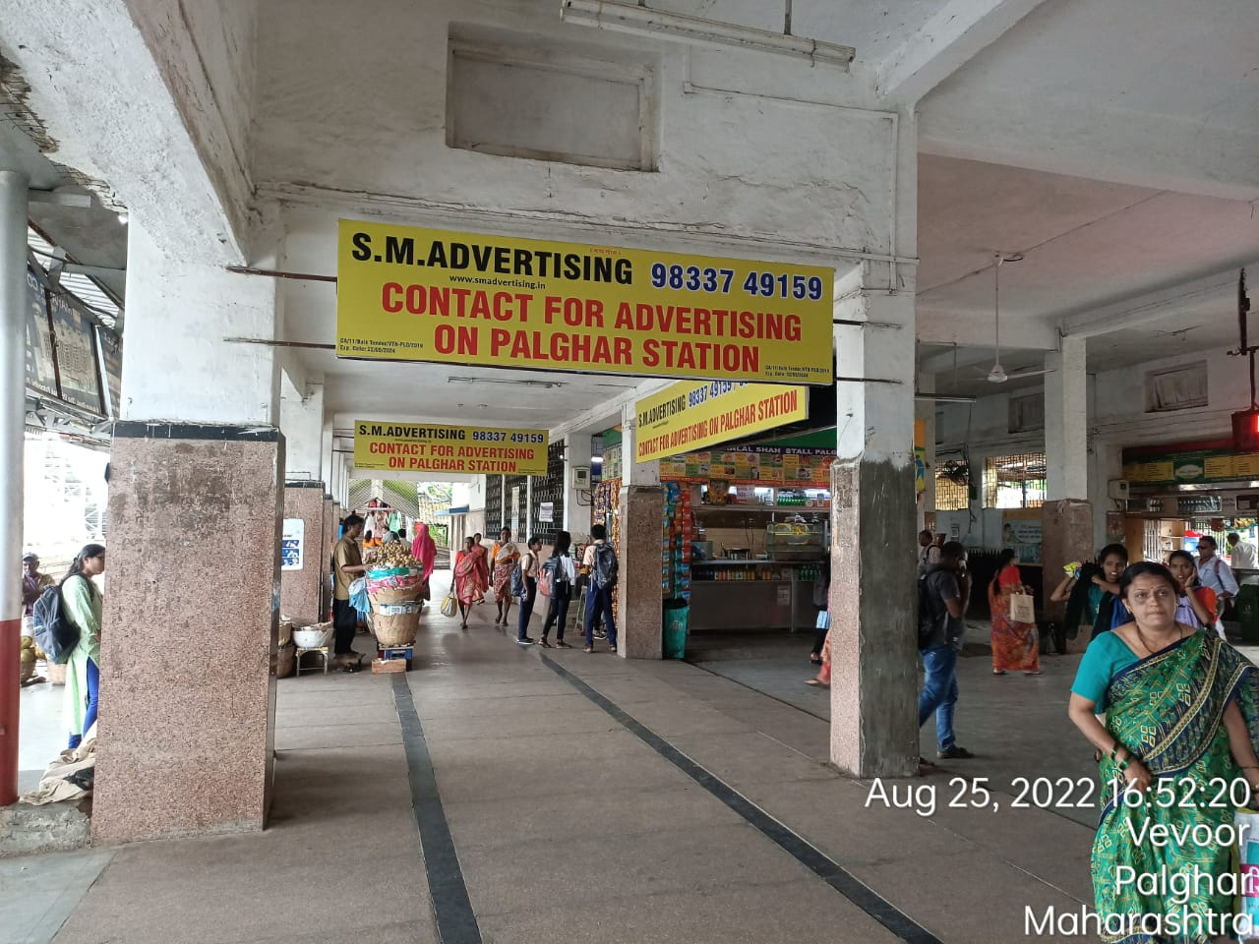
10ft x 2.5ft Frontback Display boards
http://www.themediaant.com/

Slide 4
10ft x 2.5ft Frontback Display boards
http://www.themediaant.com/

Slide 5
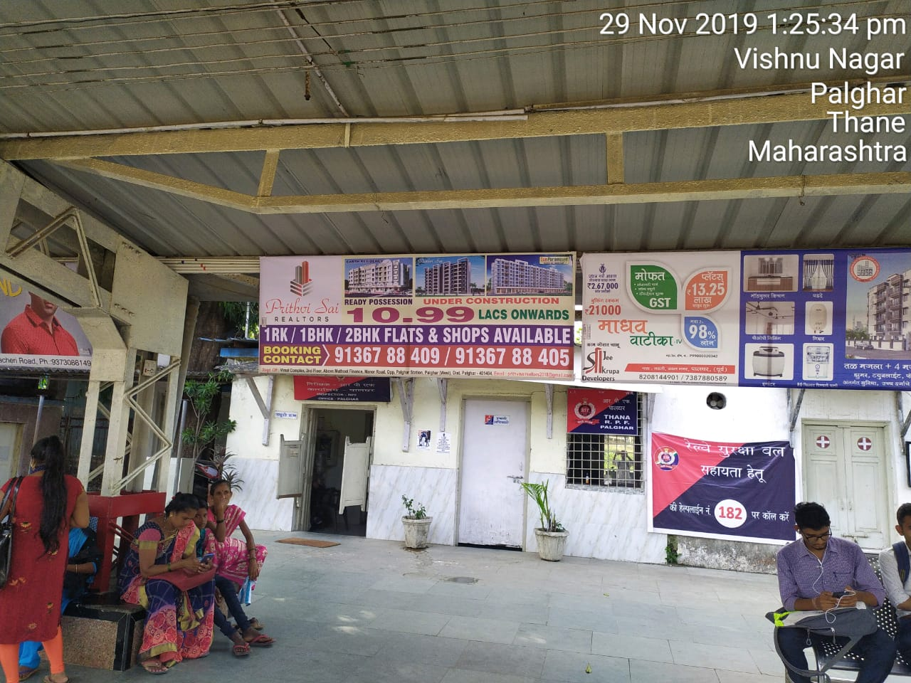
8ft x 3ft boards Palghar
http://www.themediaant.com/

Slide 6
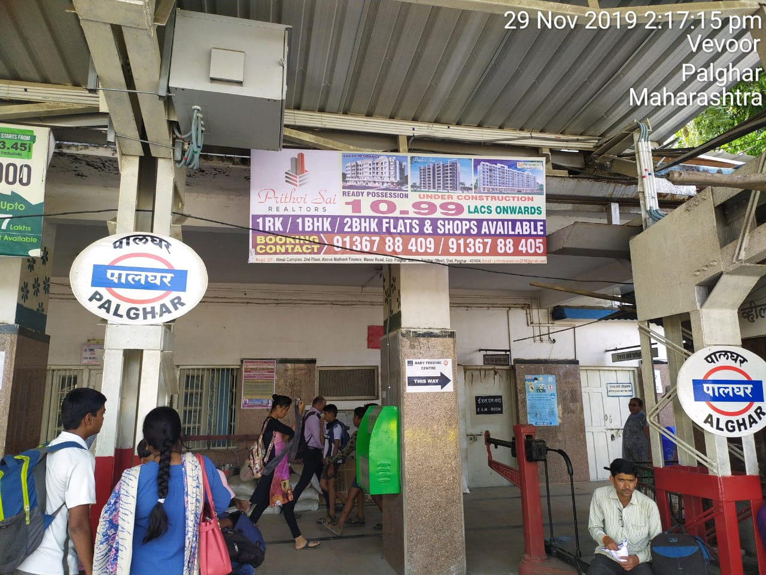
8ft x 3ft boards Palghar
http://www.themediaant.com/

Slide 7
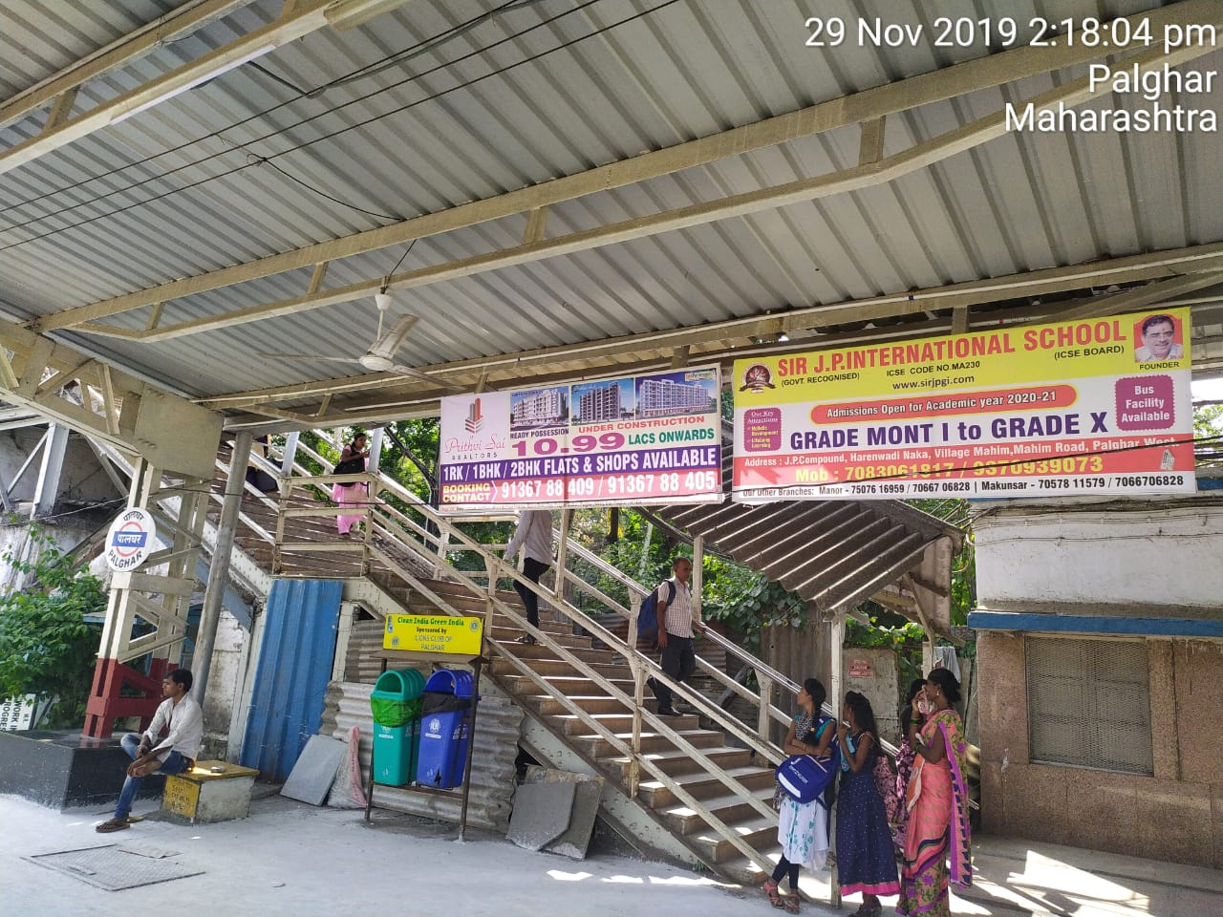
8ft x 3ft boards Palghar
http://www.themediaant.com/

Slide 8
8ft x 3ft boards Palghar
http://www.themediaant.com/

Slide 9
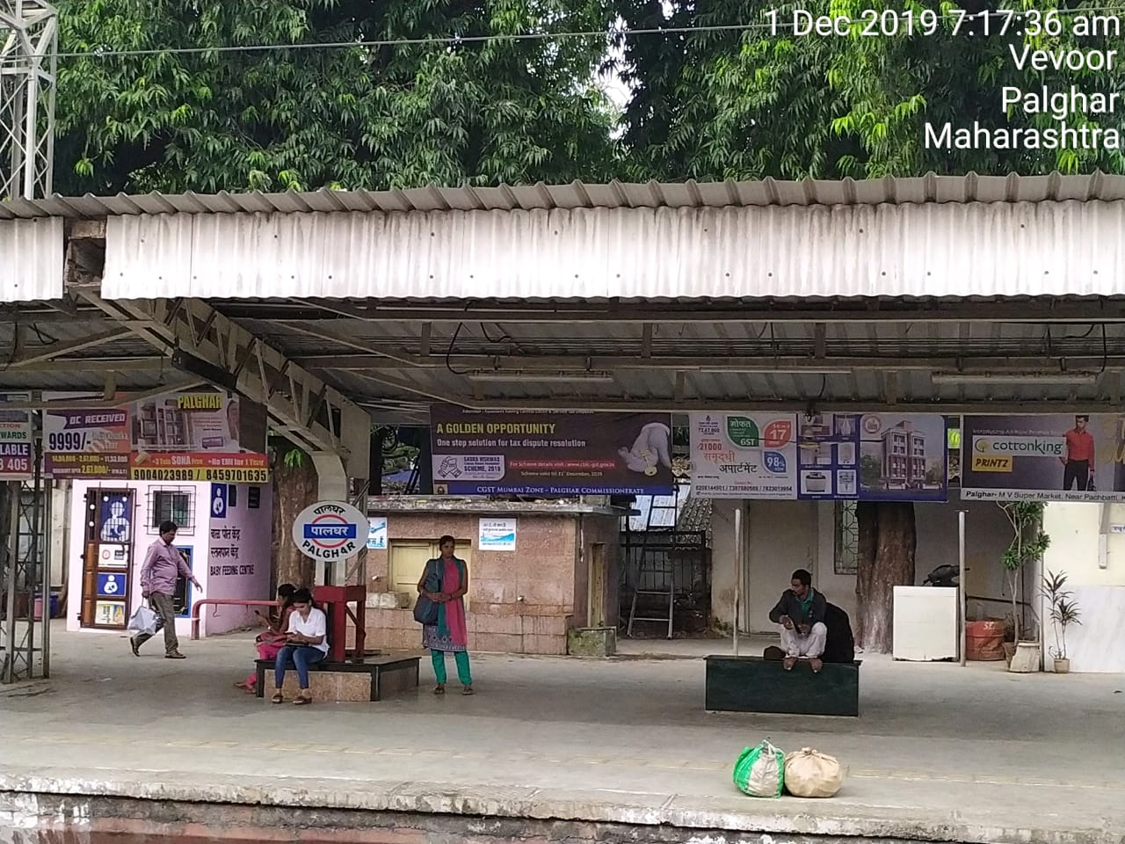
8ft x 3ft boards Palghar
http://www.themediaant.com/

Slide 10











Thank You

