Slide 1
















Reference images

Slide 2
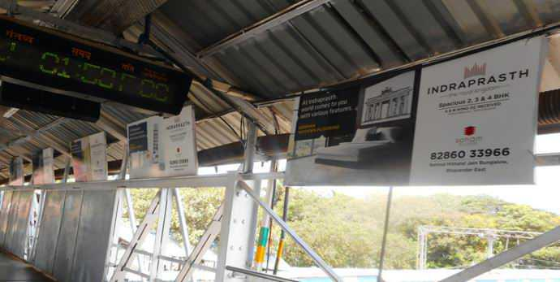
08’x03’Boards at Marine Lines Station@ Rs.9000/-P.M Per Board
http://www.themediaant.com/

Slide 3
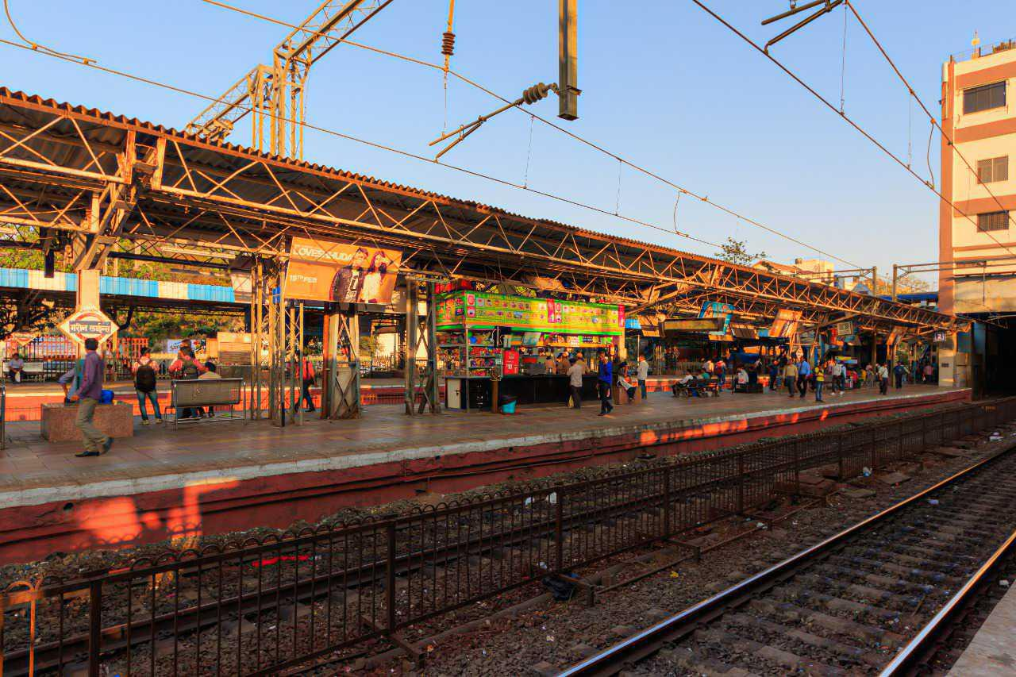
08’x03’Boards at Marine Lines Station@ Rs.9000/-P.M Per Board
http://www.themediaant.com/

Slide 4
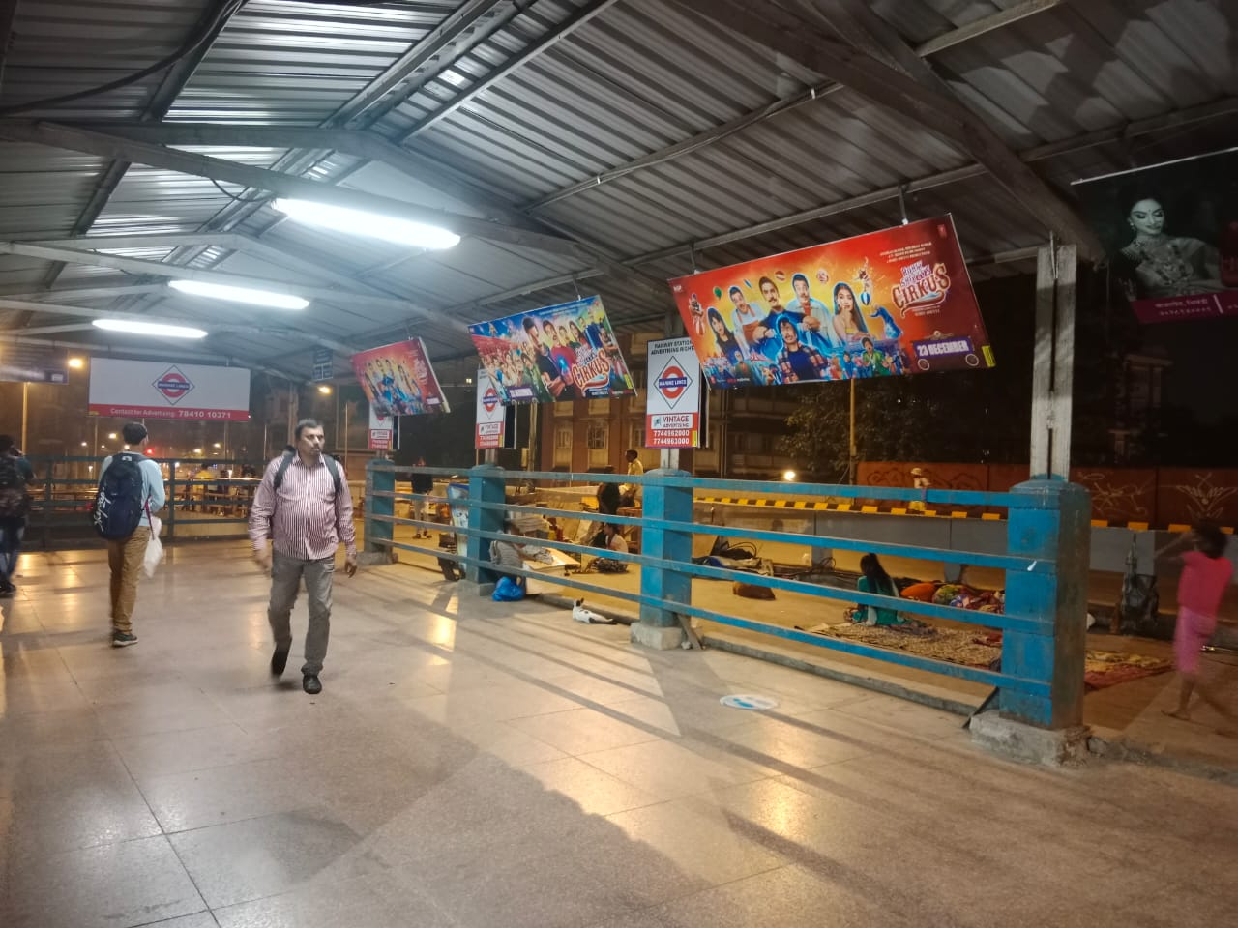
08’x03’Boards at Marine Lines Station @ Rs.9000/-P.M Per Board
http://www.themediaant.com/

Slide 5
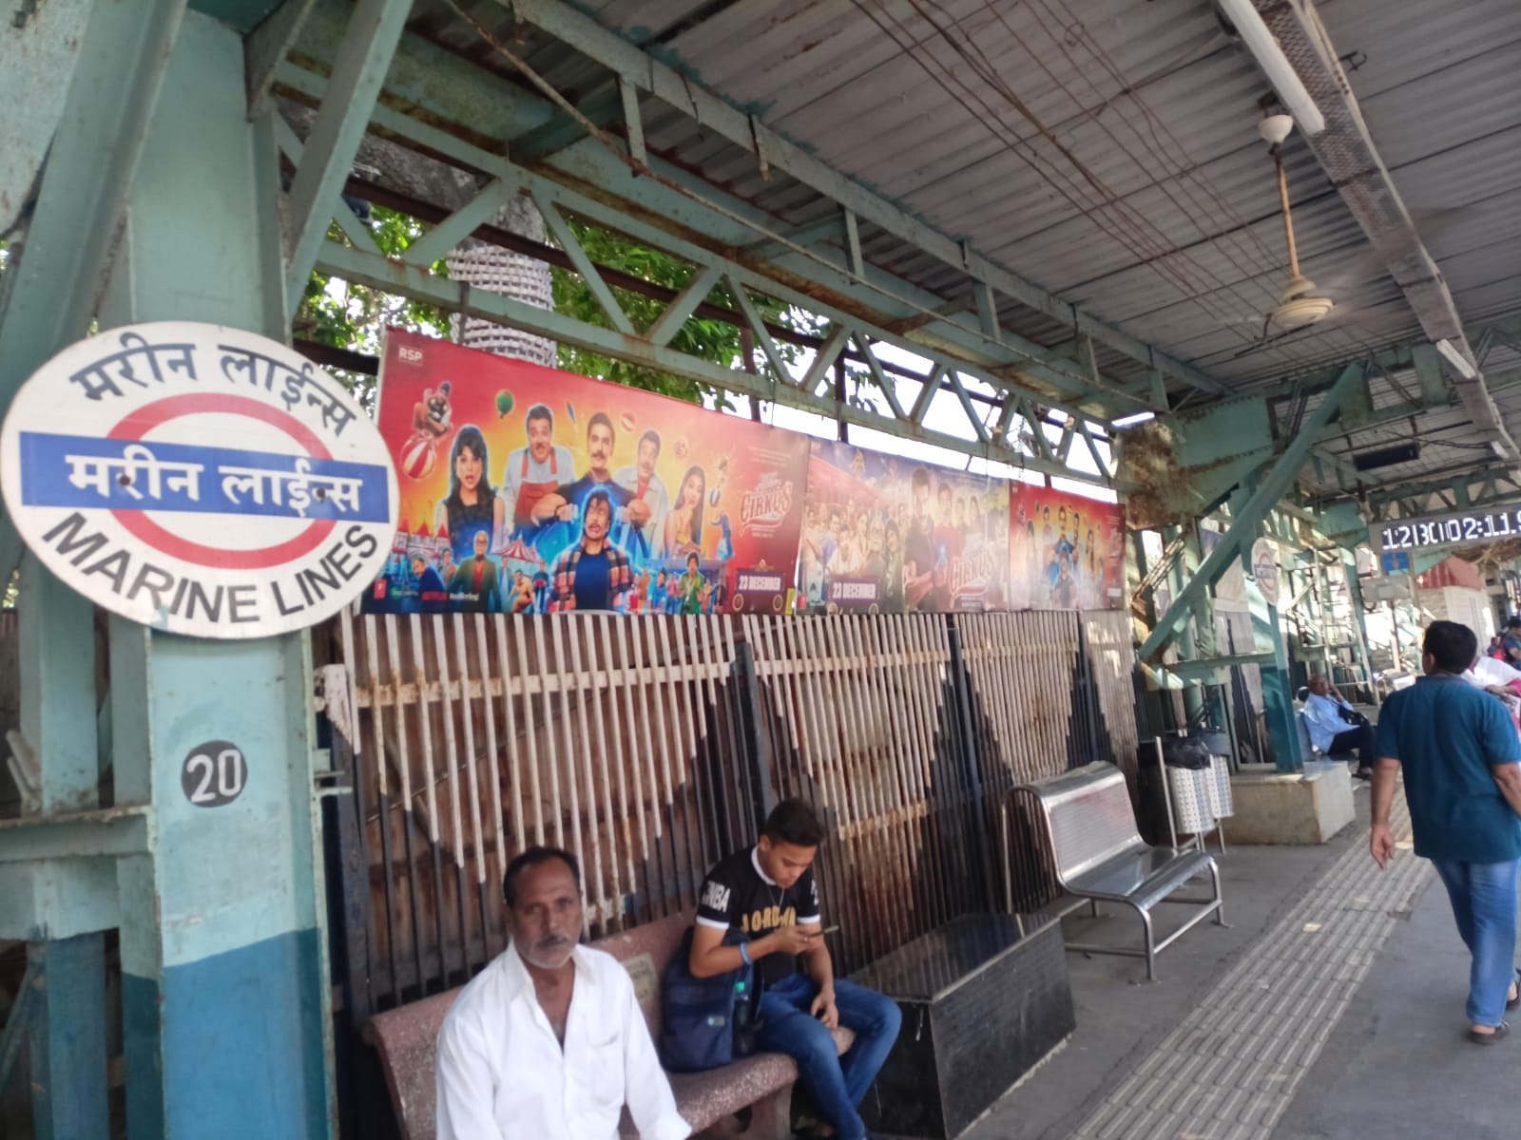
08’x03’Boards at Marine Lines Station @ Rs.9000/-P.M Per Board
http://www.themediaant.com/

Slide 6
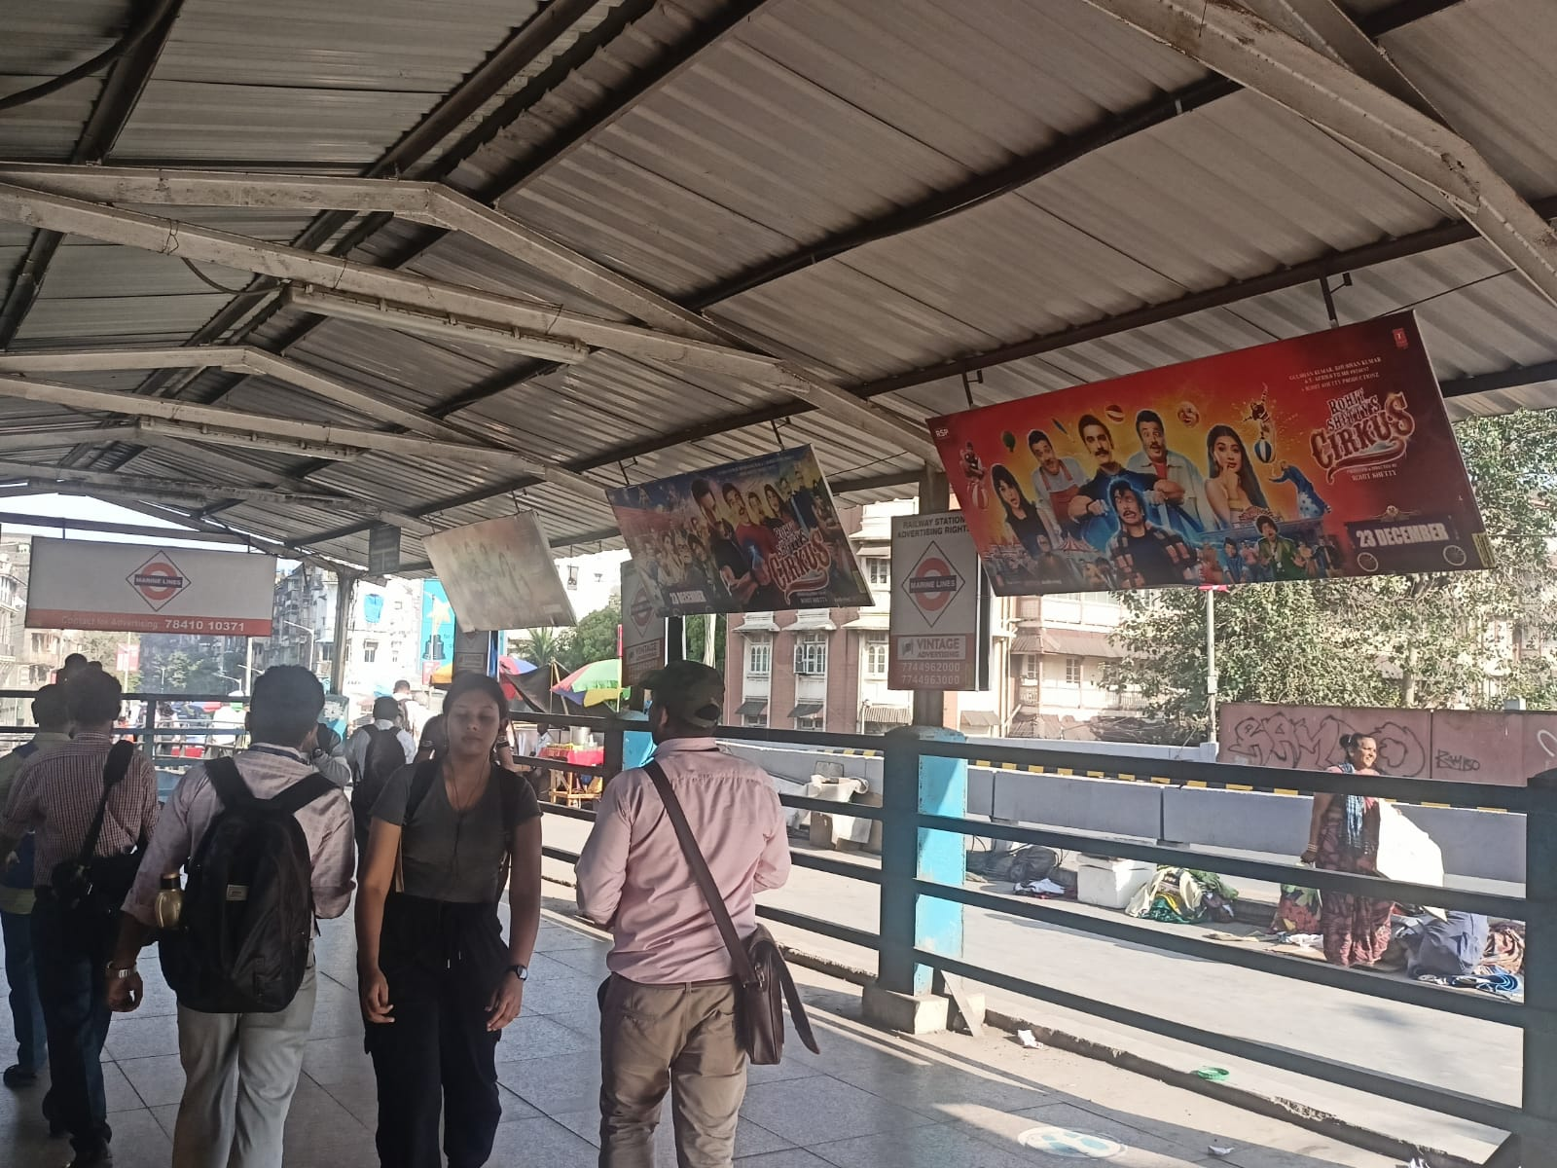
08’x03’Boards at Marine Lines Station @ Rs.9000/-P.M Per Board
http://www.themediaant.com/

Slide 7











Thank You

