Slide 1
















Reference images

Slide 2
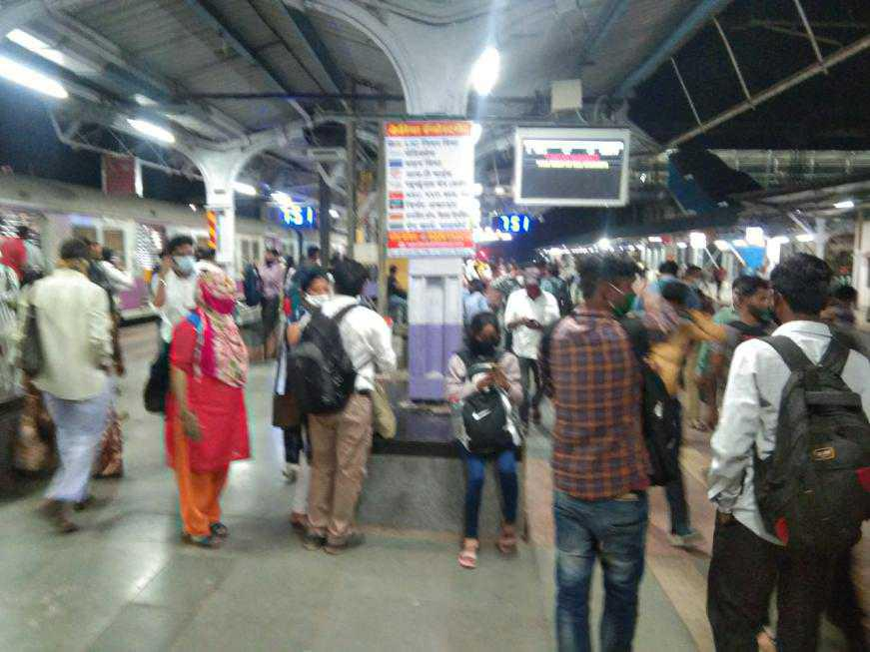
02’x03’ Unipoles at Marine Lines Station @ Rs.8,000/- Back to Back
http://www.themediaant.com/

Slide 3
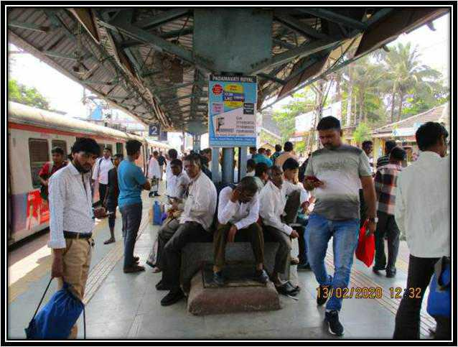
02’x03’ Unipoles at Marine Lines Station @ Rs.8,000/- Back to Back
http://www.themediaant.com/

Slide 4











Thank You

