Slide 1
















Reference images

Slide 2
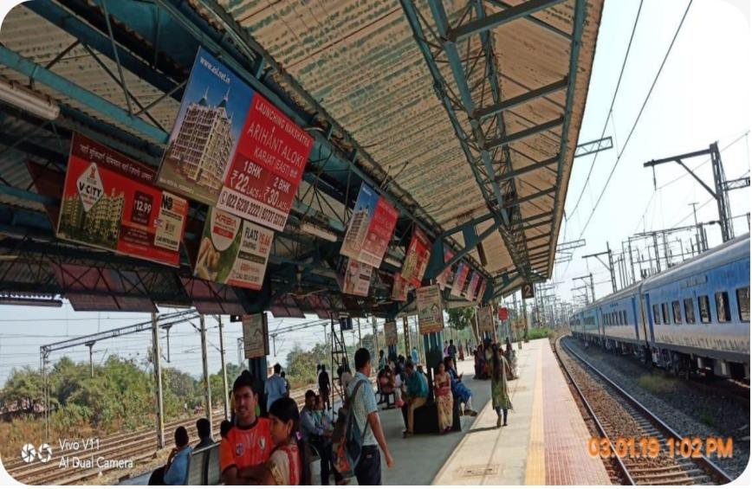
08’x03’Boards at Vithalwadi Station
http://www.themediaant.com/

Slide 3
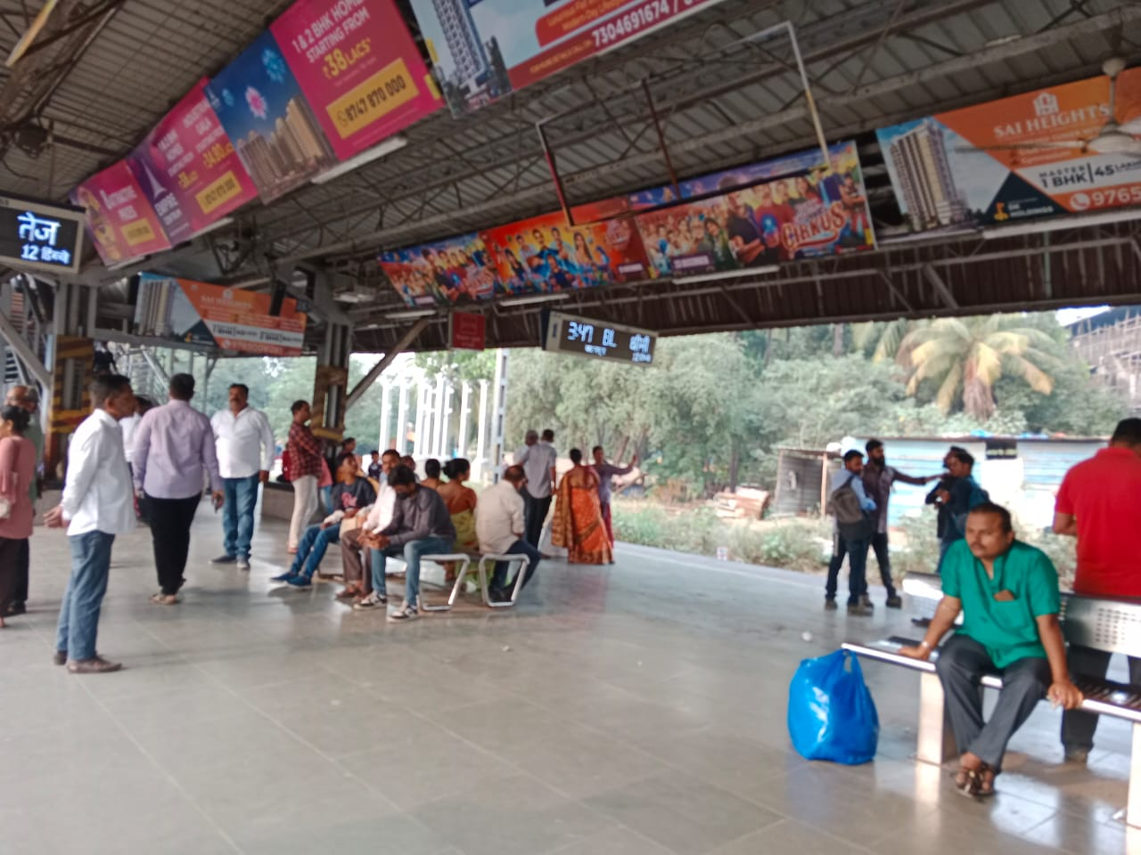
08’x03’Boards at Vithalwadi Station
http://www.themediaant.com/

Slide 4
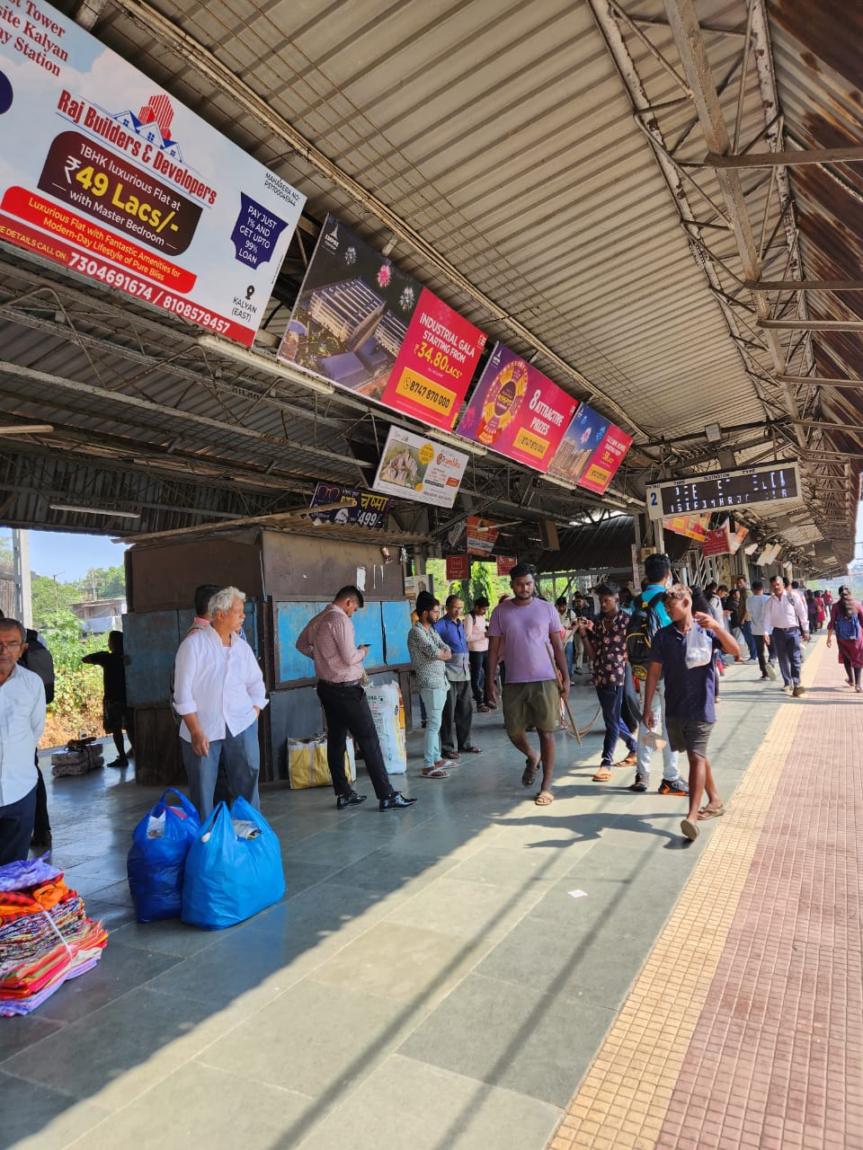
08’x03’Boards at Vithalwadi Station
http://www.themediaant.com/

Slide 5











Thank You

