Slide 1
















Reference images

Slide 2
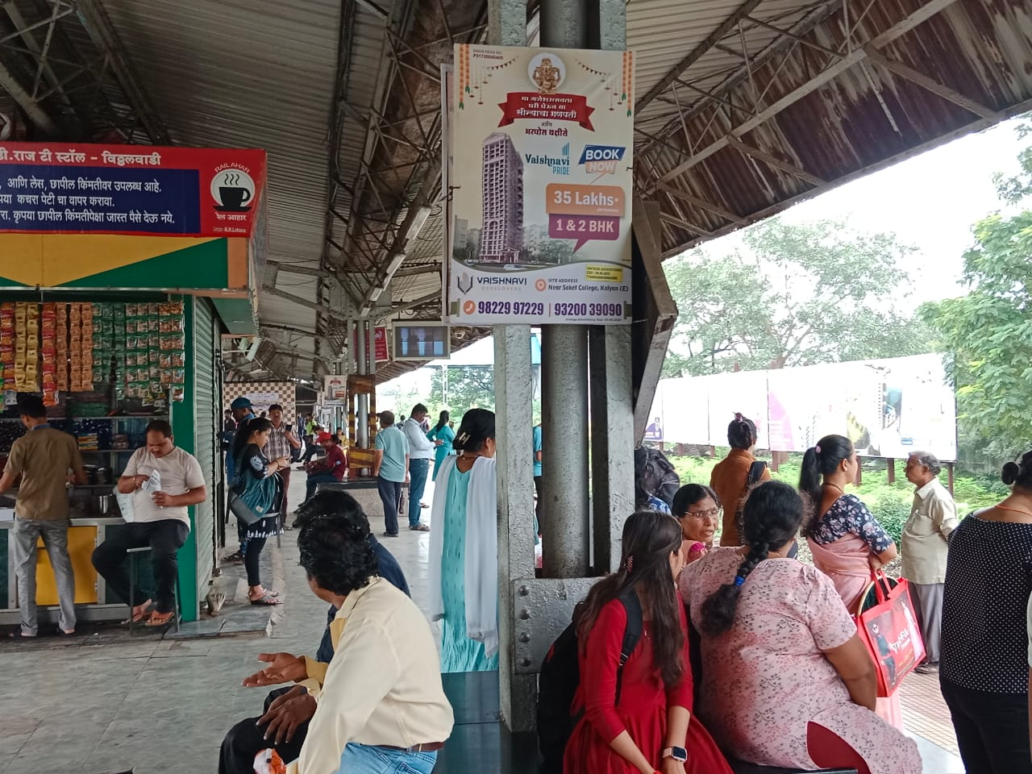
02’x03’ Unipoles at Vithalwadi Station
http://www.themediaant.com/

Slide 3
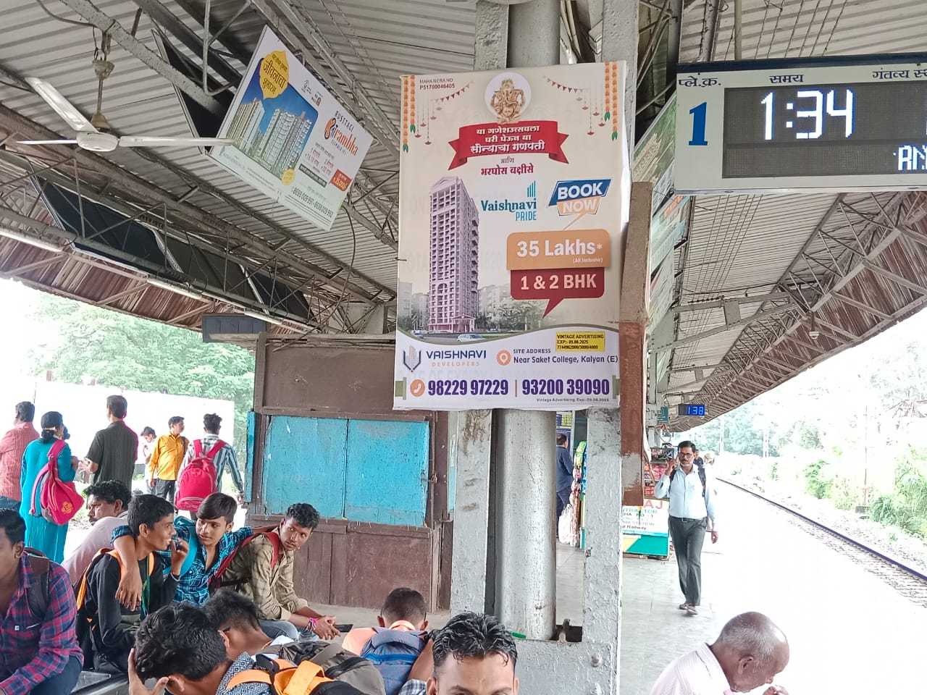
02’x03’ Unipoles at Vithalwadi Station
http://www.themediaant.com/

Slide 4
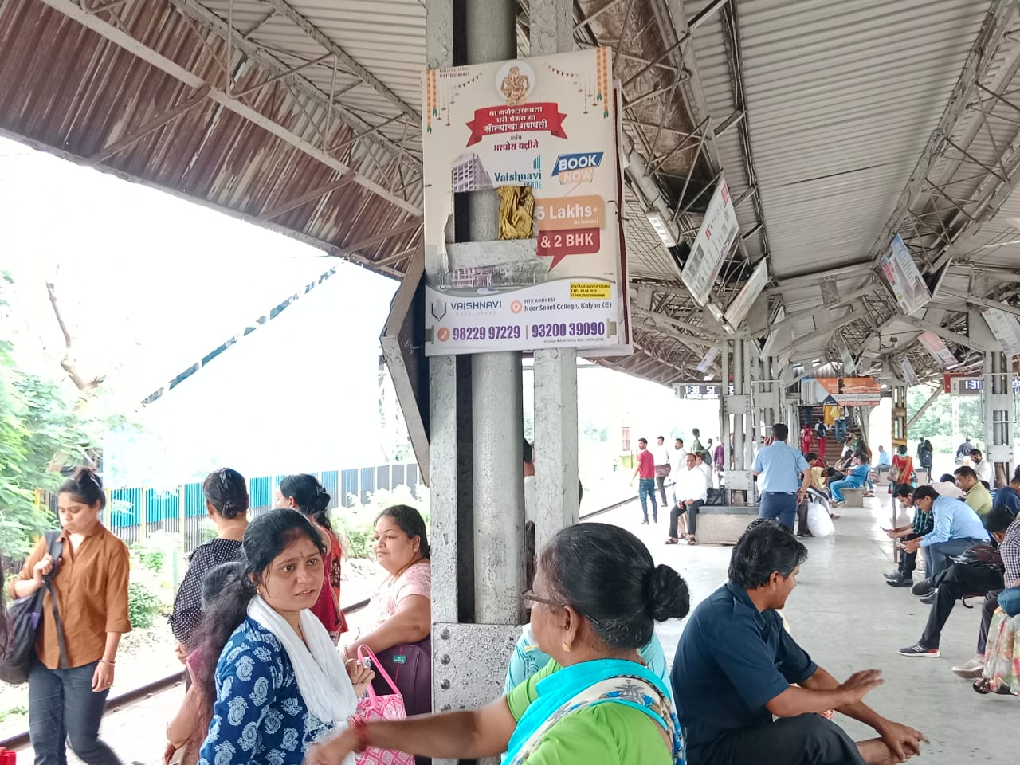
02’x03’ Unipoles at Vithalwadi Station
http://www.themediaant.com/

Slide 5











Thank You

