Slide 1
















Reference images

Slide 2
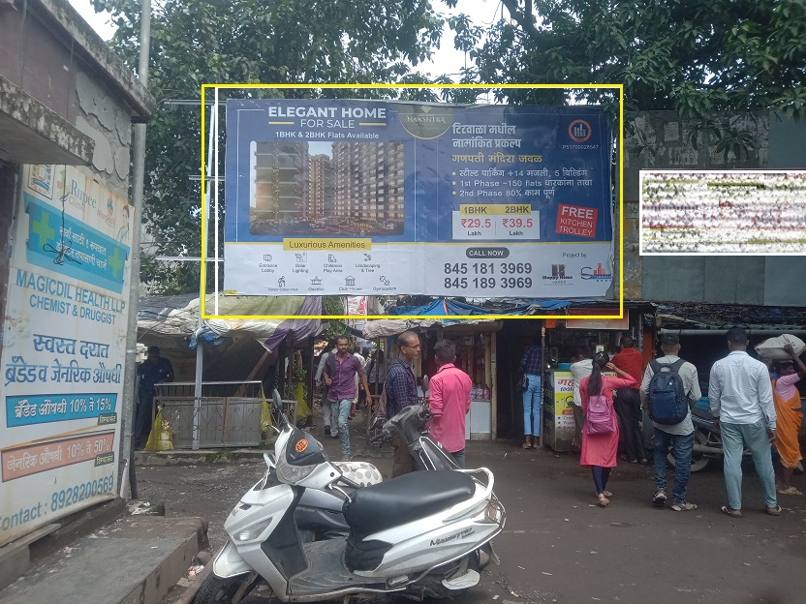
20’x10’ at Titwala Station (E) main entrance opposite EMR facing Platform no.3
http://www.themediaant.com/

Slide 3
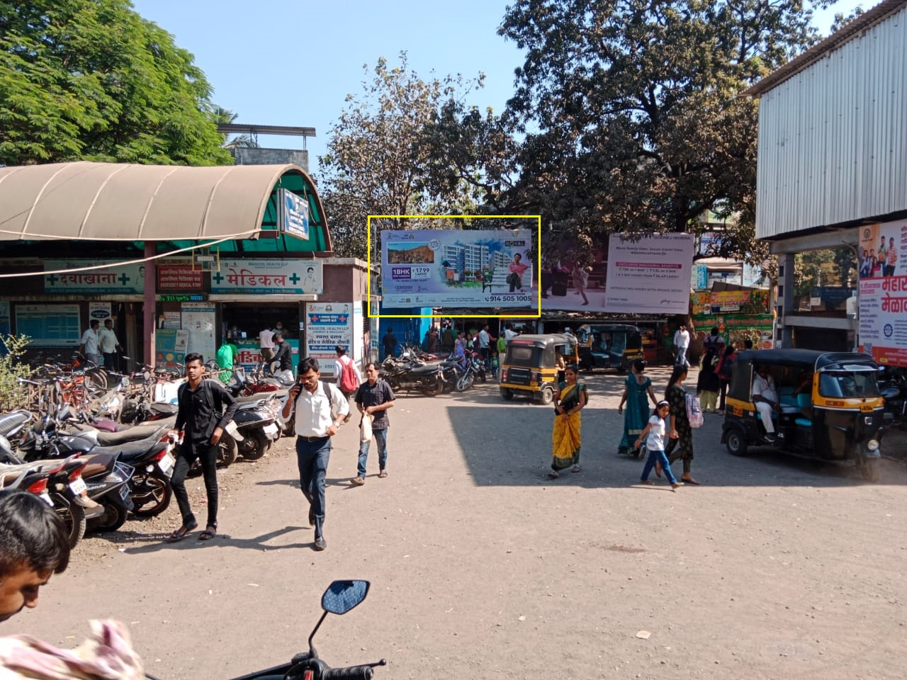
20’x10’ at Titwala Station (E) main entrance opposite EMR facing Platform no.3
http://www.themediaant.com/

Slide 4
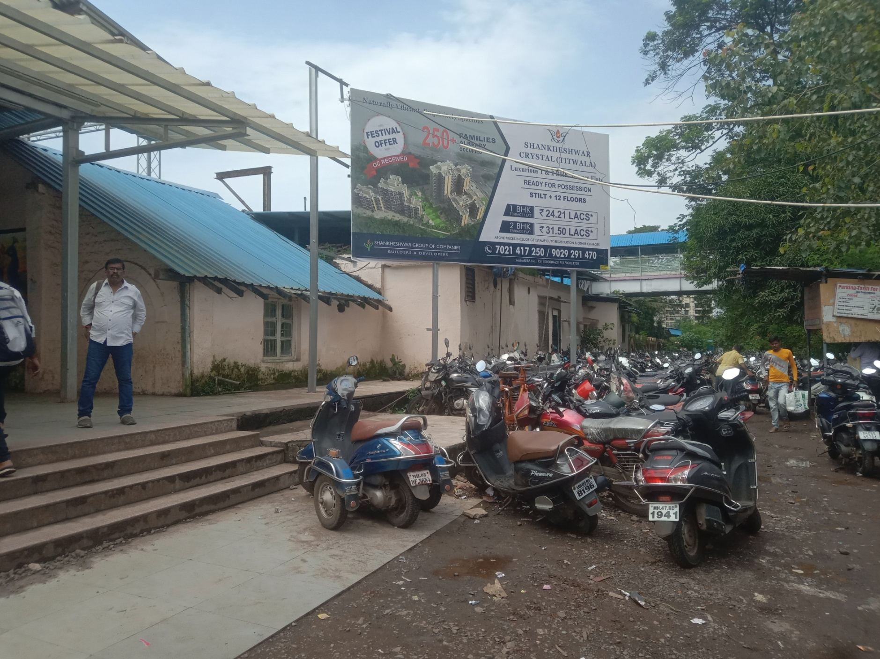
20’x10’ at Titwala Station (E) above Bank Of India ATM
http://www.themediaant.com/

Slide 5
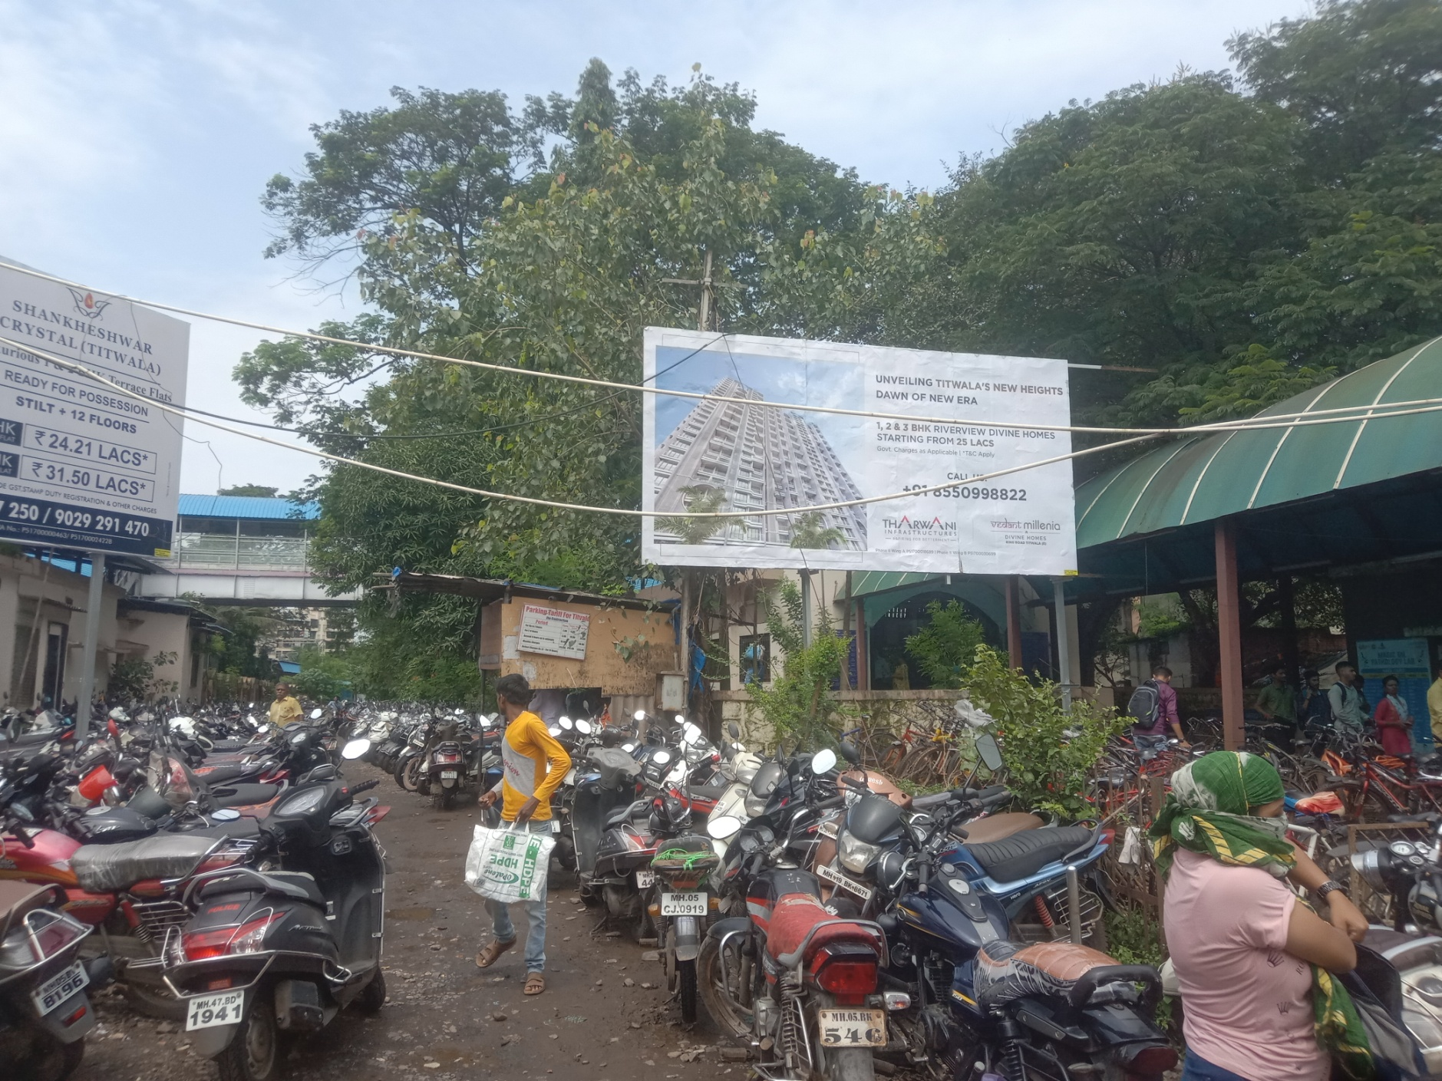
20’x10’ at Titwala Station (E) Enrance of Pay & Park
http://www.themediaant.com/

Slide 6











Thank You

