Slide 1
















Reference images

Slide 2
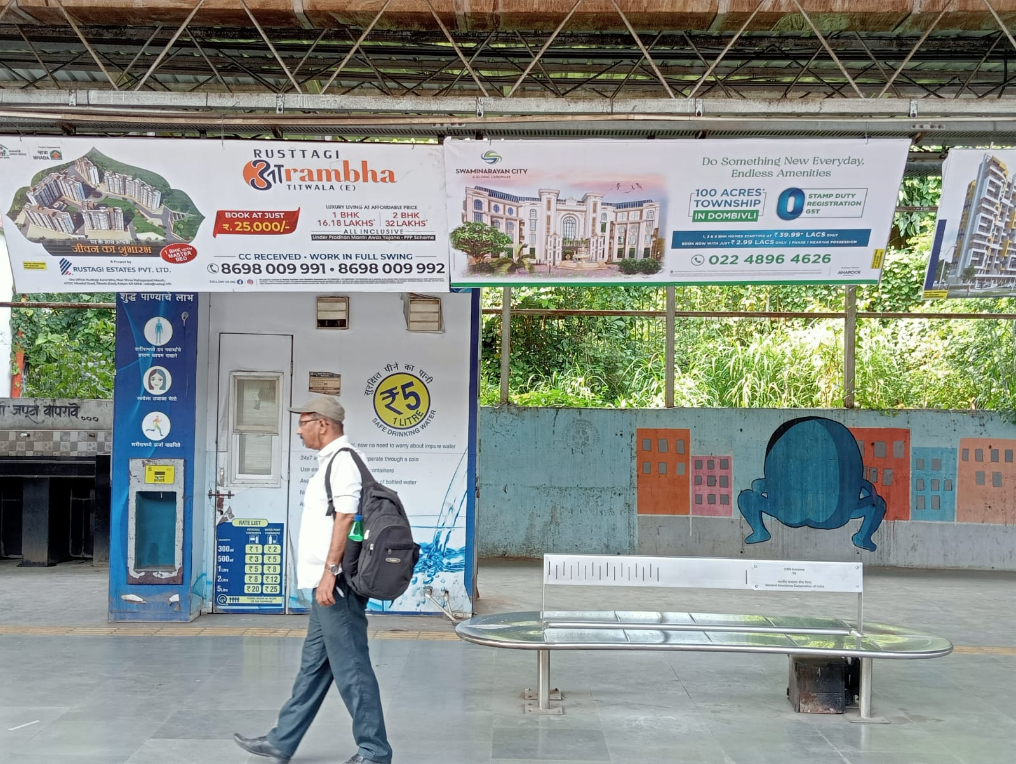
08’x03’Boards at Thakurli Station
http://www.themediaant.com/

Slide 3
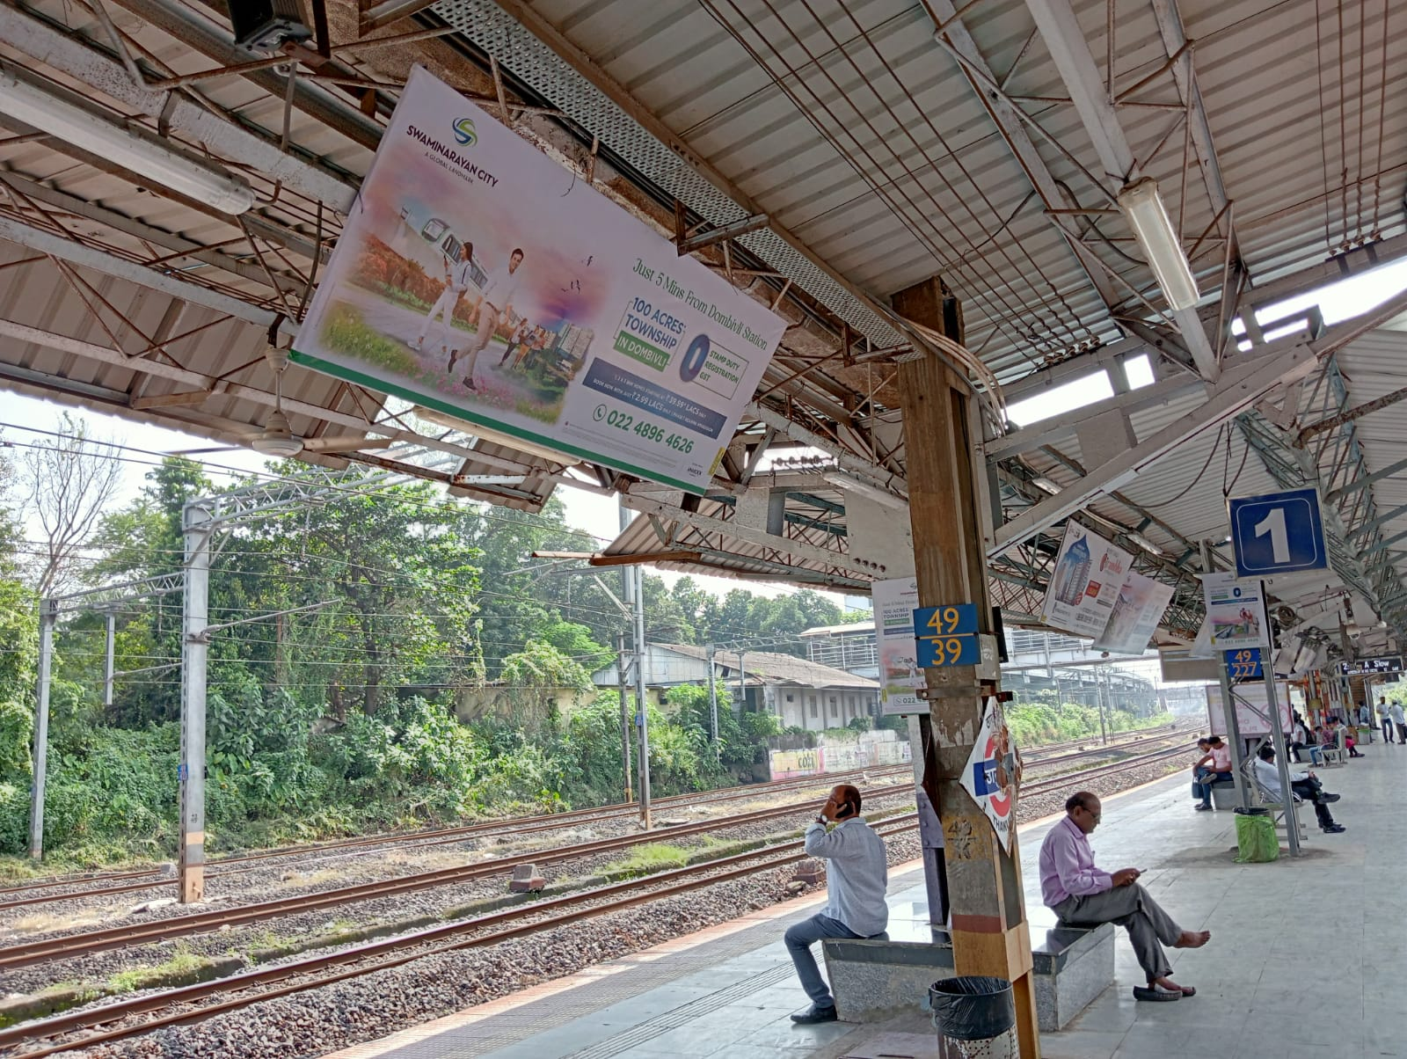
08’x03’Boards at Thakurli Station
http://www.themediaant.com/

Slide 4
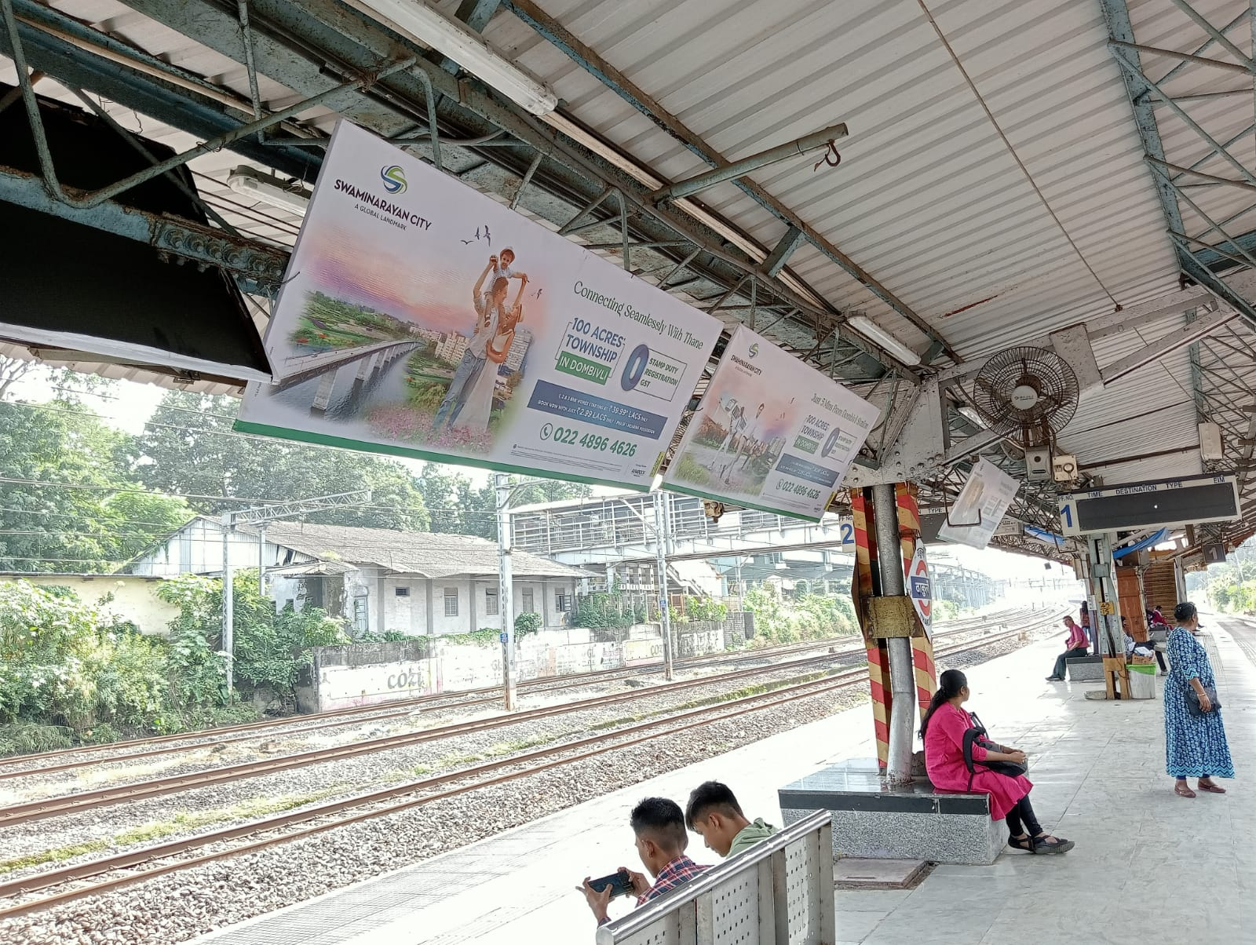
08’x03’Boards at Thakurli Station
http://www.themediaant.com/

Slide 5
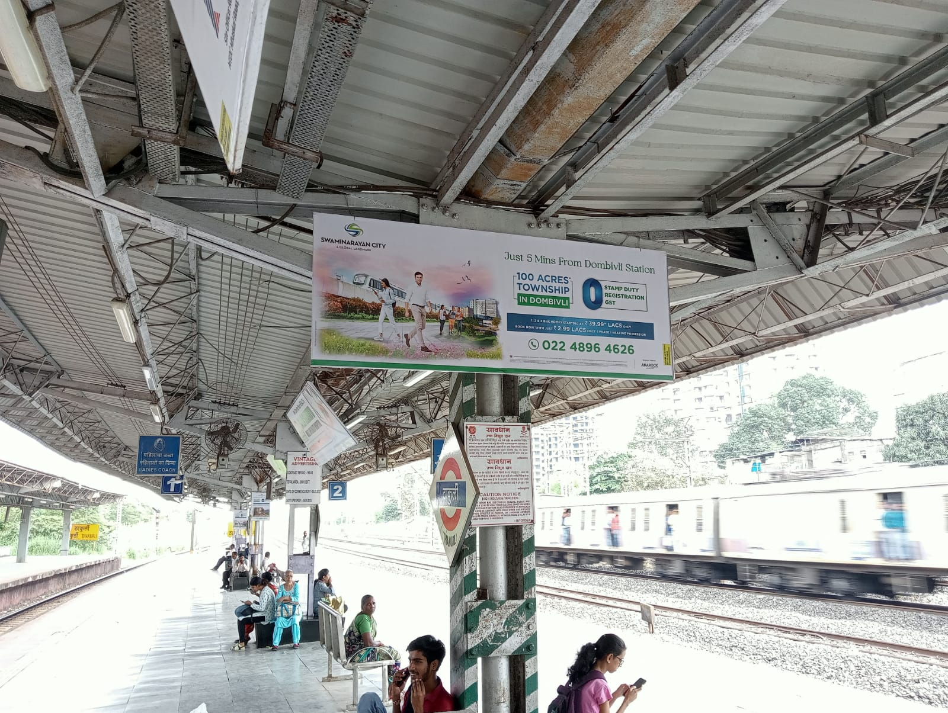
08’x03’Boards at Thakurli Station
http://www.themediaant.com/

Slide 6
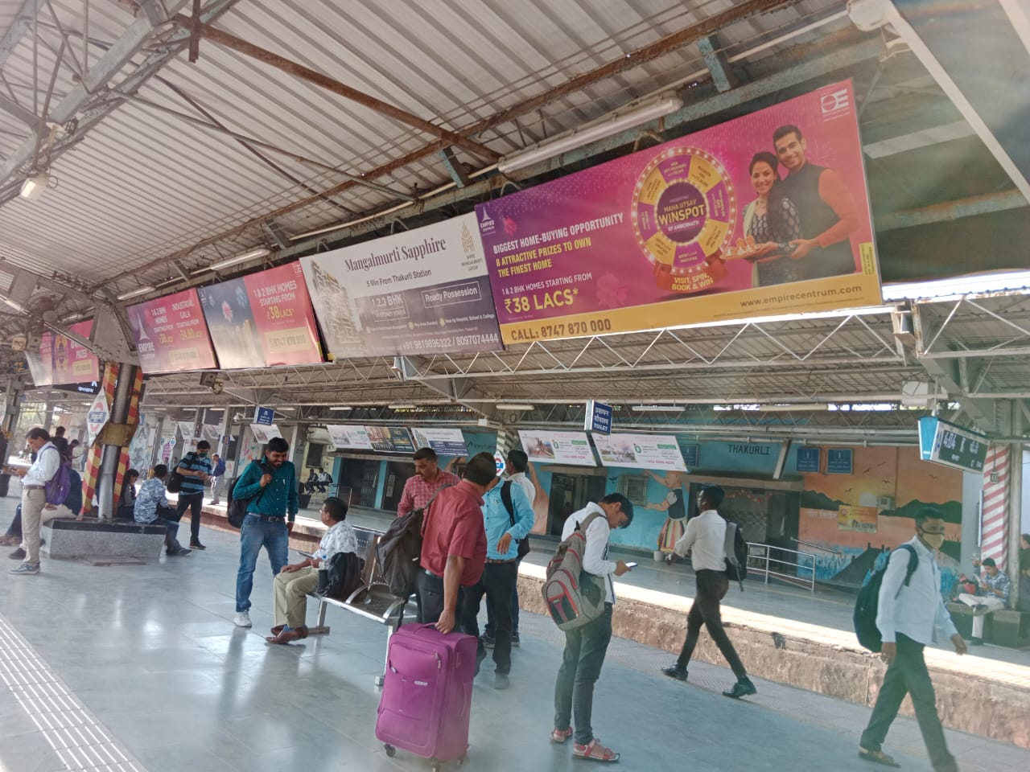
08’x03’Boards at Thakurli Station
http://www.themediaant.com/

Slide 7
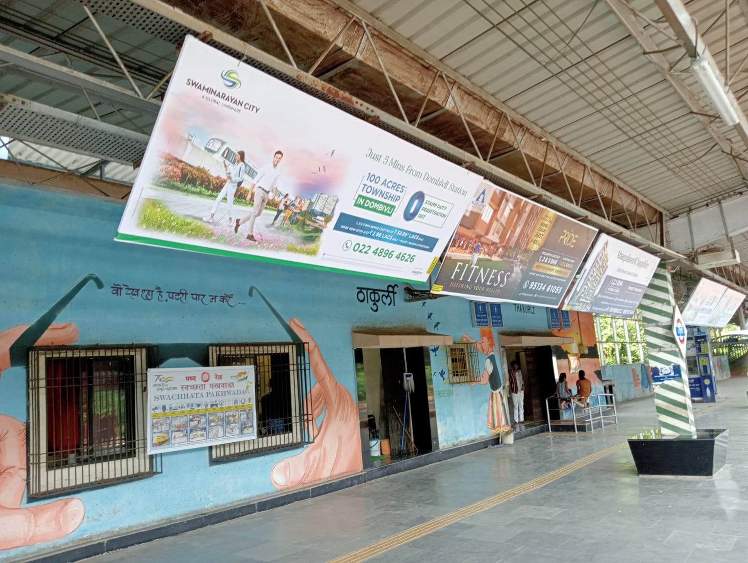
08’x03’Boards at Thakurli Station
http://www.themediaant.com/

Slide 8
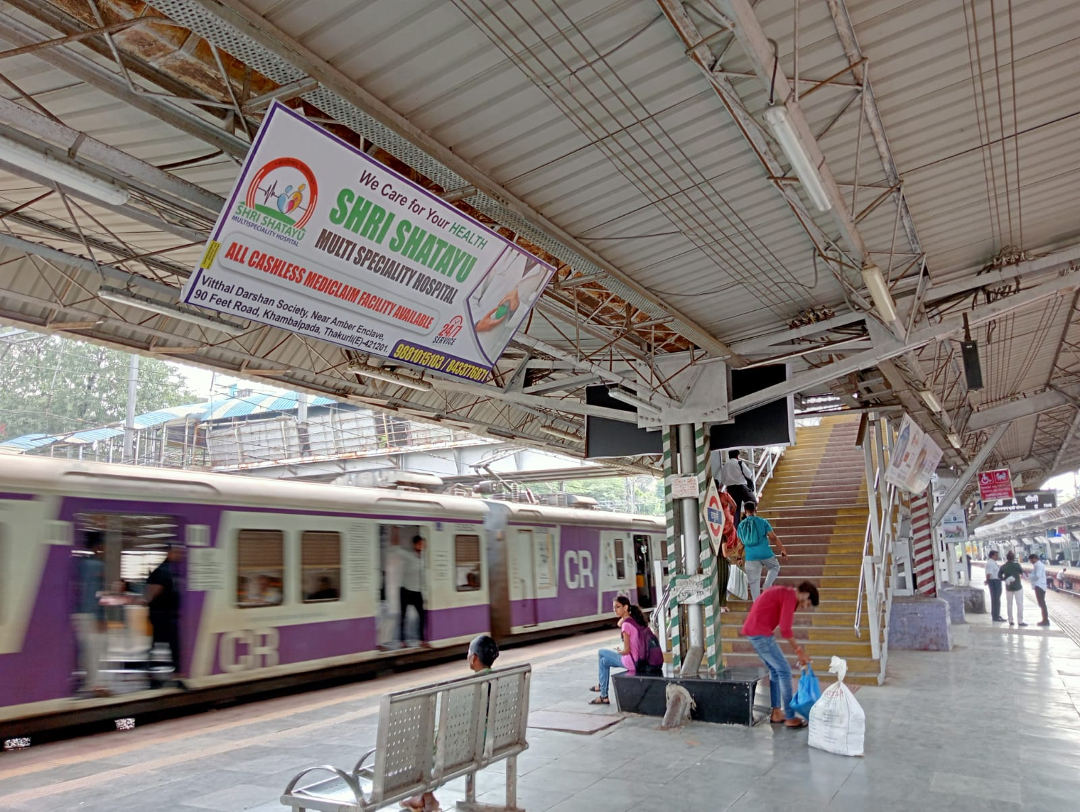
08’x03’Boards at Thakurli Station
http://www.themediaant.com/

Slide 9
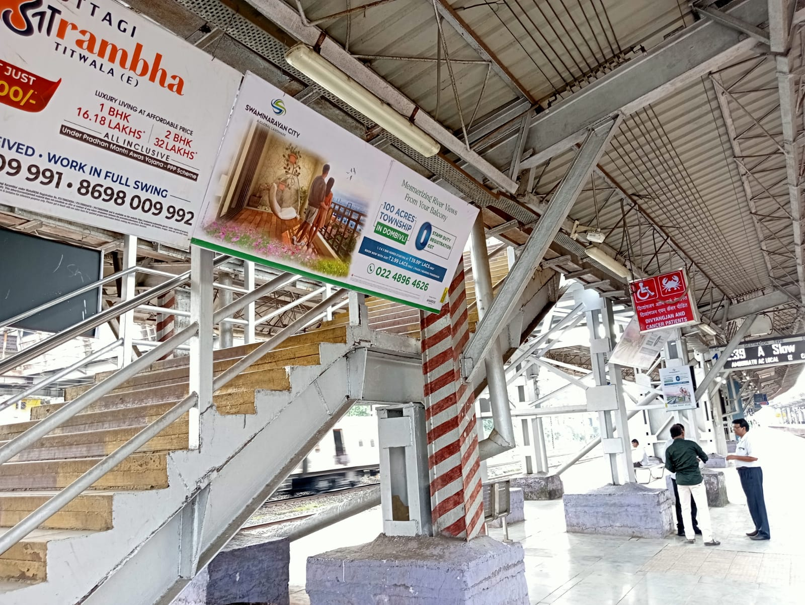
08’x03’Boards at Thakurli Station
http://www.themediaant.com/

Slide 10











Thank You

