Slide 1
















CAMPAIGN GUIDELINES

Slide 2
LEAD TIME
Volume(No of Tricycle) | Lead Time(In Days)
1 - 5 | 4
6 - 10 | 7
11 - 20 | 10
21+ | 12+
Please Note:
Lead Time is considered from the day the mock-up is approved for printing.
The shared lead time is approximate and might vary based on the availability of tricycle, unforeseen weather conditions, and festive occasions.
The number of days shared for lead time is given considering the business days, with the exclusion of public holidays and weekends.
http://www.themediaant.com/

Slide 3
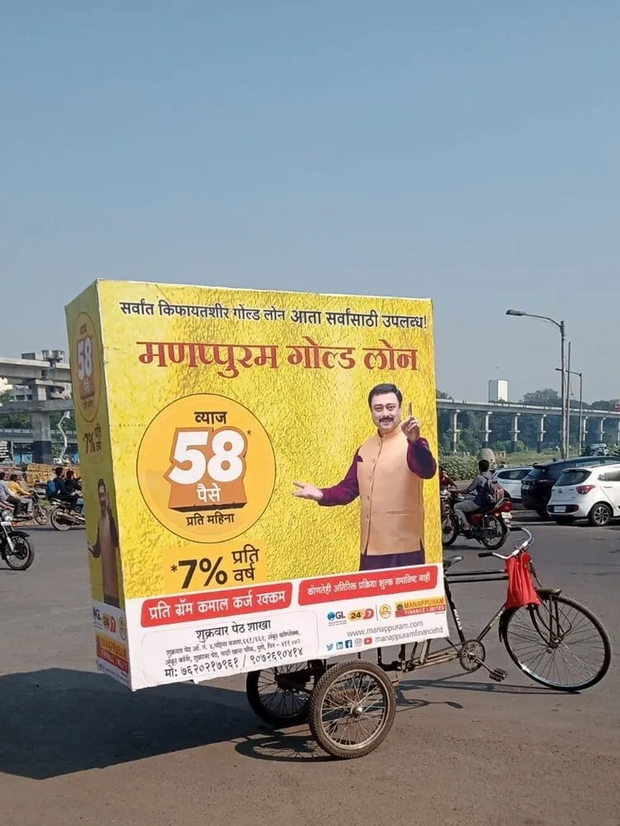
ARTWORK RELATED DETAILS
The artworks in the Tricycle campaign, Bhopal mostly use Hindi or English language in their creatives.
sample
http://www.themediaant.com/

Slide 4








CAMPAIGN EXECUTION DISCLAIMER
It is mandatory for the client to share the route details with us.
When the campaign is live, if the client wants to collect the exact geo location it cannot be shared however we can only share the exact area where the campaign is running.
We provide the phone number and name of the driver along with the proof of execution after the campaign is live, after that we are not accountable for any further queries related to this.
Once the campaign goes live after that if the clients wants to bring any change in the creative, additional charges for the same has to be incurred by the client.
http://www.themediaant.com/

Slide 5











Thank You

