Slide 1
















CAMPAIGN GUIDELINES

Slide 2







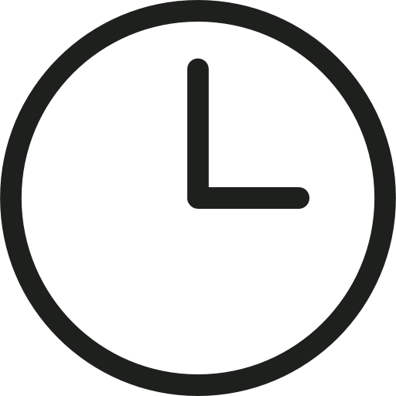
CAMPAIGN DISCLAIMER
Please note that printing and mounting fees may apply for any new modifications needs be made to the artwork after the campaign has already launched.
Post campaign execution, creatives cannot be returned to the client, unless they inform us prior to the confirmation of the campaign.
The final artwork have to be approved by the mall authority.
After the campaign goes live, we are not accountable or responsible for any damage caused to the static media placed on the exterior of the mall, i.e. facade or pole kiosk. Damages can be caused by unforeseen weather condition, etc.
In case of any construction or repair within the mall area, the mall authority has the right to cancel or postpone the ad campaign for a later date if required.
Lead Time is considered from the day the mockup for the campaign is confirmed by the advertiser.
http://www.themediaant.com/

Slide 3











Thank You

