Slide 1
















Digital Screen Network

Slide 2
Digital Screen
Sl No. | Media Option | Dimension(In Pixel) | Loop Time | Total Units
1 | Video Wall | 2304 W x 640 H .Px | 30 Sec in 3 Min
2 | Digital Screen | 768 W x 384 H .Px | 30 Sec in 3 Min
Package of 13 Units

Slide 3
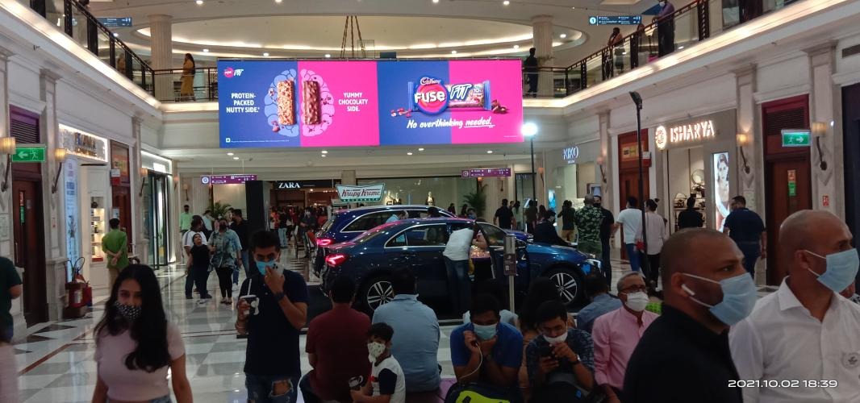
Media Option - LED Video Wall, Dimension: 2304 x 640 Pixels( Only 1 Unit Available)

Slide 4
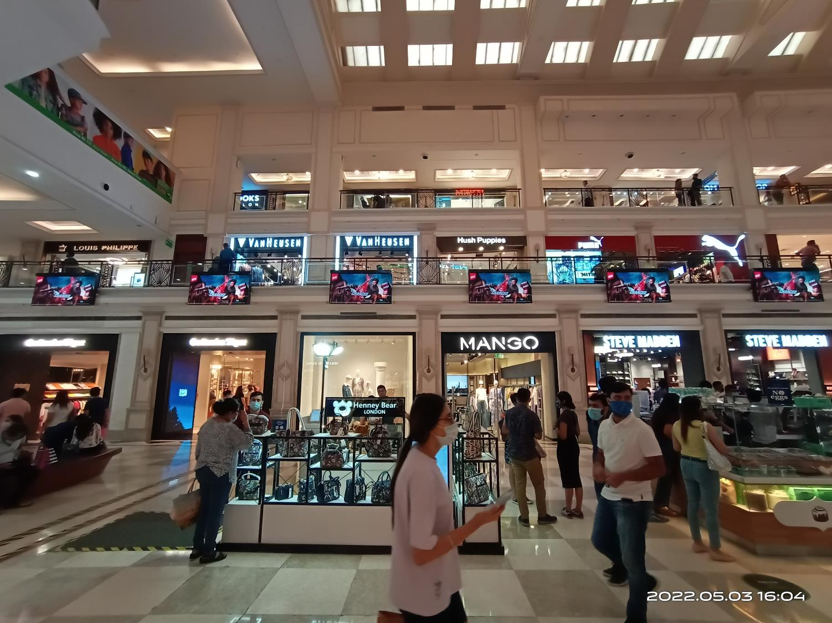
Media Option - LED Video Screen, Dimension -768 x 384 Pixels ( 12 Nos)

Slide 5











Thank You

