Slide 1
















Back-Lit Panel Branding

Slide 2
CATEGORIZATION
Sl. No. | Media Type | Location | Dimension | Total Units
1. | Back Lit Panel | Lower Ground Floor | 10 W x 6 H Ft. | 2
2. | Back Lit Panel | Lower Ground Floor | 20 W x 6 H Ft. | 2
3. | Back Lit Panel | Parking Area | 20 W x 6 H Ft. | 1
4. | Back Lit Panel | Parking Area | 10 W x 10 H Ft. | 1

Slide 3
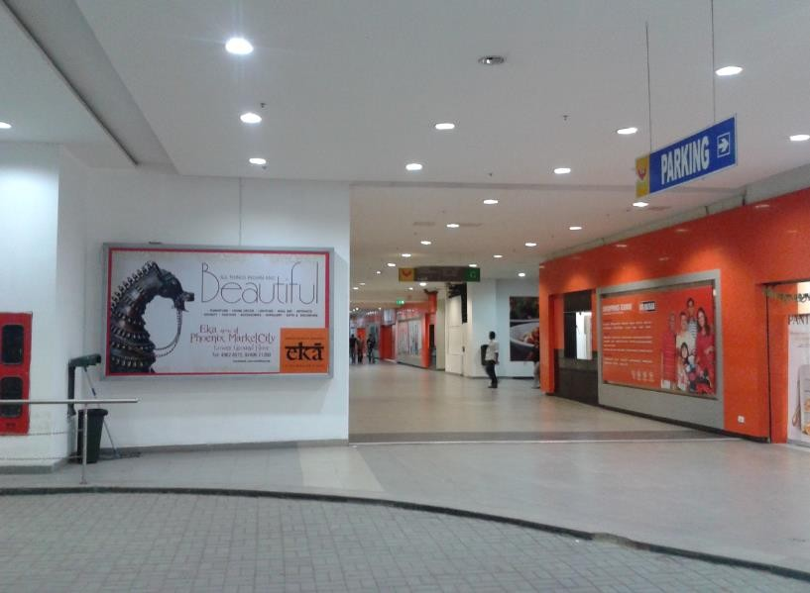
1.1
Media Type – Back Lit Panel, Location – Lower Ground Floor, Dimension – 10 W x 6 H Ft., Area – 60 Sq. Ft, Total Units - 1

Slide 4
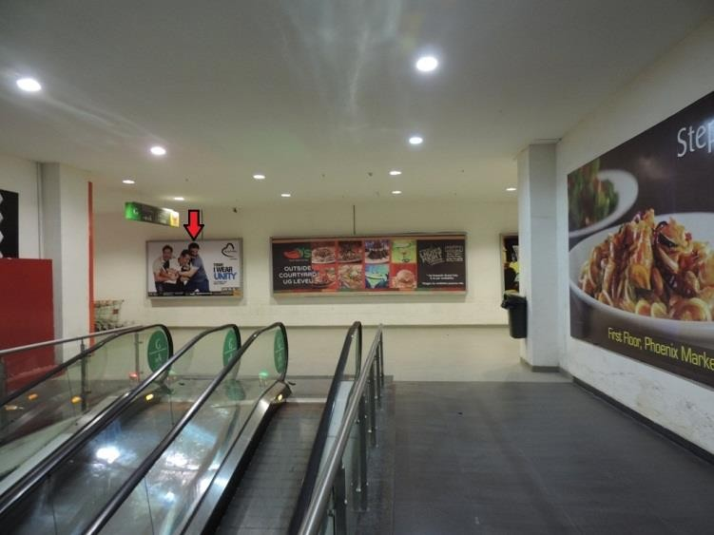
1.2
Media Type – Back Lit Panel, Location – Lower Ground Floor, Dimension – 10 W x 6 H Ft., Area – 60 Sq. Ft, Total Units - 1

Slide 5
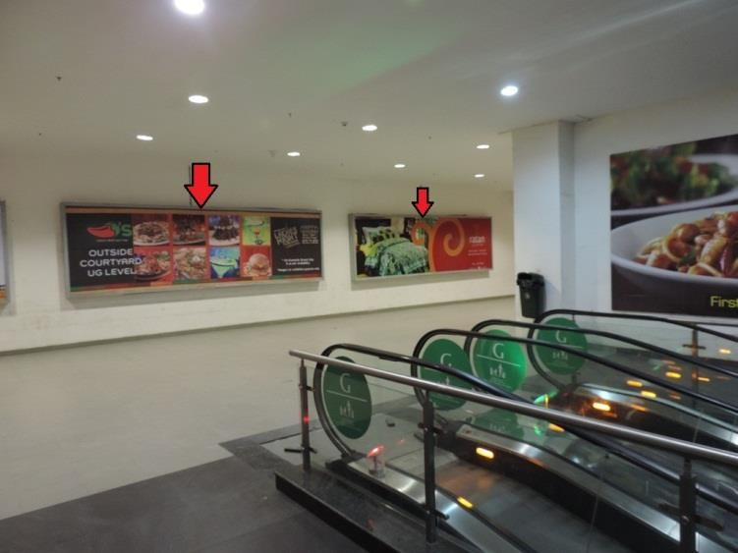
2
Media Type – Back Lit Panel, Location- Lower Ground Floor, Dimension – 20 W x 6 H Ft., Area – 120 Sq. Ft, Total Units - 2

Slide 6
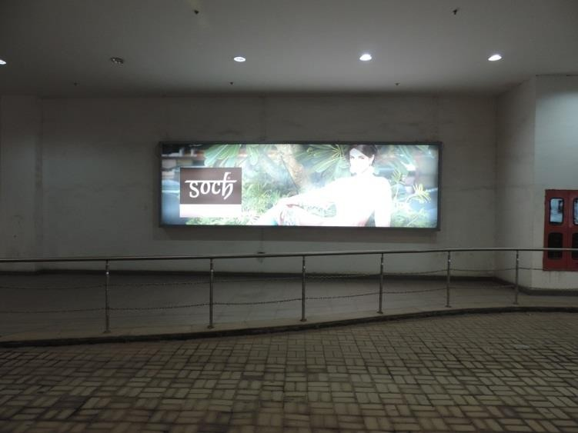
3
Media Type – Back Lit Panel, Location – Parking Area, Dimension – 20 W x 6 H Ft., Area – 120 Sq. Ft, Total Units - 1

Slide 7
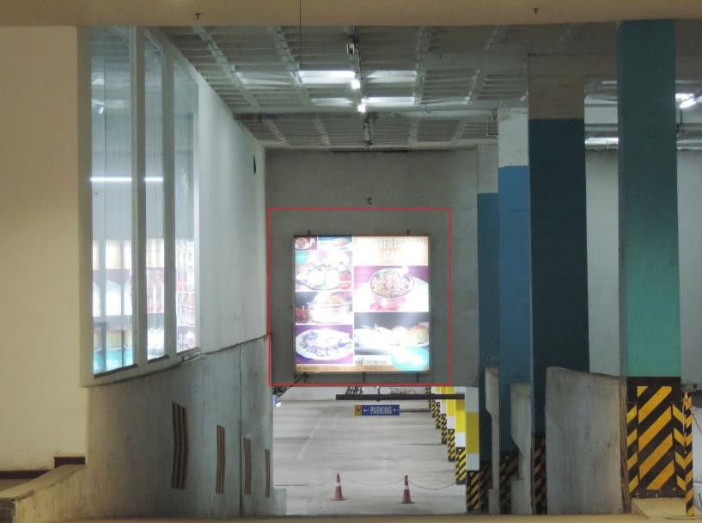
4
Media Type – Back Lit Panel, Location – Parking Area, Dimension – 10 W x 10 H Ft., Area – 100 Sq. Ft Total Units - 1

Slide 8











Thank You

