Slide 1
















Façade Branding

Slide 2
CATEGORIZATION
Sl No. | Media Type | Location | Dimension | Total Units
1. | Facade | West side exterior area | 9 W x 28 H Ft. | 5
2. | Facade | West side exterior area | 25 W x 10 H Ft. | 1
3. | Facade | West side exterior area | 11 W x 10 H Ft. | 4
4. | Facade | West side exterior area | 25 W x 10 H Ft. | 2
5. | Facade | West side exterior area | 15 W x 7.5 H Ft. | 4

Slide 3
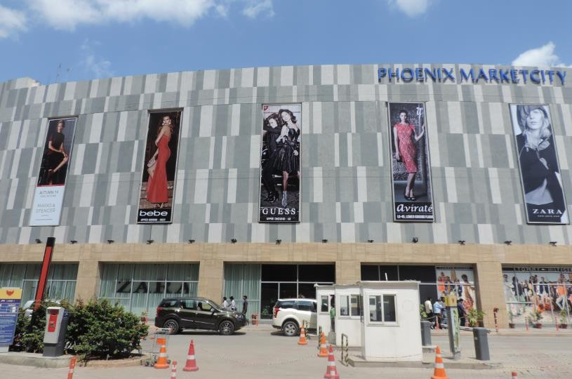
1
Media Type – Facade, Location –West side exterior area, Dimension – 9 W x 28 H Ft., Area – 252 Sq. Ft Total Units - 5

Slide 4
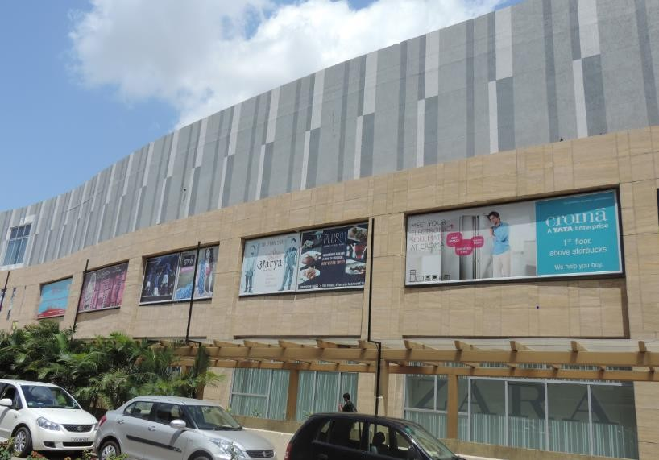
2
Media Type – Facade, Location – West side exterior area, Dimension – 25 W x 10 H Ft., Area – 250 Sq. Ft, Total Units - 1

Slide 5
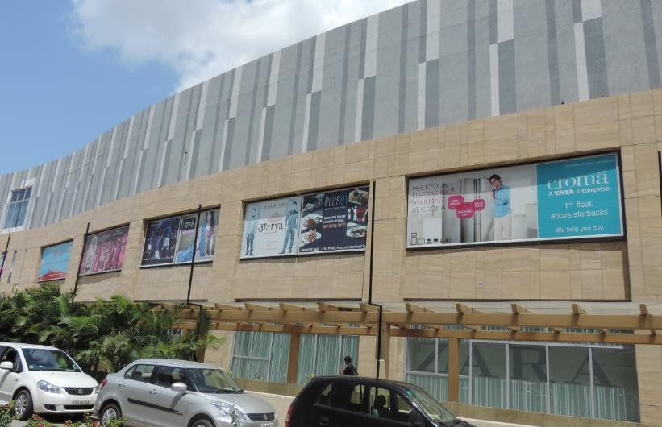
3
Media Type – Facade, Location –West side exterior area, Dimension – 11 W x 10 H Ft., Area – 110 Sq. Ft, Total Units - 4

Slide 6
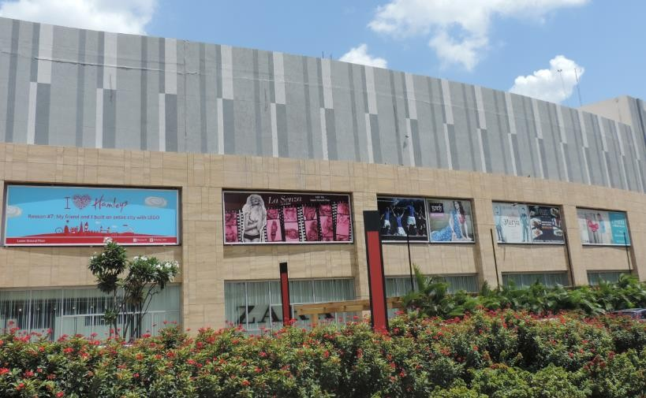
4
Media Type – Facade, Location –West side exterior area, Dimension – 25 W x 10 H Ft., Area – 250 Sq. Ft, Total Units - 2

Slide 7
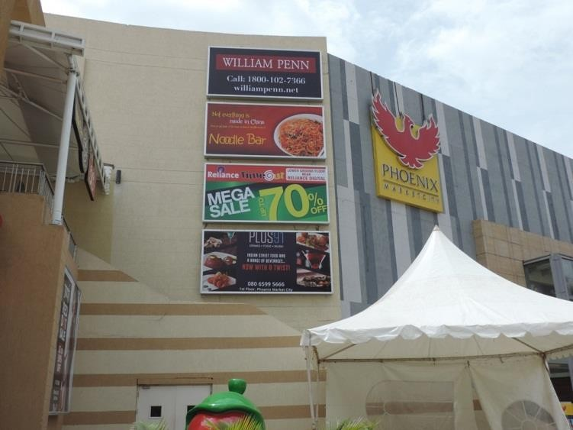
5
Media Type – Facade, Location –West side exterior area, Dimension – 15 W x 7.5 H Ft., Area – 112.5 Sq. Ft, Total Units - 4

Slide 8











Thank You

