Slide 1
















CAMPAIGN GUIDELINES

Slide 2
LEAD TIME
Volume(No of Trains) | Lead Time (In Days)
1-3 | 2-3
4-6 | 3-4
7-9 | 4-5
10+ | 6+
Please Note:
Lead Time is considered from the day the mock-up is approved for printing.
The shared lead time is approximate and might vary based on the availability of train, unforeseen weather conditions, and festive occasions.
The number of days shared for lead time is given considering the business days, with the exclusion of public holidays and weekends.
http://www.themediaant.com/

Slide 3
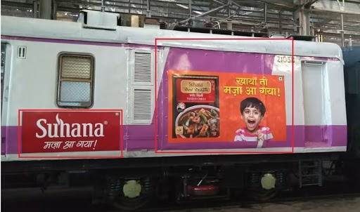
ARTWORK RELATED DETAILS
Though not mandatory in Mumbai trains, it is advised to have at least 10-15% of the artwork in Marathi language.
The regional language will be included in the form of a brand name, tagline, logo, safety instructions, etc.
http://www.themediaant.com/

Slide 4


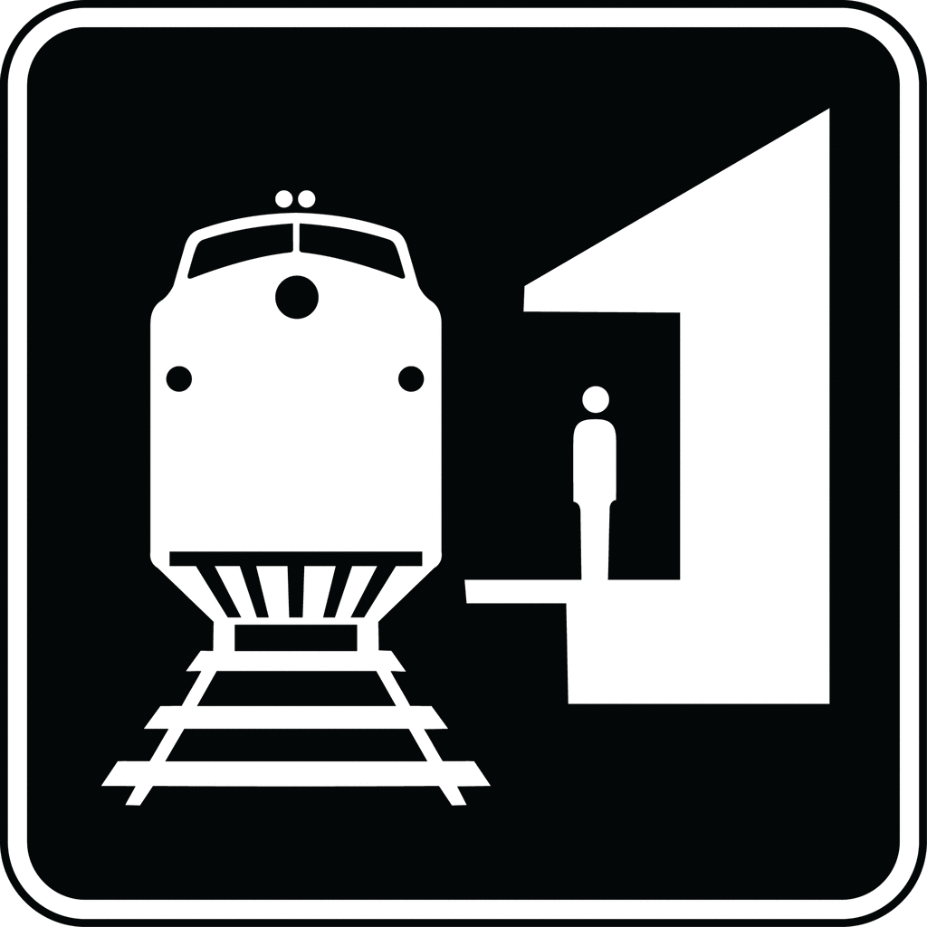






CAMPAIGN DISCLAIMER
Even if the client wants specific train targeting, it is not possible, however, route targeting is possible.
Train timings can vary based on unforeseen weather conditions, faults in the system of the train, mechanical failures, tracks overheating, yearly maintenance, etc.
The exact platform information cannot be provided about where the train halts at any particular station as it depends completely on the availability of the platform.
Once the mounting is done, demounting for the same will not be possible.
Post mounting, we are not accountable or responsible for any damage or replacement.
We will provide images as proof of execution for the campaign, only in exceptional cases videos will be provided, however, this will have extra charges applicable.
For interior branding, the number of panels available per train will be provided on request.
http://www.themediaant.com/

Slide 5


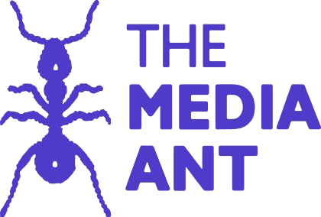








Thank You

