Slide 1
















Facade Branding

Slide 2

1
Media Type – Facade, Location – Main Entrance Area, Dimension: 63ft W x 17ft H, Total Area: 1071 Sq. Ft.

Slide 3
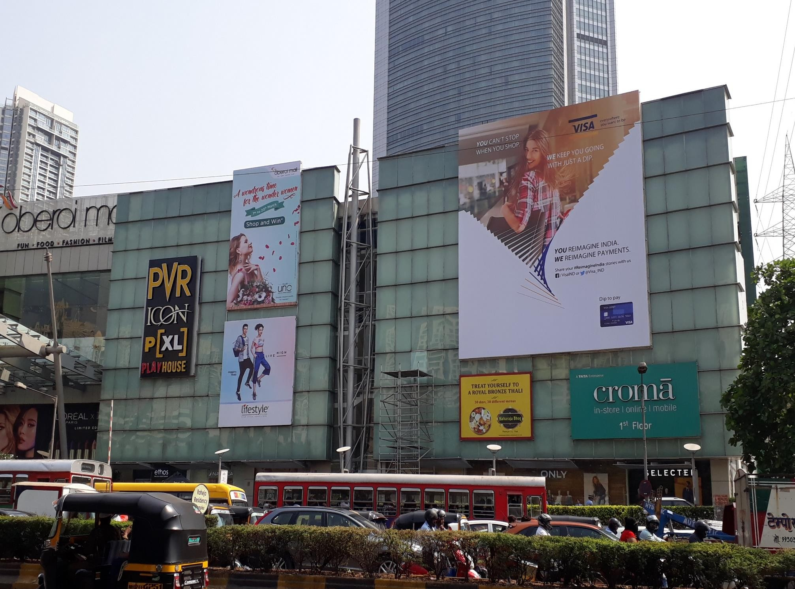
2
Media Type – Facade, Location – Main Entrance Area, Dimension – 40 W x 46 H ft., Total Area: 1840 Sq. Ft.

Slide 4
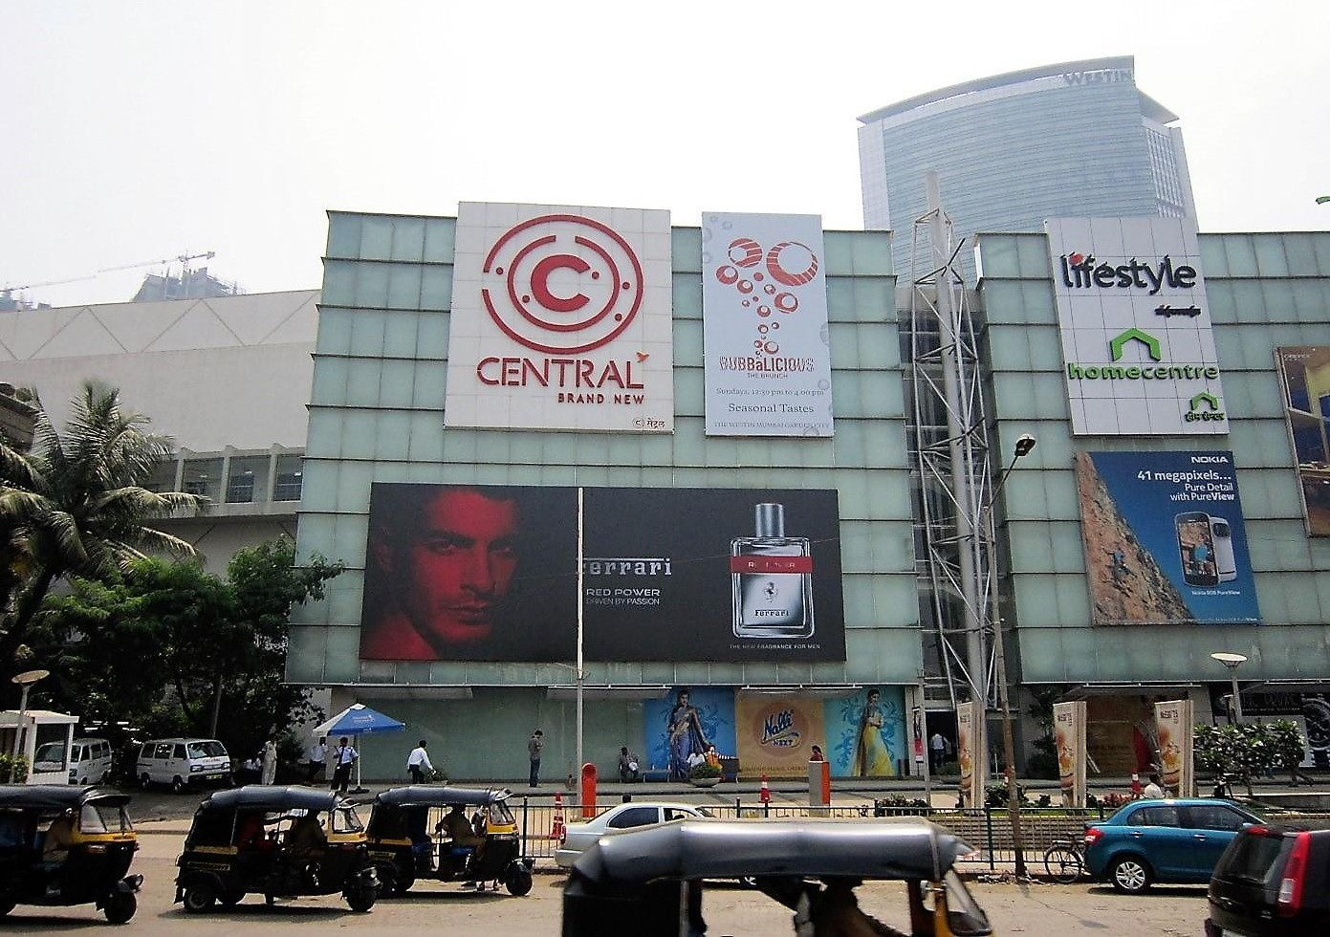
3
Media Type – Facade, Location –Main Entrance Area, Dimension–55 W x 21 H ft., Total Area: 1155 Sq. Ft.

Slide 5
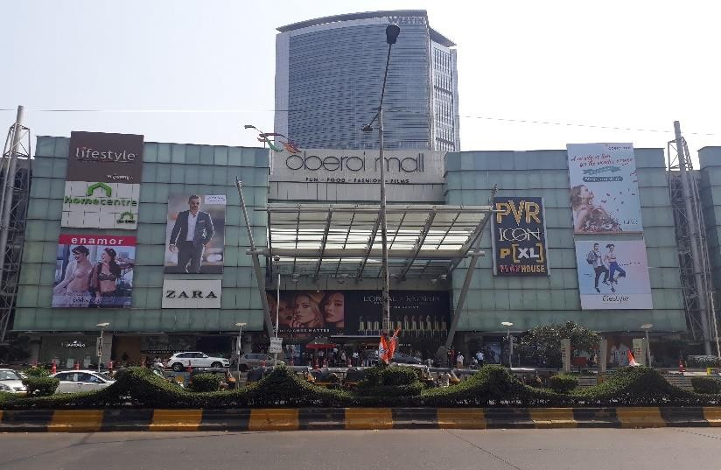
4
Media Type – Facade, Location –Main Entrance Area, Dimension –19.7 W x 22.7 H ft., Total Area: 447.19 Sq. Ft.

Slide 6

5
Media Type – Facade, Location –Main Entrance Area, Dimension–16 W x 32.6 H ft., Total Area: 521.6 Sq. Ft.

Slide 7











Thank You

