Slide 1
















Drop - Down

Slide 2
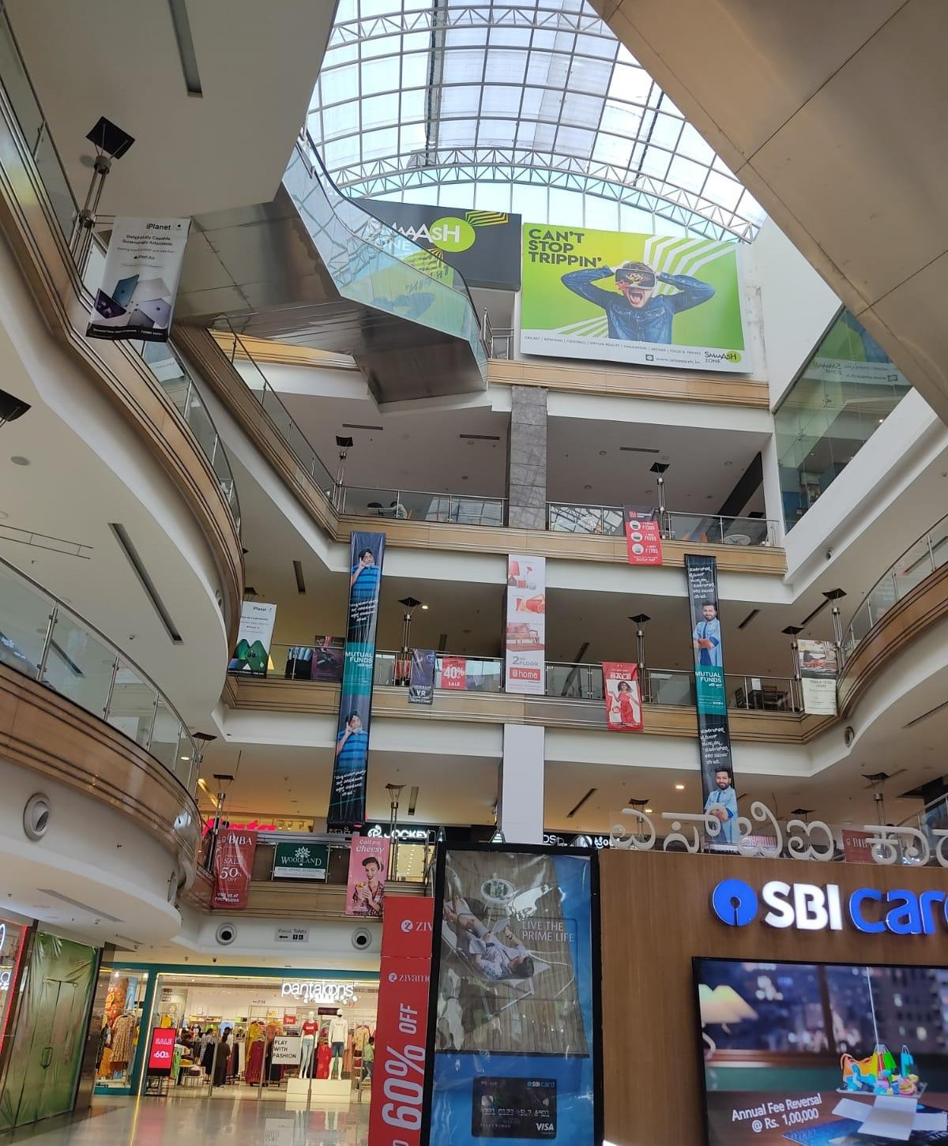
1
Media Type – Drop Down, Location – Third Floor, Dimension – 5 W X 25 H Ft., Area -125 Sq. Ft

Slide 3
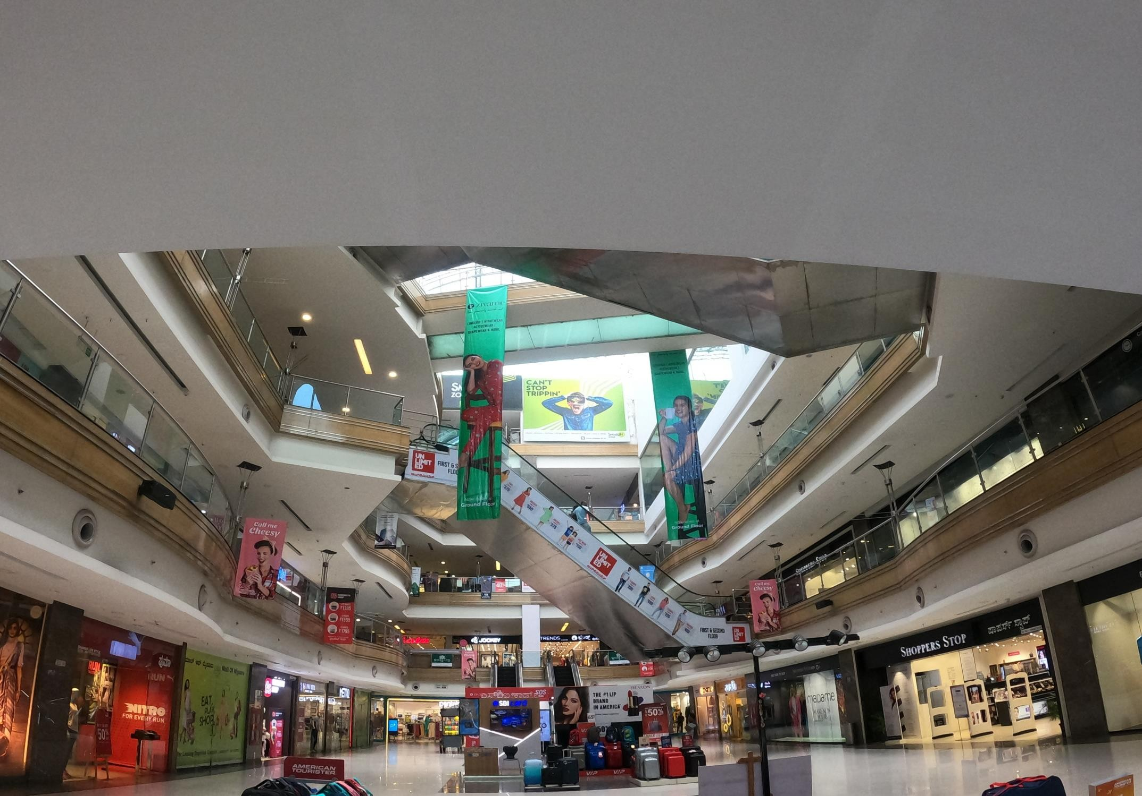
2
Media Type – Dropdown, Location – Top Floor, Dimension – 3 W X 6 HFt., Area – 18 Sq. Ft

Slide 4











Thank You

