Slide 1
















Façade

Slide 2
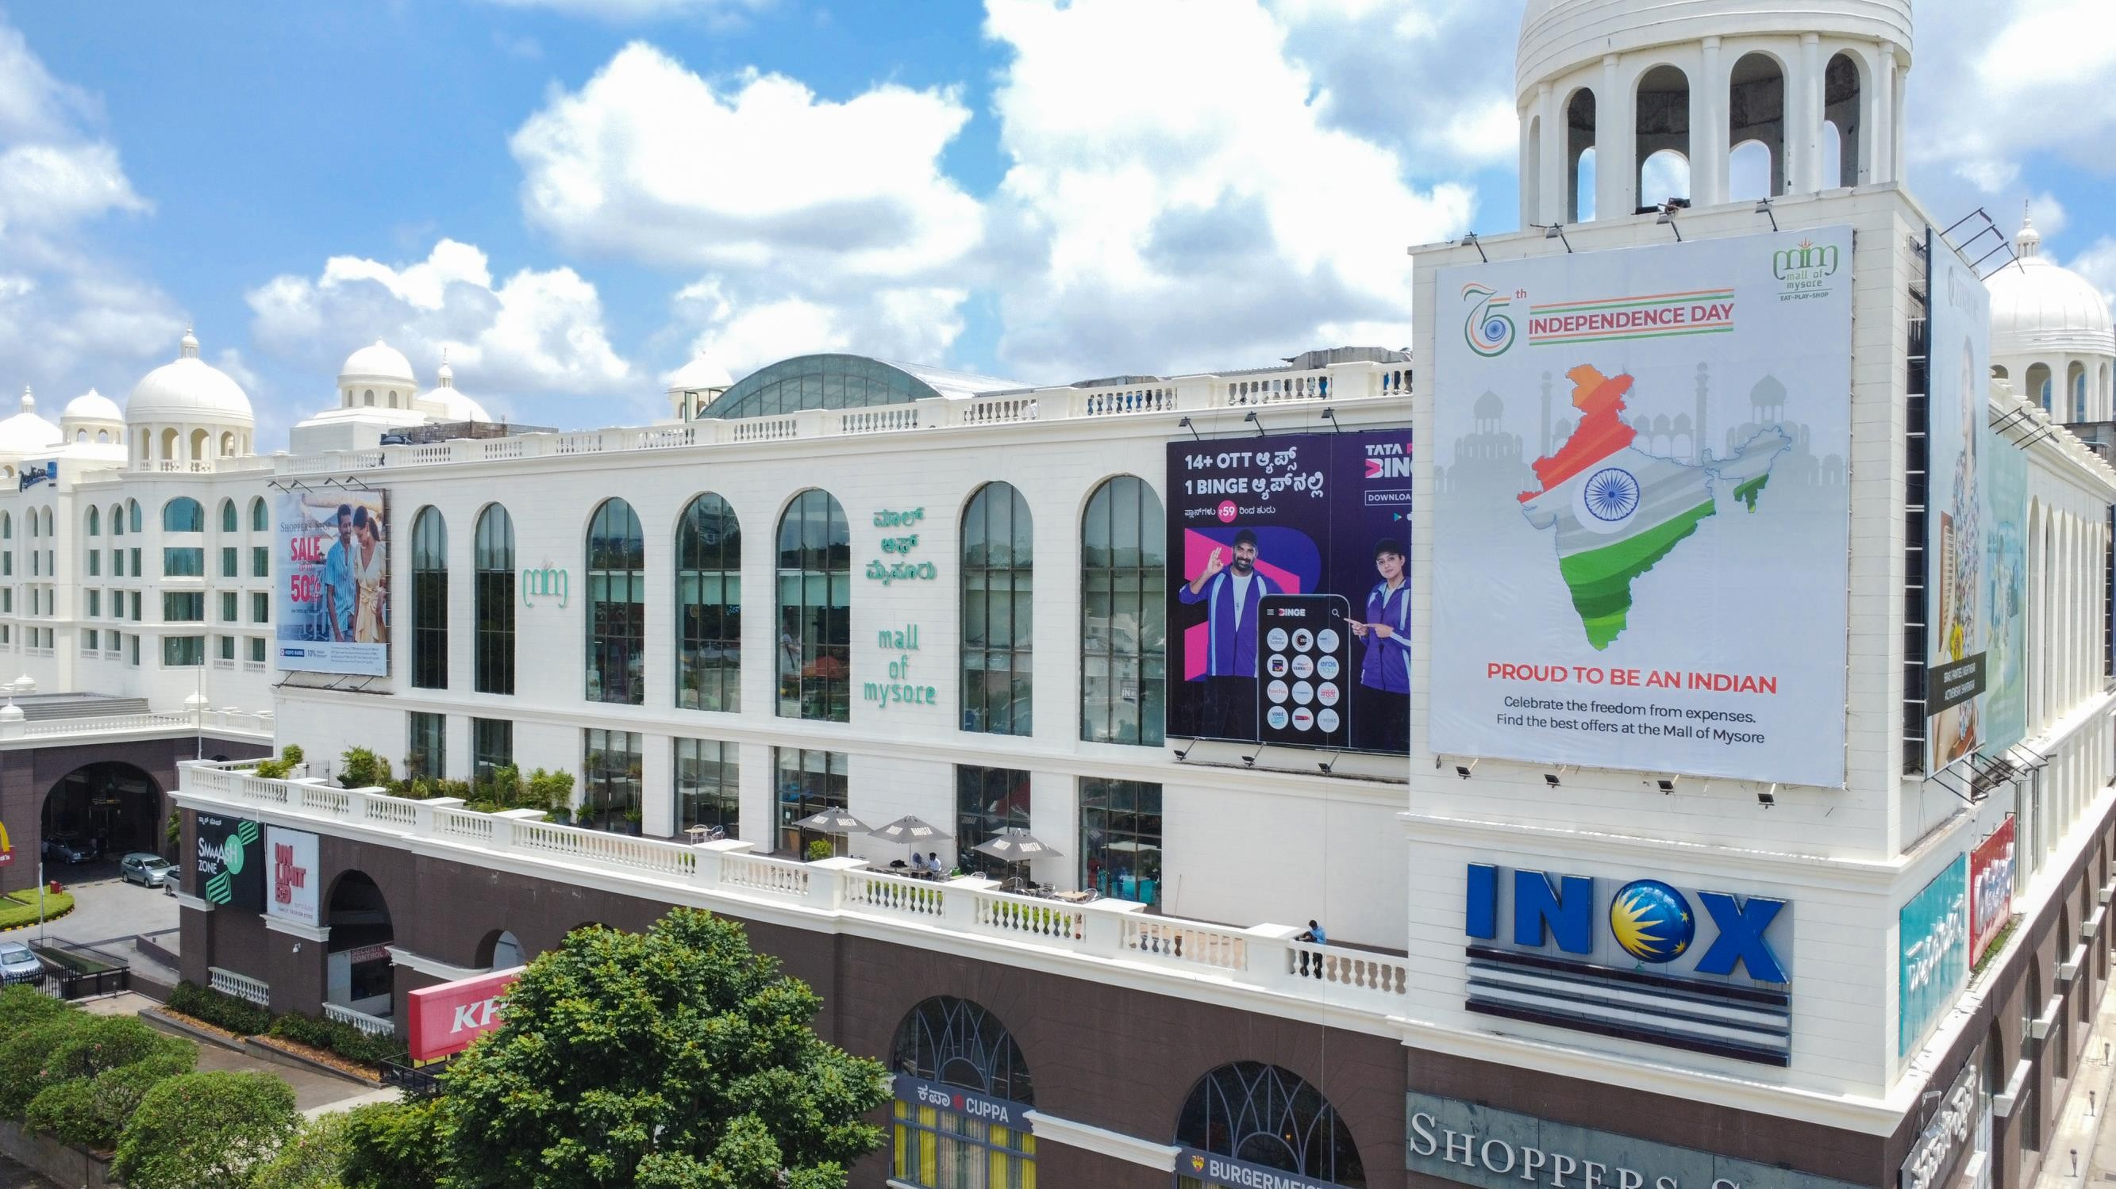
1
Media Type – Facade, Location – North facing exterior side, Dimension: 30 W X 28 H ft., Total Area: 840 Sq. Ft.

Slide 3
2
Media Type – Facade, Location –North facing exterior side, Dimension: 28 W X 36 H ft., Total Area: 1008 Sq. Ft.

Slide 4

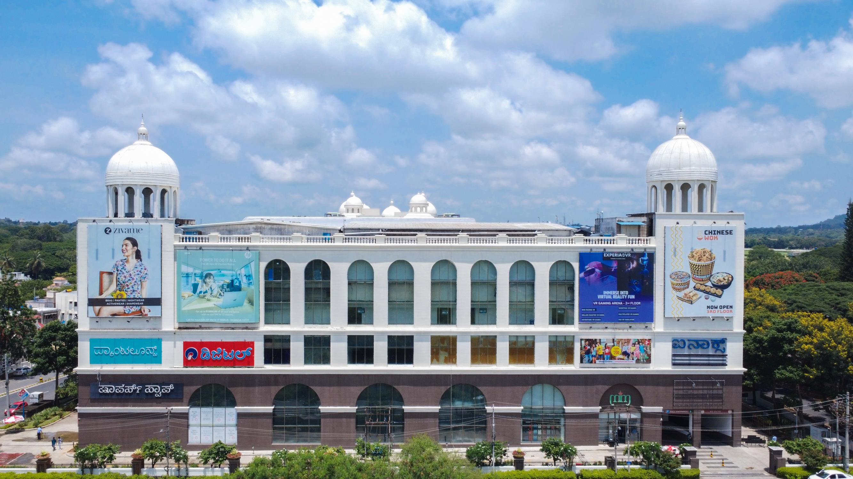
3
Media Type – Facade, Location – West facing exterior side, Dimension: 28 W X 36 H ft., Total Area: 1008 Sq. Ft.

Slide 5

5
Media Type – Facade, Location – West facing exterior side, Dimension: 31.5 W X 28 H ft., Total Area: 882 Sq. Ft.

Slide 6
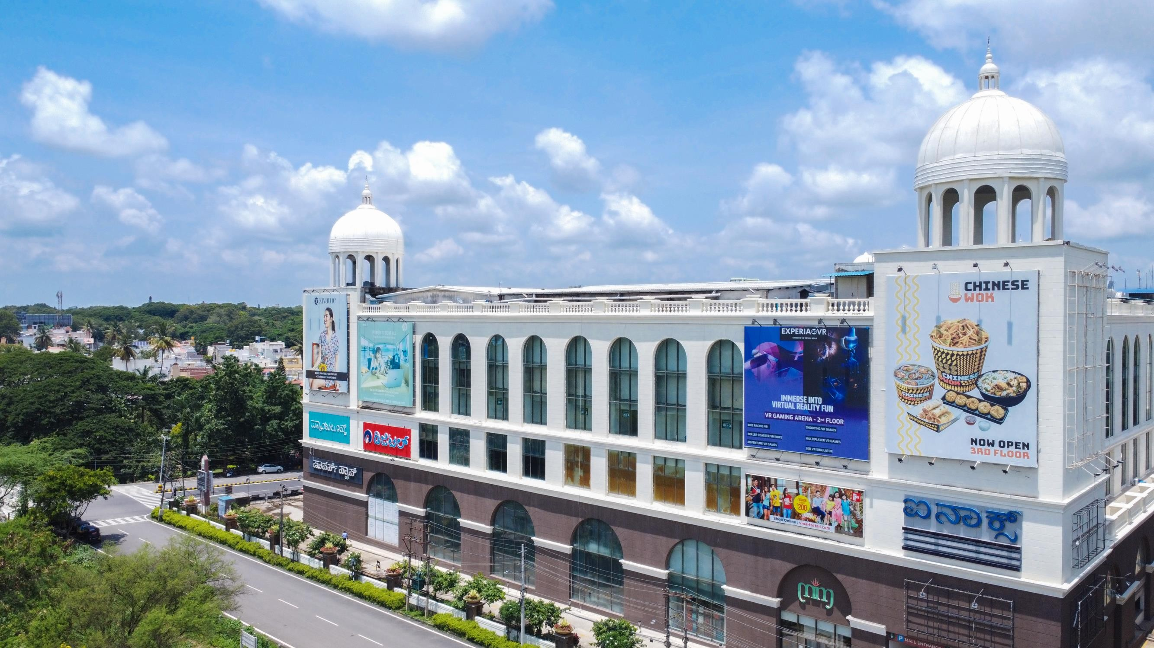
6
Media Type – Facade, Location – West facing exterior side, Dimension: 30 W X 28 H ft., Total Area: 840 Sq. Ft.

Slide 7
7
Media Type – Facade, Location – West facing exterior side, Dimension: 28 W X 36 H ft., Total Area: 1008 Sq. Ft.

Slide 8











Thank You

