Slide 1
















WALL SIGNAGE

Slide 2
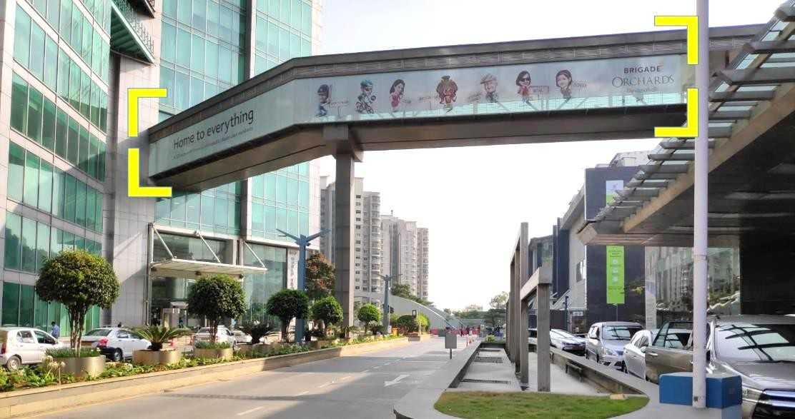
WORLD TRADE CENTRE
Type of the Media | Wall signage
Media Location | Walkway bridge
Total No. of Media | 1
Dimension - W X H (Feet) | 150 x 10

Slide 3
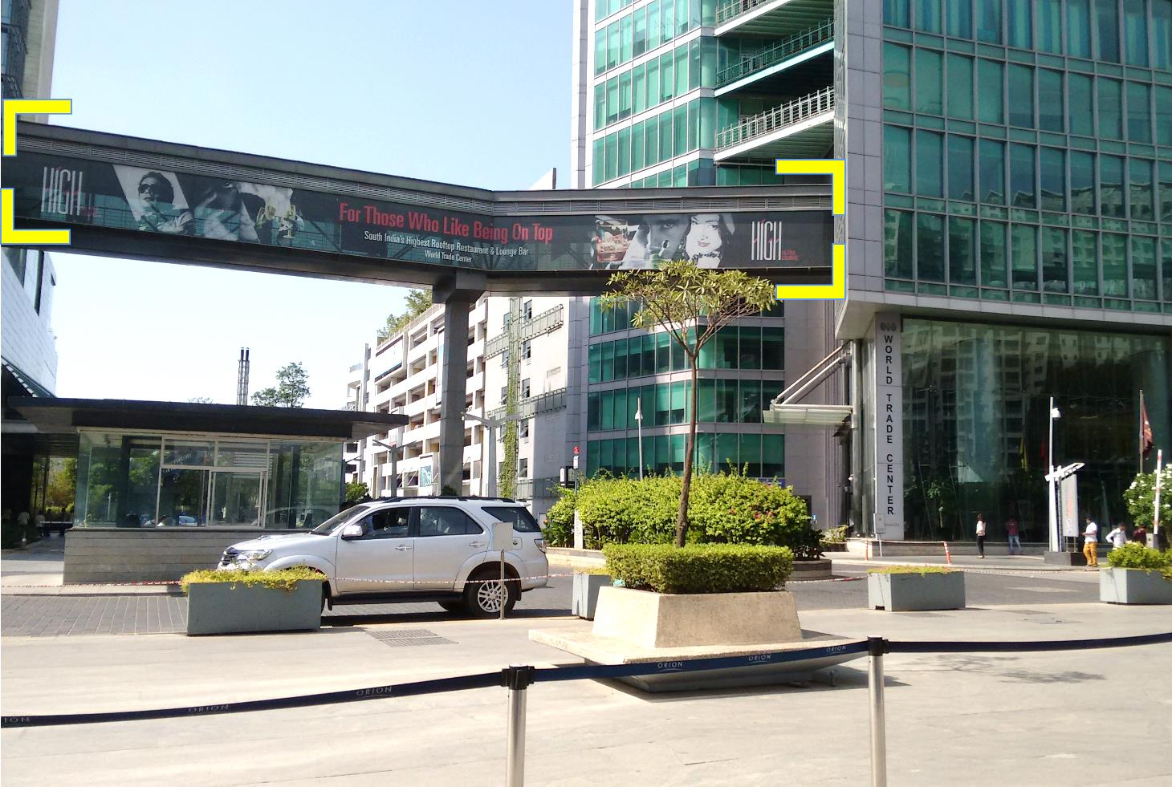
WORLD TRADE CENTRE
Type of the Media | Wall signage
Media Location | Walkway bridge
Total No. of Media | 1
Dimension - W X H (Feet) | 150 x 10

Slide 4
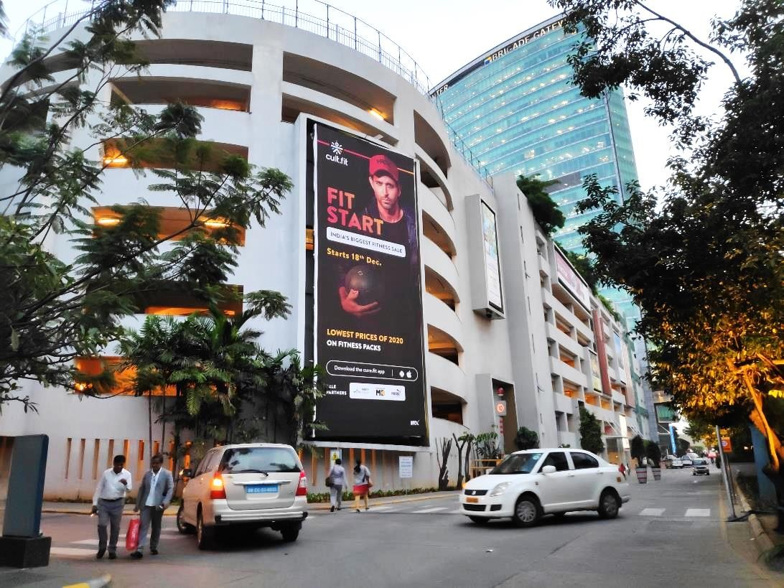
WORLD TRADE CENTRE
Type of the Media | Wall signage
Media Location | Main WTC Entry/Exit Facade
Total No. of Media | 1
Dimension - W X H (Feet) | 20 x 50

Slide 5
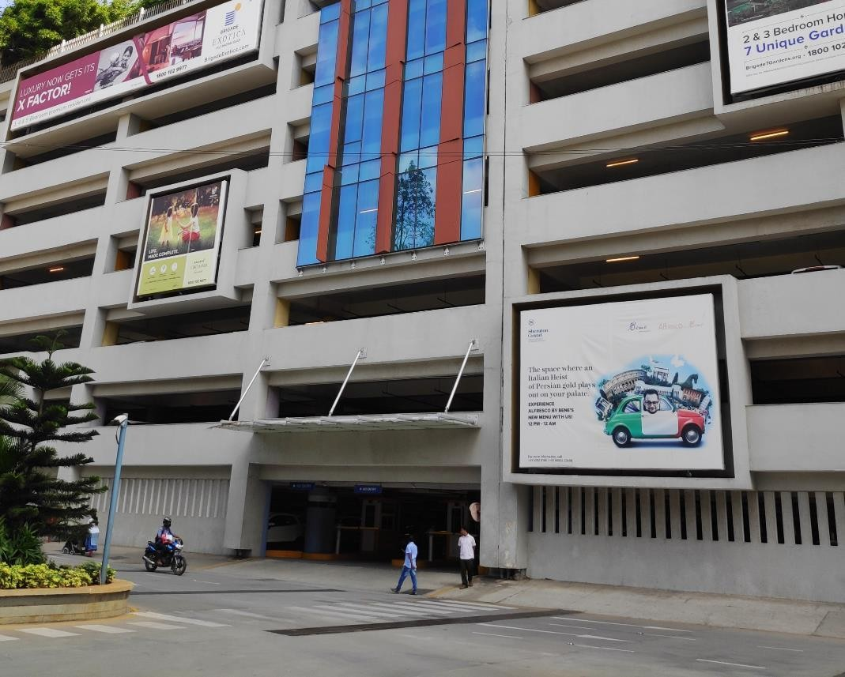
WORLD TRADE CENTRE
Type of the Media | Wall signage
Media Location | Front Facing Facade
Total No. of Media | 1
Dimension - W X H (Feet) | 20 X 15

Slide 6
WORLD TRADE CENTRE
Type of the Media | Wall signage
Media Location | Front Facing Facade
Total No. of Media | 1
Dimension - W X H (Feet) | 14 X 15

Slide 7
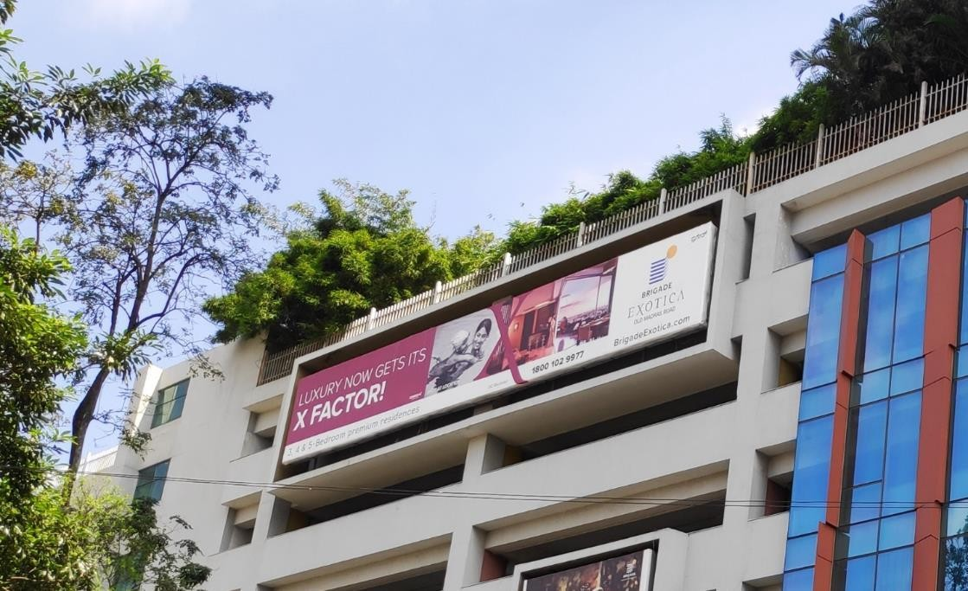
WORLD TRADE CENTRE
Type of the Media | Wall signage
Media Location | Front Facing Facade
Total No. of Media | 1
Dimension - W X H (Feet) | 61 X 10

Slide 8
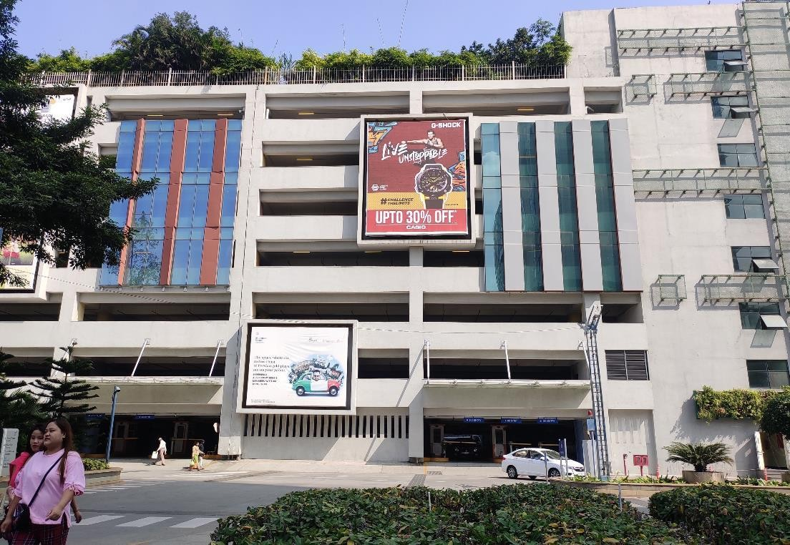
WORLD TRADE CENTRE
Type of the Media | Wall signage
Media Location | Front Facing Facade
Total No. of Media | 1
Dimension - W X H (Feet) | 21 X 26

Slide 9
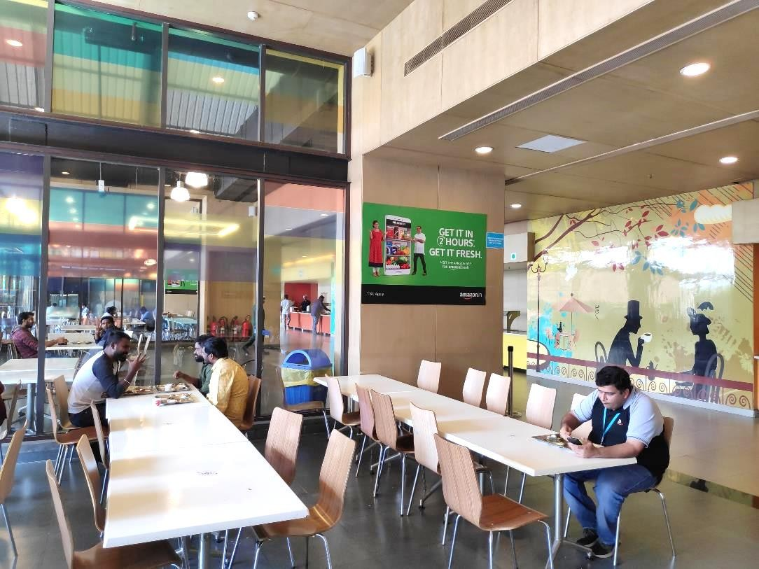
WORLD TRADE CENTRE
Type of the Media | Wall Signage
Media Location | Food Court
Total No. of Media | 4
Dimension - W X H (Feet) | 6 x 4

Slide 10

WORLD TRADE CENTRE
Type of the Media | Wall Signage
Media Location | Food Court - Walkway
Total No. of Media | 6
Dimension - W X H (Feet) | 4 x 6

Slide 11











Thank You

