Slide 1
















Back Lit Board

Slide 2
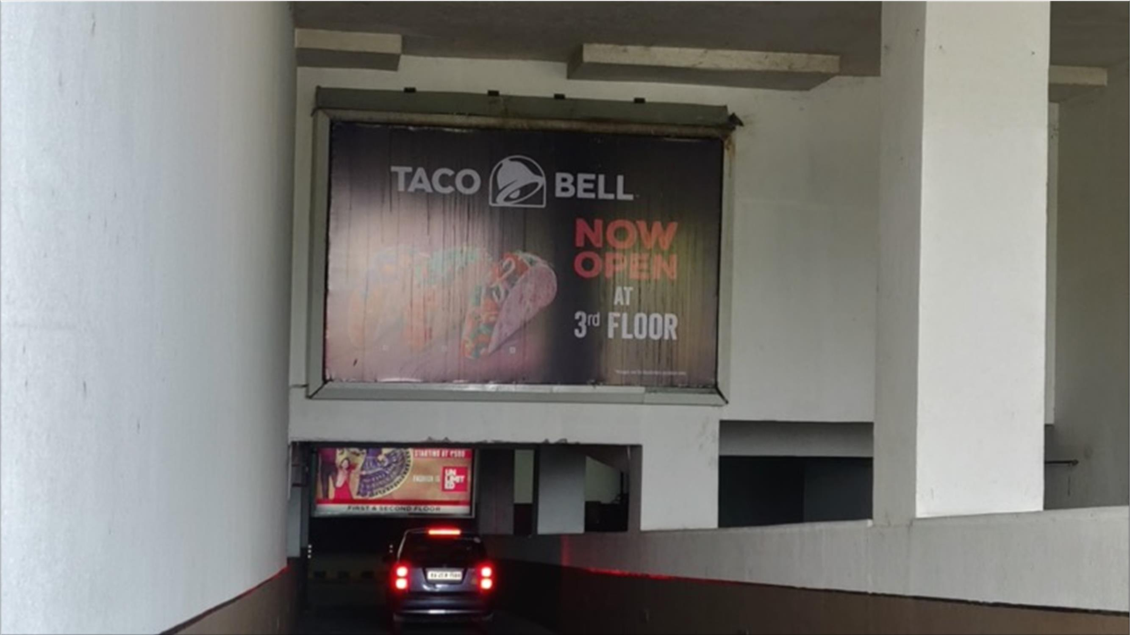

1
Media Type – Back Lit Board, Location –Basement Parking Entry Area, Dimension: 15 W X 10 H ft., Total Area: 150 Sq. Ft.

Slide 3
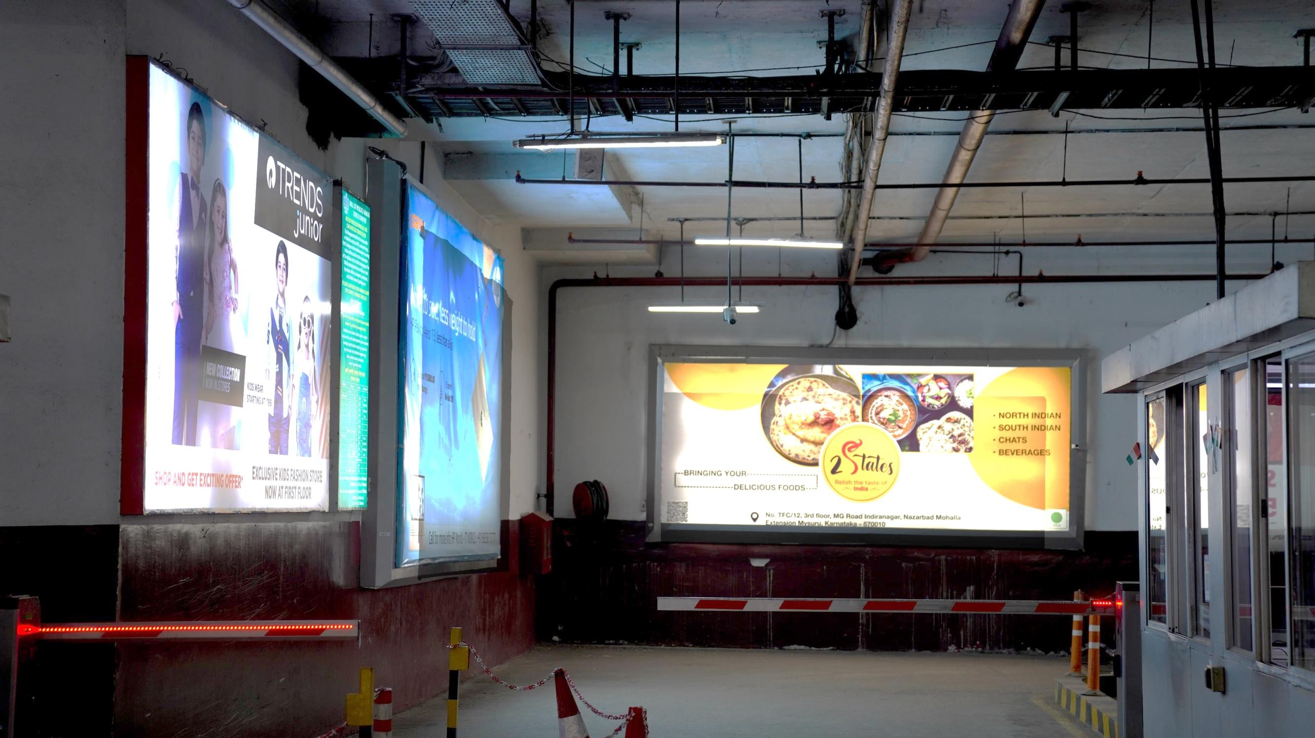
2
Media Type – Back Lit Board, Location – Basement Parking Exit Area Loc 1, Dimension: 15 W X 6 H ft., Total Area: 90 Sq. Ft.

Slide 4

3
Media Type – Back Lit Board, Location – Basement Parking Exit Area Loc 2, Dimension: 3 W X 7 H ft., Total Area: 21 Sq. Ft.

Slide 5
4
Media Type – Back Lit Board, Location – Basement Parking Exit Area Loc 3, Dimension: 12 W X 7 H ft., Total Area: 84 Sq. Ft.

Slide 6

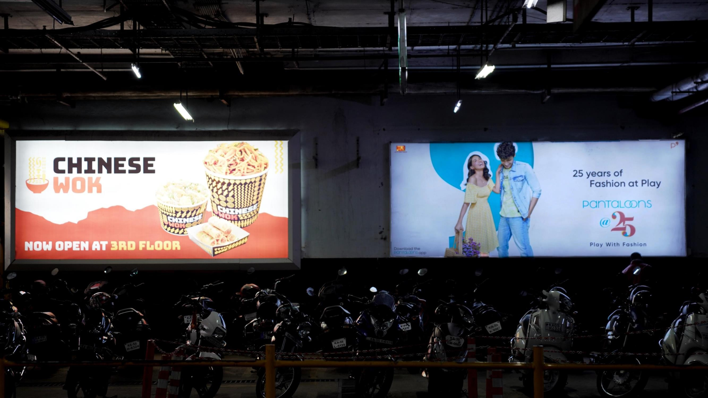
5
Media Type – Back Lit Board, Location – Basement Parking Exit Area Loc 4 , Dimension: 15 W X 6 H ft., Total Unit: 2, Total Area: 90 Sq. Ft.

Slide 7
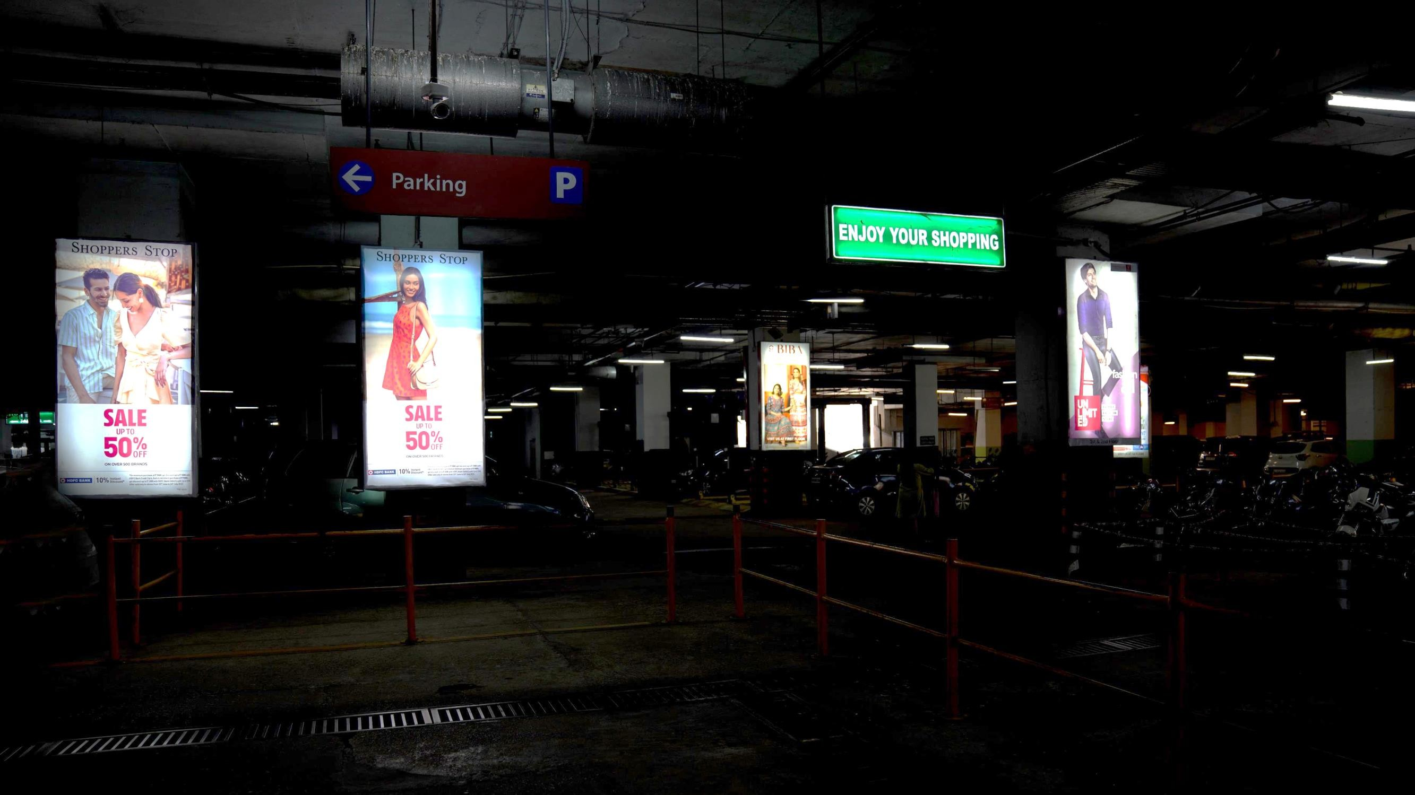
6
Media Type – Back Lit Board, Location – Basement Parking Exit Area Loc 5, Dimension: 15 W X 6 H ft., Total Units : 14, Total Area: 90 Sq. Ft.

Slide 8
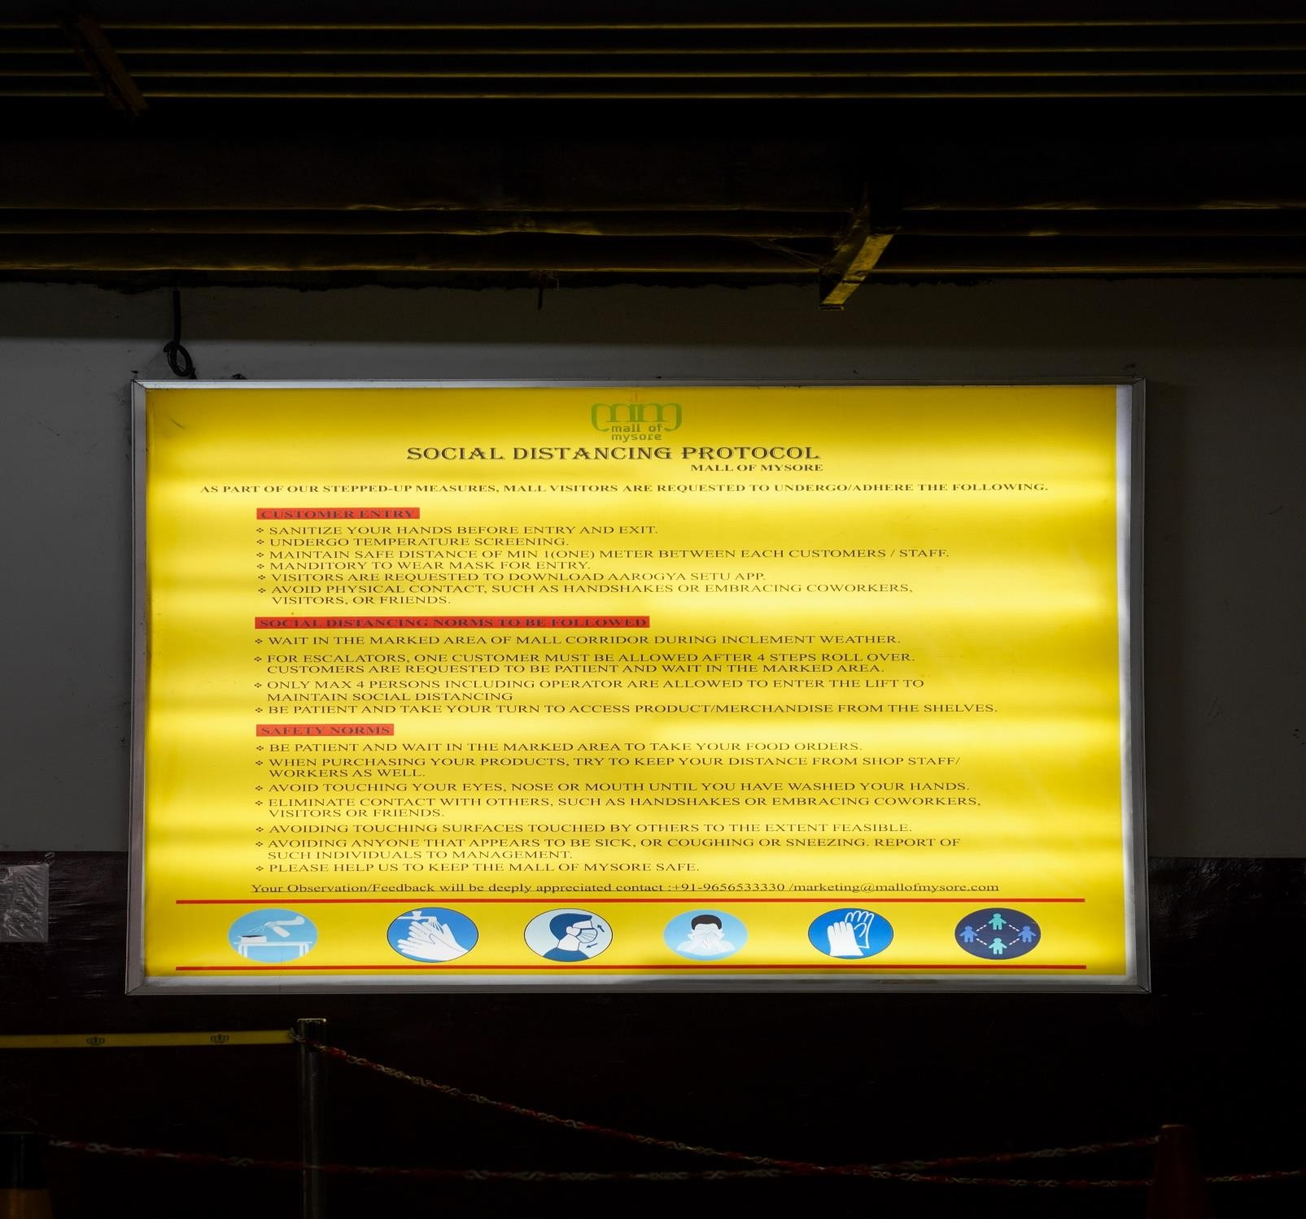
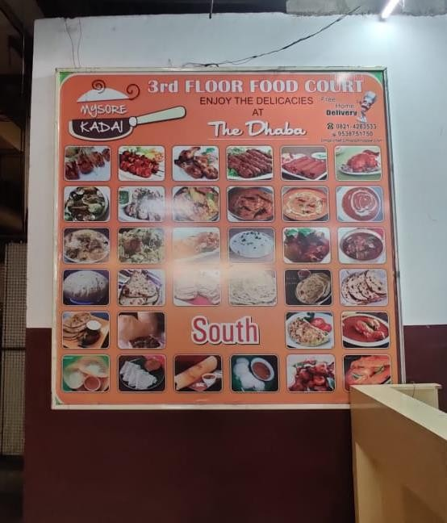
7
Media Type – Back Lit Board, Location – Basement Lift Lobby Entry Area Loc 1, Dimension: 8 W X 8 H ft., Total Units : 2, Total Area: 64 Sq. Ft.

Slide 9
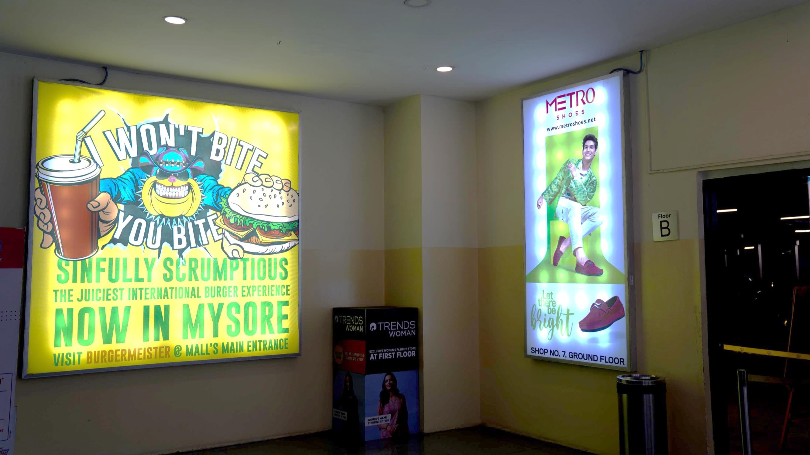
8
Media Type – Back Lit Board, Location – Basement Lift Lobby Entry Area Loc 2, Dimension: 8 W X 8 H ft., Total Area: 64 Sq. Ft.

Slide 10
9
Media Type – Back Lit Board, Location –Basement Lift Lobby Entry Area Loc 3, Dimension: 4 W X 8 H ft., Total Area: 32 Sq. Ft.

Slide 11
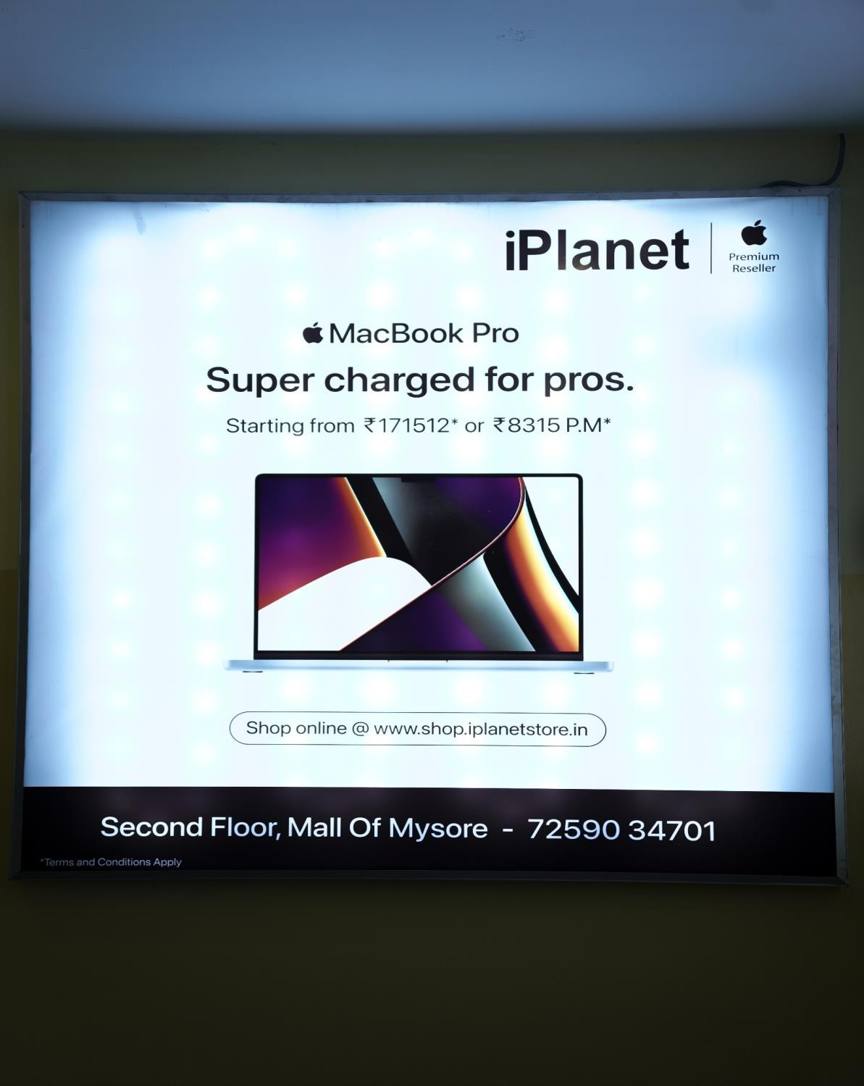
10
Media Type – Back Lit Board, Location –Basement Lift Lobby Entry Area Loc 4, Dimension: 8 W X 8 H ft., Total Area: 64 Sq. Ft.

Slide 12
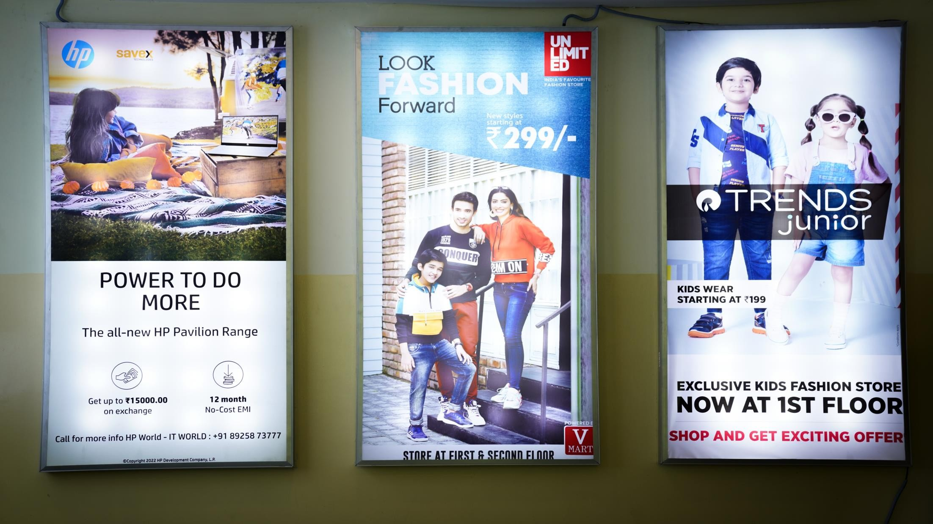
11
Media Type – Back Lit Board, Location –Basement Lift Lobby Entry Area Loc 5, Dimension: 4 W X 8 H ft., Total Units: 3, Total Area: 32 Sq. Ft.

Slide 13
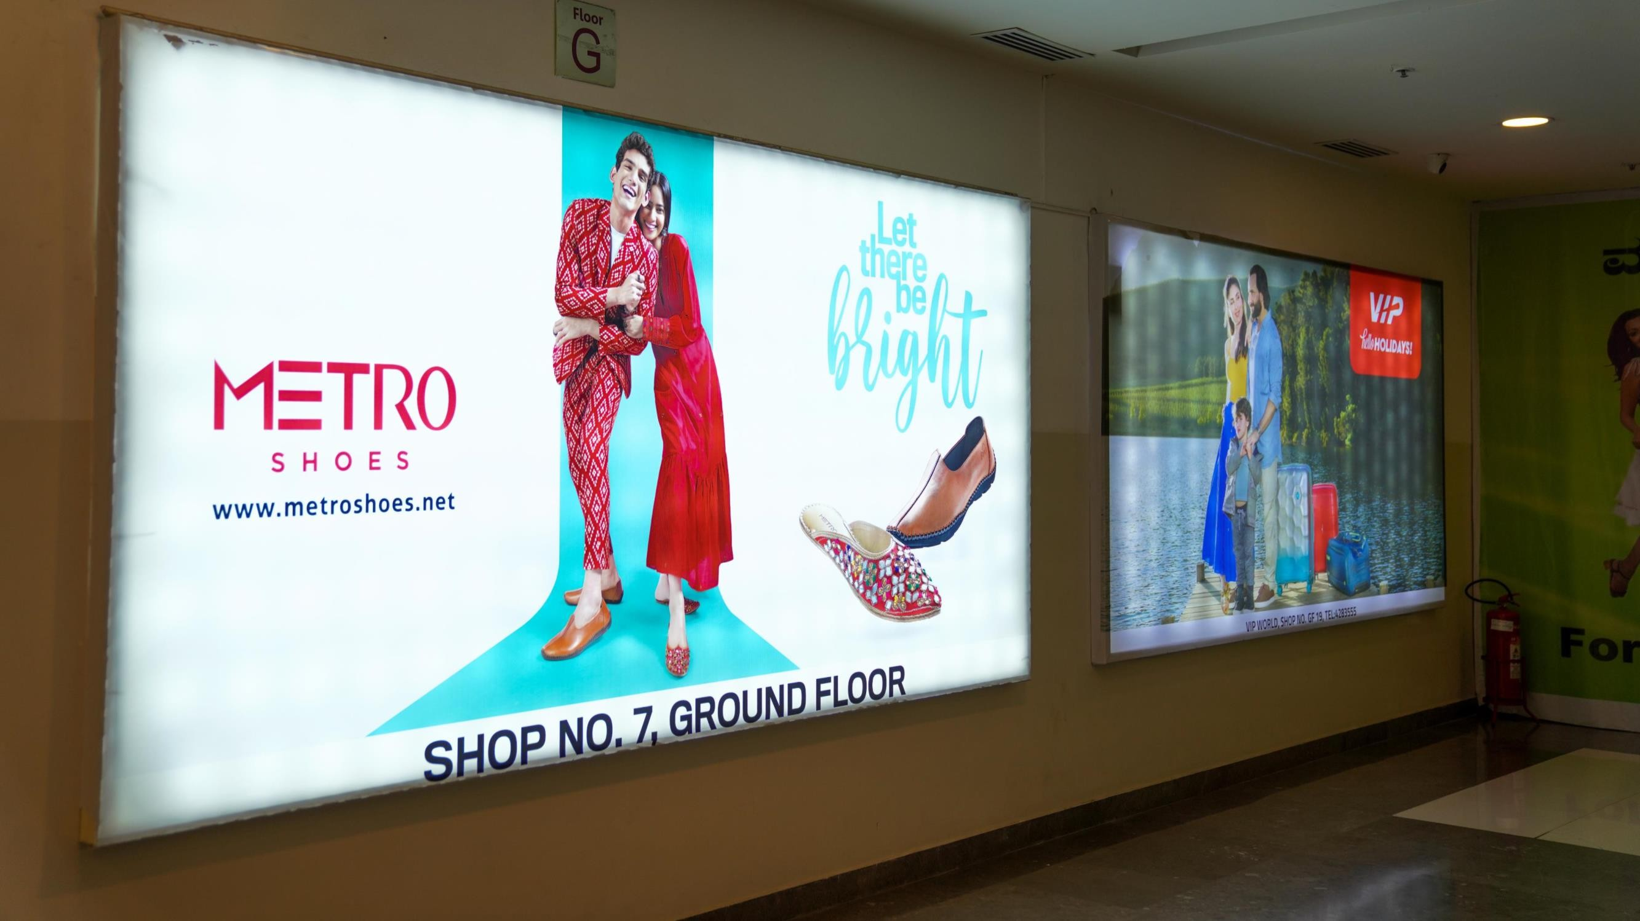
12
Media Type – Back Lit Board, Location – Ground Floor Escalator Area , Dimension: 10 W X 06 H ft., Total Units: 2, Total Area: 60 Sq. Ft.

Slide 14











Thank You

