Slide 1
















Wall Signage

Slide 2
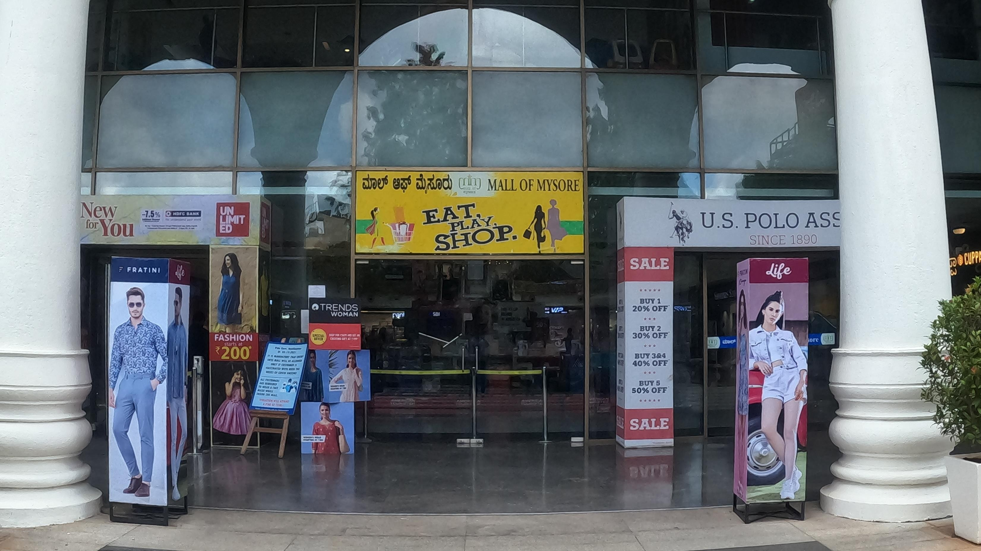
1
Media Type – Wall Signage, Location –Entrance Area, Dimension: 6 W X 6 H ft., Total Area: 36 Sq. Ft.

Slide 3
2
Media Type – Wall Signage, Location – Entrance Area, Dimension –4 W X 4 Hft., Total Area: 16 Sq. Ft., Package of 6 Unit

Slide 4











Thank You

