Slide 1
















Glass Branding

Slide 2
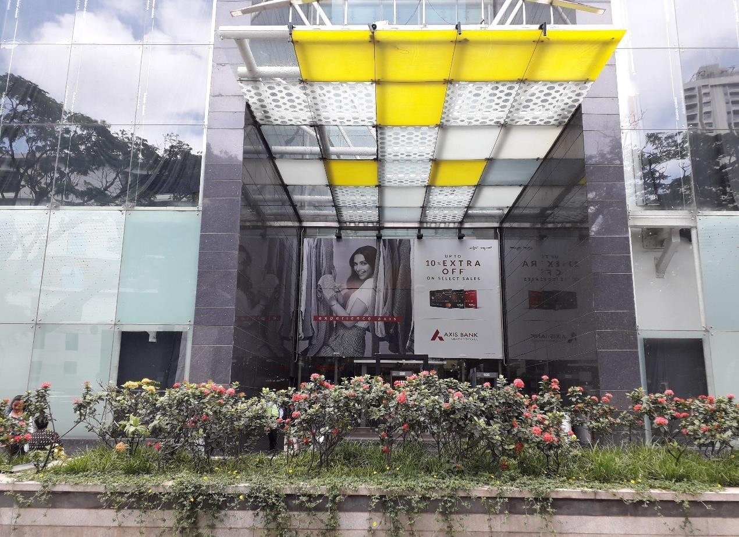
1
Location - Entrance Area, Dimension – 29 W x 17 H Ft.

Slide 3
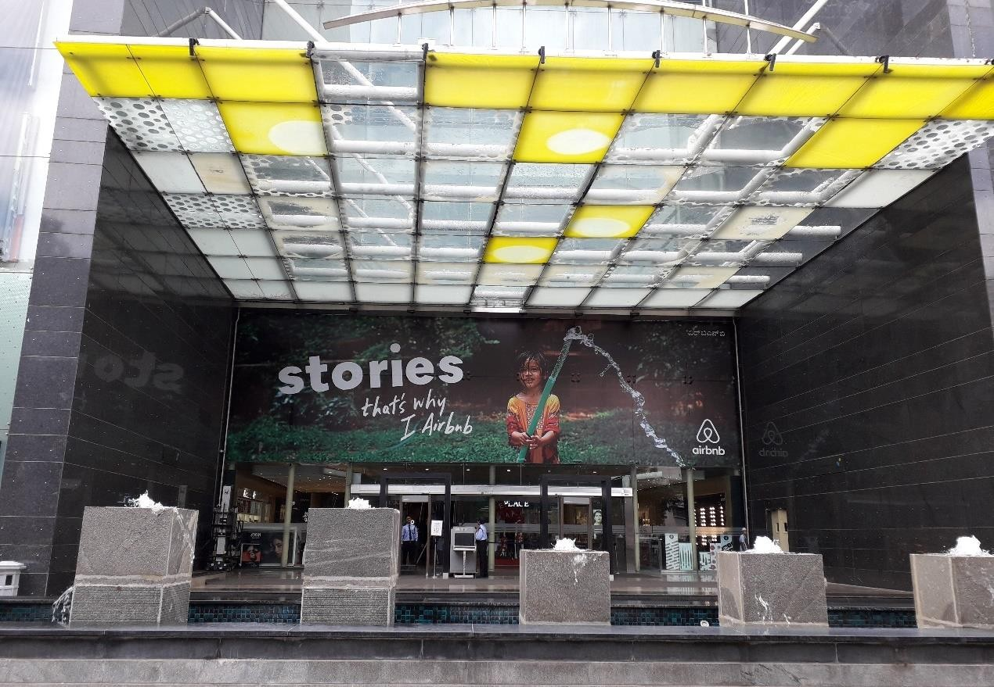
2
Location - Entrance Facing Raj Kumar Rd, Dimension – 60 W x 17.5 H Ft.

Slide 4
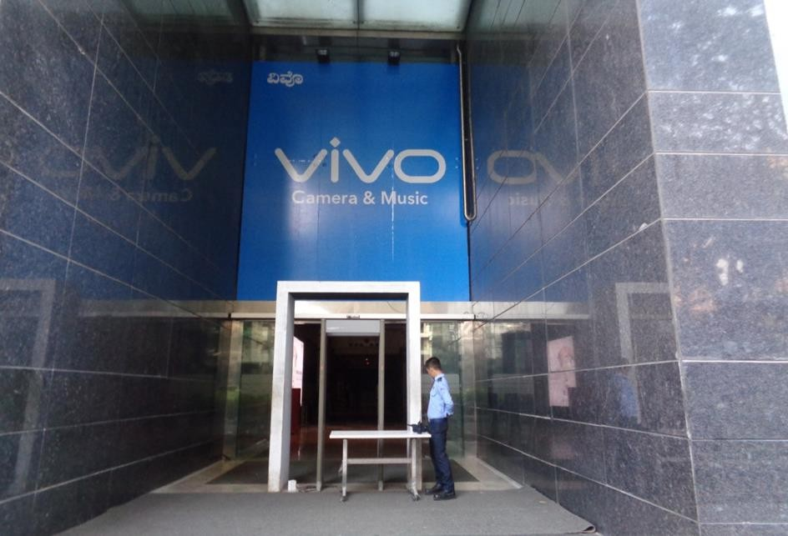
3
Location - Entrance Facing Raj Kumar Rd, Dimension – 16 W x 18 H Ft.

Slide 5
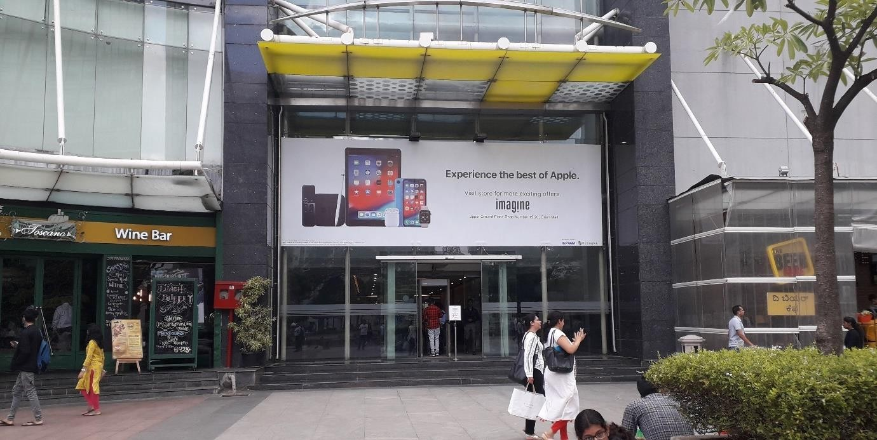
4
Location - Lakeside Facing Area Site 1, Dimension – 30 W x 10 H Ft.

Slide 6
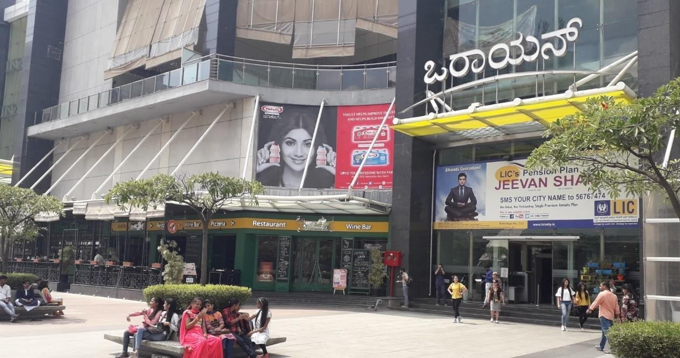
5
Location - Lakeside Facing Area Site 2, Dimension – 24 W x 14 H Ft.

Slide 7
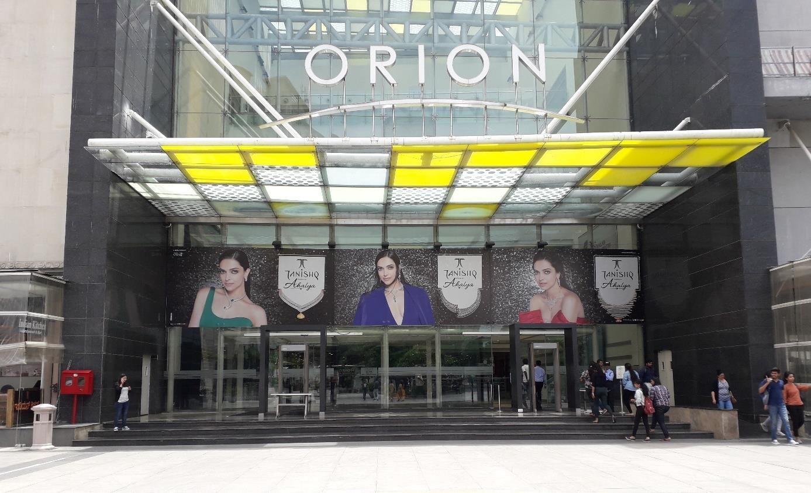
6
Location - Lakeside Facing Area Site 3, Dimension – 60 W x 10 H Ft.

Slide 8
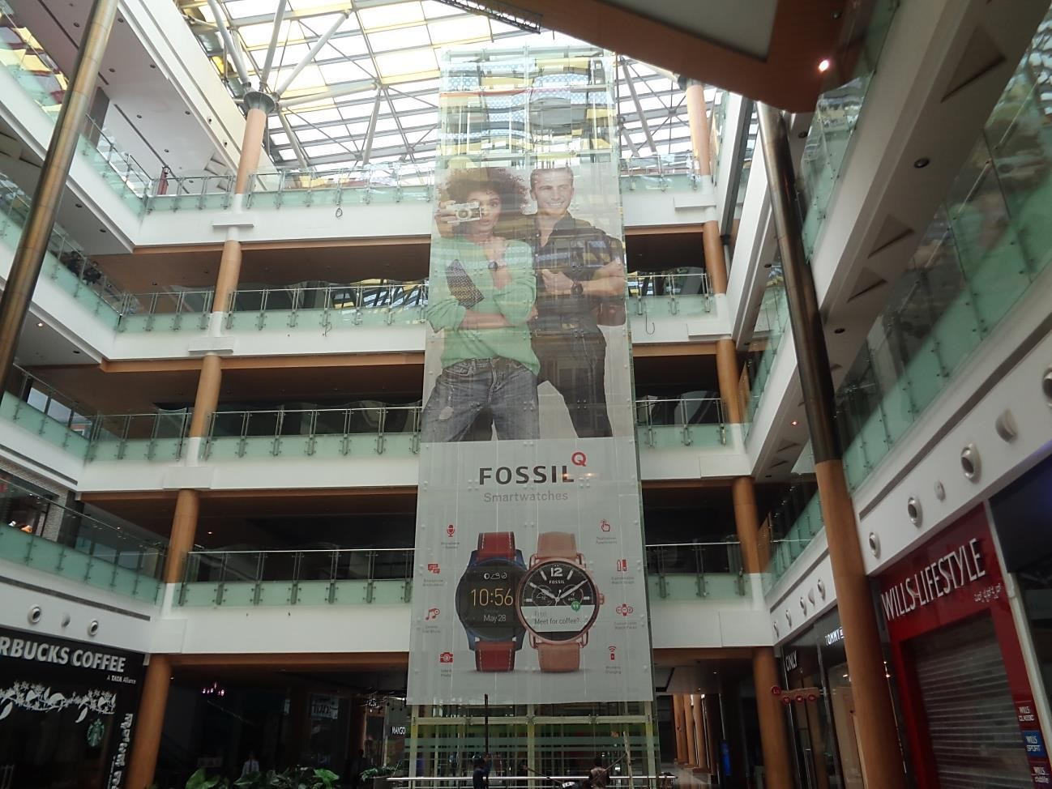
7
Location – Mall Centre Area, Dimension – 22 W x 60 H Ft.

Slide 9











Thank You

