Slide 1
















ARCH BRANDING

Slide 2
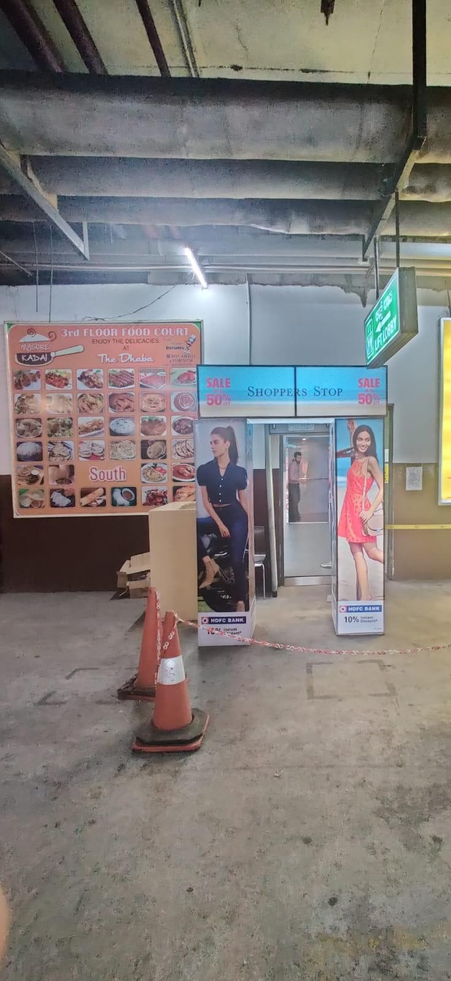
1
Media Type – Arch, Location – Basement Lift Lobby Area, Dimension – 6 W X 8 H Ft., Area – 48 Sq. Ft

Slide 3

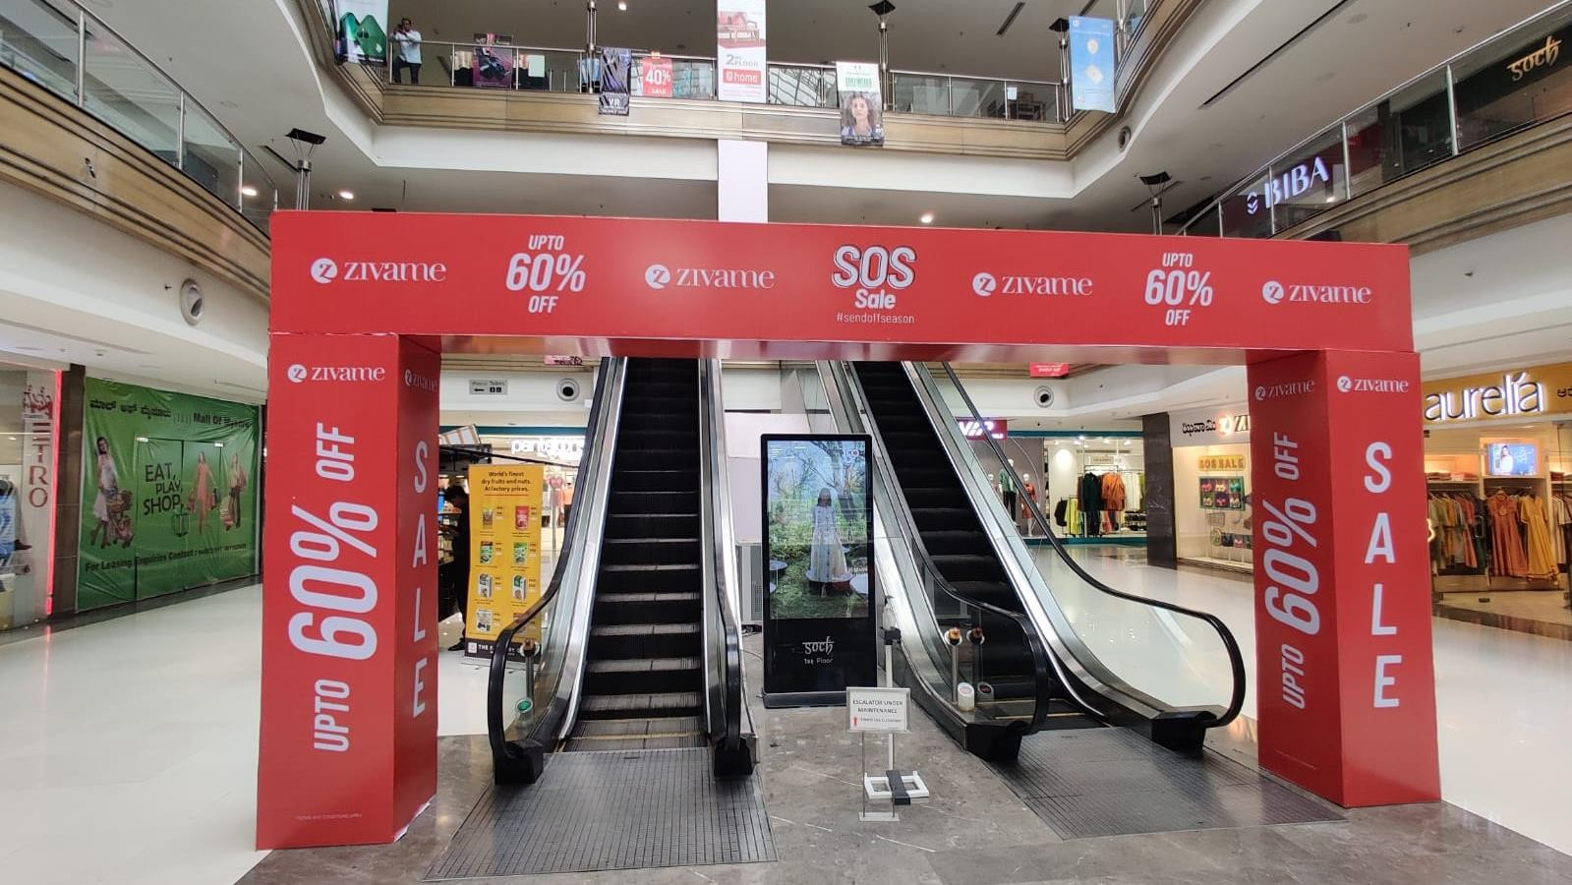
2
Media Type – Arch, Location –Ground Floor, Dimension – 28 W X 10 H Ft., Area – 280 Sq. Ft

Slide 4











Thank You

