Slide 1
















Kiosk Dimension Detail and Location

Slide 2
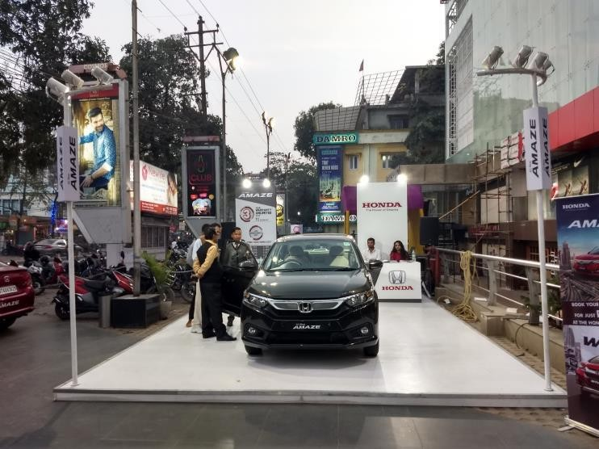
Dimension - 20 (W) x 15 (H) Ft., Location – Mall Periphery

Slide 3
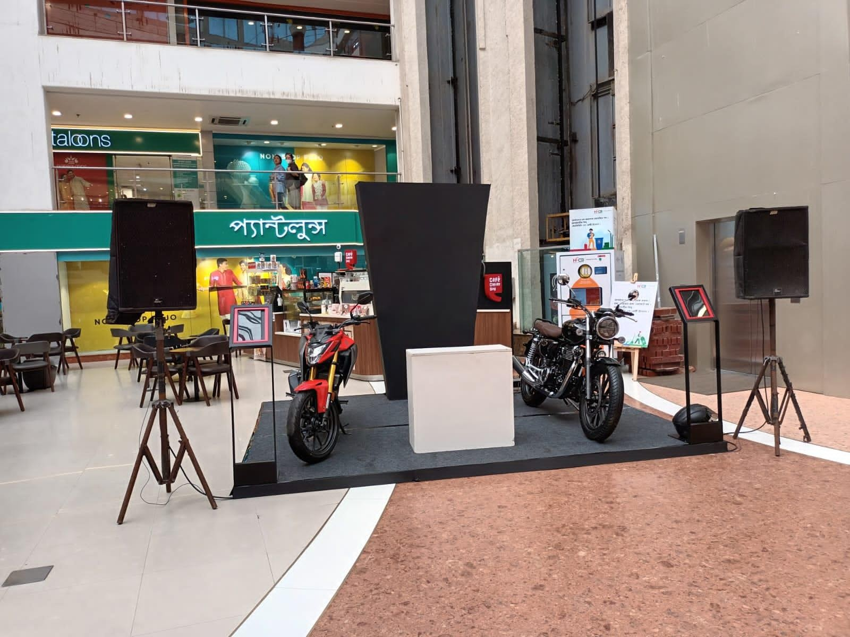
Dimension - 12 (W) x 10 (H) Ft., Location – Mall Atrium

Slide 4
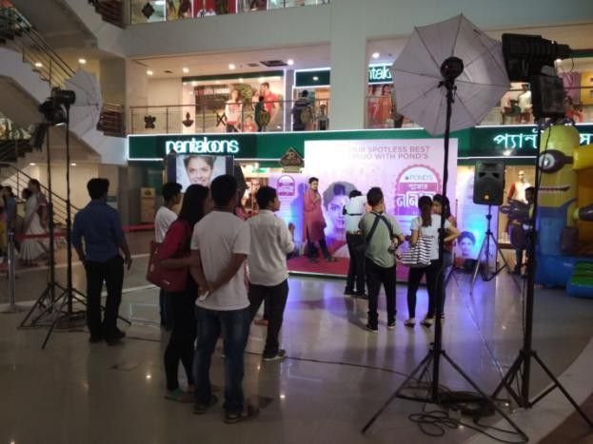
Dimension - 10 (W) x 10 (H) Ft., Location – Mall Atrium

Slide 5
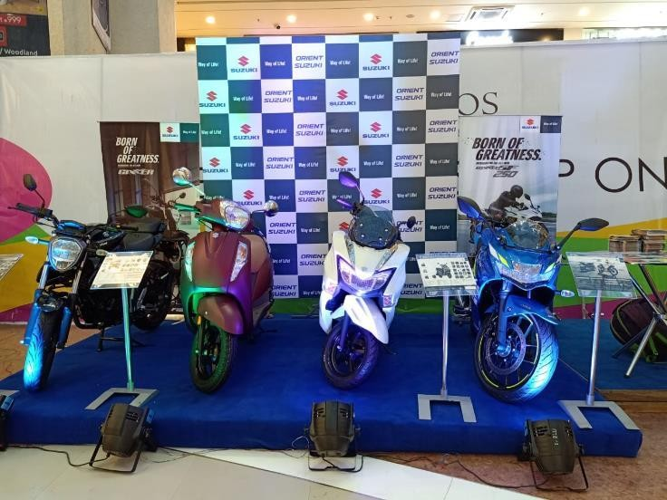
Dimension – 15 (W) x 10 (H) Ft., Location – Mall Atrium

Slide 6











Thank You

