Slide 1
















MOBILE VAN DIMENSION

Slide 2
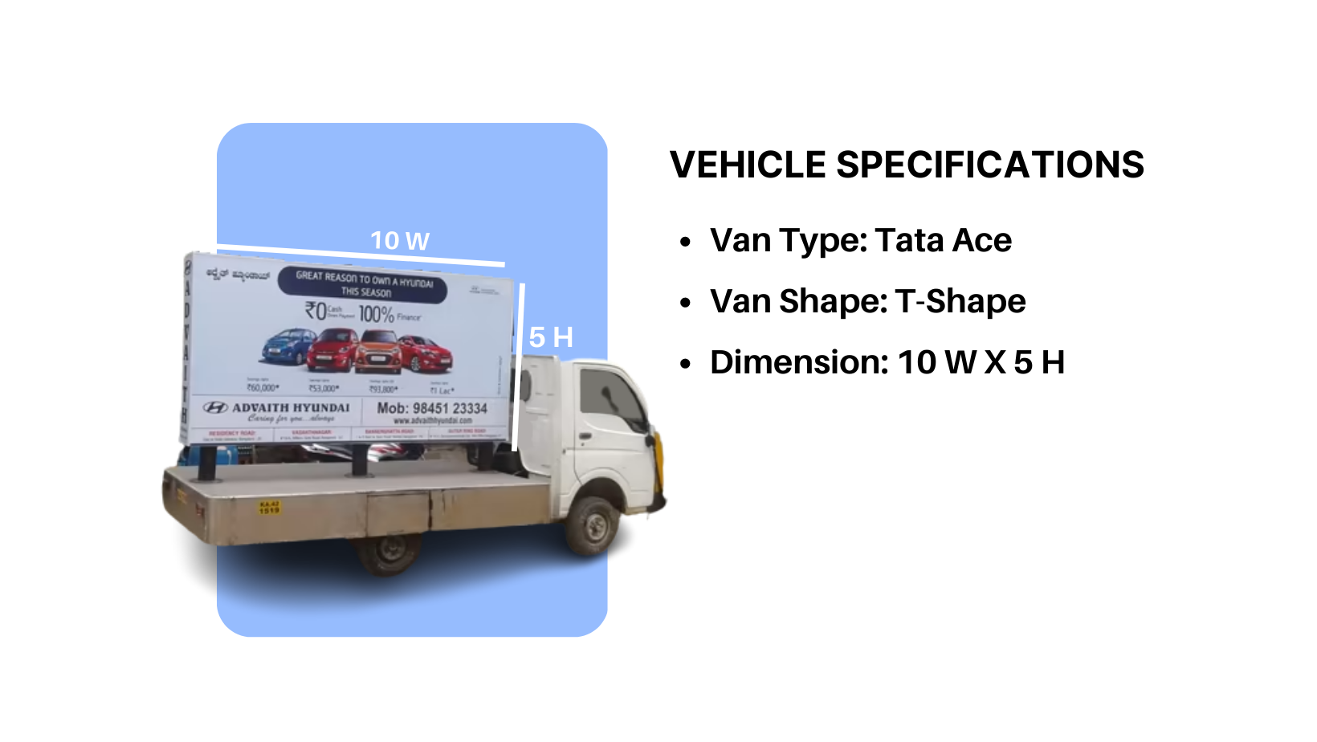
JCDecaux Airport India

Slide 3
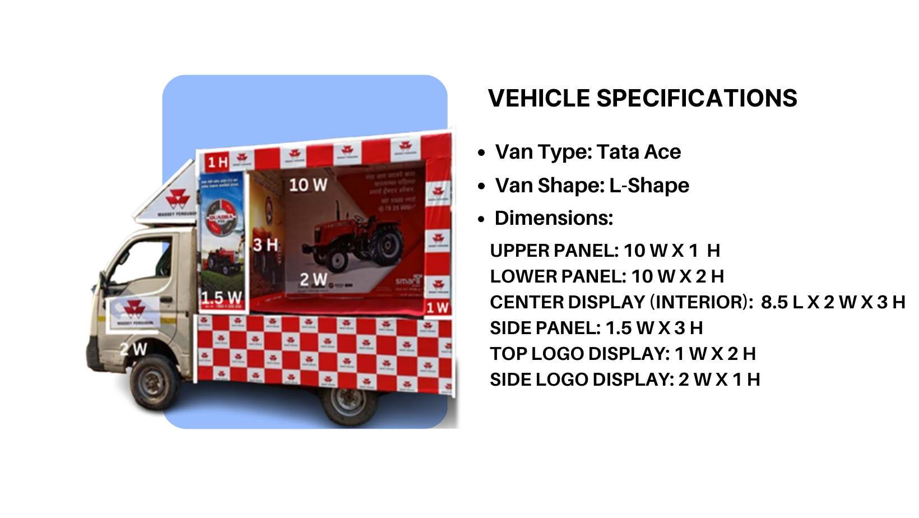

Slide 4











Thank You

