Slide 1
















Digital Screen - Locations

Slide 2
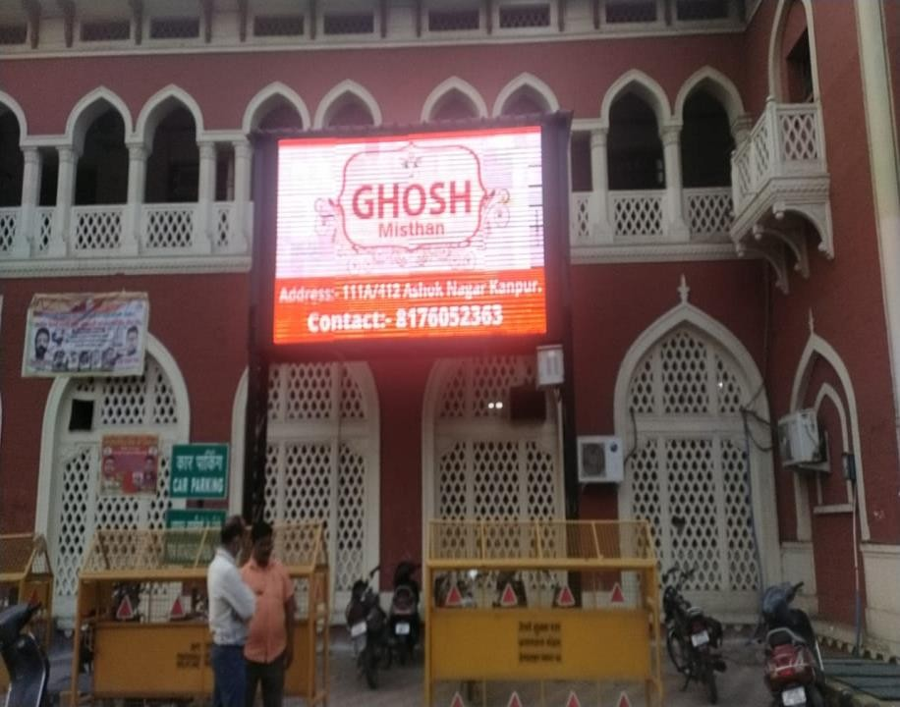
Dimension – 17 W x 7 H Ft., Location – Entry Point Area

Slide 3

Dimension – 17 W x 7 H Ft., Location – Entry Point Area

Slide 4
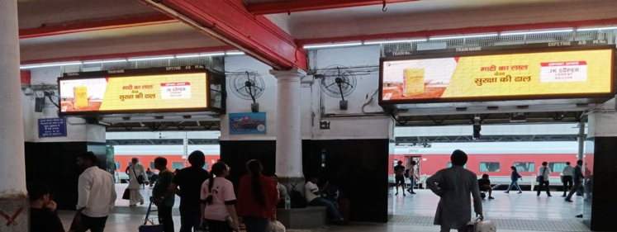
Dimension – 13 W x 3 H Ft., Location – Entry Hall Area

Slide 5
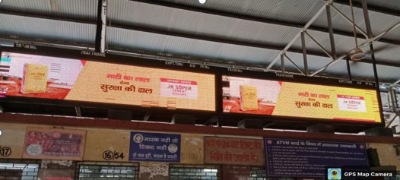
Dimension – 13 W x 3 H Ft., Location – Inside Railway Station

Slide 6











Thank You

