Slide 1
















Kerala AC Bus Dimensions

Slide 2
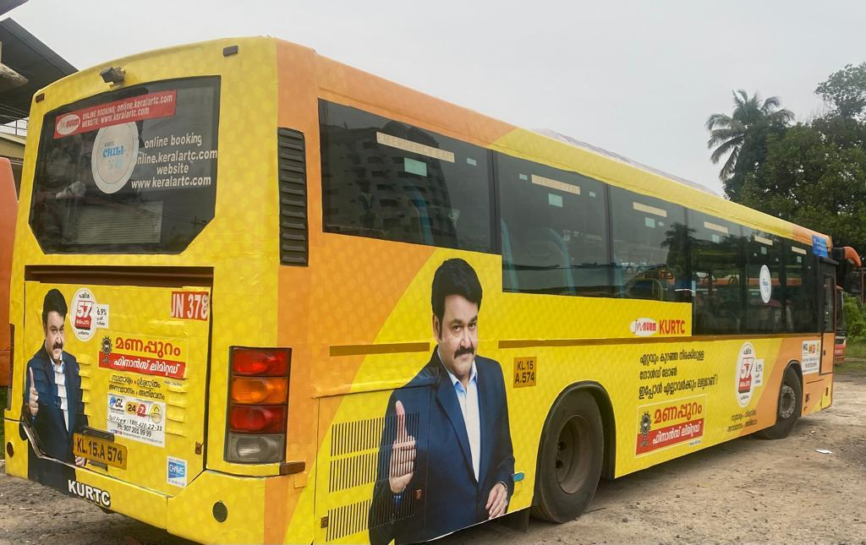
KSTRC Bus External Wrapping
External Wrapping
Size: 750 Sq. Ft

Slide 3











Thank You

