Slide 1
















DIGITAL SCREEN

Slide 2
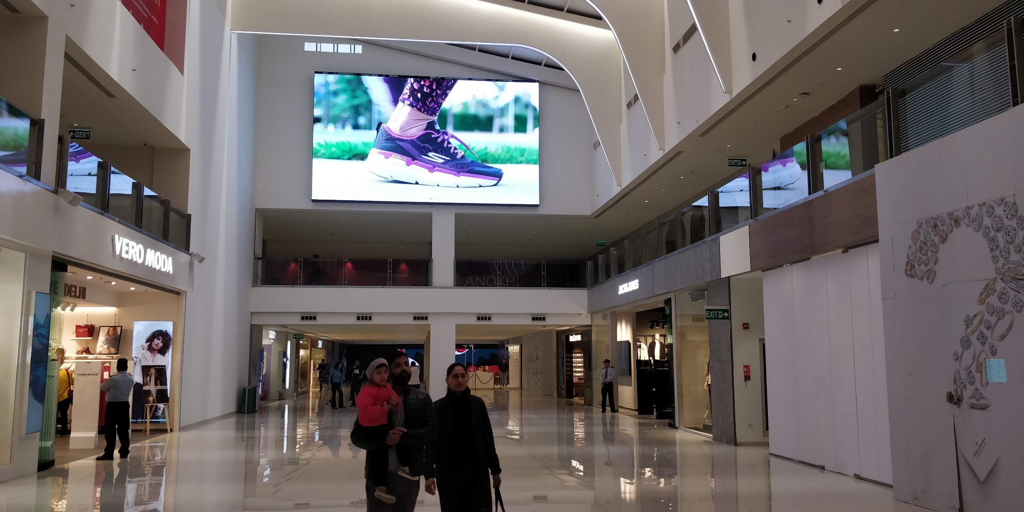
Location – Centre Atrium, Dimension – 26 W X 13 H Ft., Total Unit - 1

Slide 3
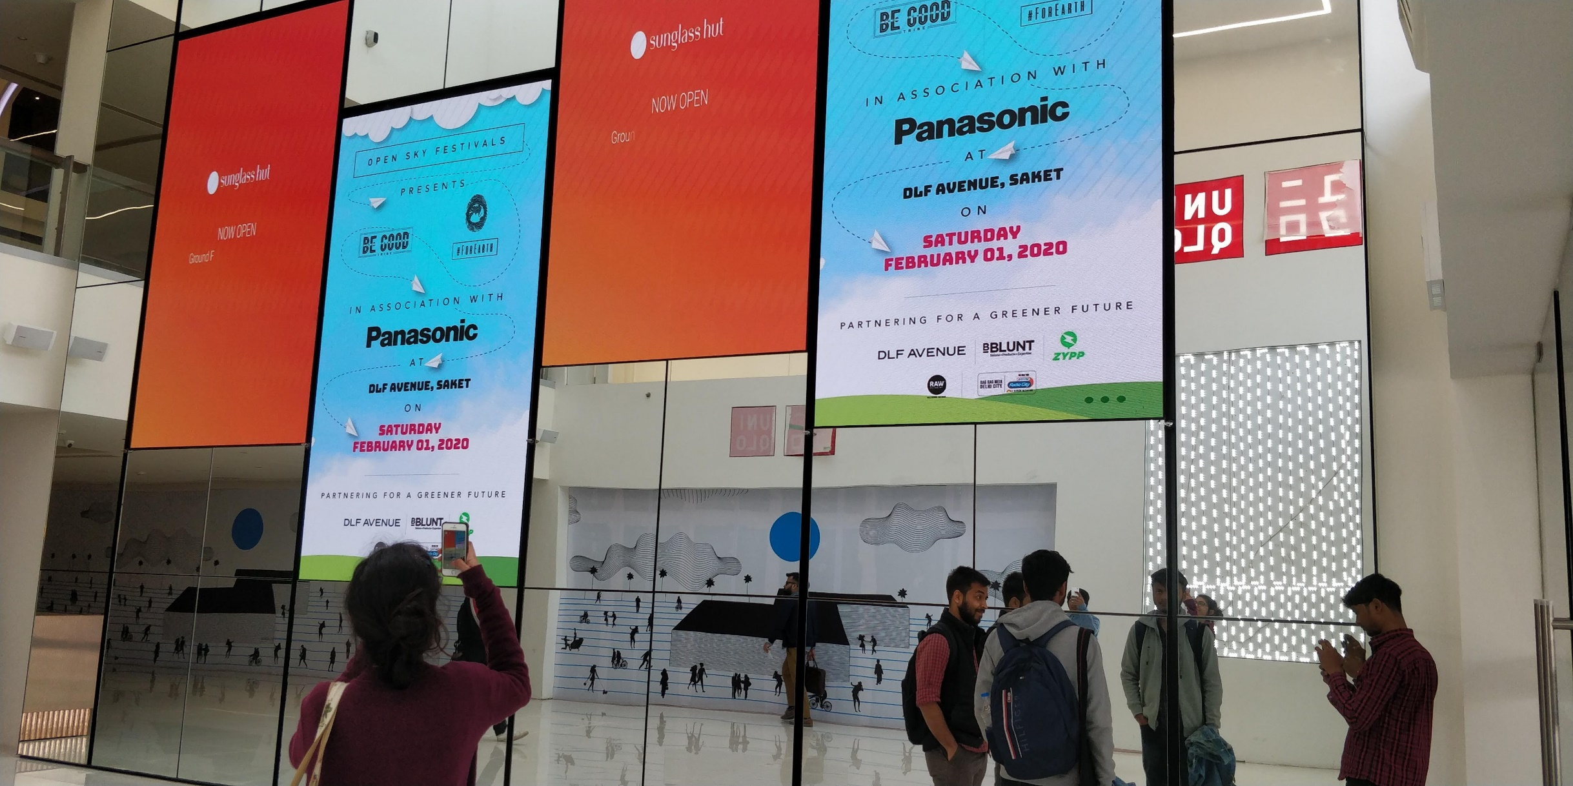
Location - Near Uniqlo Entrance, Dimension – 6.7 W X 11.6 H Ft., Total Unit - 4

Slide 4











Thank You

