Slide 1
















REFERENCE IMAGES

Slide 2
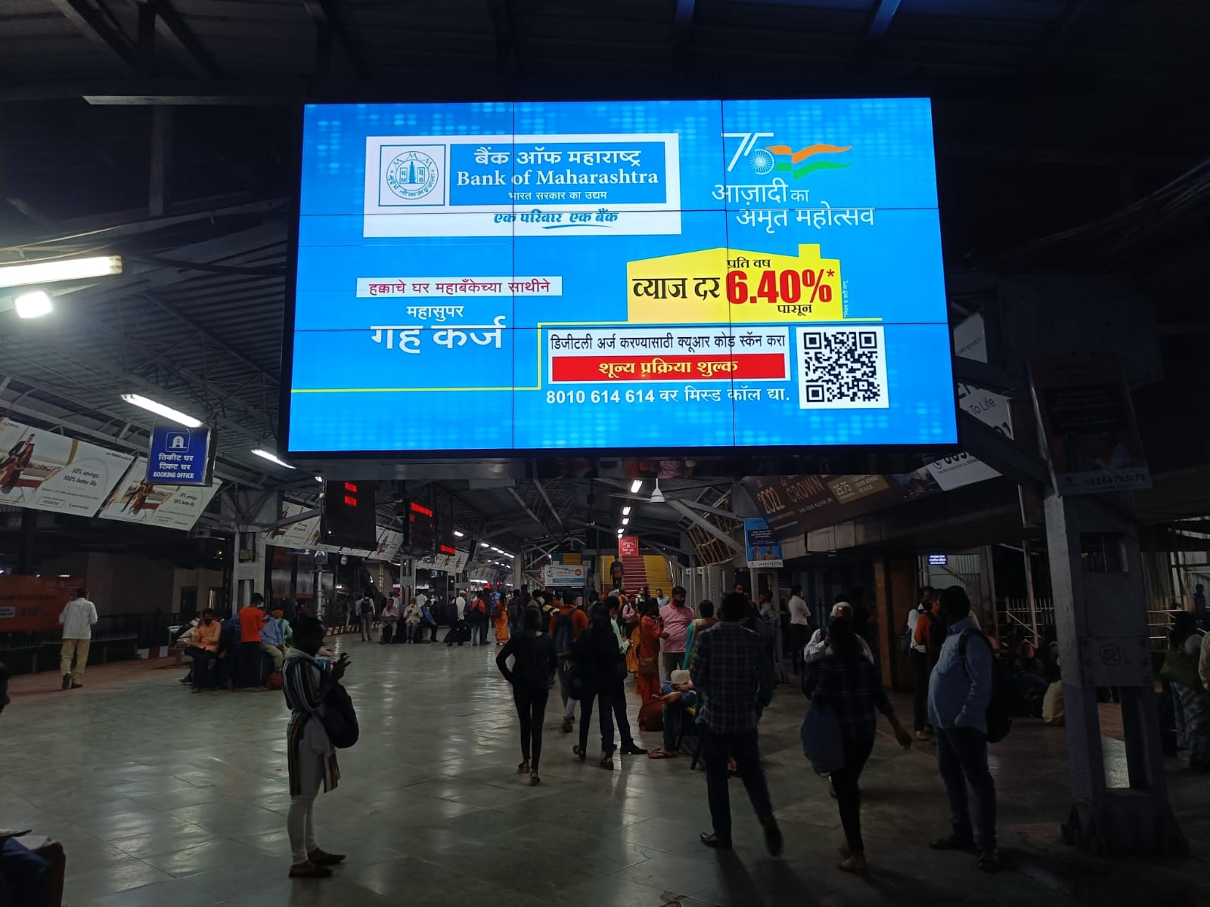
KALYAN STATION – PLATFORM NO1 TICKET COUNTER
http://www.themediaant.com/

Slide 3
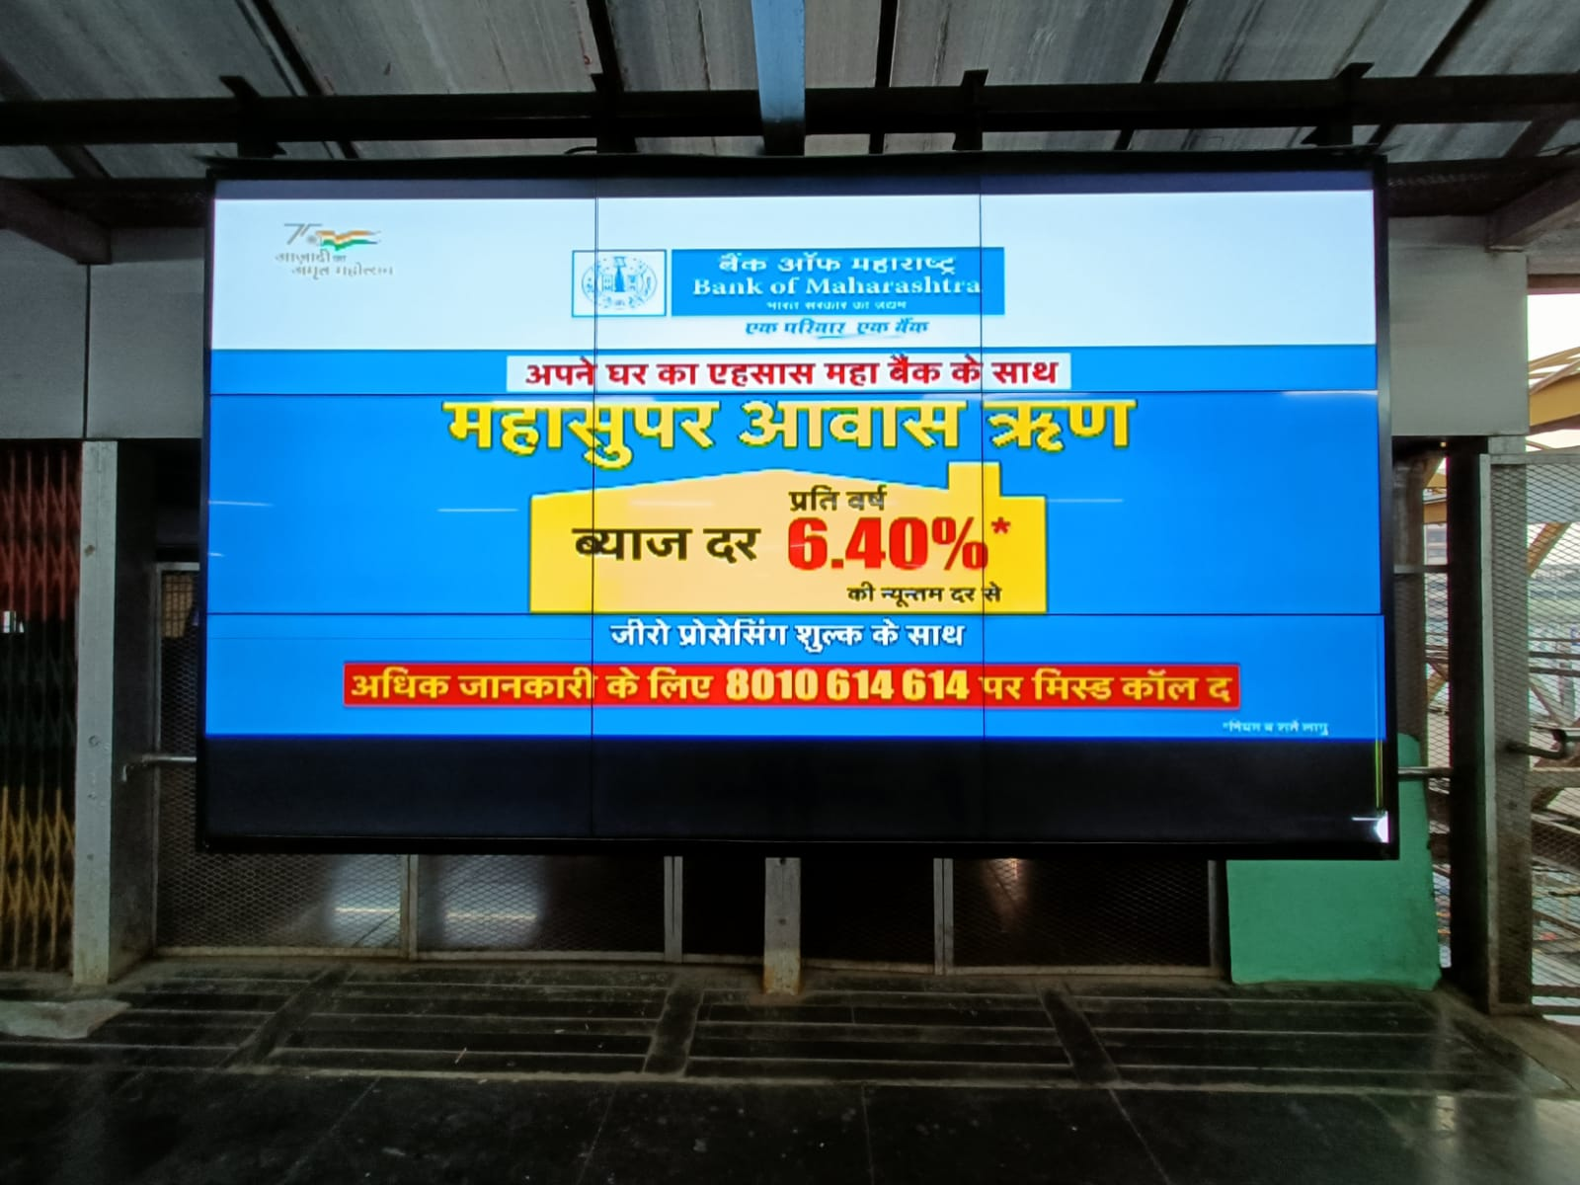
WAITING AREA – OUTSTATION TRAINS
KALYAN STATION – FOOTOVER BRIDGE
WAITING AREA – OUTSTATION TRAINS
http://www.themediaant.com/

Slide 4











Thank You

