Slide 1
















REFERENCE IMAGES

Slide 2
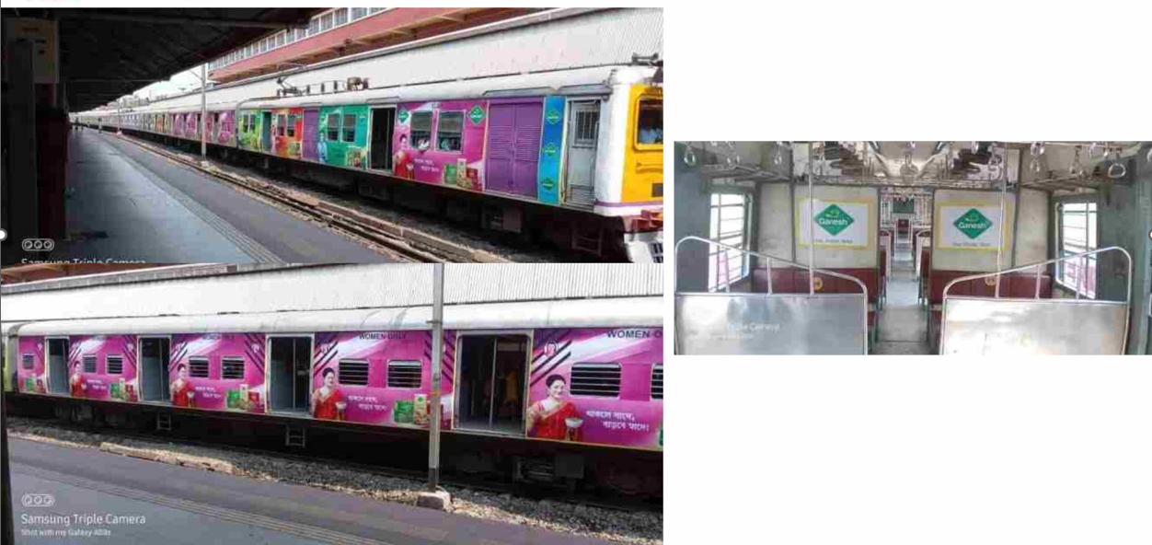
FULL TRAIN BRANDING
http://www.themediaant.com/

Slide 3
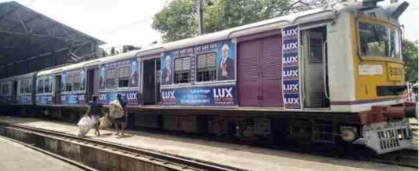
EXTERIOR TRAIN BRANDING
http://www.themediaant.com/

Slide 4
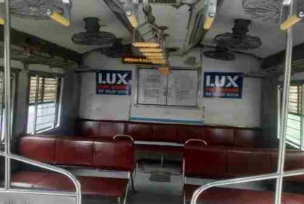
INTERIOR TRAIN BRANDING
http://www.themediaant.com/

Slide 5
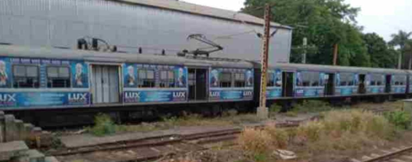
EXTERIOR TRAIN BRANDING
http://www.themediaant.com/

Slide 6
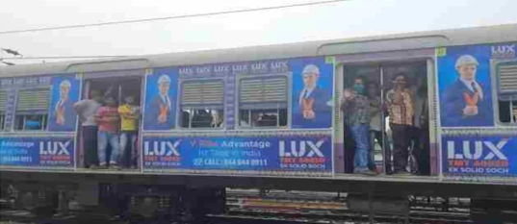
EXTERIOR TRAIN BRANDING
http://www.themediaant.com/

Slide 7
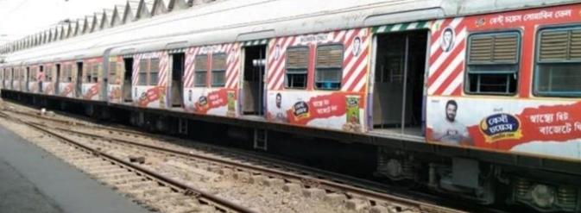
EXTERIOR TRAIN BRANDING
http://www.themediaant.com/

Slide 8
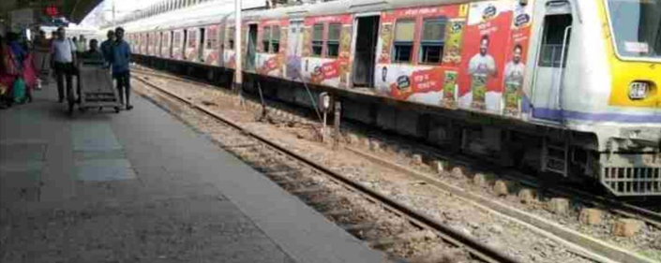
EXTERIOR TRAIN BRANDING
http://www.themediaant.com/

Slide 9











Thank You

