Slide 1
















Back Lit Board

Slide 2
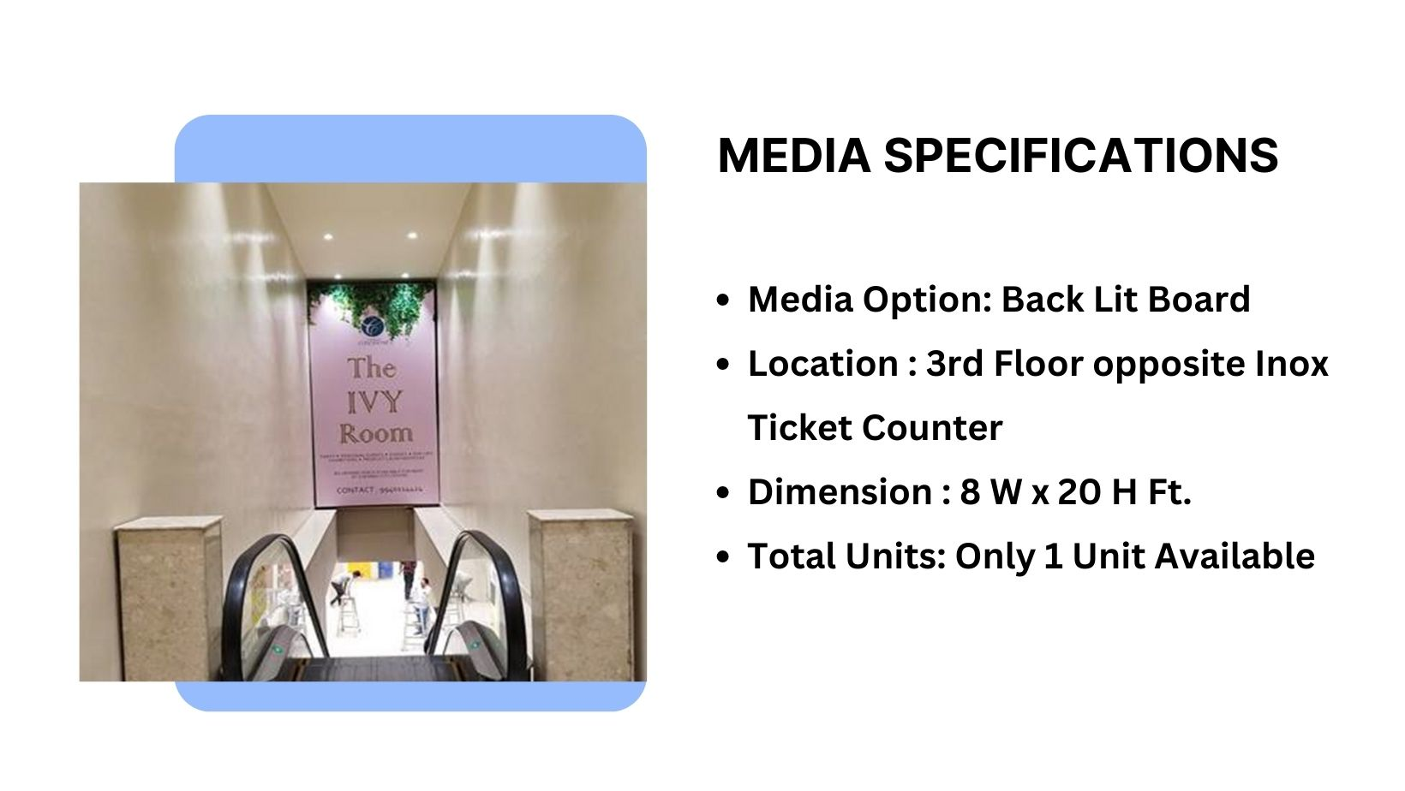
Site Code – T - 06

Slide 3
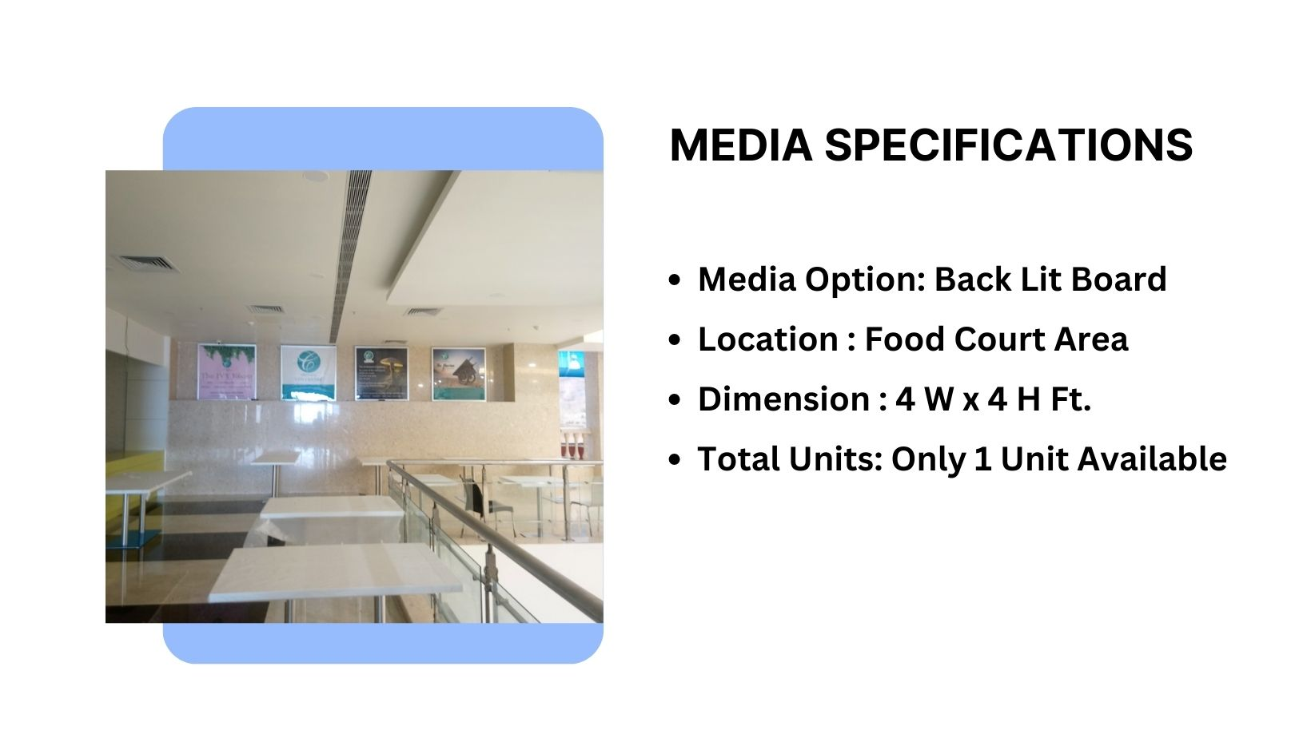
Site Code - M - 05

Slide 4
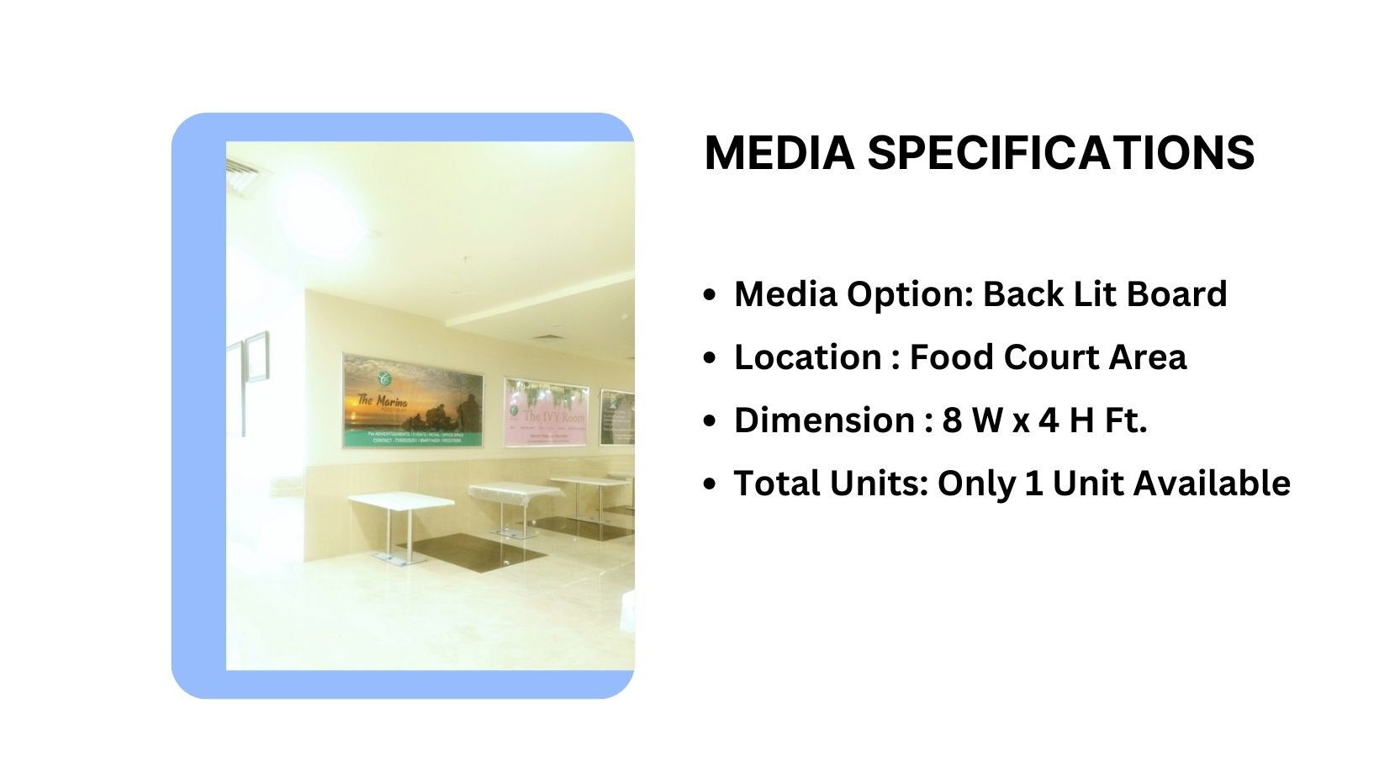
Site Code – M - 04

Slide 5
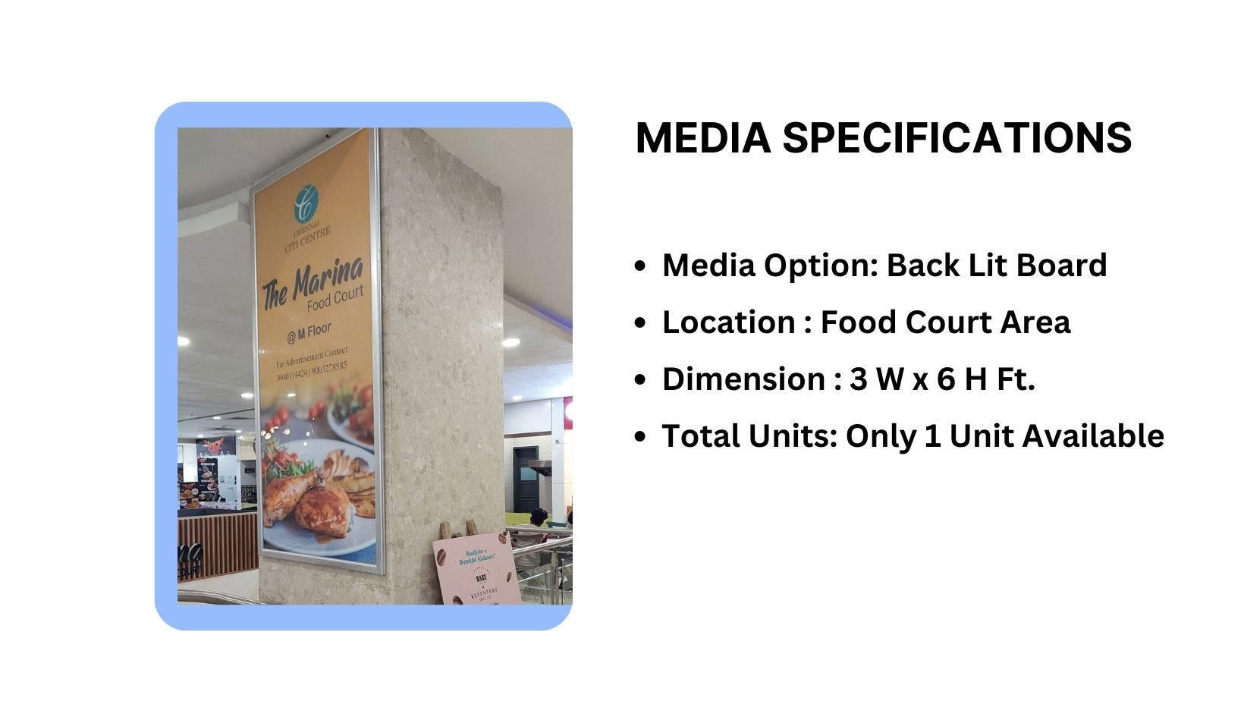
Site Code – M – 01

Slide 6
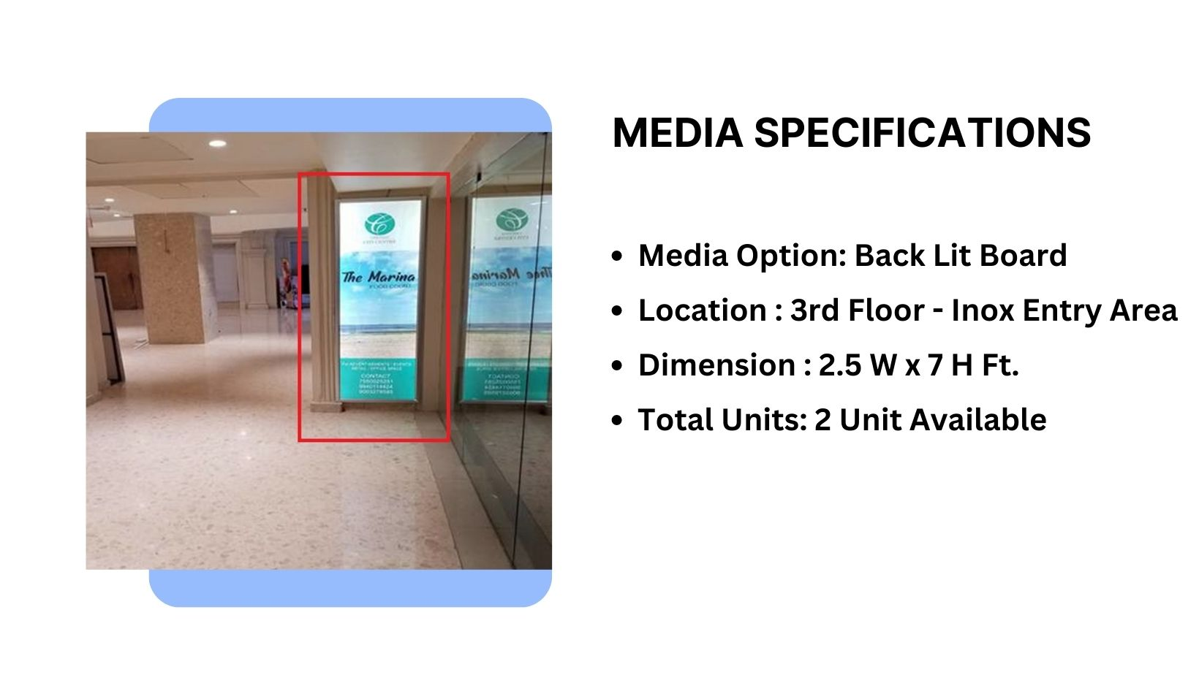
Site Code – T-01, T-02

Slide 7











Thank You

