Slide 1
















Wall - Signage

Slide 2
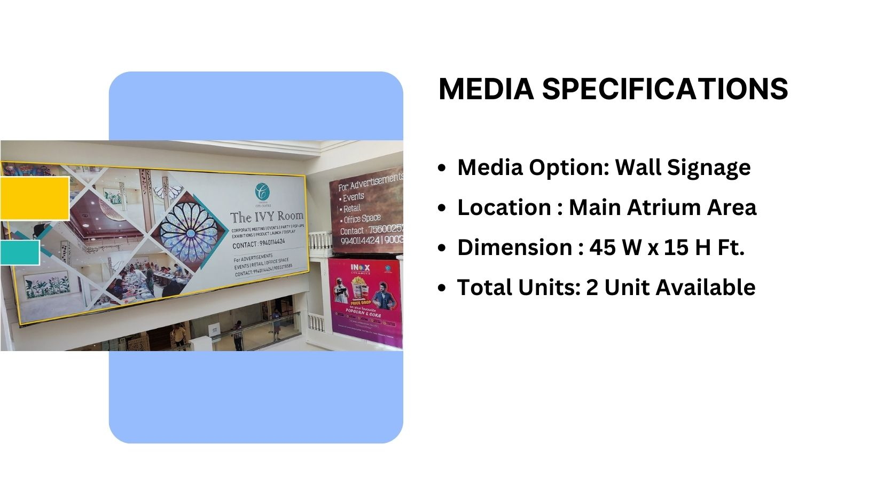
Site Code – ATR – 01 – Top(Flex), ATR – 02 – Top(Flex)

Slide 3
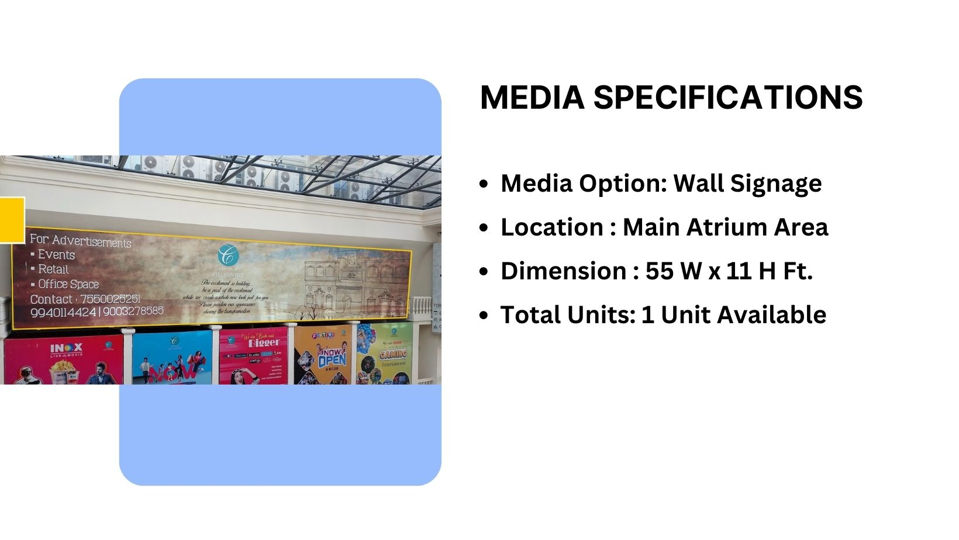
Site Code – ATR – 03 – Top(Flex)

Slide 4
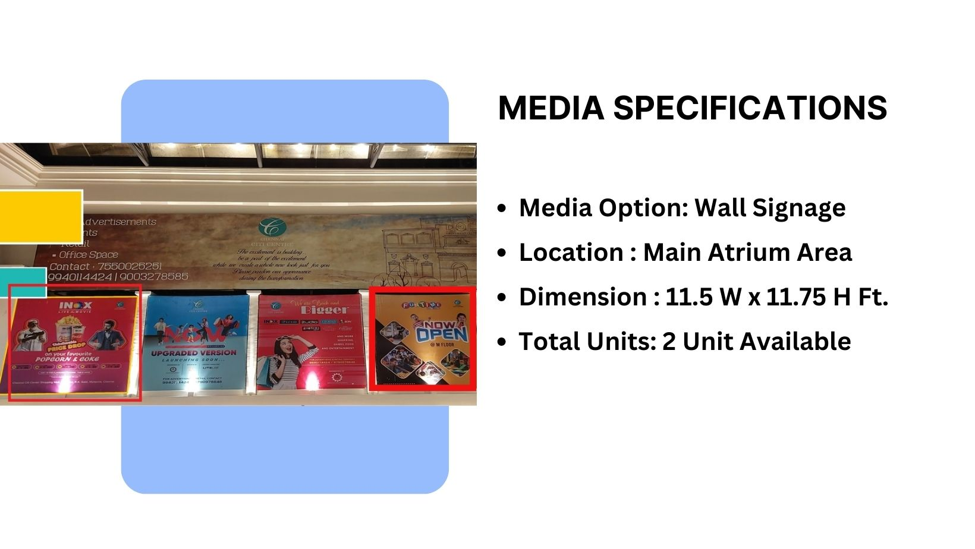
Site Code – ATR – 04 – Top(Flex), ATR – 08 – Top(Flex)

Slide 5
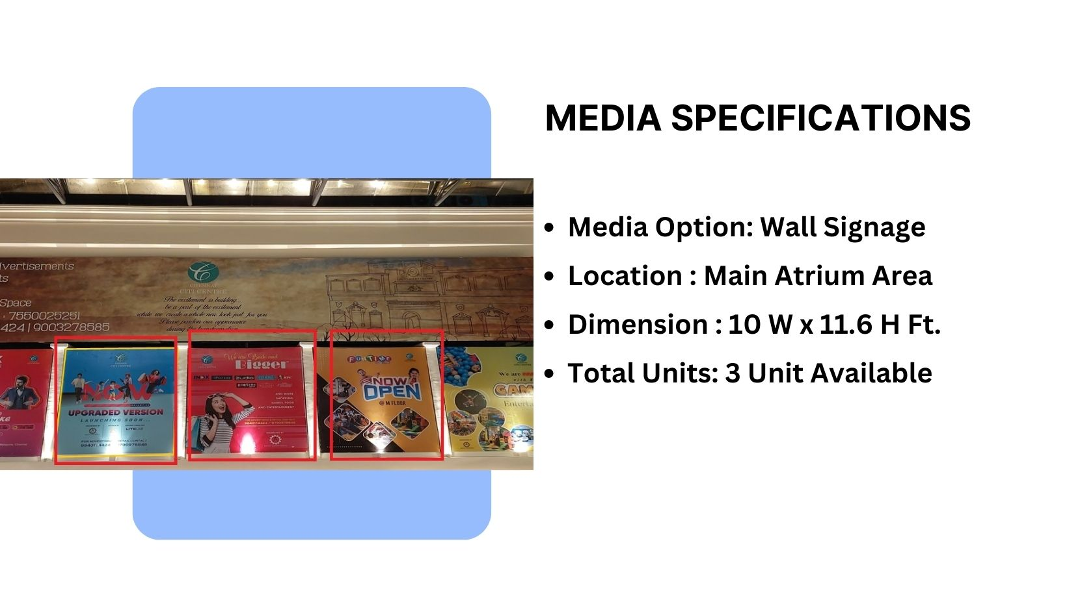
Site Code – ATR – 05,06,07 – Top(Flex)

Slide 6











Thank You

