Slide 1
















Façade Branding

Slide 2
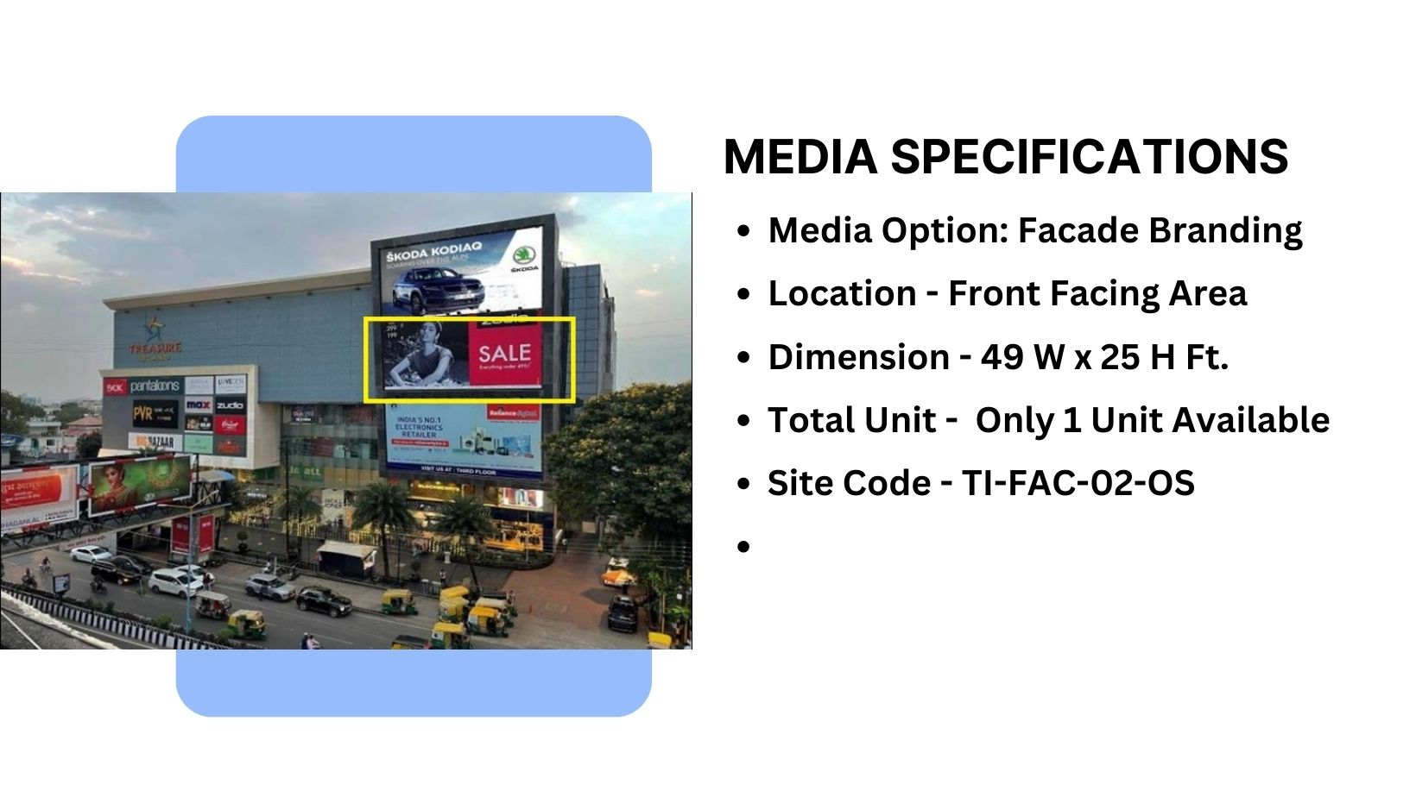
Material used - Flex

Slide 3
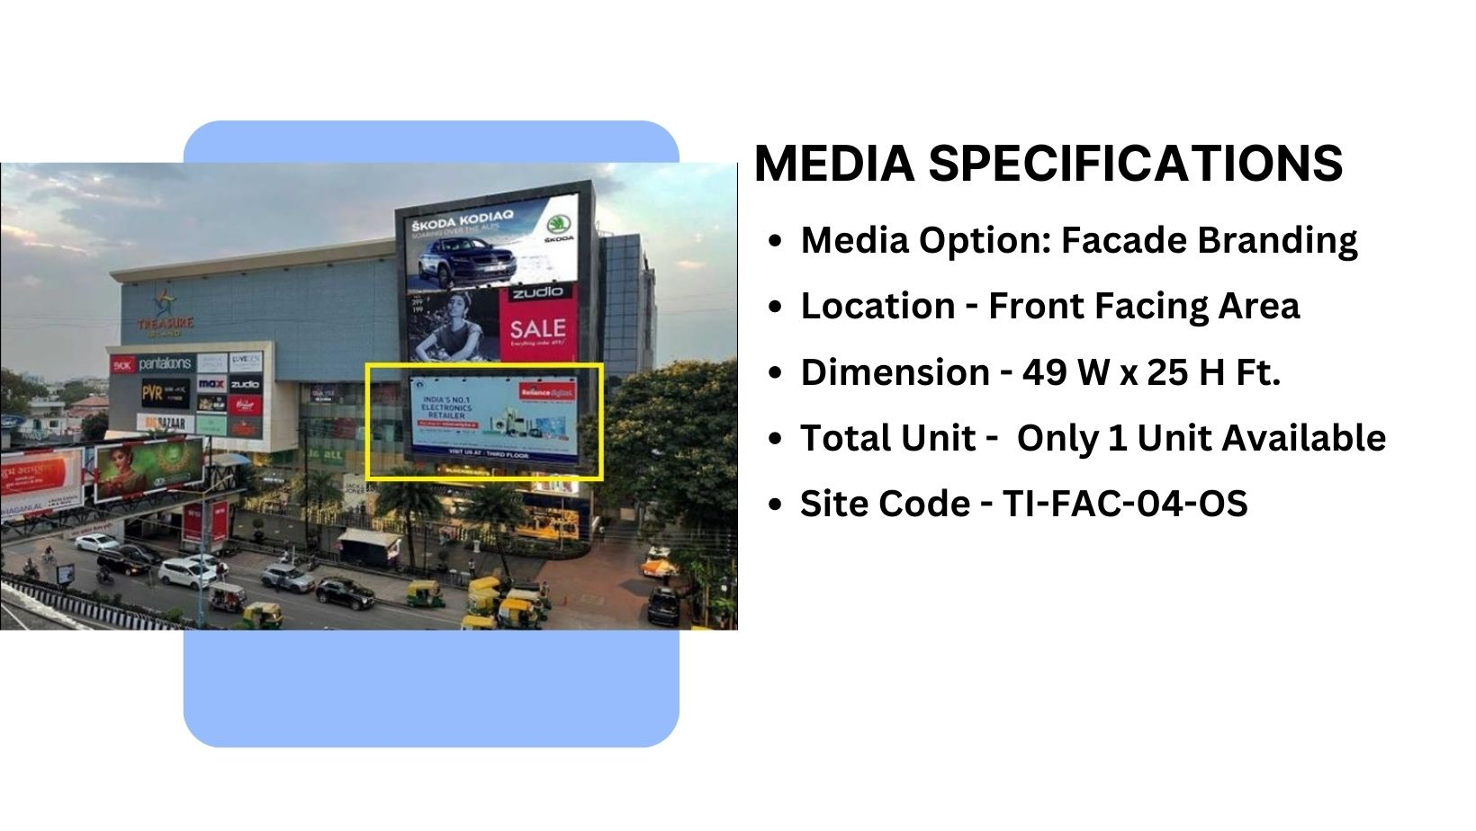
Material used - Flex

Slide 4
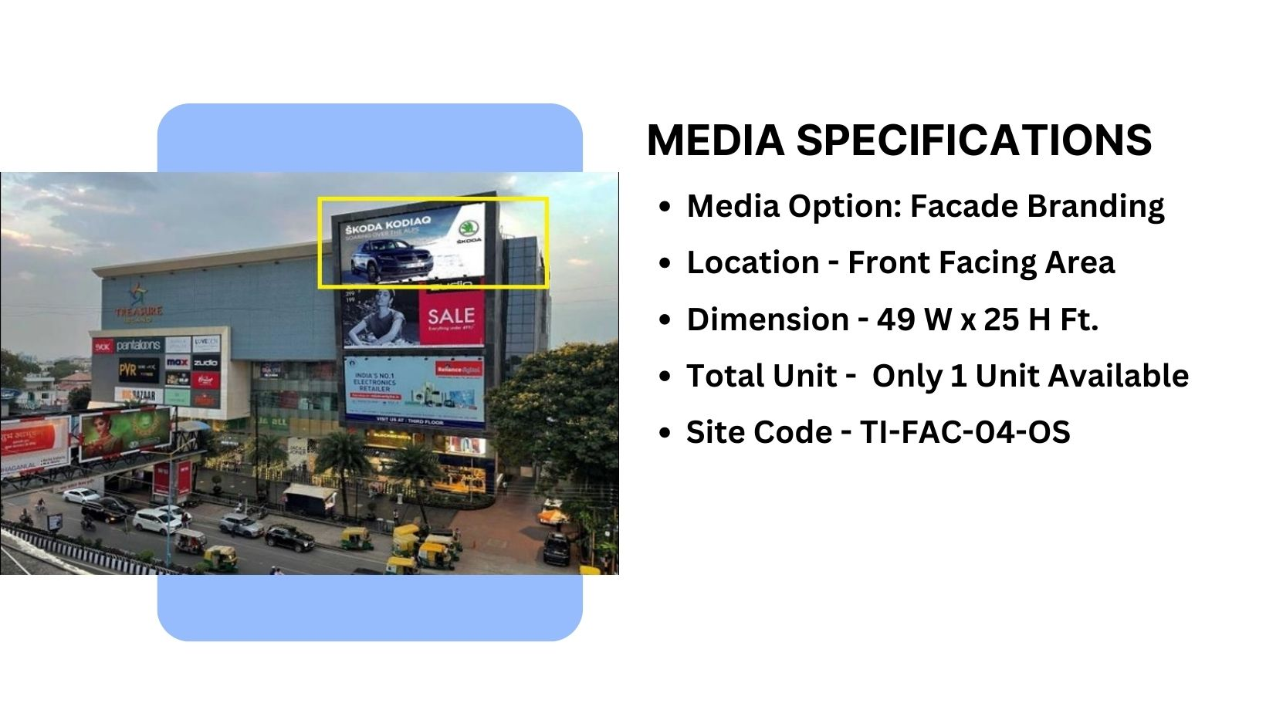
Material used - Flex

Slide 5
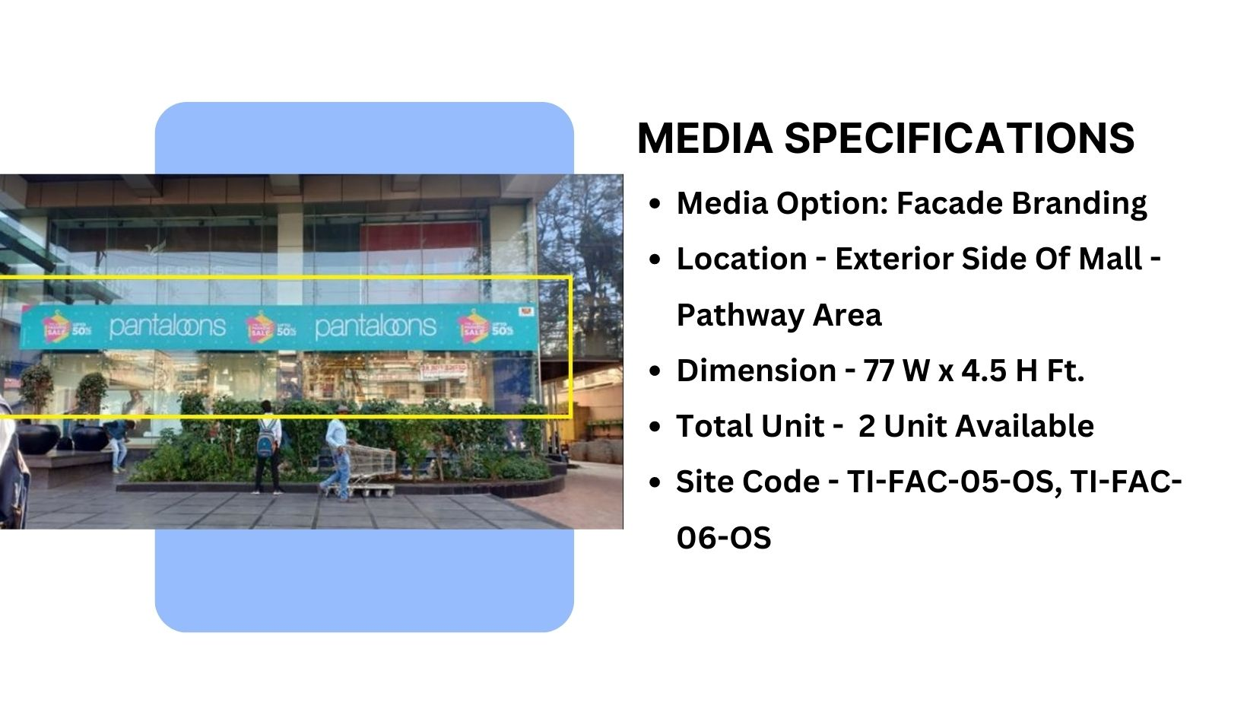
Material used - Vinyl with lamination

Slide 6











Thank You

