Slide 1
















Digital Screen

Slide 2
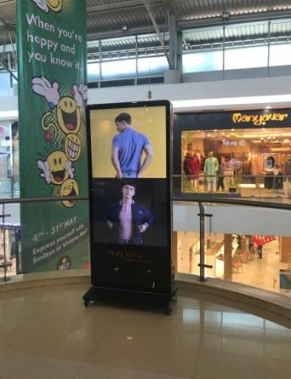
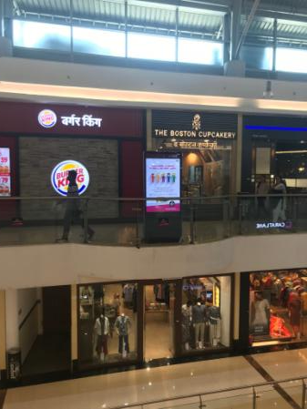
DOUBLE SIDE LED PANEL
Location : In front of Burger King

Slide 3
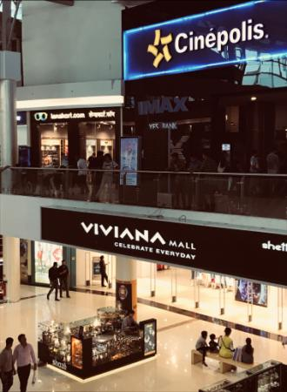
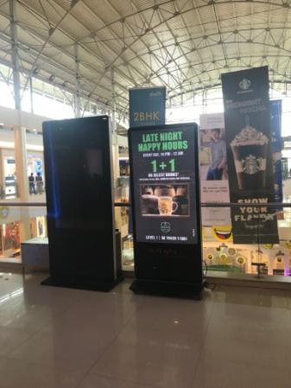
DOUBLE SIDE LED PANEL
Location : In front of Cinepolis

Slide 4
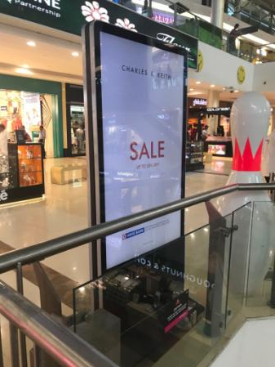
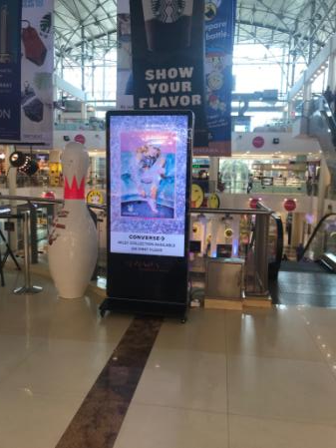
DOUBLE SIDE LED PANEL
Location : In front of Pantaloon

Slide 5
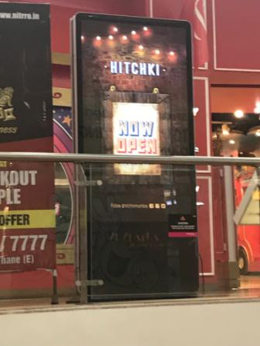
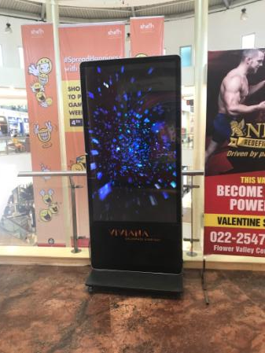
DOUBLE SIDE LED PANEL
Location : In front of Hamleys

Slide 6
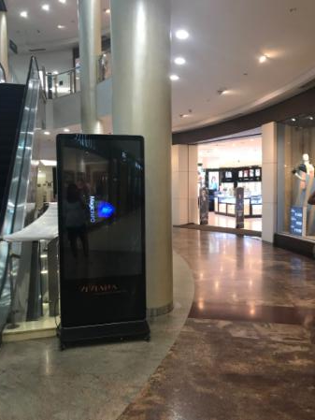
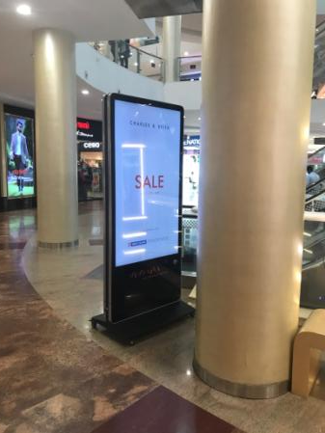
DOUBLE SIDE LED PANEL
Location : In front of Lifestyle

Slide 7
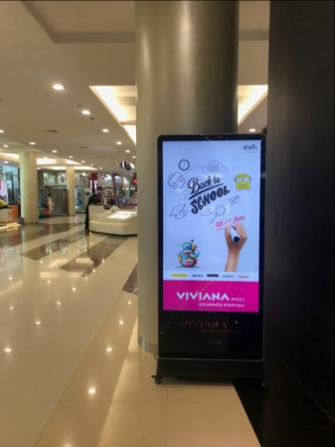
Single LED PANEL
Location : Beside Ethos

Slide 8
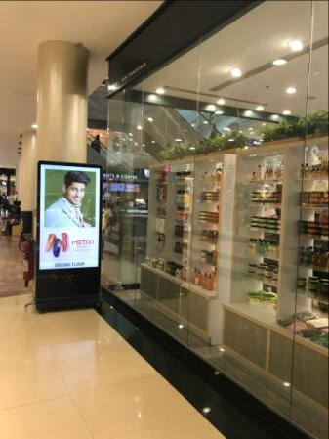
Single LED PANEL
Location : Beside Body shop

Slide 9
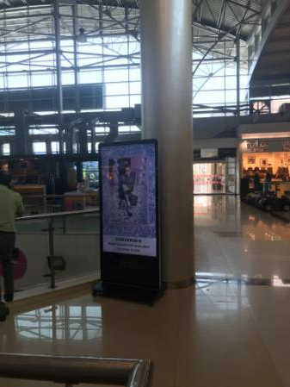
Single LED PANEL
Location : beside hastkala

Slide 10
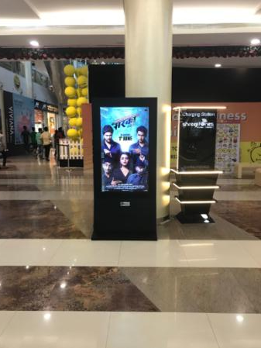
Single LED PANEL
Location : beside Info desk

Slide 11
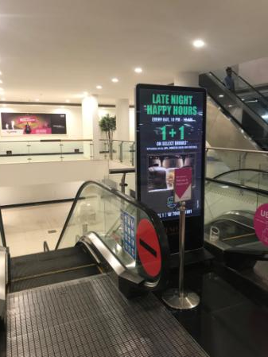
Single LED PANEL
Location : UB – near Mall office

Slide 12
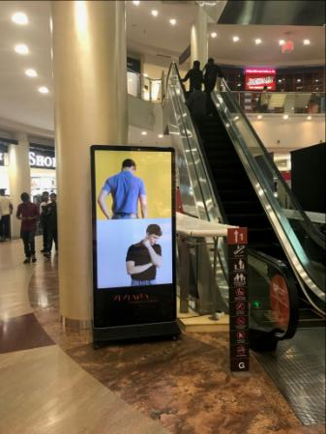
Single LED PANEL
Location : In front of Shoppers stop

Slide 13











Thank You

