Slide 1

Ahmedabad Airport
Hoarding

Slide 2

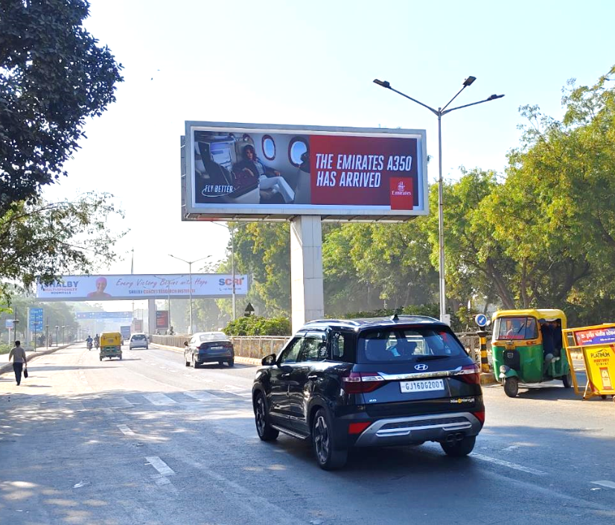

T1 & T2- DOMESTIC + INTERNATIONAL
Departure | Way Of Departure Road | 30 W X 10 H ft (Only 1 Unit) | Back Lit
Hoarding
www.themediaant.com
Notes:
‹#›

Slide 3
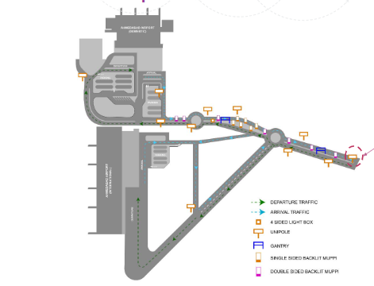
T1 & T2- DOMESTIC + INTERNATIONAL
Departure | Way Of Departure Road | 30 W X 10 H ft (Only 1 Unit) | Back Lit
www.themediaant.com
Notes:
‹#›

Slide 4
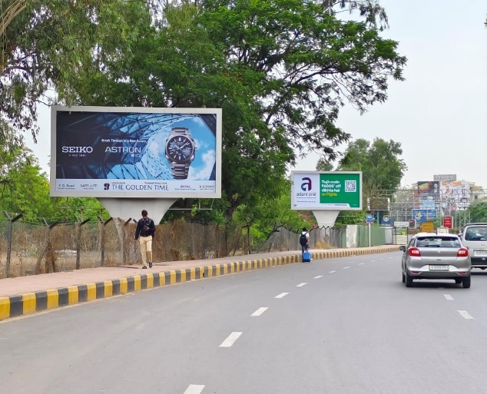
T1- DOMESTIC
Arrival | Exit Road | 20 W X 10 H ft (Only 1 Unit) | Back Lit
Hoarding
www.themediaant.com
Notes:
‹#›

Slide 5
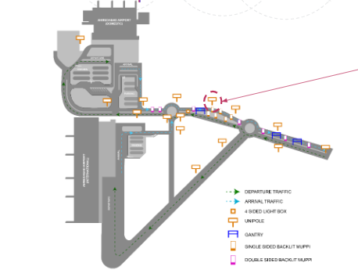
T1- DOMESTIC
Arrival | Exit Road | 20 W X 10 H ft (Only 1 Unit) | Back Lit
www.themediaant.com
Notes:
‹#›

Slide 6





www.themediaant.com
ad@themediaant.com
Thank You
080-067415510
Empowering All To Advertise
Notes:
‹#›

