Slide 1
Bangalore Airport Media Kit

Slide 2
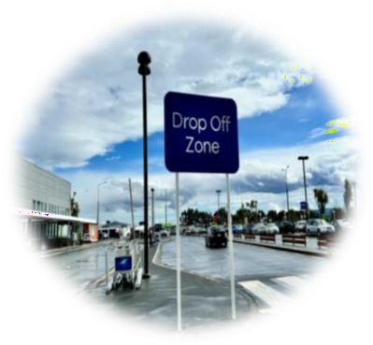

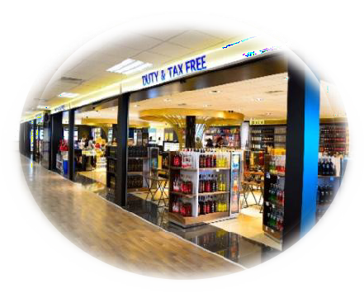

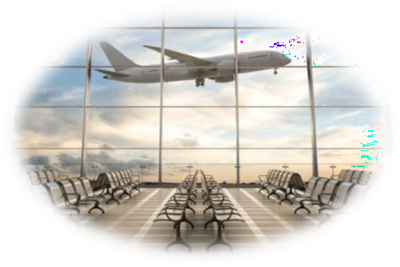
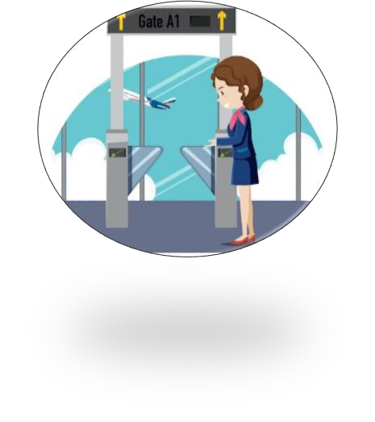


Drop Off
AIRPORT LAYOUT
DEPARTURE
Check In Area
Target travelers and Waiting area Meeters & Greeters.
High Traffic Areas for
Impactful advertising.
Retail Area
Security check Area
Opportunities for ads in shopping & Dinning Zone.
Captive Audience for targeted advertising
Boarding Area/ Lounge
Boarding Gate
High Dwell time area for awareness-based campaign.
Waiting Areas ideal for engagement.
www.themediaant.com

Slide 3
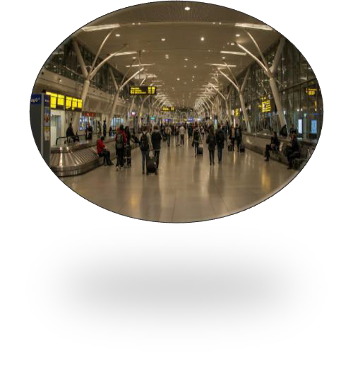
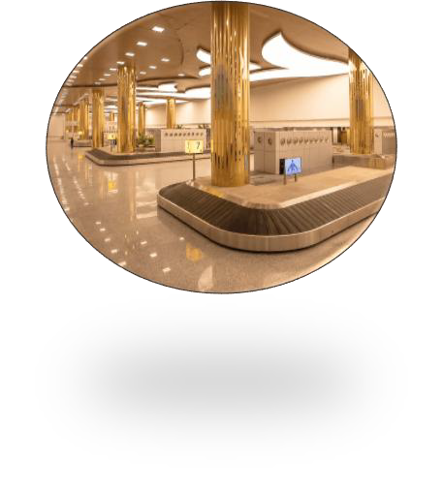
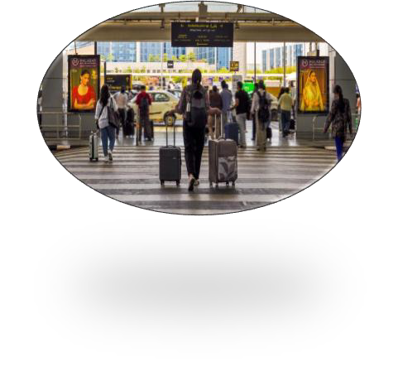
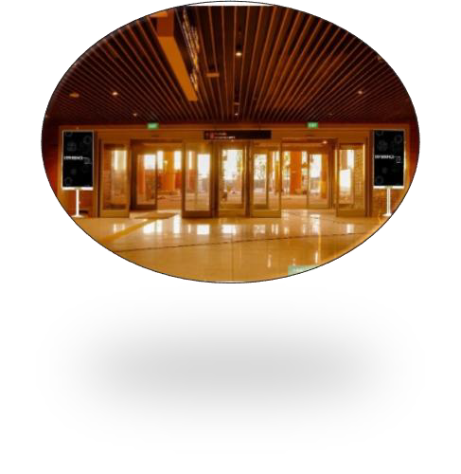
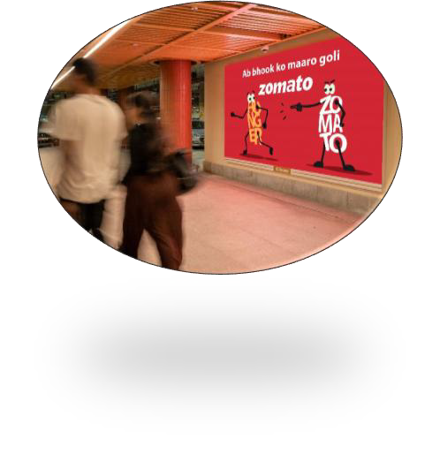
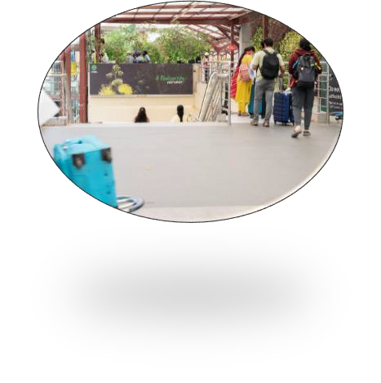
Arrival Hall
LAYOUT
Baggage Belt
Welcoming spaces for arrival focused advertisement .
High Traffic & High Dwell time area for awareness-based campaign.
ARRIVAL
AIRPORT
Meet & Greet Area
Exit Gate
Unique and large screen brand placement
100 % Arriving passenger coverage – Impact placement
Parking
Bus / Taxi Pick
Up
www.themediaant.com

Slide 4
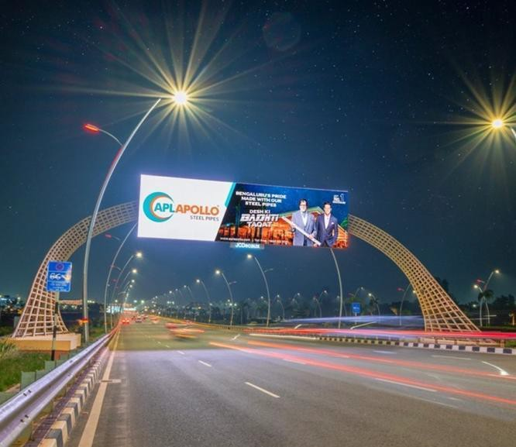

T1&2 - DOMESTIC + INTERNATIONAL
DEPATURE | DEPATURE OUTDOOR ACCESS ROAD | 53 W x 13 H FT – 1920 x 540 PX (Only 1 Unit) | 10 Sec In Every 1 Min
Digital Gantry
Rental Cost | 27,37,000 P/M Per Slot
Production Cost | 11,800
www.themediaant.com

Slide 5

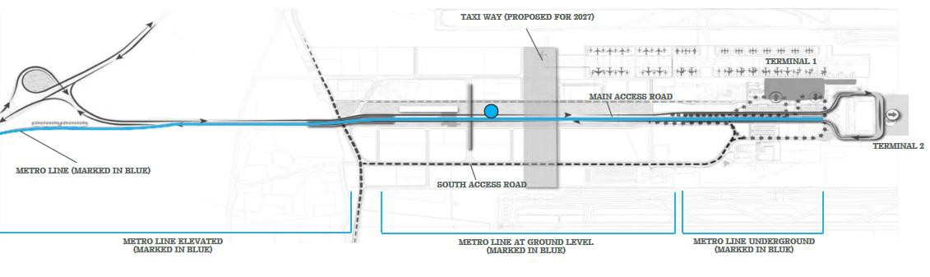
T1&2 - DOMESTIC + INTERNATIONAL
DEPATURE | DEPATURE OUTDOOR ACCESS ROAD | 53 W x 13 H FT – 1920 x 540 PX (Only 1 Unit) | 10 Sec In Every 1 Min
www.themediaant.com

Slide 6
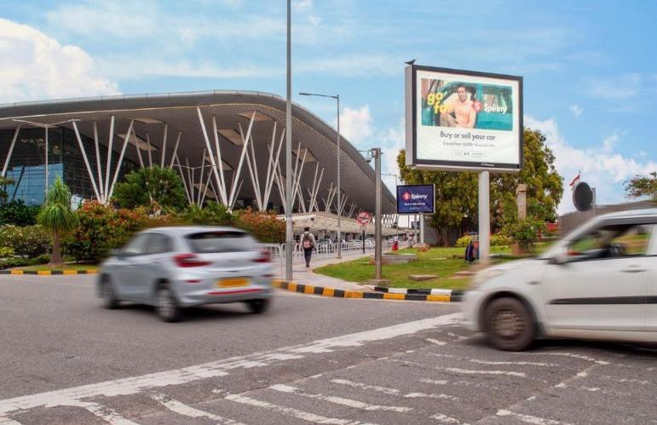
T1&2 - DOMESTIC + INTERNATIONAL
DEPATURE | DEPATURE OUTDOOR MAIN APPROACH ROAD | 10.2 W x 7.5 H FT (Package of 3 Units) | BACKLIT
Hoarding
Rental Cost | 18,00,000 P/M
Production Cost | 1,50,000
www.themediaant.com

Slide 7
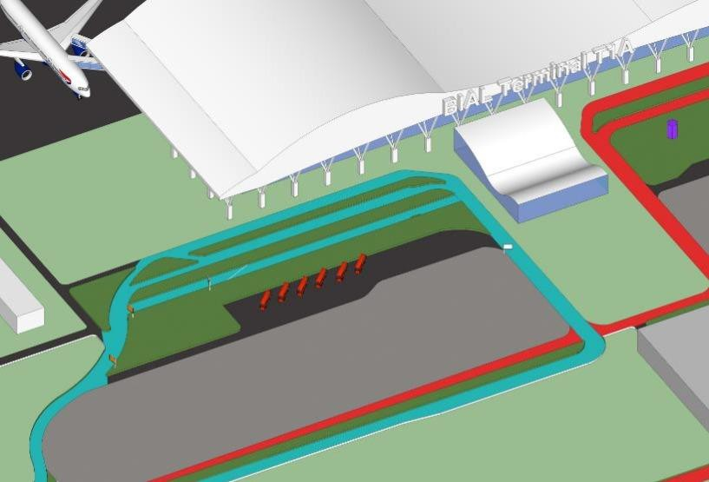



T1&2 - DOMESTIC + INTERNATIONAL
DEPATURE | DEPATURE OUTDOOR MAIN APPROACH ROAD | 10.2 W x 7.5 H FT (Package of 3 Units) | BACKLIT
www.themediaant.com

Slide 8
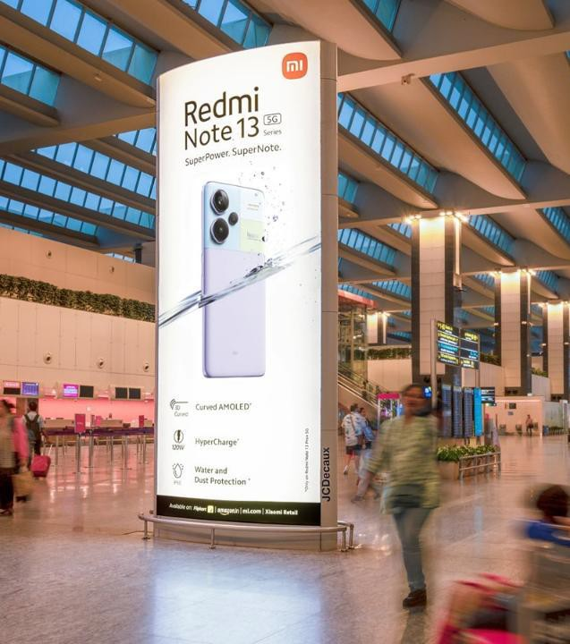
T1 - DOMESTIC
DEPATURE | CHECK IN HALL | 17.3 W X H 7.5 FT (Only 1 Unit) | BACKLIT
Static Totem Double Sided
Rental Cost | 17,62,000 P/M
Production Cost | 49,800
www.themediaant.com

Slide 9
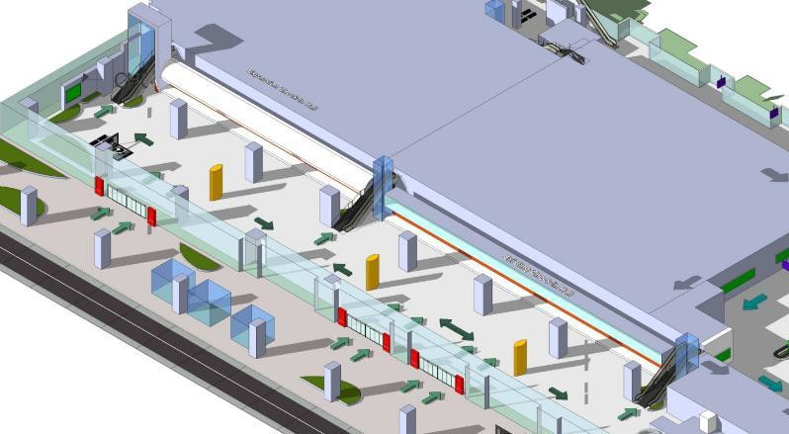


T1 - DOMESTIC
DEPATURE | CHECK IN HALL | 17.3 W X H 7.5 FT (Only 1 Unit) | BACKLIT
www.themediaant.com

Slide 10
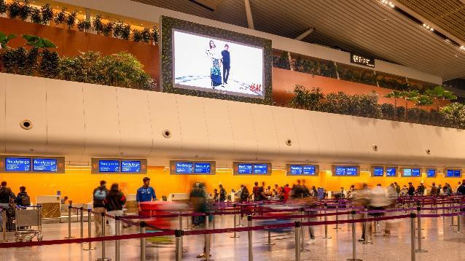
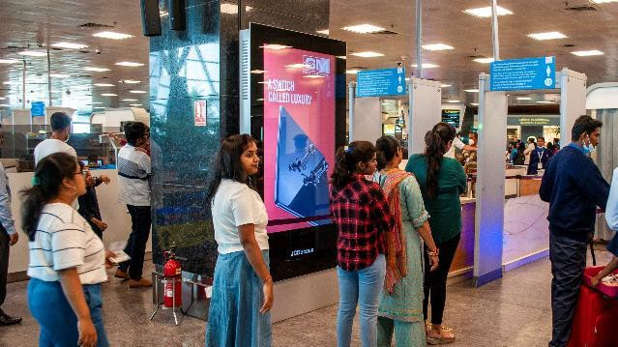
T1 - DOMESTIC
DEPATURE | CHECK IN + SECURITY CHECK | 20 W X H 10 FT & 70 INCHES - 1440 x 720 PX & 1080 x 1920 PX (Package of 5 Units) | 10 Sec In Every 1 Min
Digital Wall
Rental Cost | 13,60,000 P/M Per Slot
Production Cost | 14,200
www.themediaant.com

Slide 11


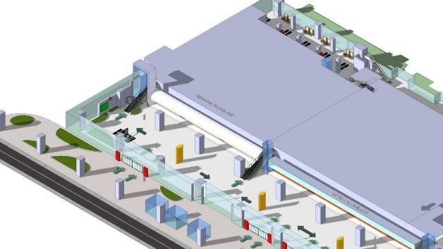

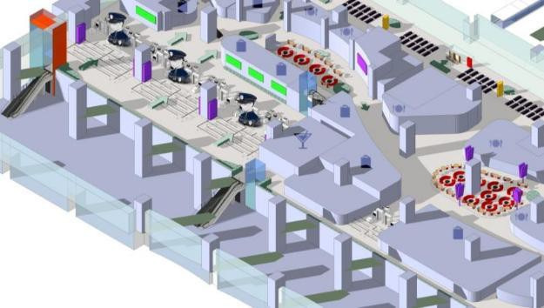




T1 - DOMESTIC
DEPATURE | CHECK IN + SECURITY CHECK | 20 W X H 10 FT & 70 INCHES - 1440 x 720 PX & 1080 x 1920 PX (Package of 5 Units) | 10 Sec In Every 1 Min
www.themediaant.com

Slide 12
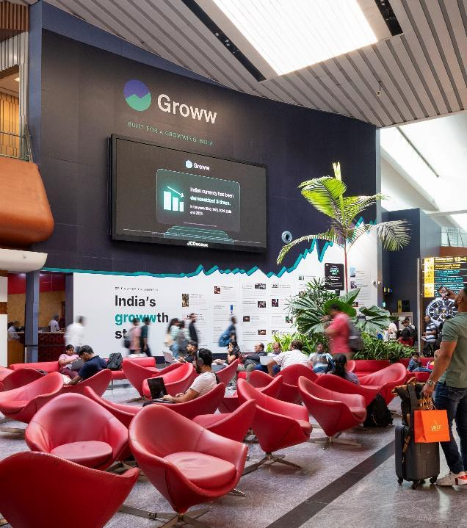
T1 - DOMESTIC
DEPATURE | RETAIL AREA | 20 W X H 10 FT – 1920 x 960 PX (Only 1 Unit) | 10 Sec In Every 1 Min
Digital Wall
Rental Cost | 20,25,000 P/M Per Slot
Production Cost | 14,200
www.themediaant.com

Slide 13
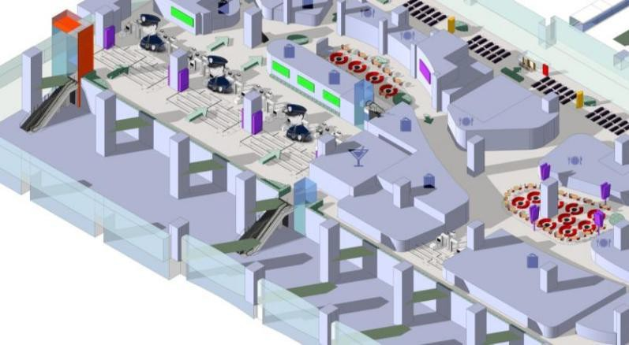
T1 - DOMESTIC
DEPATURE | RETAIL AREA | 20 W X H 10 FT – 1920 x 960 PX (Only 1 Unit) | 10 Sec In Every 1 Min
www.themediaant.com

Slide 14
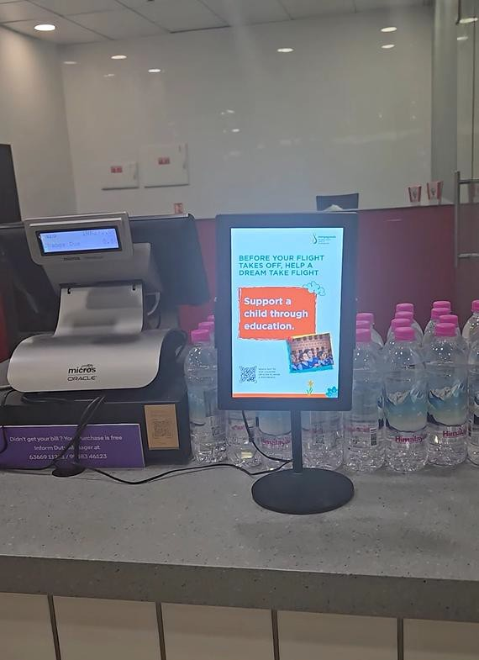
T1&2 - DOMESTIC + INTERNATIONAL
DEPATURE | RETAIL STORE | 10 Inches – 1920 x 1200 PX (Package of 230 Units) | 12 Sec In Every 1 Min
Digital Tablet
Rental Cost | 10,00,000 P/M Per Slot
Production Cost | As Per Actual
www.themediaant.com

Slide 15
T1&2 - DOMESTIC + INTERNATIONAL
DEPATURE | RETAIL STORE | 10 Inches – 1920 x 1200 PX (Package of 230 Units) | 12 Sec In Every 1 Min
www.themediaant.com

Slide 16
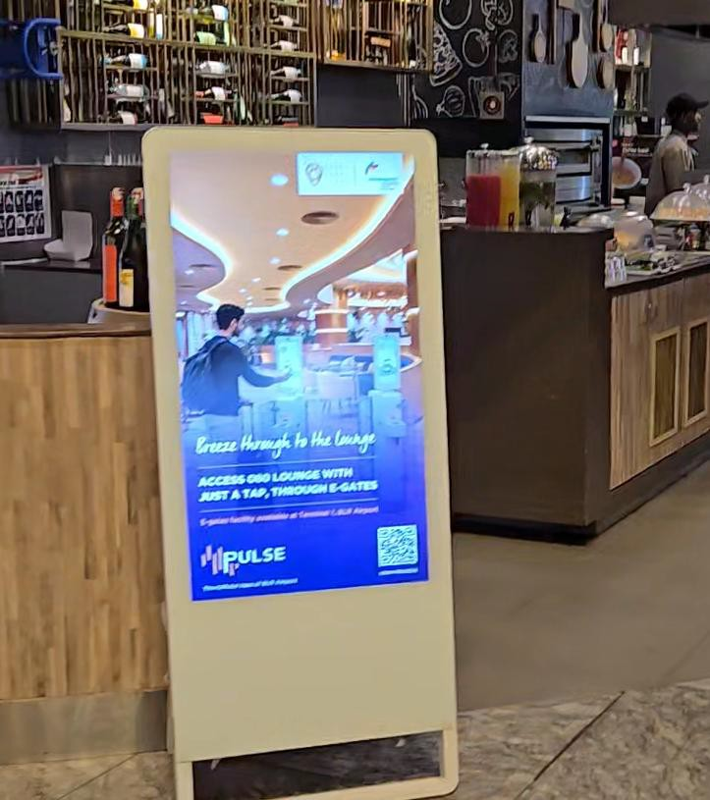
T1&2 - DOMESTIC + INTERNATIONAL
DEPATURE | RETAIL AREA | 32 Inches – 1920 x 1080 PX (Package of 76 Units) | 12 Sec In Every 1 Min
Digital Standee
Rental Cost | 15,00,000 P/M Per Slot
Production Cost | As Pe Actual
www.themediaant.com

Slide 17
T1&2 - DOMESTIC + INTERNATIONAL
DEPATURE | RETAIL AREA | 10 Inches – 1920 x 1080 PX (Package of 76 Units) | 12 Sec In Every 1 Min
www.themediaant.com

Slide 18
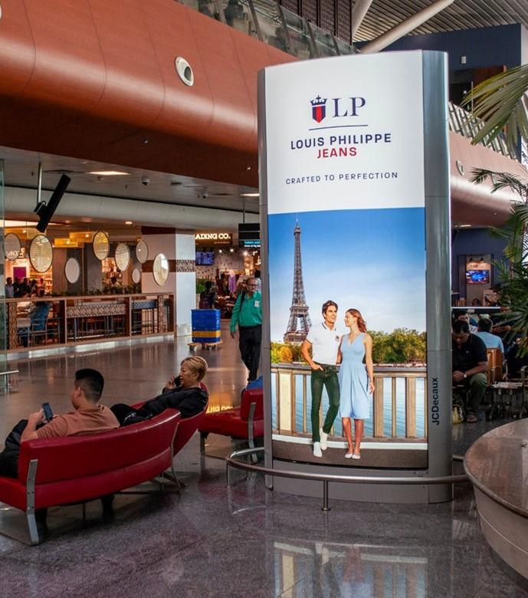

T1 - DOMESTIC
DEPATURE | BOARDING GATE WAITING AREA | 10.4 W X H 4.8 FT (Package of 4 Units) | BACKLIT
Static Mini Totem Double Sided
Rental Cost | 40,00,000 P/M
Production Cost | 53,200
www.themediaant.com

Slide 19


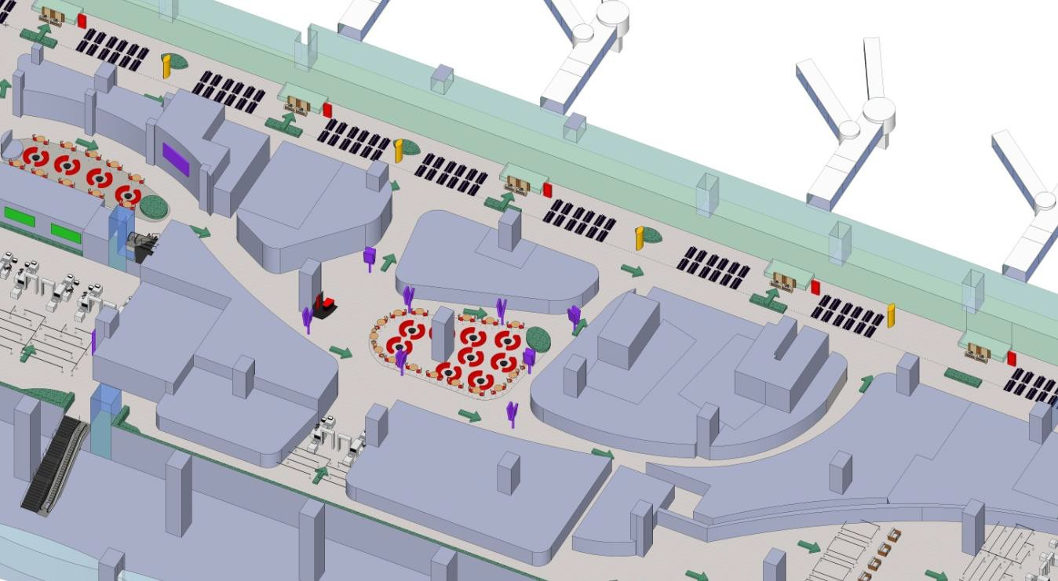

T1 - DOMESTIC
DEPATURE | BOARDING GATE WAITING AREA | 10.4 W X H 4.8 FT (Package of 4 Units) | BACKLIT
www.themediaant.com

Slide 20
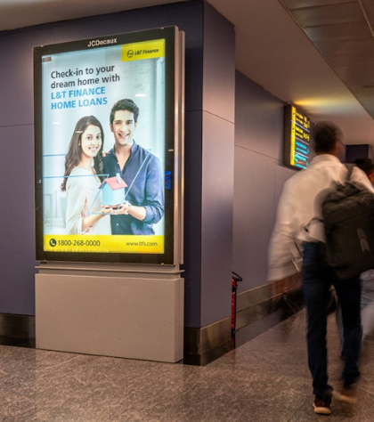
T1 - DOMESTIC
DEPATURE | BOARDING LOUNGE | 4 W X 6 H FT (Package of 22 Units) | 10 Sec In Every 40 Sec
Digital Pod
Rental Cost | 23,50,000/- P/M Per Slot
Production Cost | 97,728/-
www.themediaant.com

Slide 21
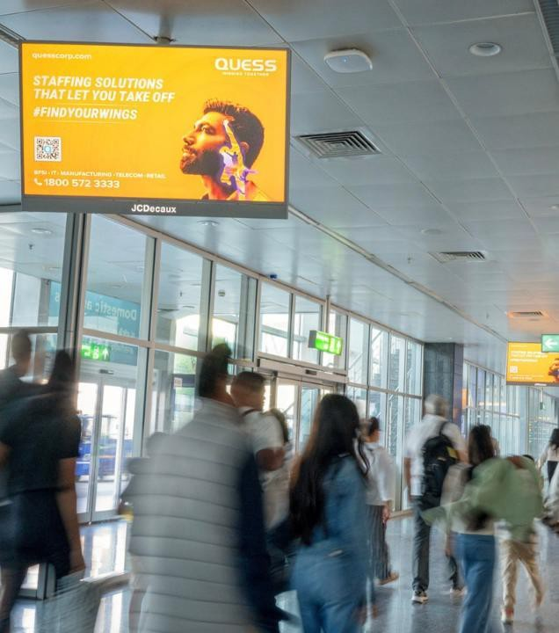
T1 - DOMESTIC
ARRIVAL | ARRIVAL HALL | 20 W X H 10 FT – 1920 x 1080 PX (Package of 8 Units) | 10 Sec In Every 1 Min
Digital TV
Rental Cost | 6,16,000 P/M Per Slot
Production Cost | 14,200
www.themediaant.com

Slide 22
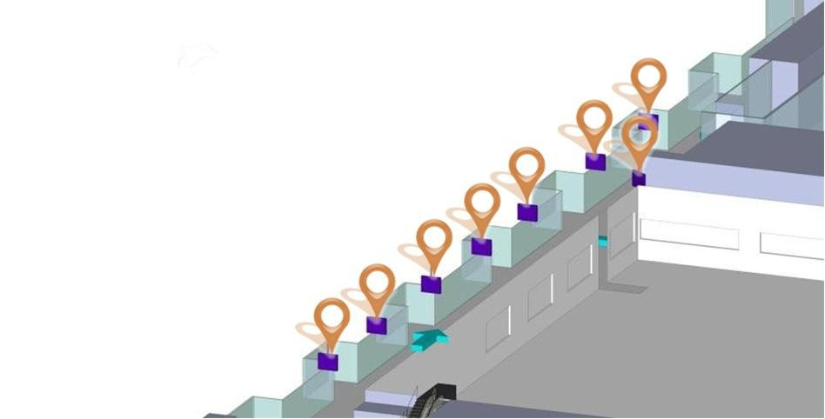
T1 - DOMESTIC
ARRIVAL | ARRIVAL HALL | 20 W X H 10 FT – 1920 x 1080 PX (Package of 8 Units) | 10 Sec In Every 1 Min
www.themediaant.com

Slide 23
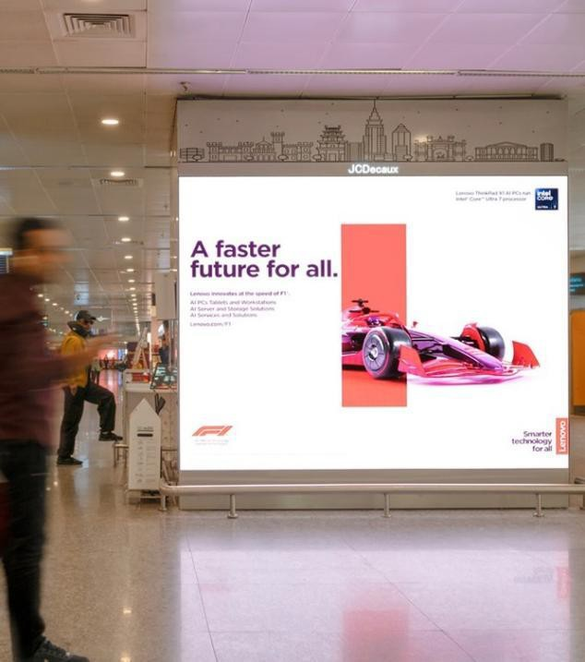

T1 - DOMESTIC
ARRIVAL | BAGGAGE BELT | 10 W X H 10 FT – 1280 x 1024 PX (Package of 2 Units) | 10 Sec In Every 1 Min
Digital Wall
Rental Cost | 26,25,000 P/M Per Slot
Production Cost | 14,200
www.themediaant.com

Slide 24
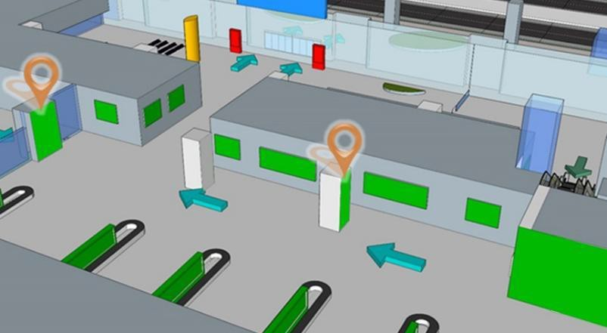
T1 - DOMESTIC
ARRIVAL | BAGGAGE BELT | 10 W X H 10 FT – 1280 x 1024 PX (Package of 2 Units) | 10 Sec In Every 1 Min
www.themediaant.com

Slide 25
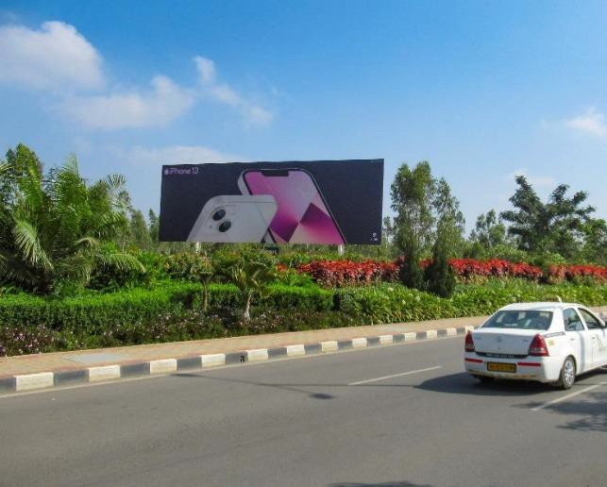
T2 - DOMESTIC + INTERNATIONAL
DEPATURE | DEPATURE OUTDOOR SOUTH ACCESS ROAD | 60 W x 20 H FT (Only 1 Unit) | FRONTLIT
Hoarding
Rental Cost | 20,00,000 P/M
Production Cost | 1,00,000
www.themediaant.com

Slide 26
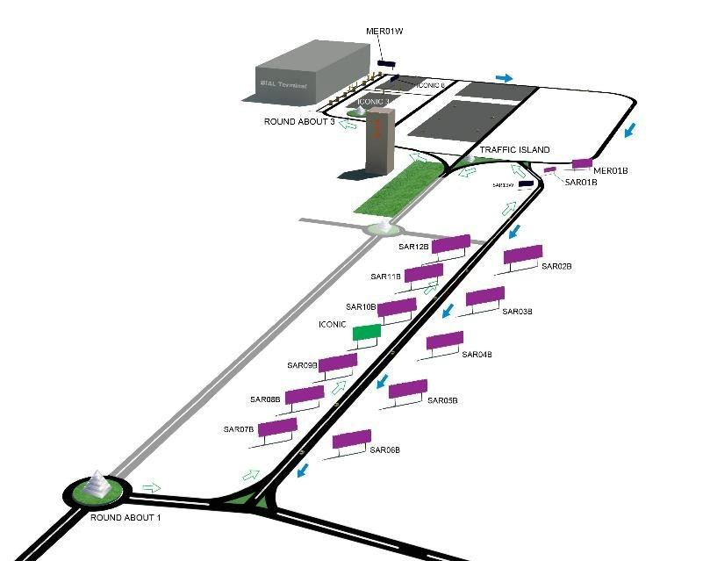

T2 - DOMESTIC + INTERNATIONAL
DEPATURE | DEPATURE OUTDOOR SOUTH ACCESS ROAD | 60 W x 20 H FT (Only 1 Unit) | FRONTLIT
www.themediaant.com

Slide 27
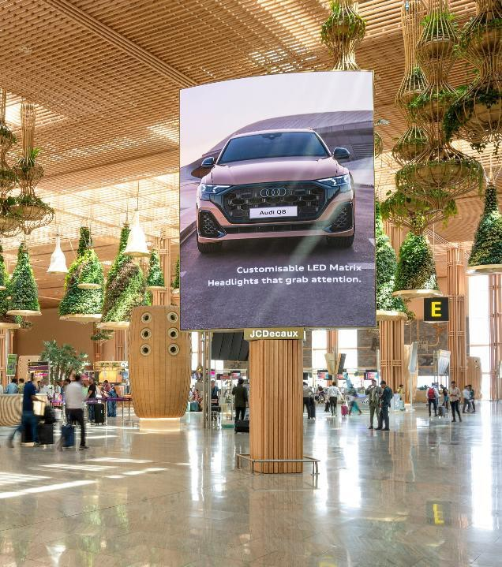
T2 - DOMESTIC + INTERNATIONAL
DEPARTURE | CHECK IN | 11 W X H 13.8 FT – 1120 x 1440 PX (Only 1 Unit) | 10 Sec In Every 1 Min
Digital Rotating 360° Double Sided
Rental Cost | 24,75,000 P/M Per Slot
Production Cost | 14,200
www.themediaant.com

Slide 28
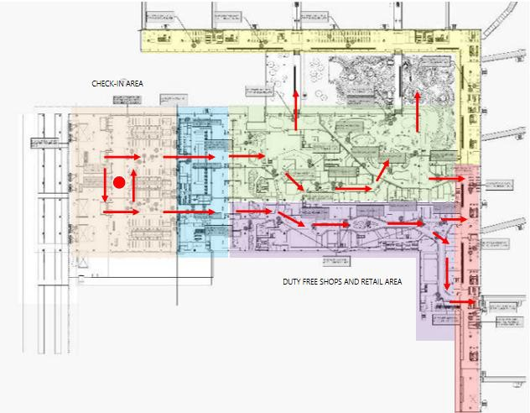
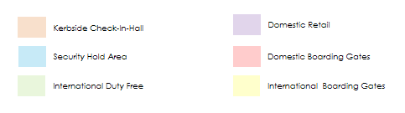
T2 - DOMESTIC + INTERNATIONAL
DEPARTURE | CHECK IN | 11 W X H 13.8 FT – 1120 x 1440 PX (Only 1 Unit) | 10 Sec In Every 1 Min
www.themediaant.com

Slide 29
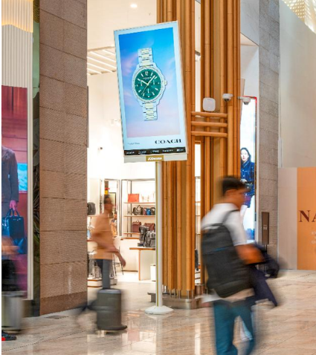
T2 - DOMESTIC
DEPARTURE | DEPARTING FLOW | 85 INCHES – 1080 x 1920 PX (Package of 19 Units) | 10 Sec In Every 1 Min
Digital Pole
Rental Cost | 45,00,000 P/M Per Slot
Production Cost | 14,160
www.themediaant.com

Slide 30
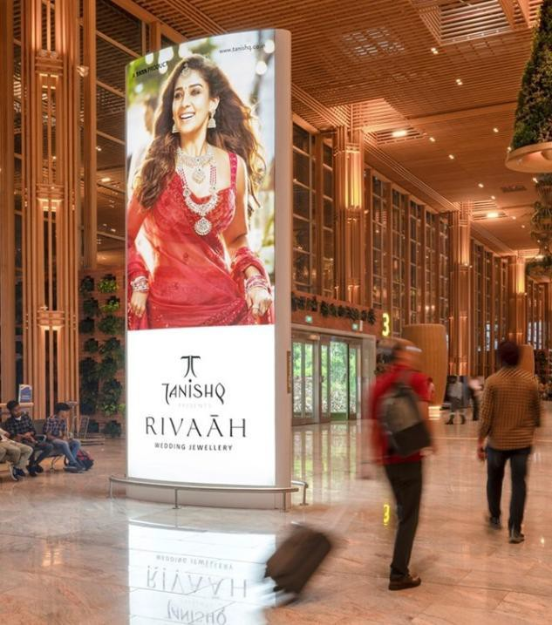
T2 - DOMESTIC + INTERNATIONAL
DEPATURE | CHECK IN HALL | 17.3 W X H 7.5 FT (Only 1 Unit) | BACKLIT
Static Totem Double Sided
Rental Cost | 16,50,000 P/M
Production Cost | 49,800
www.themediaant.com

Slide 31
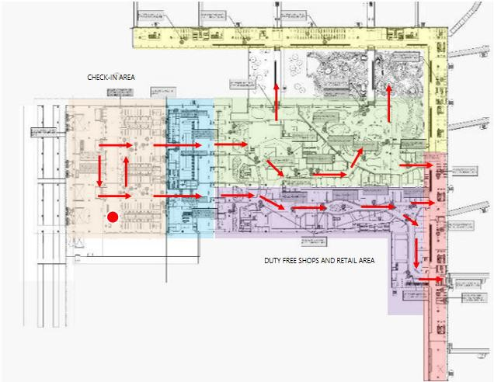
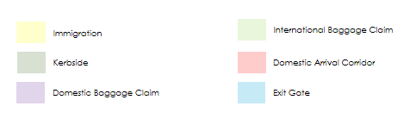
T2 - DOMESTIC + INTERNATIONAL
DEPATURE | CHECK IN HALL | 17.3 W X H 7.5 FT (Only 1 Unit) | BACKLIT
www.themediaant.com

Slide 32
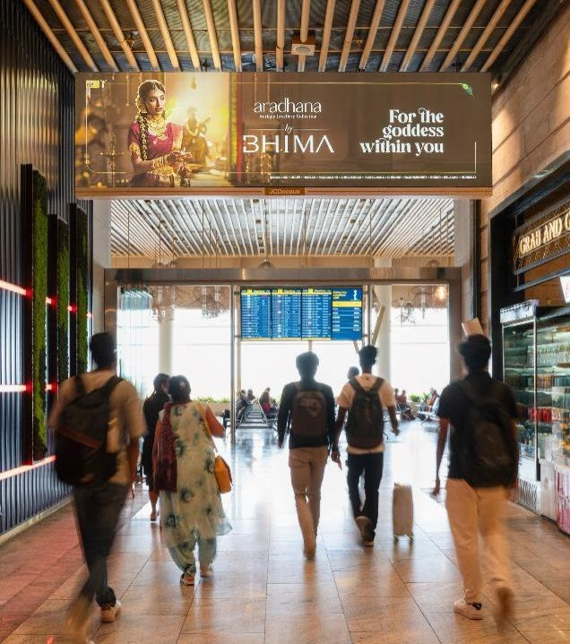
T2 - DOMESTIC
DEPATURE | RETAIL AREA | 5 W X H 1.5 FT (Package of 2 Units) | BACKLIT
Static Lightbox Single Sided
Rental Cost | 21,00,000 P/M
Production Cost | 44,500
www.themediaant.com

Slide 33
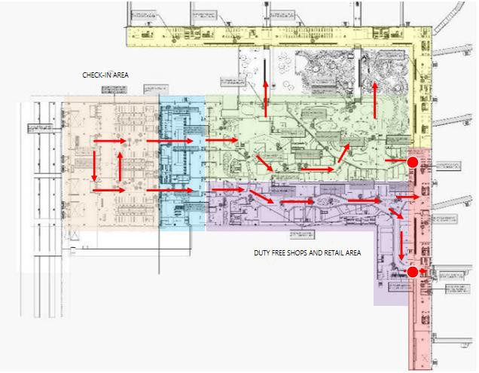

T2 - DOMESTIC
DEPATURE | RETAIL AREA | 5 W X H 1.5 FT (Package of 2 Units) | BACKLIT
www.themediaant.com

Slide 34
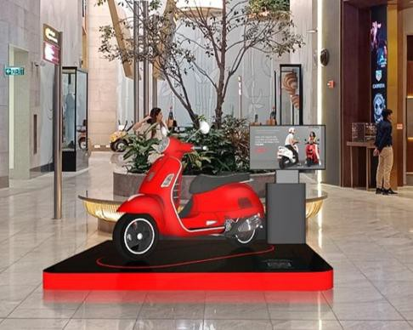
T2 - DOMESTIC + INTERNATIONAL
DEPATURE | RETAIL AREA | 6 W X H 6 FT (Only 1 Unit)
Promotional Space
Rental Cost | 23,00,000 P/M
Production Cost | Actual Cost
www.themediaant.com

Slide 35
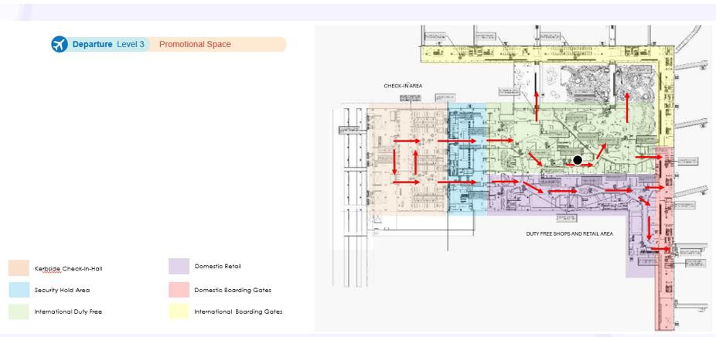
T2 - DOMESTIC + INTERNATIONAL
DEPATURE | RETAIL AREA | 6 W X H 6 FT (Only 1 Unit)
www.themediaant.com

Slide 36
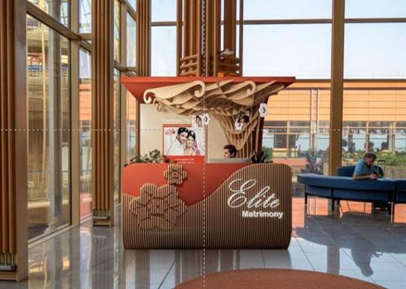
T2 - DOMESTIC + INTERNATIONAL
DEPATURE | RETAIL AREA | 8 W X H 8 FT (Only 1 Unit)
Promotional Space
Rental Cost | 23,00,000 P/M
Production Cost | Actual Cost
www.themediaant.com

Slide 37
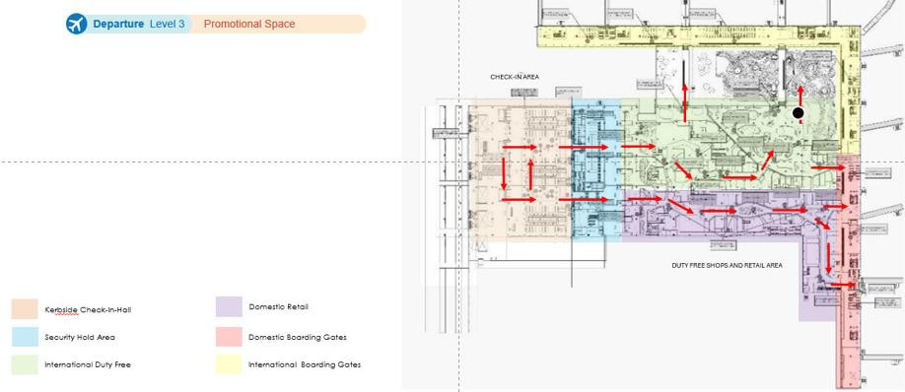
T2 - DOMESTIC + INTERNATIONAL
DEPATURE | RETAIL AREA | 8 W X H 8 FT (Only 1 Unit)
www.themediaant.com

Slide 38
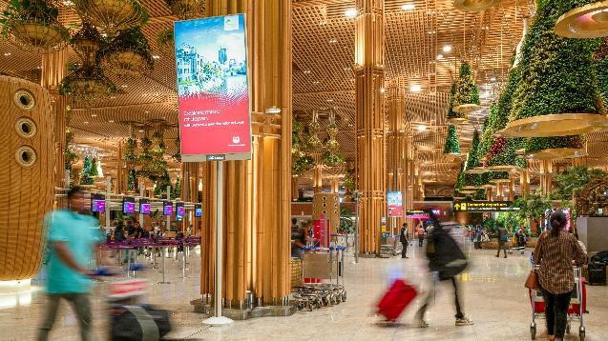
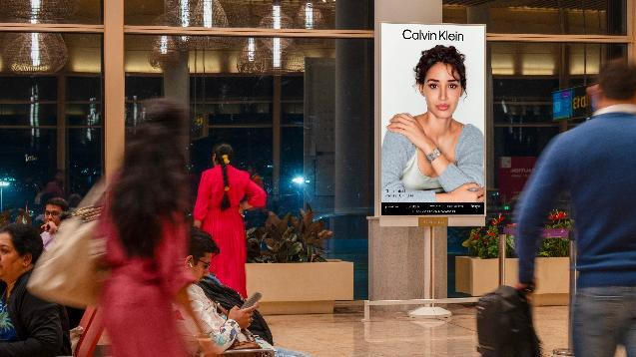
T2 - DOMESTIC
DEPARTURE | BOARDING GATE | 85 INCHES – 1080 x 1920 PX (Package of 17 Units) | 10 Sec In Every 1 Min
Digital Pole
Rental Cost | 33,75,000 P/M Per Slot
Production Cost | 14,200
www.themediaant.com

Slide 39
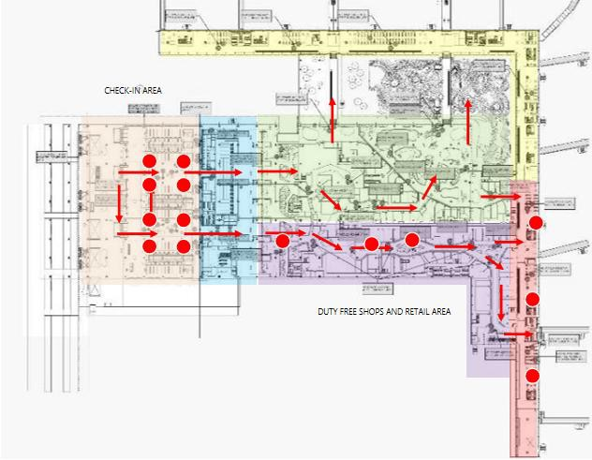
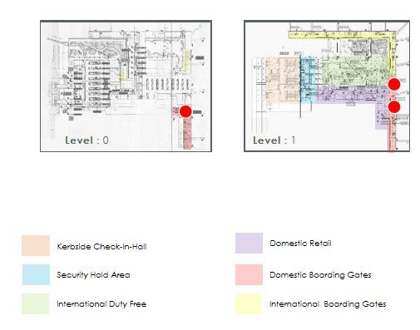
T2 - DOMESTIC
DEPARTURE | BOARDING GATE | 85 INCHES – 1080 x 1920 PX (Package of 17 Units) | 10 Sec In Every 1 Min
www.themediaant.com

Slide 40


T2 - DOMESTIC
DEPATURE | BOARDING GATE WAITING AREA | 6 W X H 2.1 FT (Package of 2 Units) | BACKLIT
Static Lightbox Single Sided
Rental Cost | 24,00,000 P/M
Production Cost | 49,400
www.themediaant.com

Slide 41

T2 - DOMESTIC
DEPATURE | BOARDING GATE WAITING AREA | 6 W X H 2.1 FT (Package of 2 Units) | BACKLIT
www.themediaant.com

Slide 42


T2 - INTERNATIONAL
DEPATURE | BOARDING GATE WAITING AREA | 85 INCHES – 1080 x 1920 PX (Package of 18 Units) | 10 Sec In Every 1 Min
Digital Pole
Rental Cost | 22,50,000 P/M Per Slot
Production Cost | 14,200
www.themediaant.com

Slide 43


T2 - INTERNATIONAL
DEPATURE | BOARDING GATE WAITING AREA | 85 INCHES – 1080 x 1920 PX (Package of 18 Units) | 10 Sec In Every 1 Min
www.themediaant.com

Slide 44



T2 - INTERNATIONAL
DEPATURE | BOARDING GATE WAITING AREA | 3 W X H 2.1 FT (Package of 3 Units) | BACKLIT
Static Lightbox Single Sided
Rental Cost | 23,62,000 P/M
Production Cost | 39,000
www.themediaant.com

Slide 45

T2 - INTERNATIONAL
DEPATURE | BOARDING GATE WAITING AREA | 3 W X H 2.1 FT (Package of 3 Units) | BACKLIT
www.themediaant.com

Slide 46


T2 - DOMESTIC
ARRIVAL | ARRIVAL HALL + BAGGAGE BELT | 55, 85 & 100 INCHES – 1080 x 1920 & 1920 x 1080 PX (Package of 22 Units) | 10 Sec In Every 1 Min
Digital Pole
Rental Cost | 36,00,000 P/M Per Slot
Production Cost | 14,200
www.themediaant.com

Slide 47


T2 - DOMESTIC
ARRIVAL | ARRIVAL HALL + BAGGAGE BELT | 55, 85 & 100 INCHES – 1080 x 1920 & 1920 x 1080 PX (Package of 22 Units) | 10 Sec In Every 1 Min
www.themediaant.com

Slide 48


T2 - DOMESTIC
ARRIVAL | ARRIVAL HALL | 20 W X H 10 FT – 2304 x 1152 PX (Only 1 Unit) | 10 Sec In Every 1 Min
Digital Wall
Rental Cost | 18,75,000 P/M Per Slot
Production Cost | 14,200
www.themediaant.com

Slide 49

T2 - DOMESTIC
ARRIVAL | ARRIVAL HALL | 20 W X H 10 FT – 2304 x 1152 PX (Only 1 Unit) | 10 Sec In Every 1 Min
www.themediaant.com

Slide 50

T2 - DOMESTIC
ARRIVAL | RETAIL AARRIVAL HALL + BAGGAGE BELT | 30 W X H 13.5 FT (Only 1 Unit) | NONLIT
Static Wall Signage Single Sided
Rental Cost | 26,25,000 P/M
Production Cost | 1,00,000
www.themediaant.com

Slide 51

T2 - DOMESTIC
ARRIVAL | RETAIL AARRIVAL HALL + BAGGAGE BELT | 30 W X H 13.5 FT (Only 1 Unit) | NONLIT
www.themediaant.com

Slide 52


T2 - INTERNATIONAL
ARRIVAL | ARRIVAL HALL + BAGGAGE BELT | 100 INCHES – 1080 x 1920 PX (Package of 9 Units) | 10 Sec In Every 1 Min
Digital Pole
Rental Cost | 16,00,000 P/M Per Slot
Production Cost | 14,200
www.themediaant.com

Slide 53

T2 - INTERNATIONAL
ARRIVAL | ARRIVAL HALL + BAGGAGE BELT | 100 INCHES – 1080 x 1920 PX (Package of 9 Units) | 10 Sec In Every 1 Min
www.themediaant.com

Slide 54

T2 - DOMESTIC + INTERNATIONAL
ARRIVAL | MEET & GREET AREA | 3 W X H 1.5 FT (Package of 2 Units) | BACKLIT
Static Totem Three Sided
Rental Cost | 16,00,000 P/M
Production Cost | 70,500
www.themediaant.com

Slide 55

T2 - DOMESTIC + INTERNATIONAL
ARRIVAL | MEET & GREET AREA | 3 W X H 1.5 FT (Package of 2 Units) | BACKLIT
www.themediaant.com

Slide 56

T2 - DOMESTIC + INTERNATIONAL
ARRIVAL | MEET AND GREET AREA | 3 W X H 1.5 FT (Package of 2 Units) | BACKLIT
Static Totem Three Sided
Rental Cost | 16,00,000 P/M
Production Cost | 70,500
www.themediaant.com

Slide 57
T2 - DOMESTIC + INTERNATIONAL
ARRIVAL | MEET AND GREET AREA | 3 W X H 1.5 FT (Package of 2 Units) | BACKLIT
www.themediaant.com

Slide 58


T1&2 - DOMESTIC + INTERNATIONAL
ARRIVAL | ARRIVAL OUTDOOR ACCESS ROAD | 53 W x 13 H FT – 1920 x 540 PX (Only 1 Unit) | 10 Sec In Every 1 Min
Digital Gantry
Rental Cost | 27,37,000 P/M Per Slot
Production Cost | 14,200
www.themediaant.com

Slide 59

T1&2 - DOMESTIC + INTERNATIONAL
ARRIVAL | ARRIVAL OUTDOOR ACCESS ROAD | 53 W x 13 H FT – 1920 x 540 PX (Only 1 Unit) | 10 Sec In Every 1 Min
www.themediaant.com

Slide 60

T1&2 - DOMESTIC + INTERNATIONAL
DEPATURE + ARRIVAL | FRONT - TOP & BOTTOM AND BACK SIDE
Luggage Trolley
Rental Cost | 1,500 P/M Per Trolley
Production Cost | Inclusive
www.themediaant.com

Slide 61





Thank
www.themediaant.com
ad@themediaant.com
You
080-067415510
Empowering All To Advertise

