Slide 1















Empowering All To Advertise
Tiruchirappalli
Airport
Static Lightbox
Notes:
‹#›

Slide 2

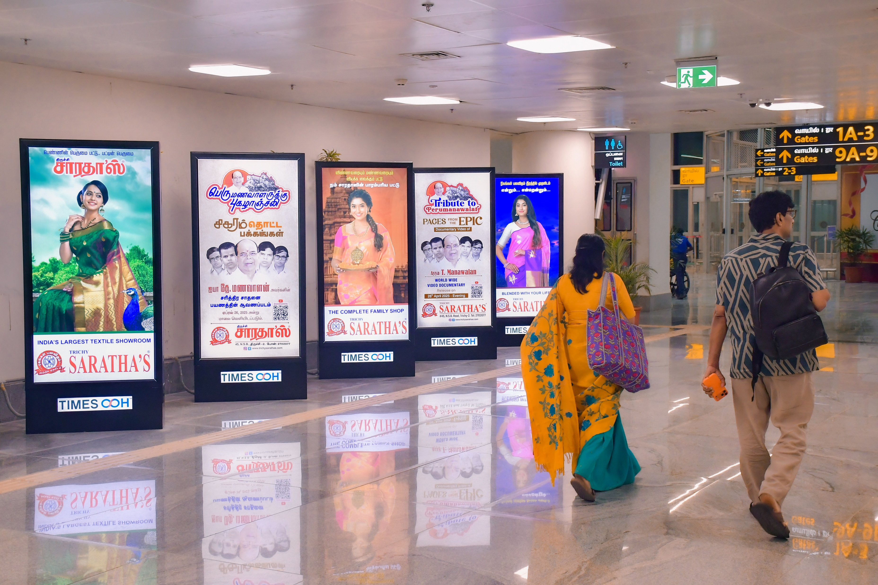
T1- DOMESTIC
Departure | Passage To Security Hold Area | 3 W X 6 H ft (Package Of 5 Units) | Back Lit
Static Lightbox Single Sided
www.themediaant.com
Notes:
‹#›

Slide 3
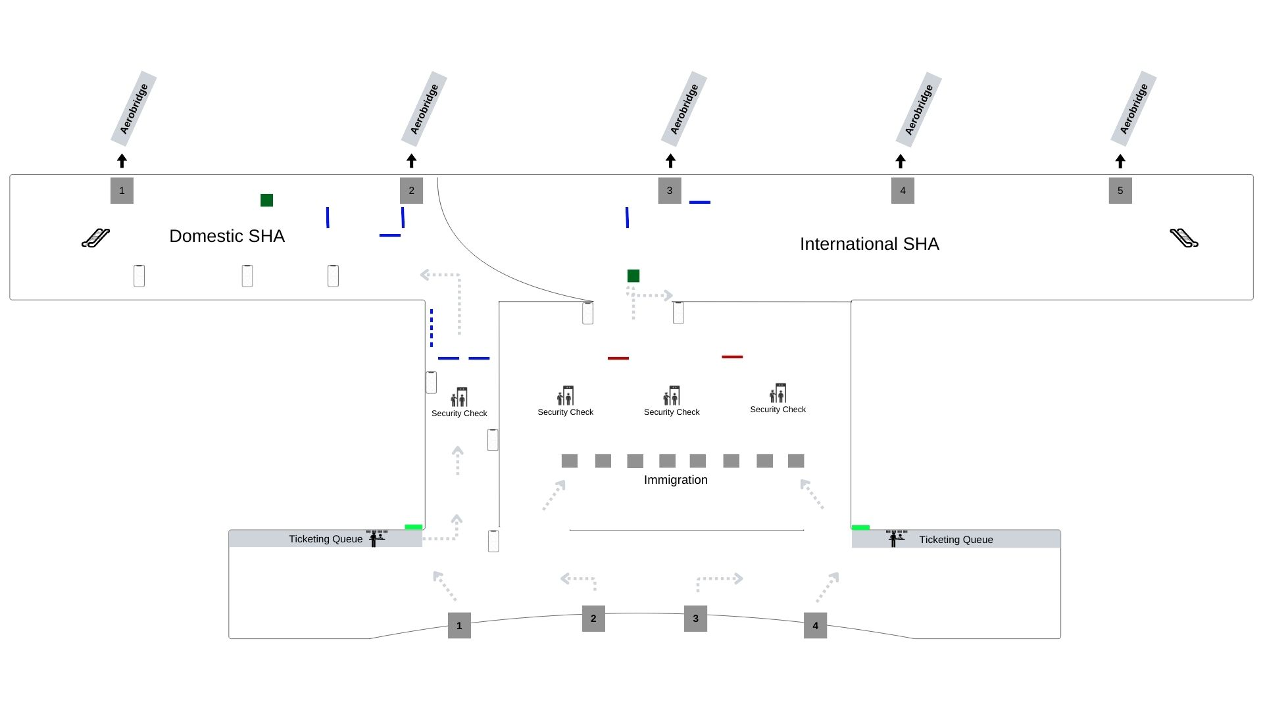
T1- DOMESTIC
Departure | Passage To Security Hold Area | 3 W X 6 H ft (Package Of 5 Units) | Back Lit
www.themediaant.com
Notes:
‹#›

Slide 4
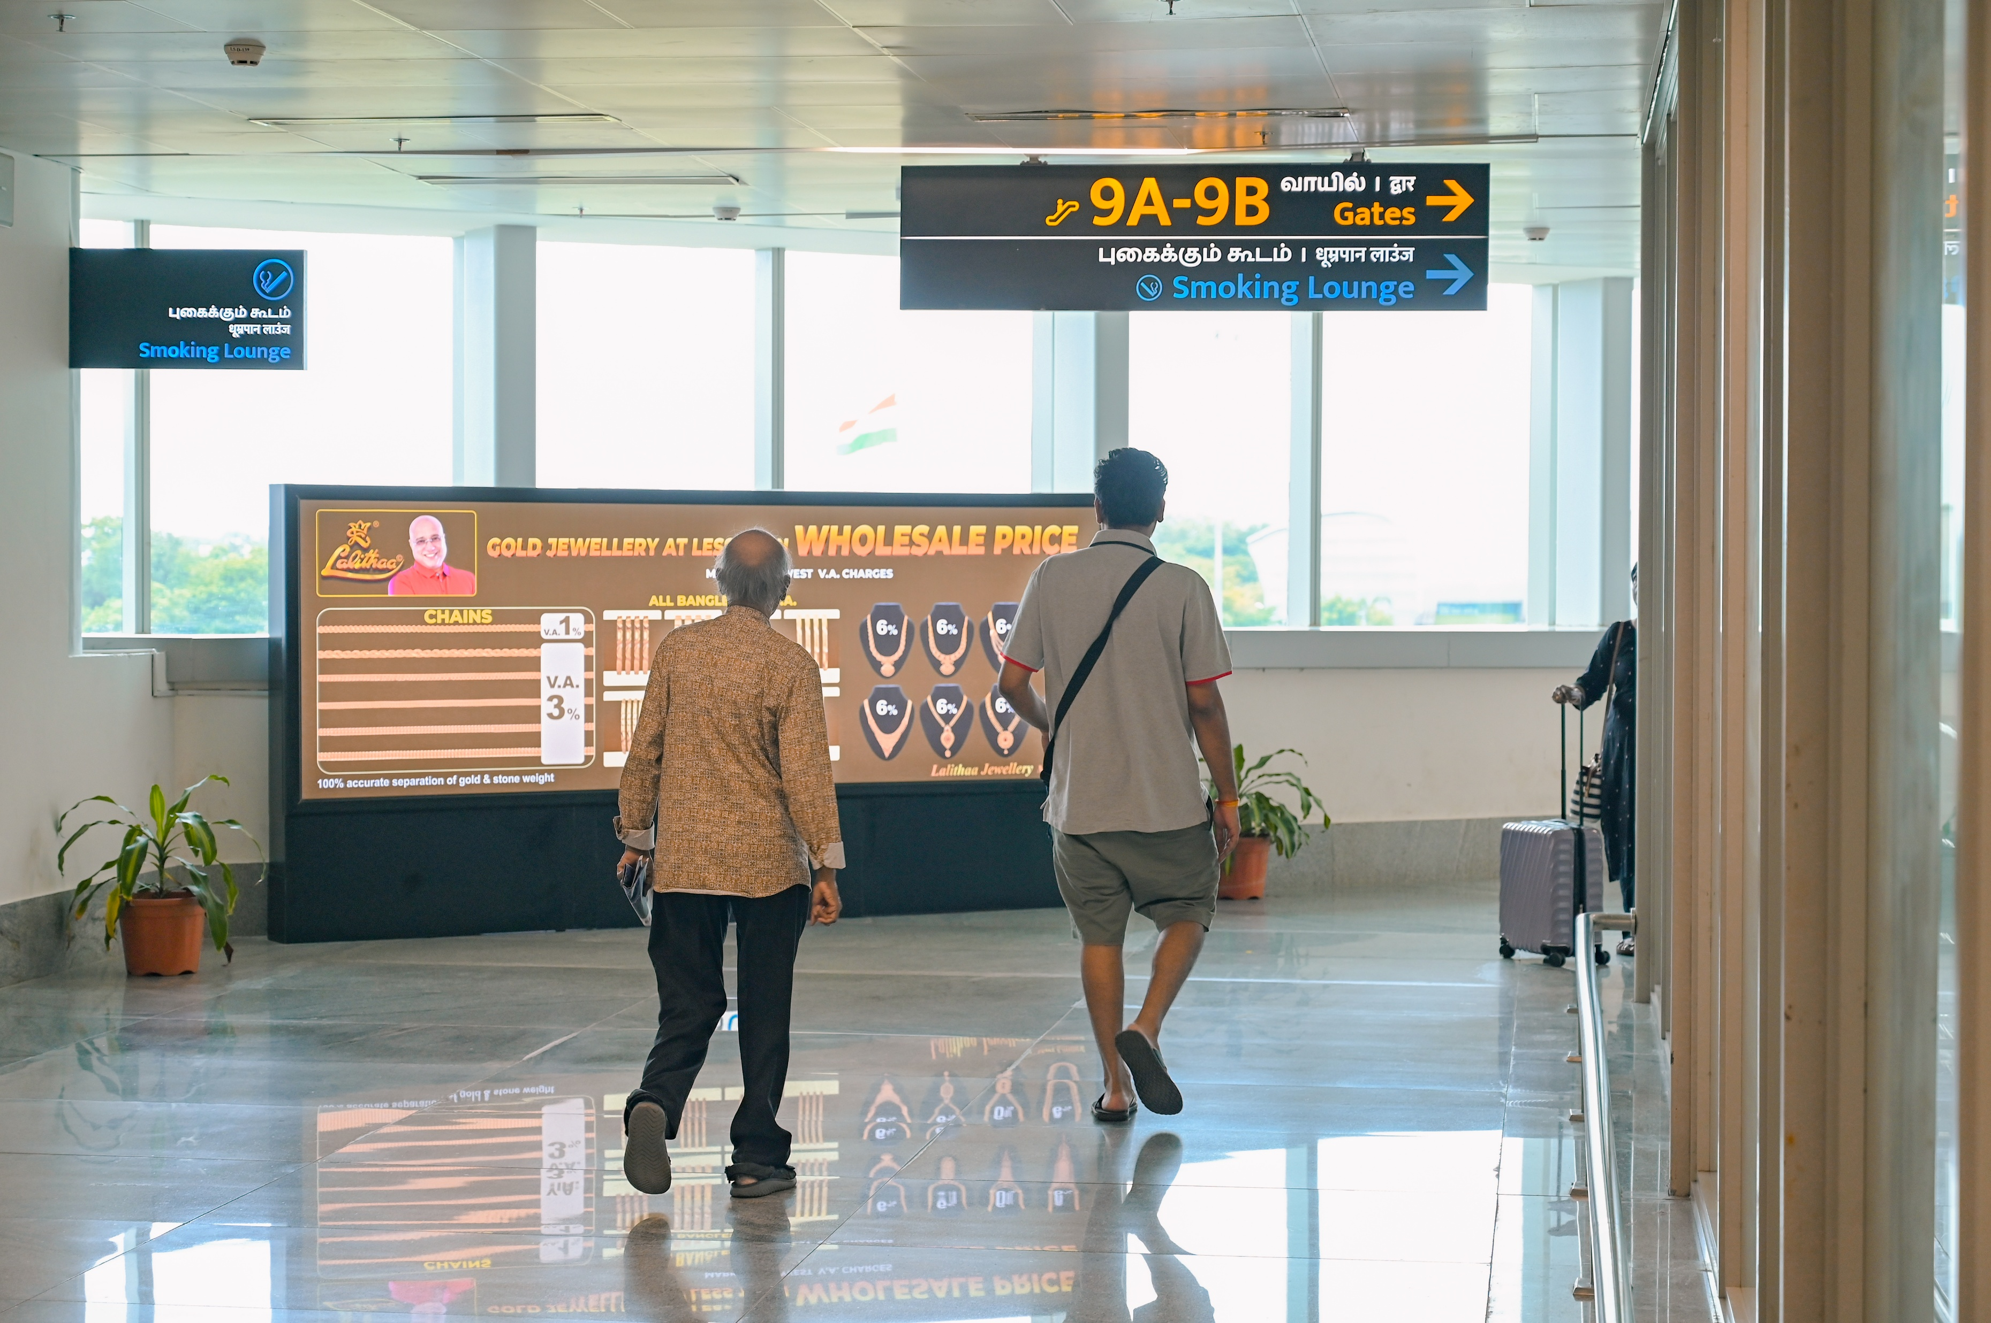
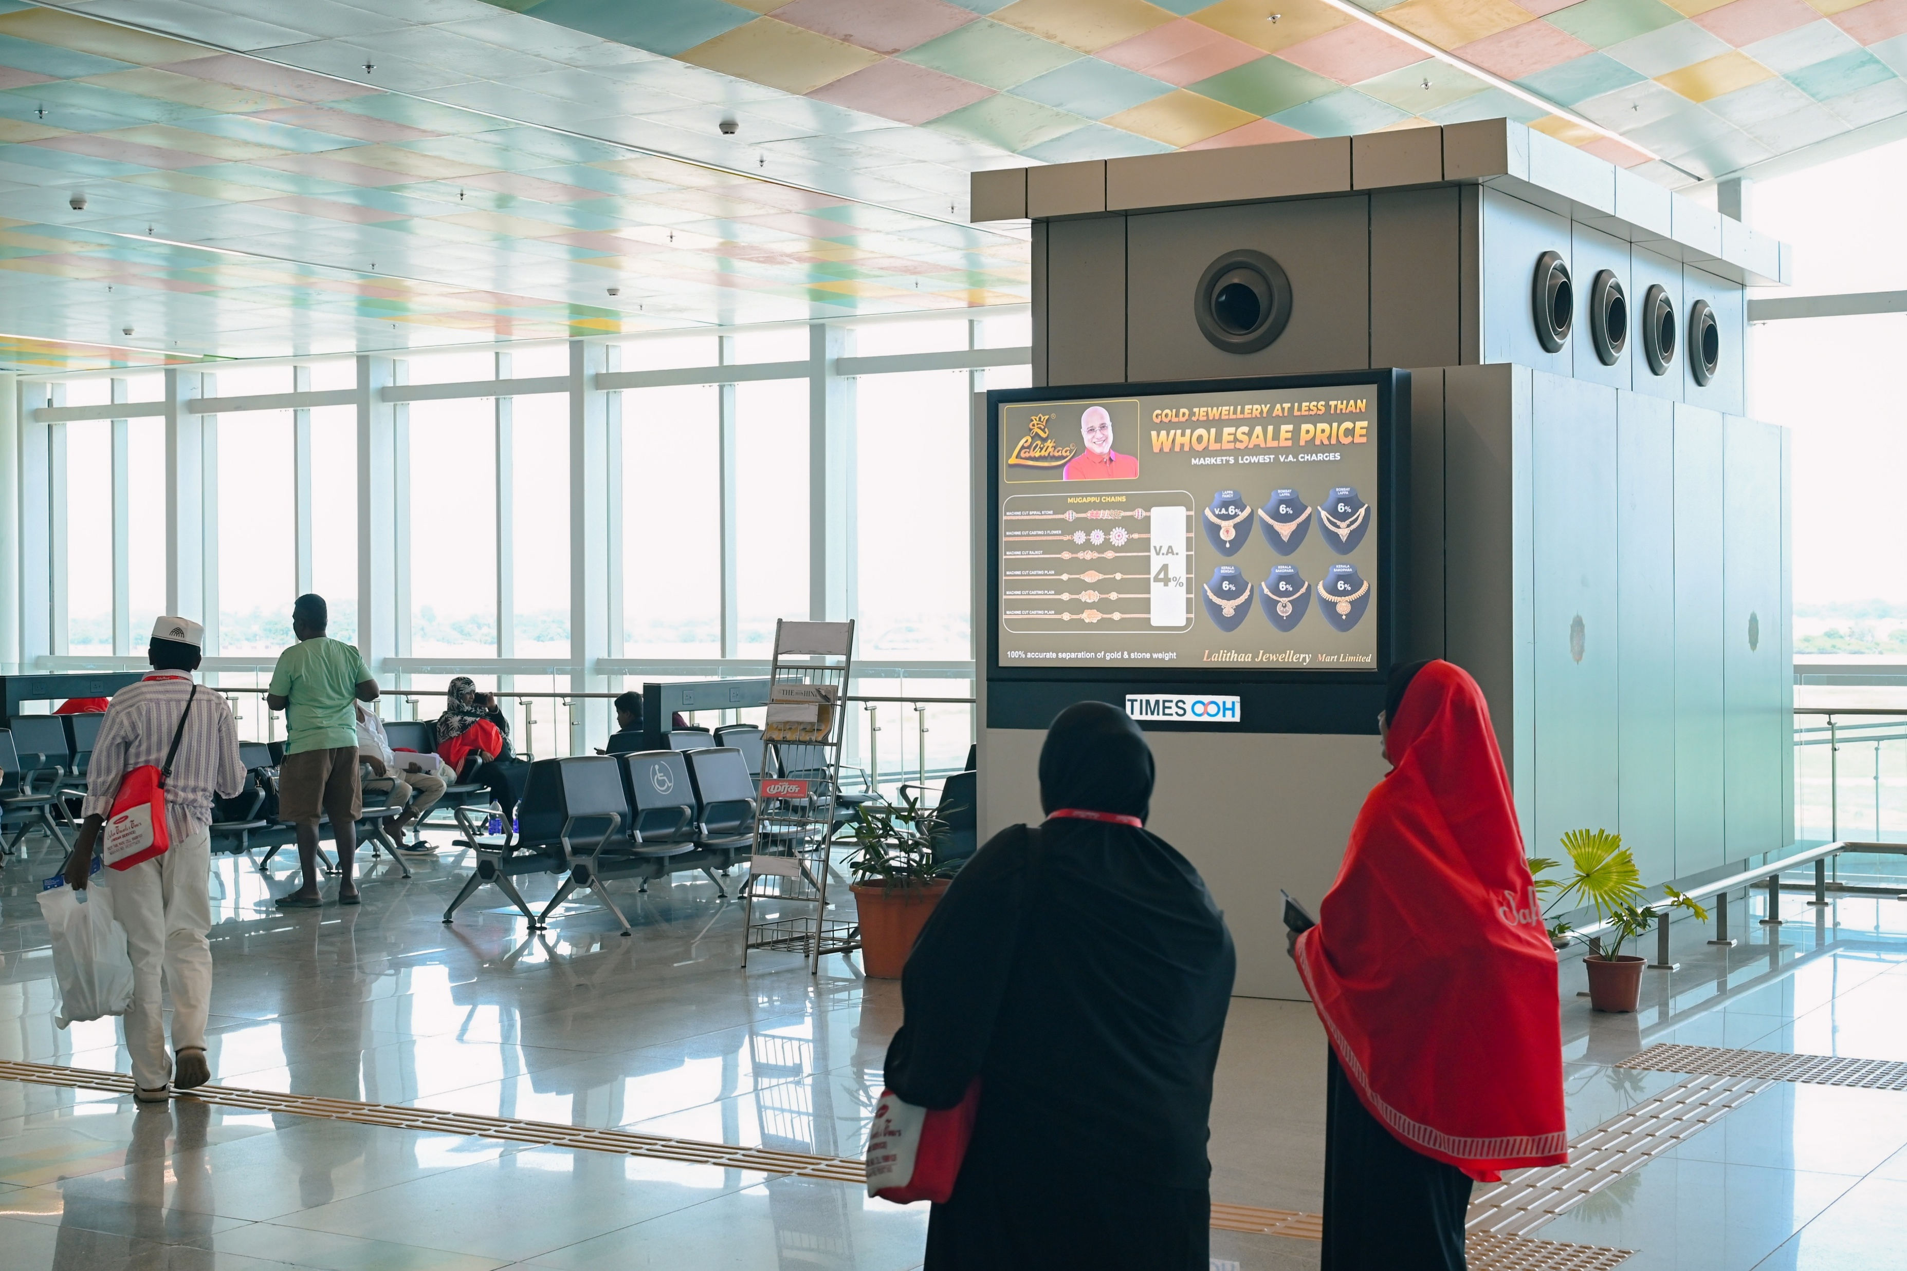
T1- DOMESTIC
Departure | Security Hold Area | 6 W X 4 H ft & 12 W X 4 H ft (Package Of 2 Units) | Back Lit
Static Lightbox Single Sided
www.themediaant.com
Notes:
‹#›

Slide 5
T1- DOMESTIC
Departure | Security Hold Area | 6 W X 4 H ft & 12 W X 4 H ft (Package Of 2 Units) | Back Lit
www.themediaant.com
Notes:
‹#›

Slide 6
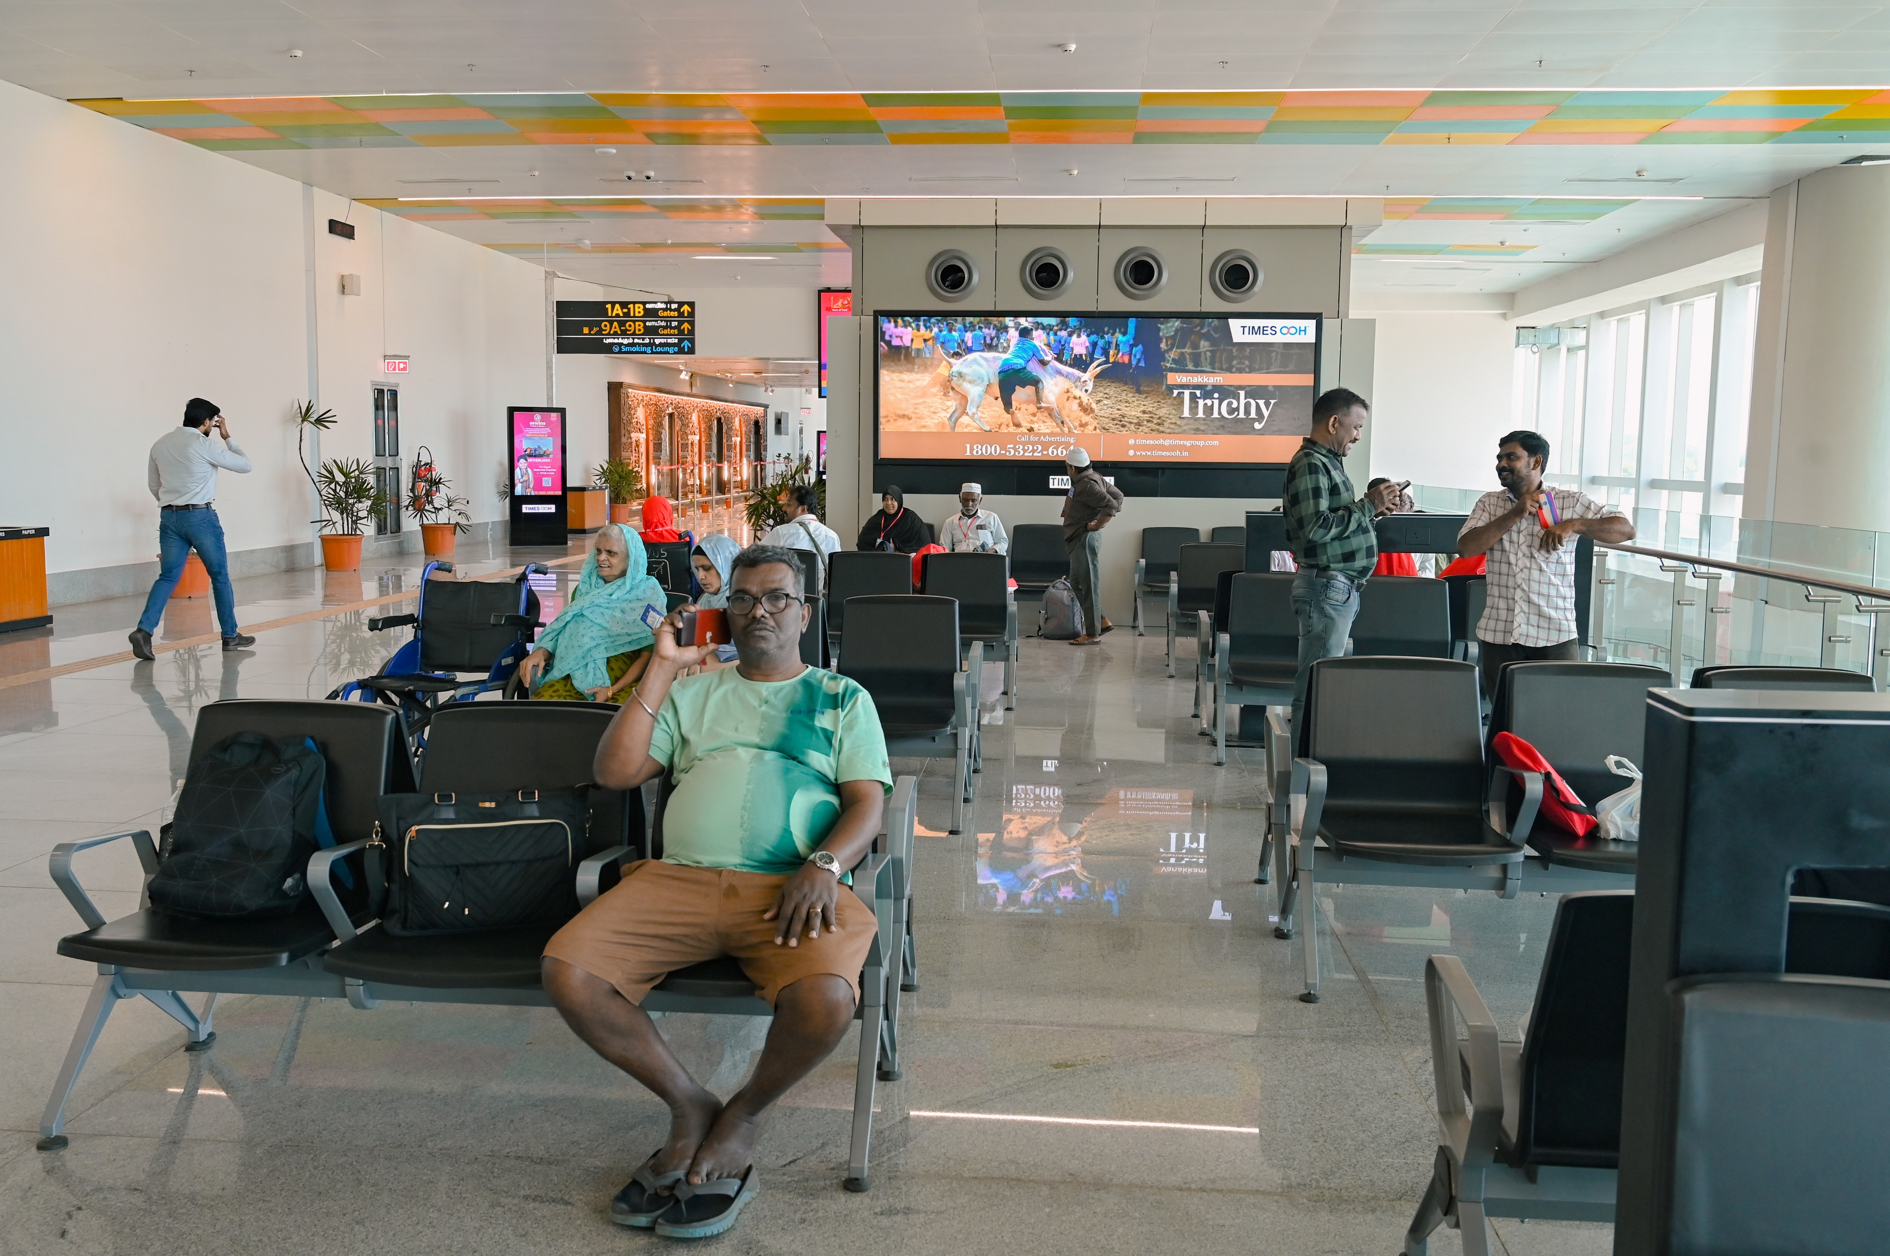
T1- DOMESTIC
Departure | Security Hold Area | 12 W X 4 H ft (Only 1 Unit) | Back Lit
Static Lightbox Single Sided
www.themediaant.com
Notes:
‹#›

Slide 7
T1- DOMESTIC
Departure | Security Hold Area | 12 W X 4 H ft (Only 1 Unit) | Back Lit
www.themediaant.com
Notes:
‹#›

Slide 8
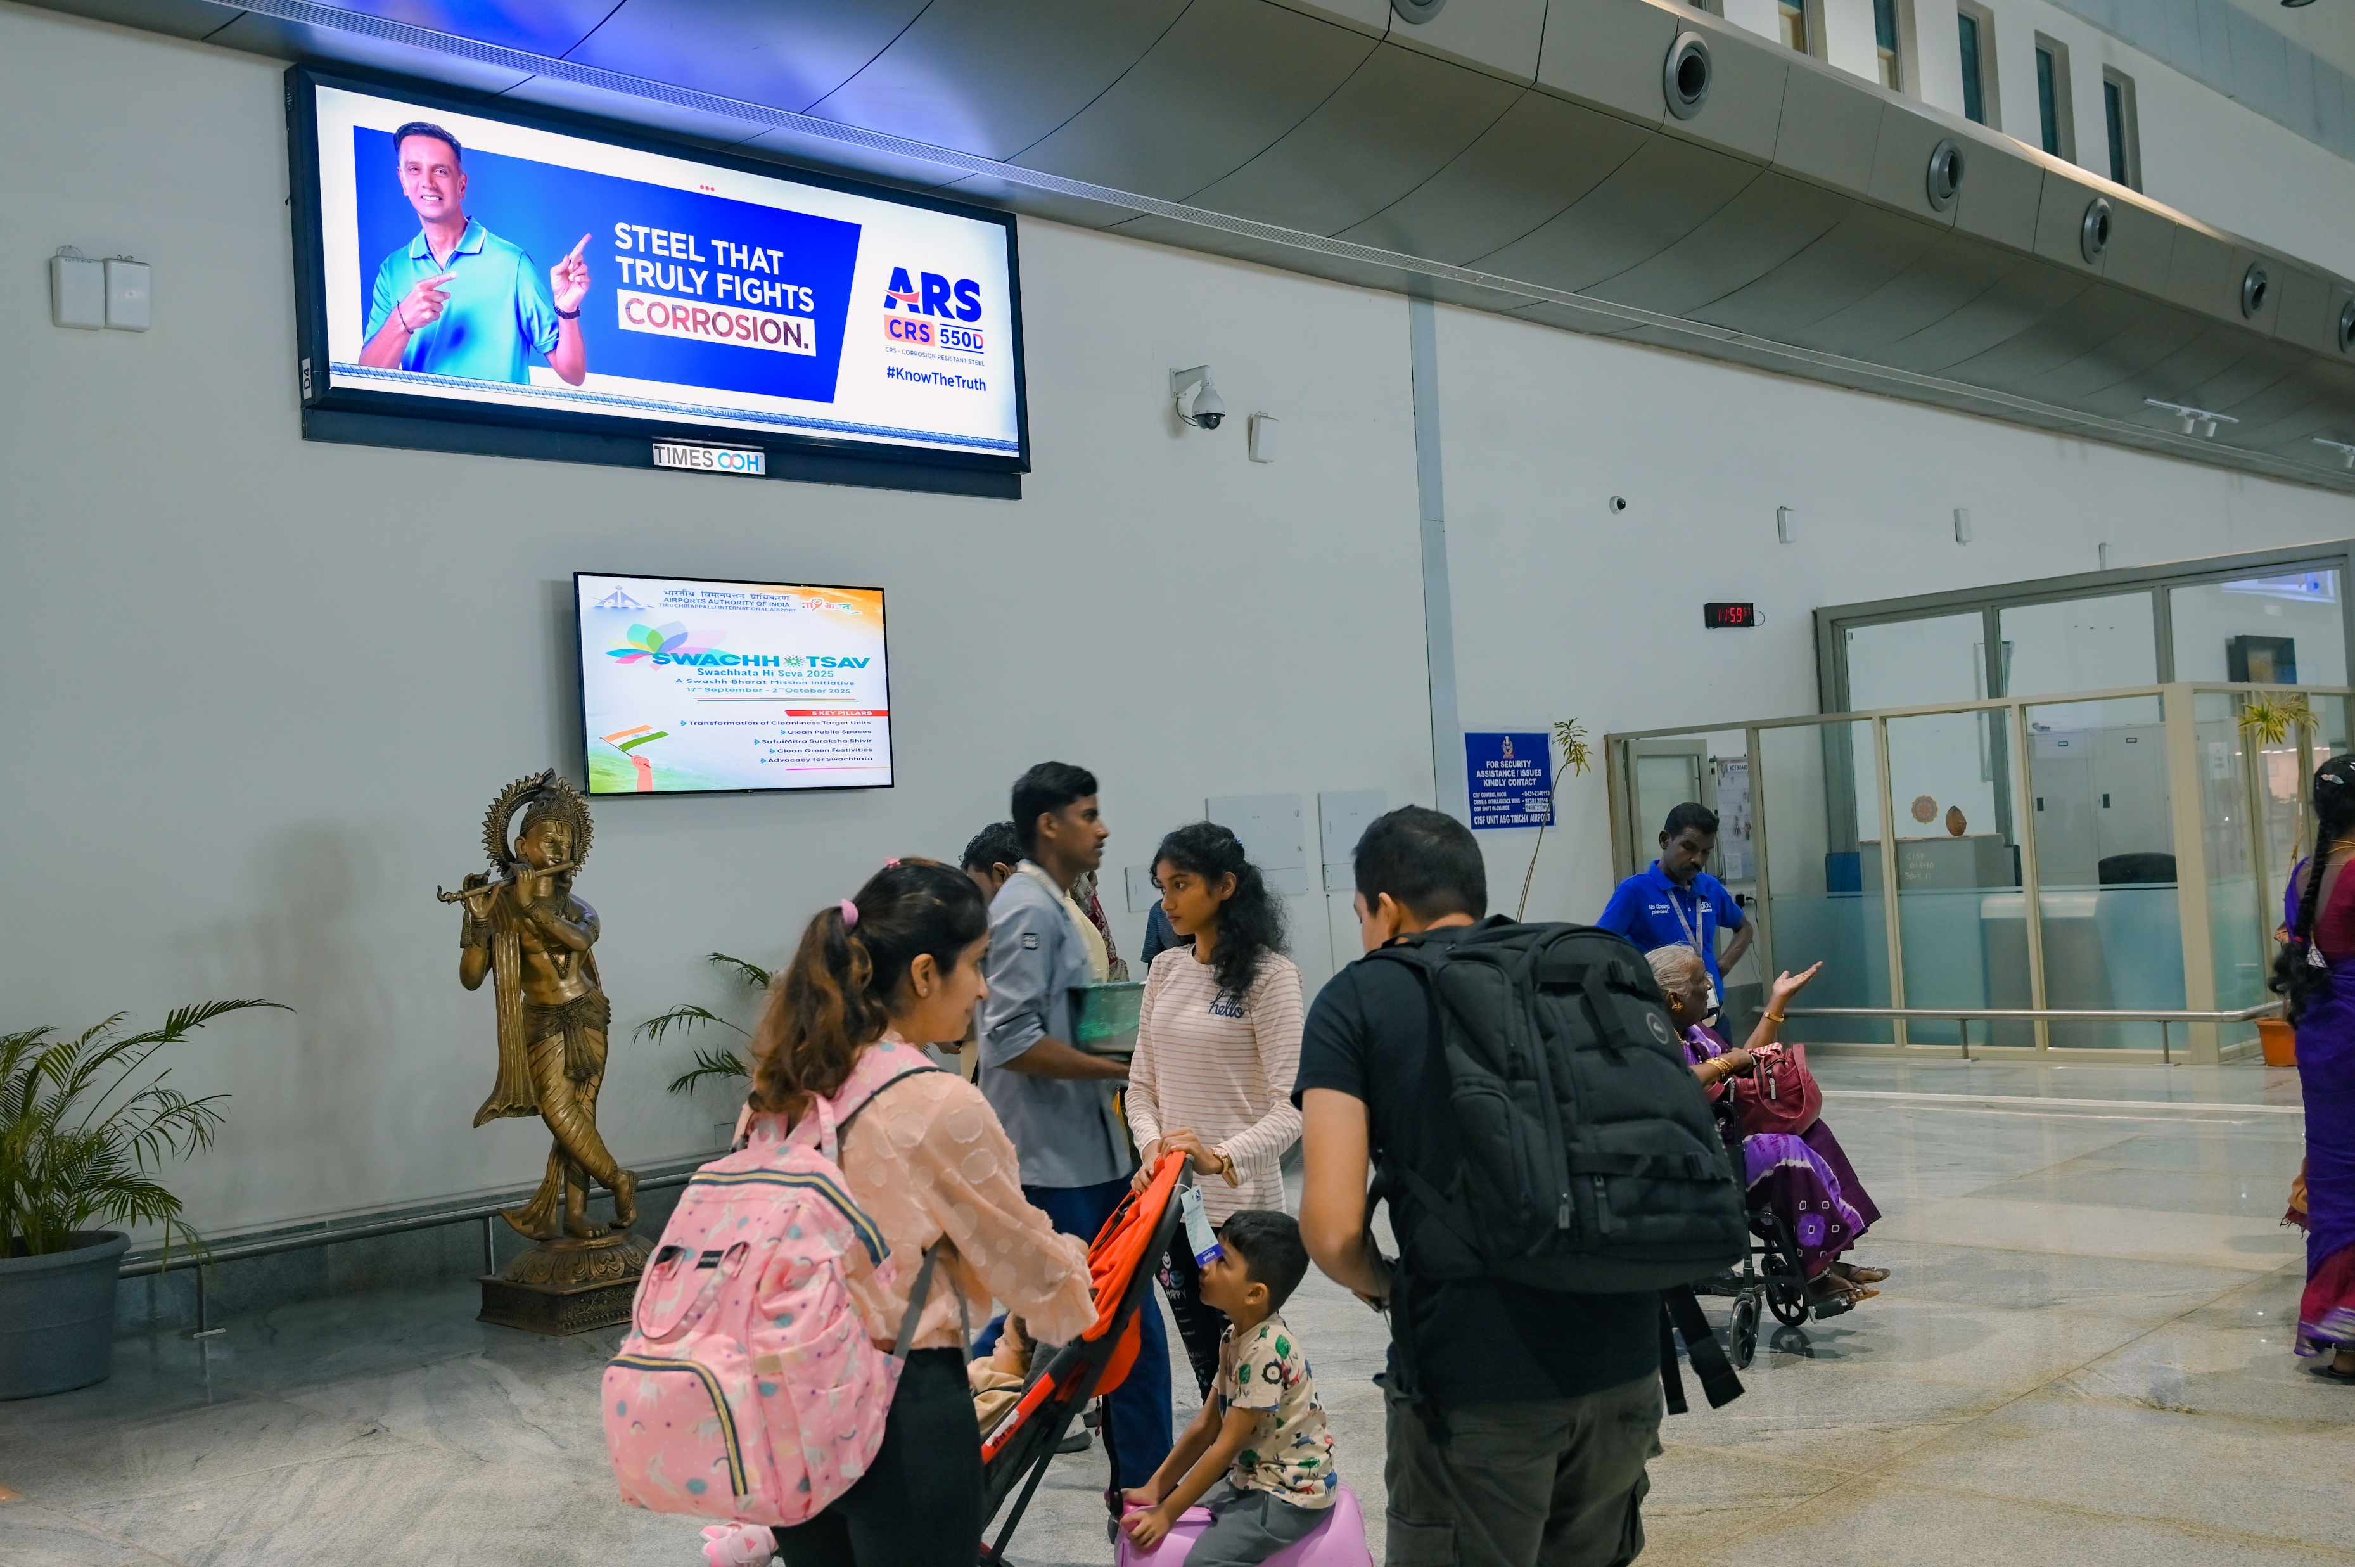
T1- DOMESTIC
Departure | After Frisking Area | 12 W X 4 H ft (Only 1 Unit) | Back Lit
Static Lightbox Single Sided
www.themediaant.com
Notes:
‹#›

Slide 9
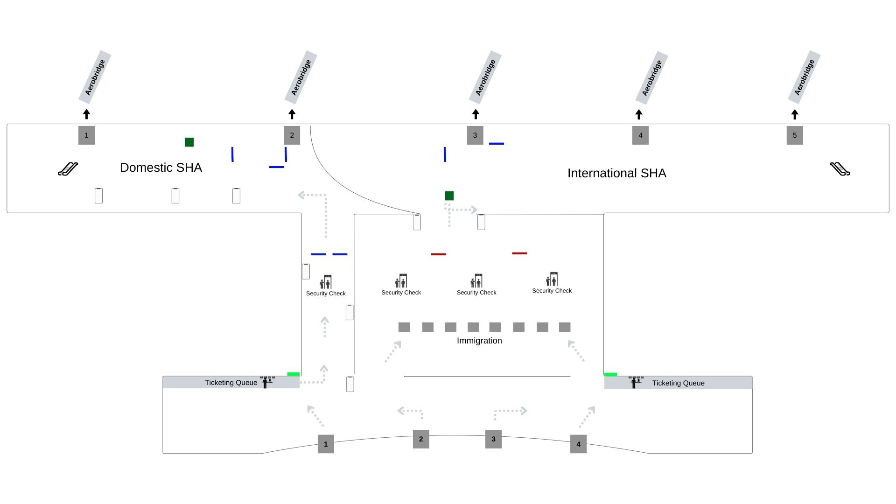
T1- DOMESTIC
Departure | After Frisking Area | 12 W X 4 H ft (Only 1 Unit) | Back Lit
www.themediaant.com
Notes:
‹#›

Slide 10
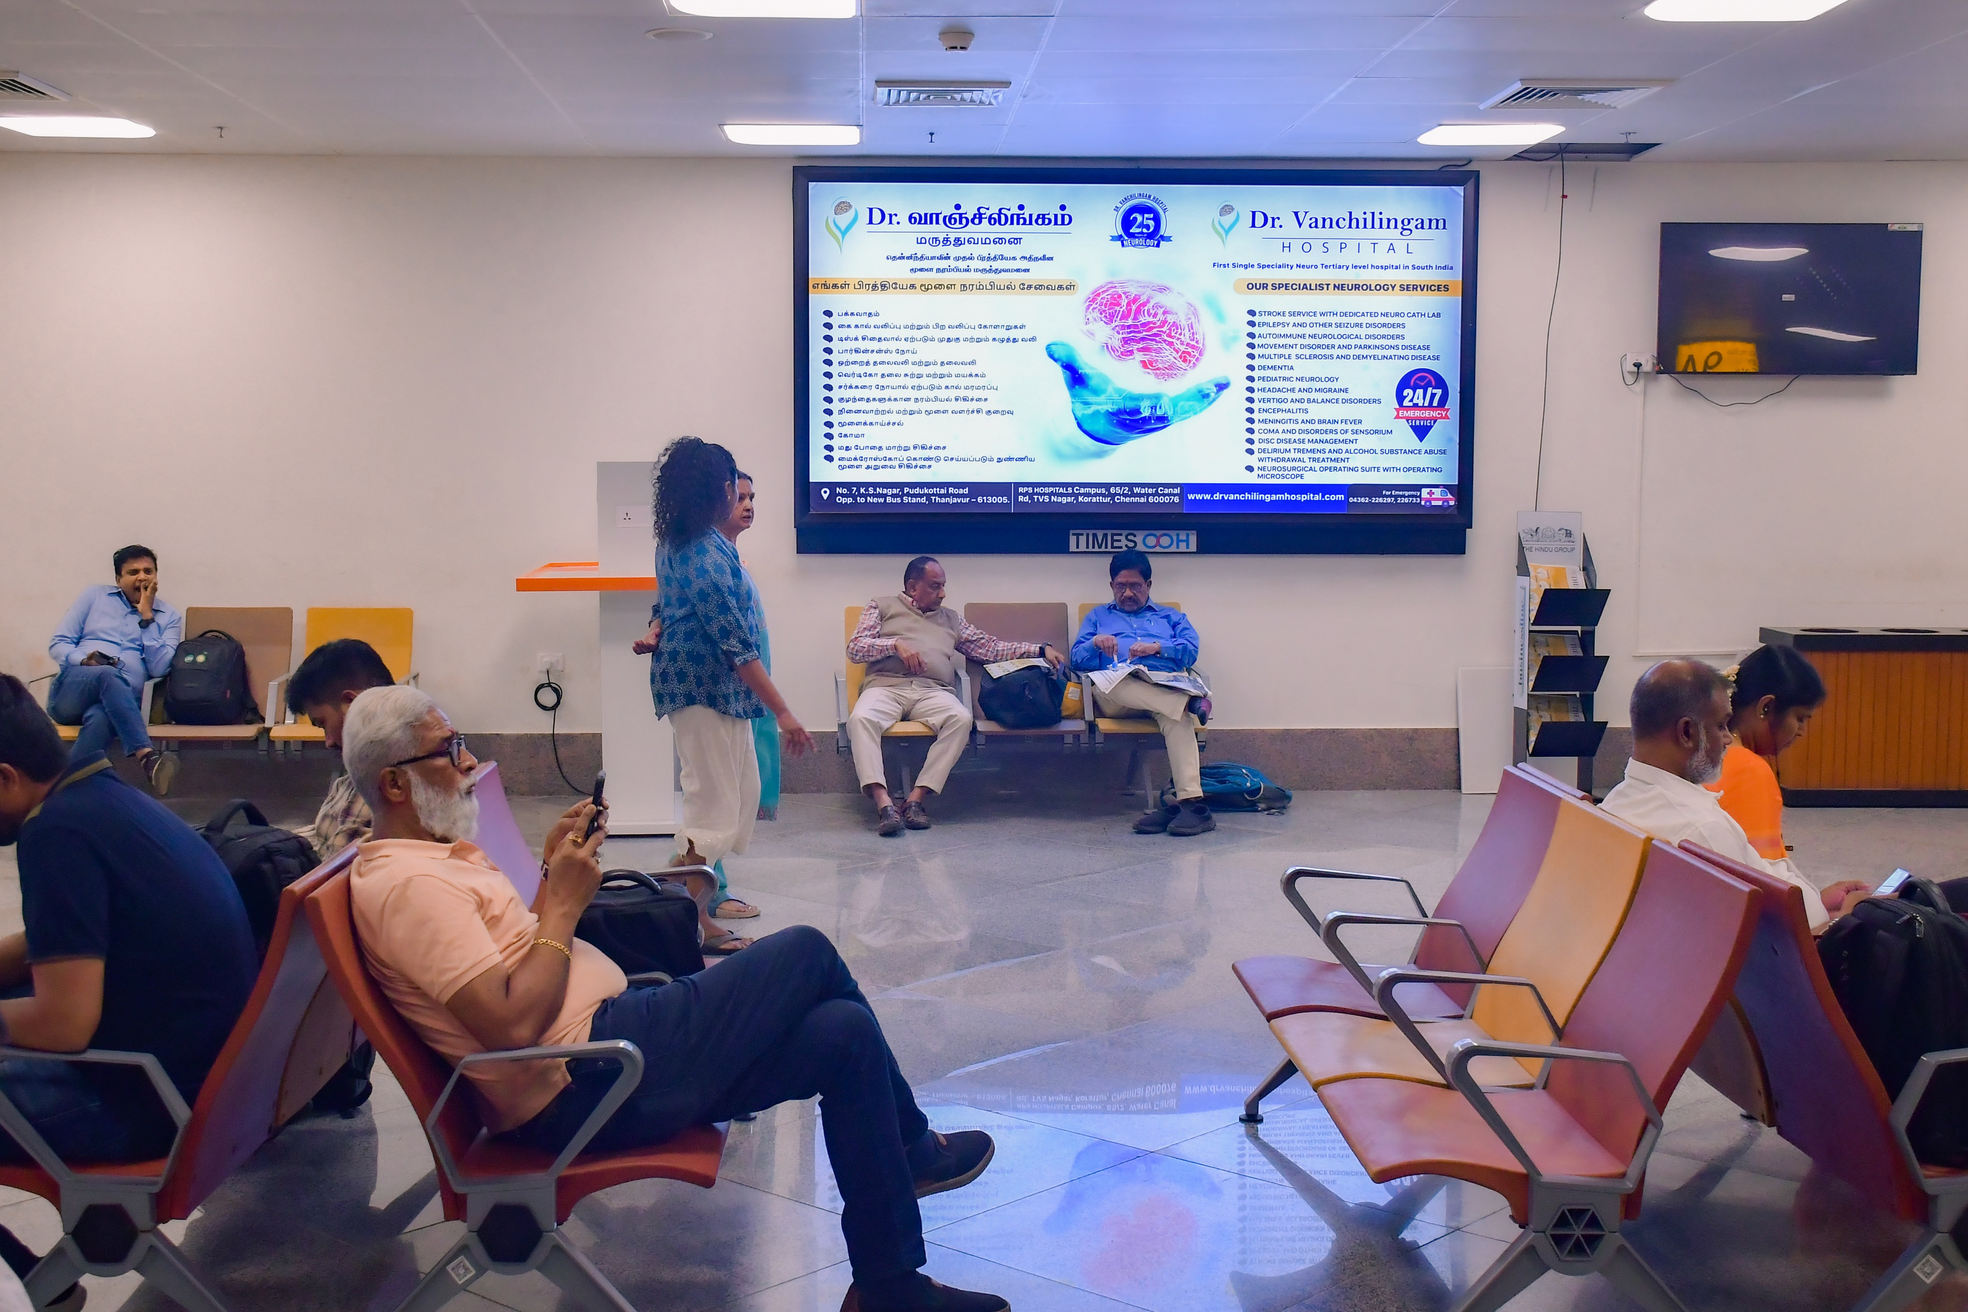
T1- DOMESTIC
Departure | Inside Security Hold Area | 10 W X 5 H ft (Only 1 Unit) | Back Lit
Static Lightbox Single Sided
www.themediaant.com
Notes:
‹#›

Slide 11
T1- DOMESTIC
Departure | Inside Security Hold Area | 10 W X 5 H ft (Only 1 Unit) | Back Lit
www.themediaant.com
Notes:
‹#›

Slide 12
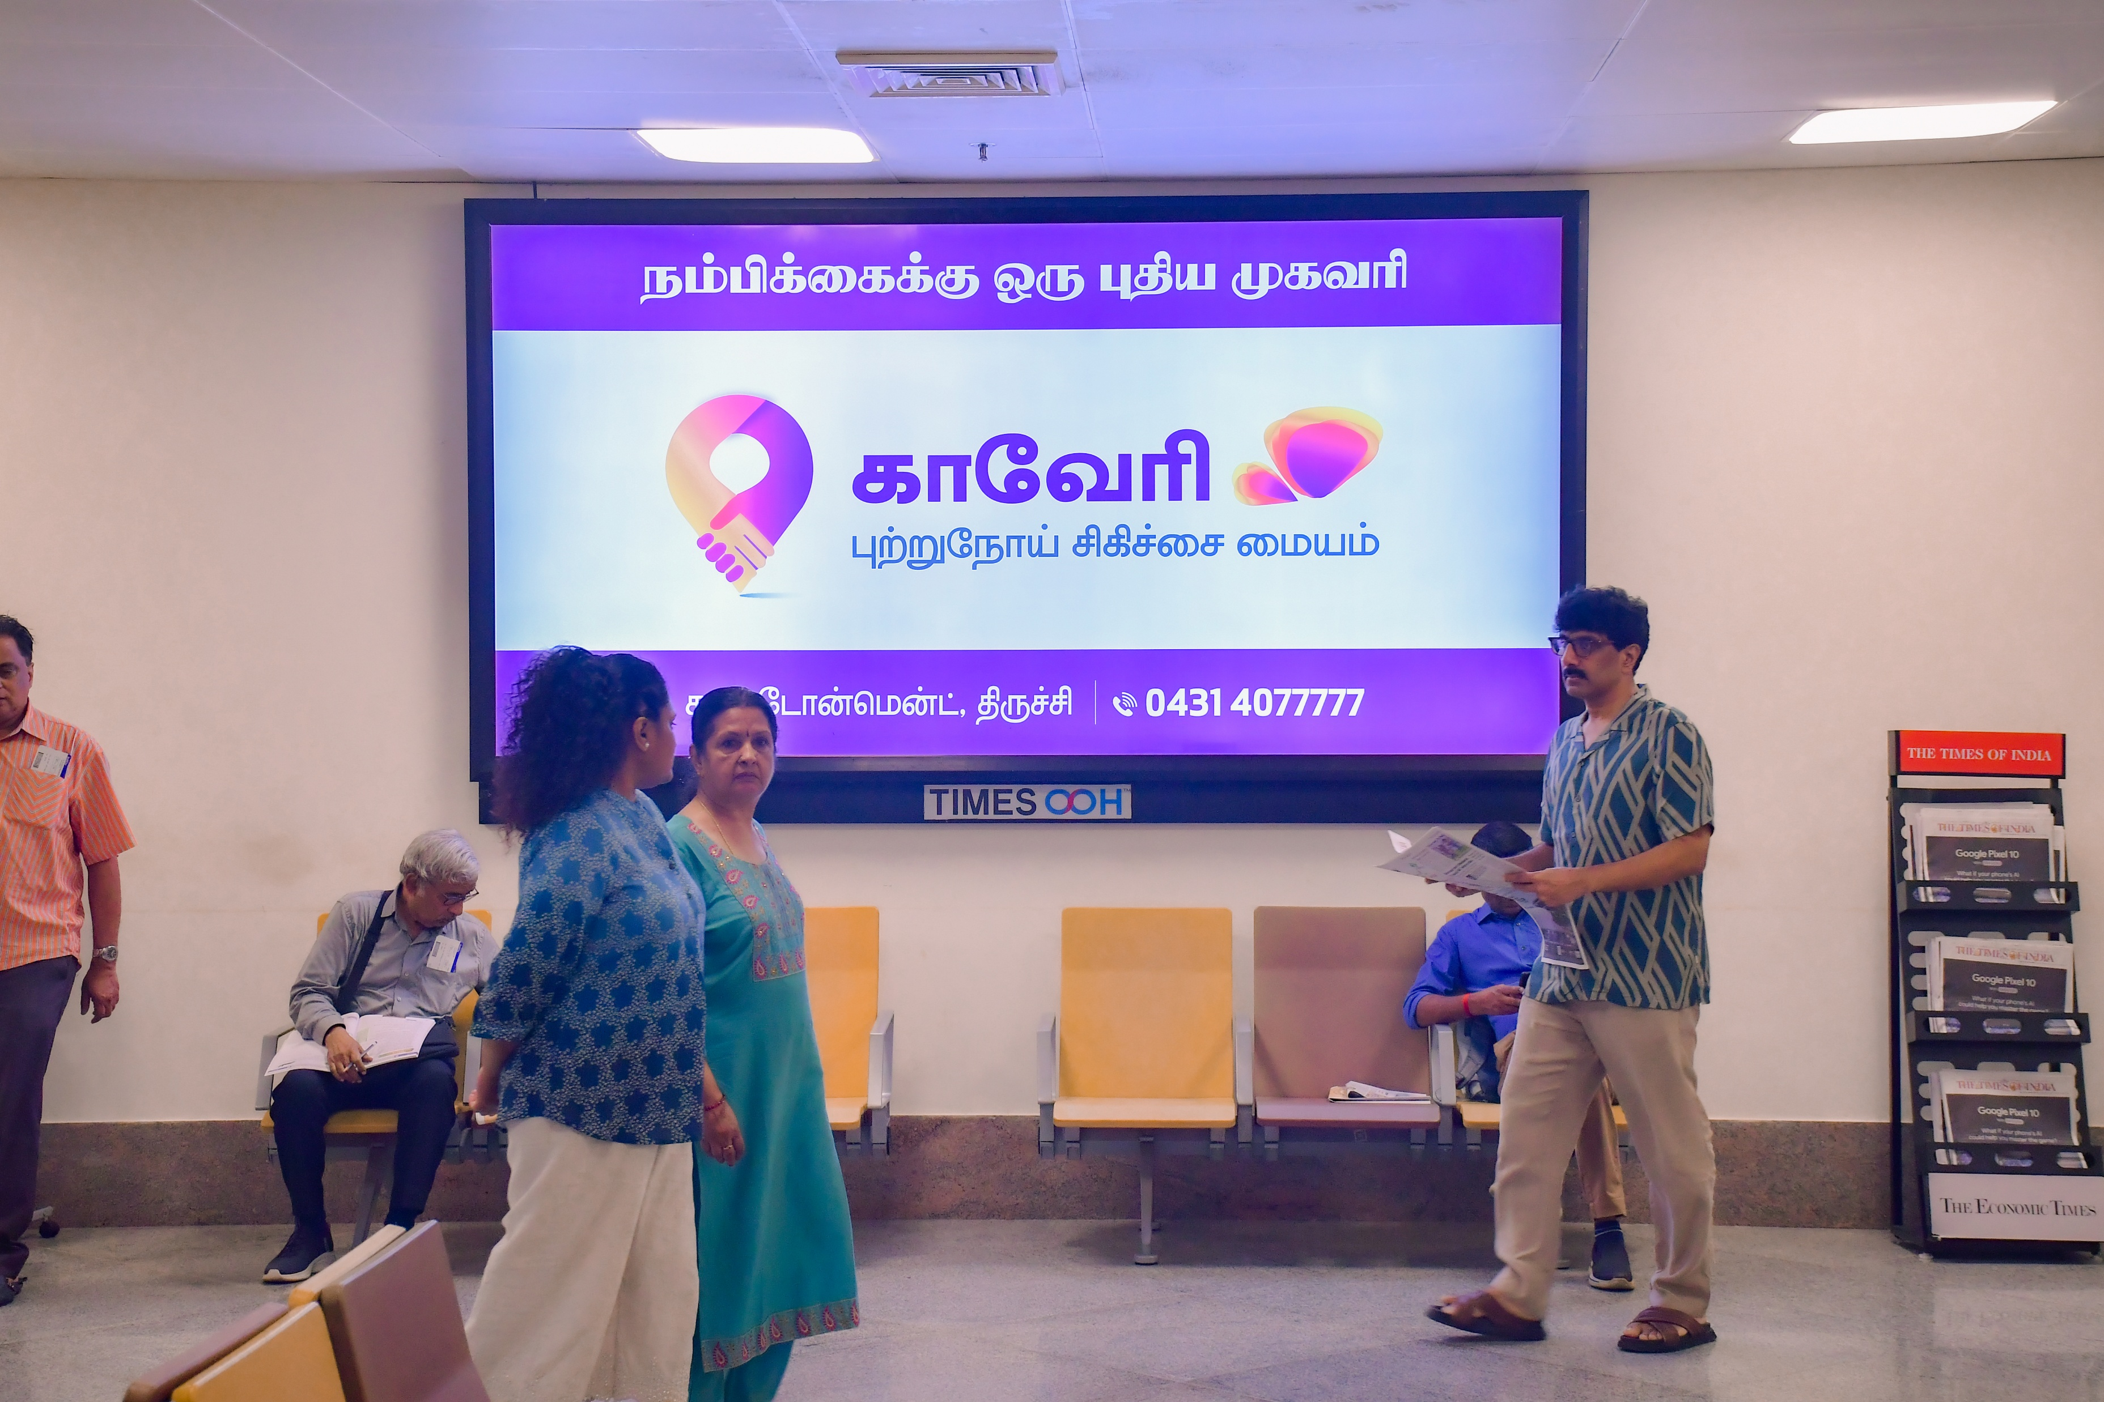
T1- DOMESTIC
Departure | Inside Security Hold Area | 10 W X 5 H ft (Only 1 Unit) | Back Lit
Static Lightbox Single Sided
www.themediaant.com
Notes:
‹#›

Slide 13
T1- DOMESTIC
Departure | Inside Security Hold Area | 10 W X 5 H ft (Only 1 Unit) | Back Lit
www.themediaant.com
Notes:
‹#›

Slide 14
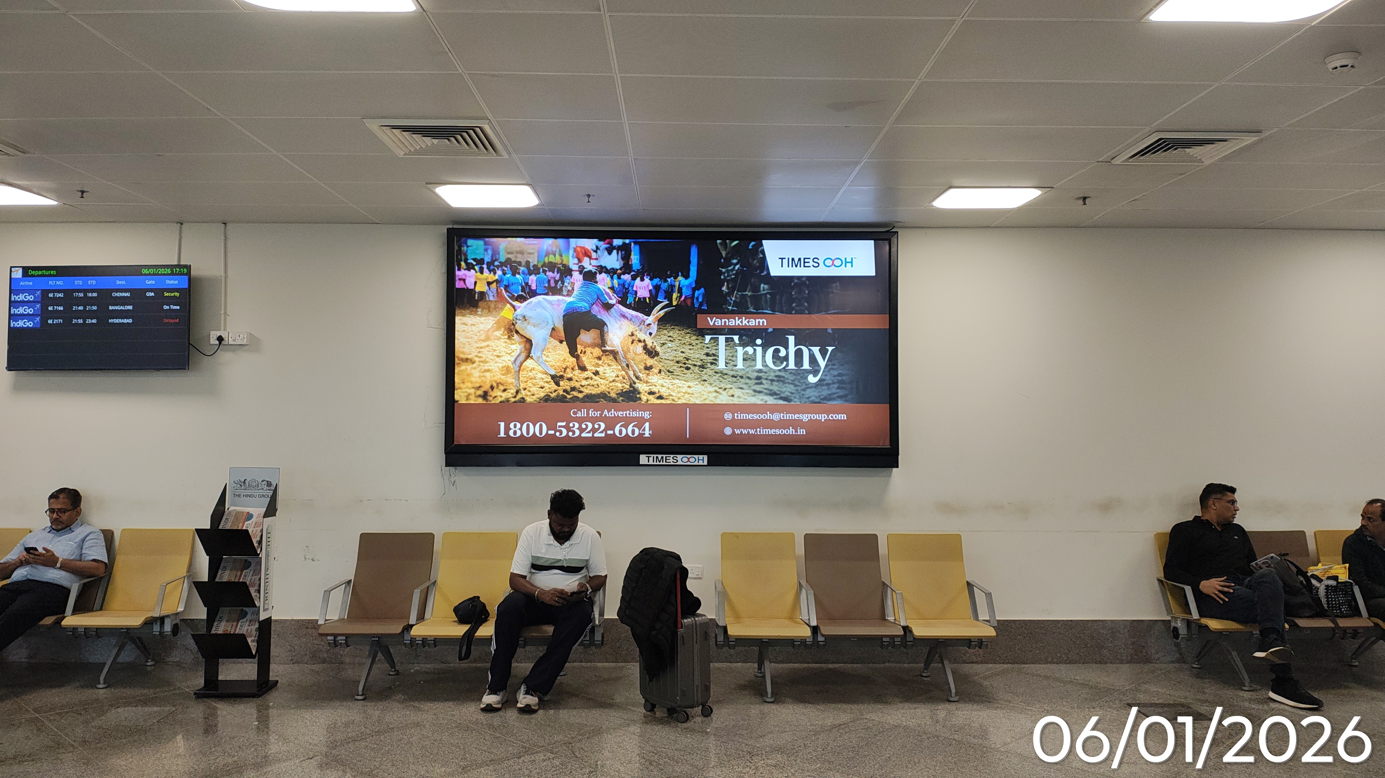
T1- DOMESTIC
Departure | Inside Security Hold Area | 10 W X 5 H ft (Only 1 Unit) | Back Lit
Static Lightbox Single Sided
www.themediaant.com
Notes:
‹#›

Slide 15
T1- DOMESTIC
Departure | Inside Security Hold Area | 10 W X 5 H ft (Only 1 Unit) | Back Lit
www.themediaant.com
Notes:
‹#›

Slide 16
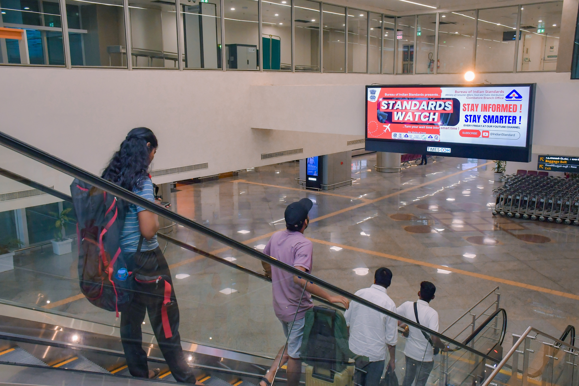
T1- DOMESTIC
Arrival | Arrival Corridor | 12 W X 4 H ft (Only 1 Unit) | Back Lit
Static Lightbox Single Sided
www.themediaant.com
Notes:
‹#›

Slide 17
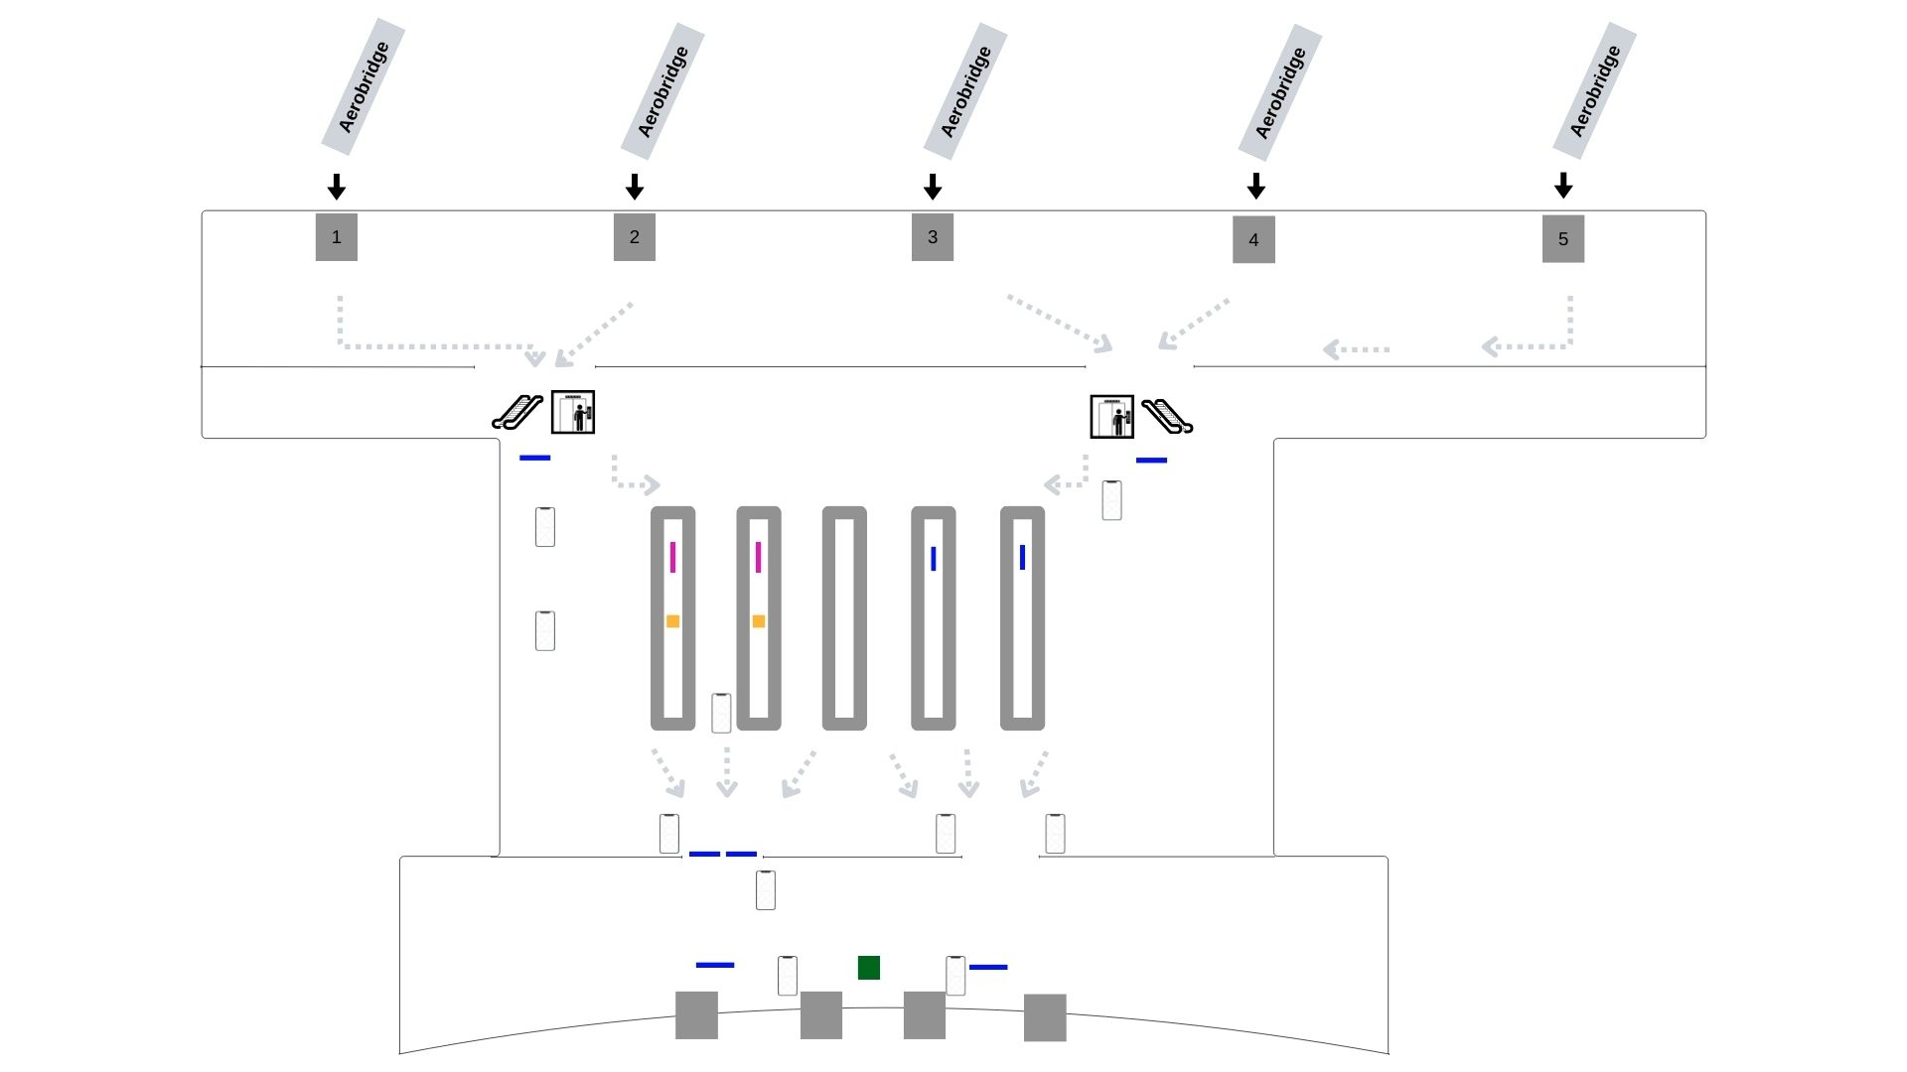
T1- DOMESTIC
Arrival | Arrival Corridor | 12 W X 4 H ft (Only 1 Unit) | Back Lit
www.themediaant.com
Notes:
‹#›

Slide 18
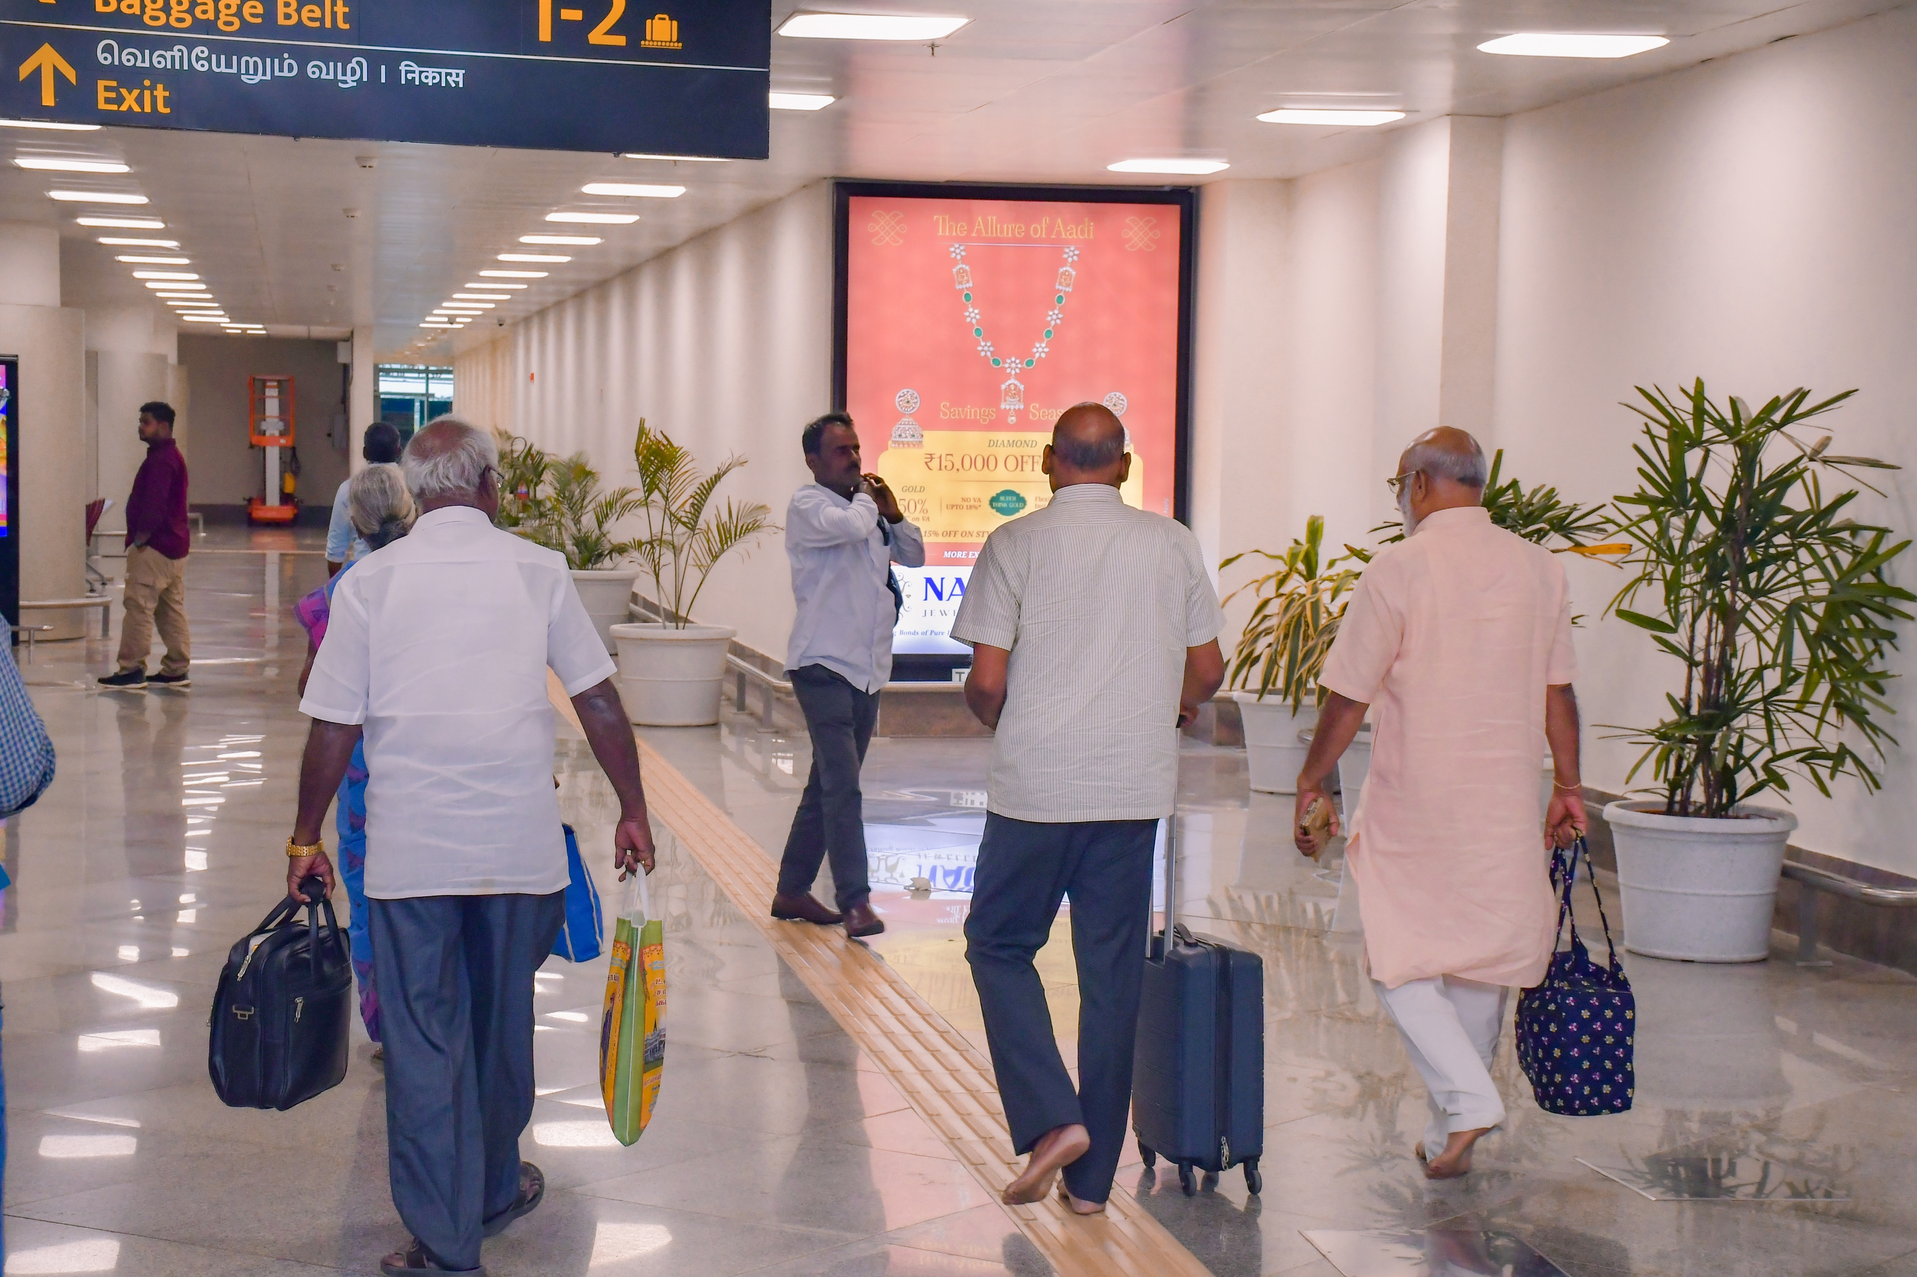
T1- DOMESTIC
Arrival | Arrival Corridor | 6 W X 8 H ft (Only 1 Unit) | Back Lit
Static Lightbox Single Sided
www.themediaant.com
Notes:
‹#›

Slide 19
T1- DOMESTIC
Arrival | Arrival Corridor | 6 W X 8 H ft (Only 1 Unit) | Back Lit
www.themediaant.com
Notes:
‹#›

Slide 20
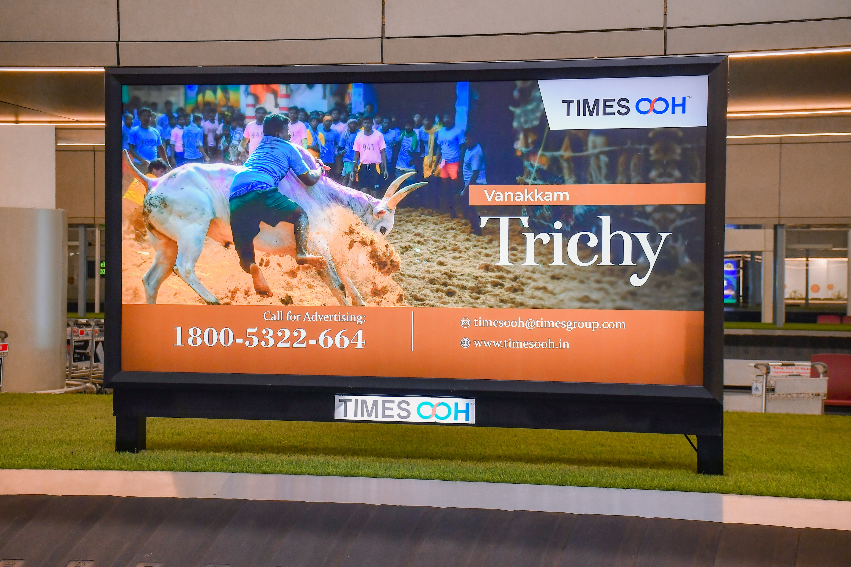
T1- DOMESTIC
Arrival | Baggage Reclaim Area | 8 W X 4 H ft (Package Of 2 Units) | Back Lit
Static Lightbox Single Sided
www.themediaant.com
Notes:
‹#›

Slide 21
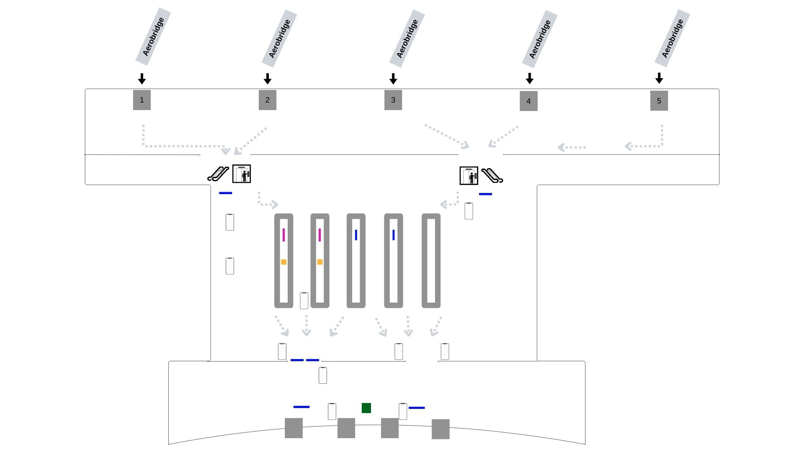
T1- DOMESTIC
Arrival | Baggage Reclaim Area | 8 W X 4 H ft (Package Of 2 Units) | Back Lit
www.themediaant.com
Notes:
‹#›

Slide 22
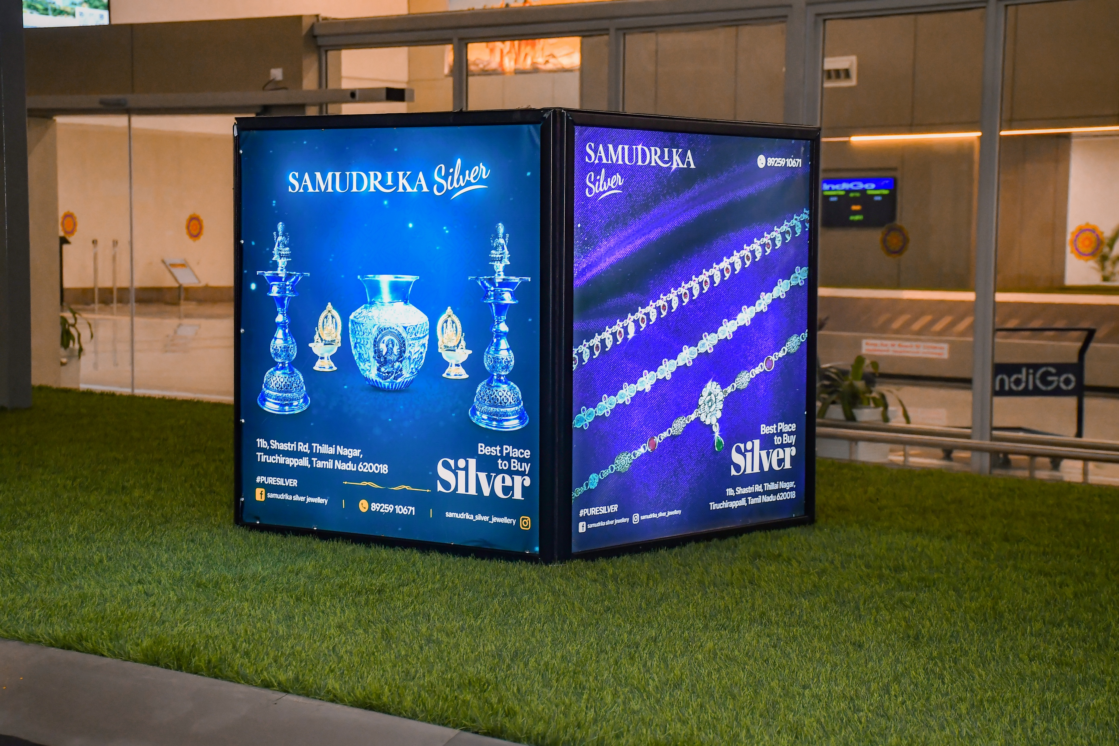
T1- DOMESTIC
Arrival | Baggage Reclaim Area | 3 W X 3 H ft (Package Of 2 Units) | Back Lit
Static Lightbox 4 Sided
www.themediaant.com
Notes:
‹#›

Slide 23
T1- DOMESTIC
Arrival | Baggage Reclaim Area | 3 W X 3 H ft (Package Of 2 Units) | Back Lit
www.themediaant.com
Notes:
‹#›

Slide 24
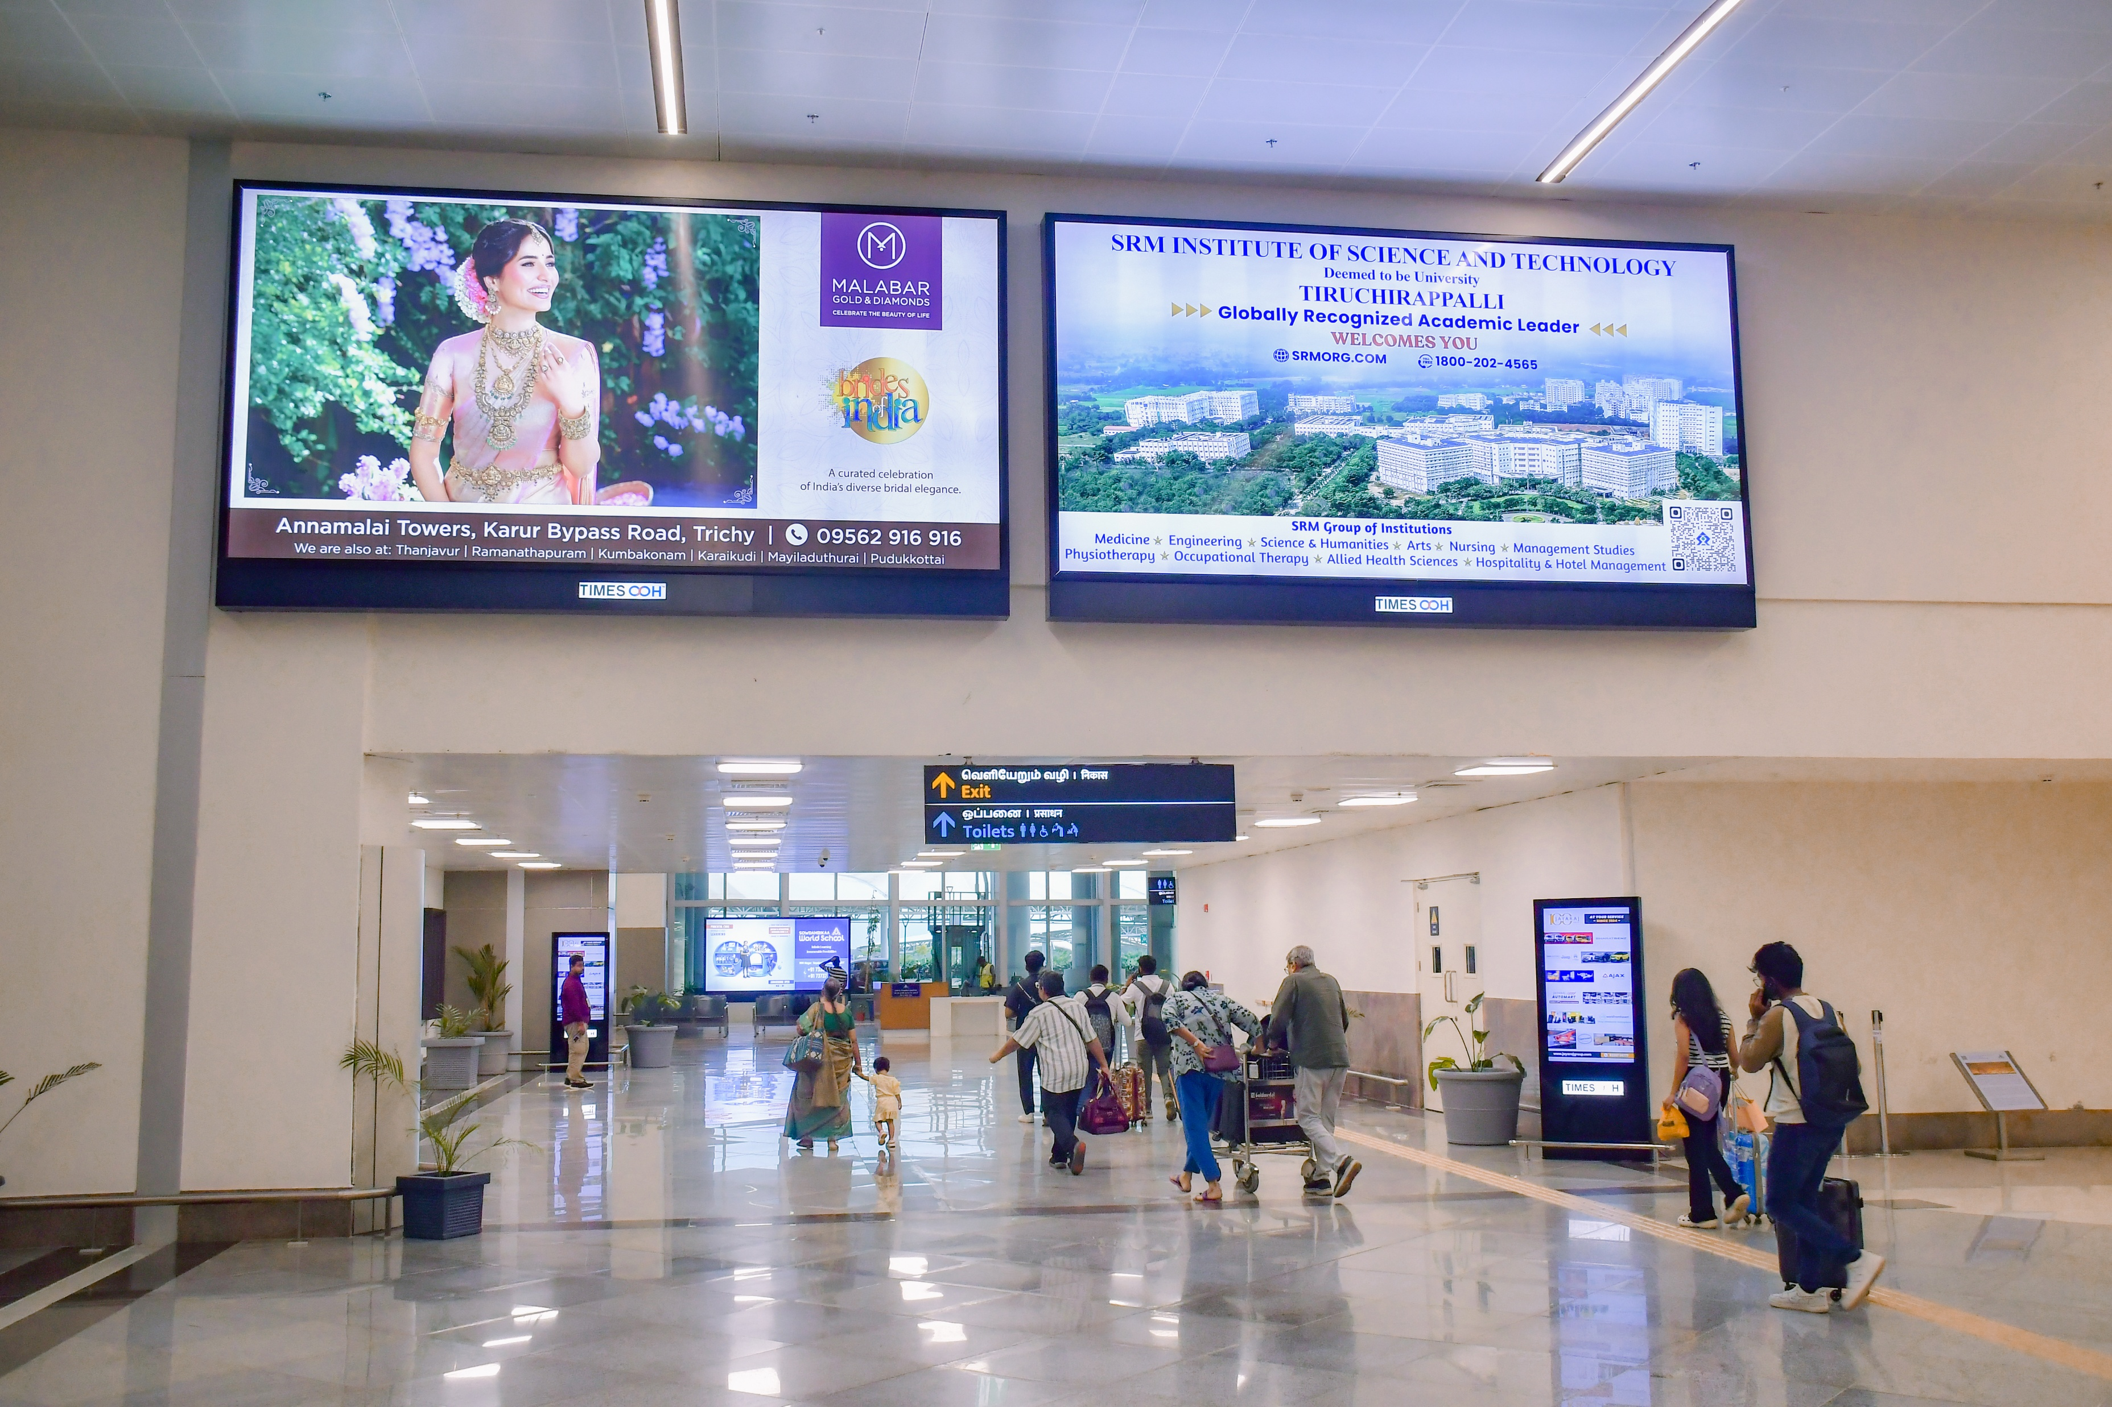
T1- DOMESTIC
Arrival | Exit Passage | 16 W X 8 H ft (Package Of 2 Units) | Back Lit
Static Lightbox Single Sided
www.themediaant.com
Notes:
‹#›

Slide 25
T1- DOMESTIC
Arrival | Exit Passage | 16 W X 8 H ft (Package Of 2 Units) | Back Lit
www.themediaant.com
Notes:
‹#›

Slide 26
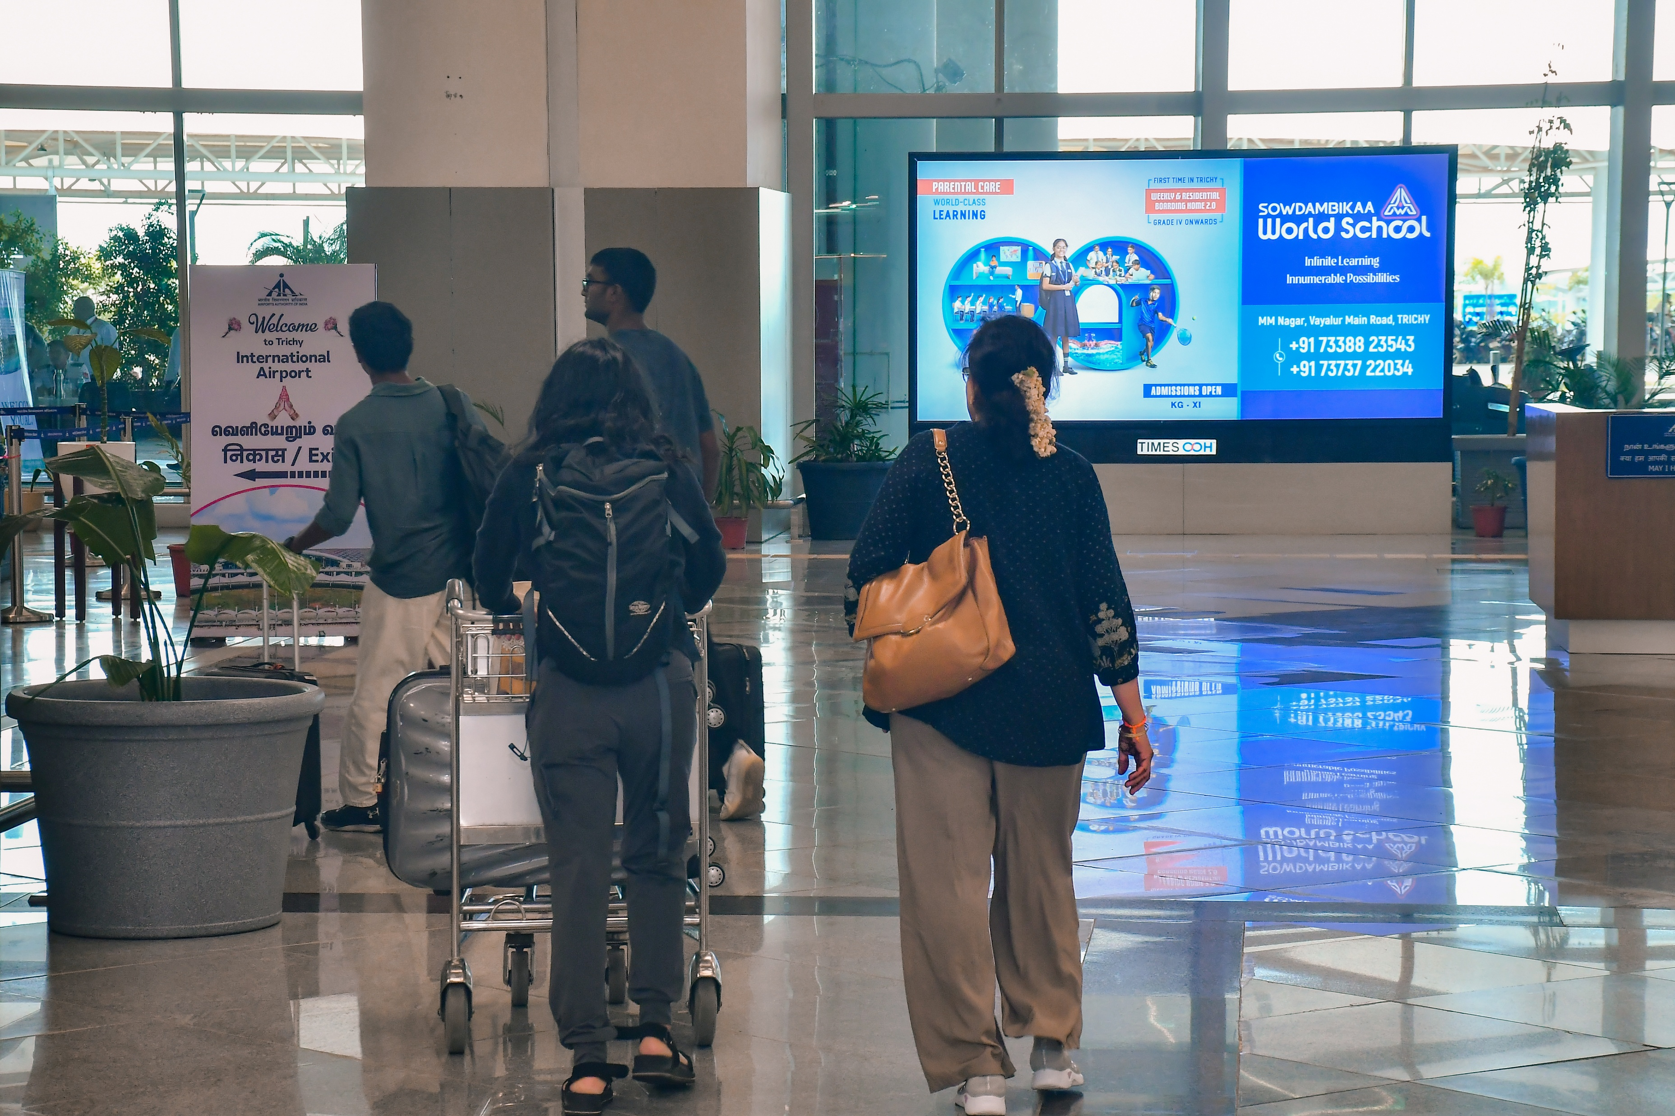
T1- DOMESTIC
Arrival | Exit Passage | 12 W X 6 H ft (Only 1 Unit) | Back Lit
Static Lightbox Single Sided
www.themediaant.com
Notes:
‹#›

Slide 27
T1- DOMESTIC
Arrival | Exit Passage | 12 W X 6 H ft (Only 1 Unit) | Back Lit
www.themediaant.com
Notes:
‹#›

Slide 28




www.themediaant.com
ad@themediaant.com
Thank You
080-067415510
Empowering All To Advertise
Notes:
‹#›

