Slide 1















Empowering All To Advertise
Tiruchirappalli
Airport
Digital Screen
Notes:
‹#›

Slide 2

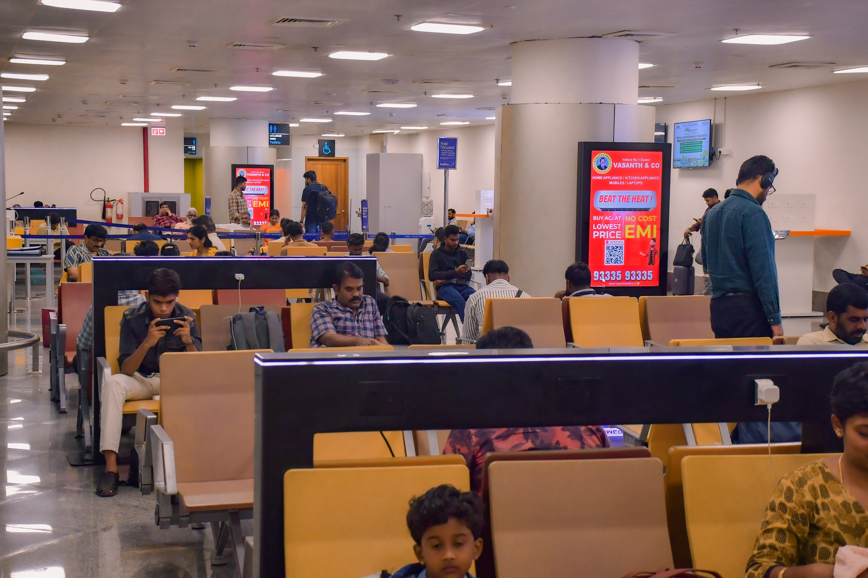
T1- DOMESTIC
Departure | Check In To Boarding Gate | 2.5 W X 5 H ft (Package Of 10 Units) | 15 Sec In Every 2.5 Min
Digital Pod
www.themediaant.com
Notes:
‹#›

Slide 3
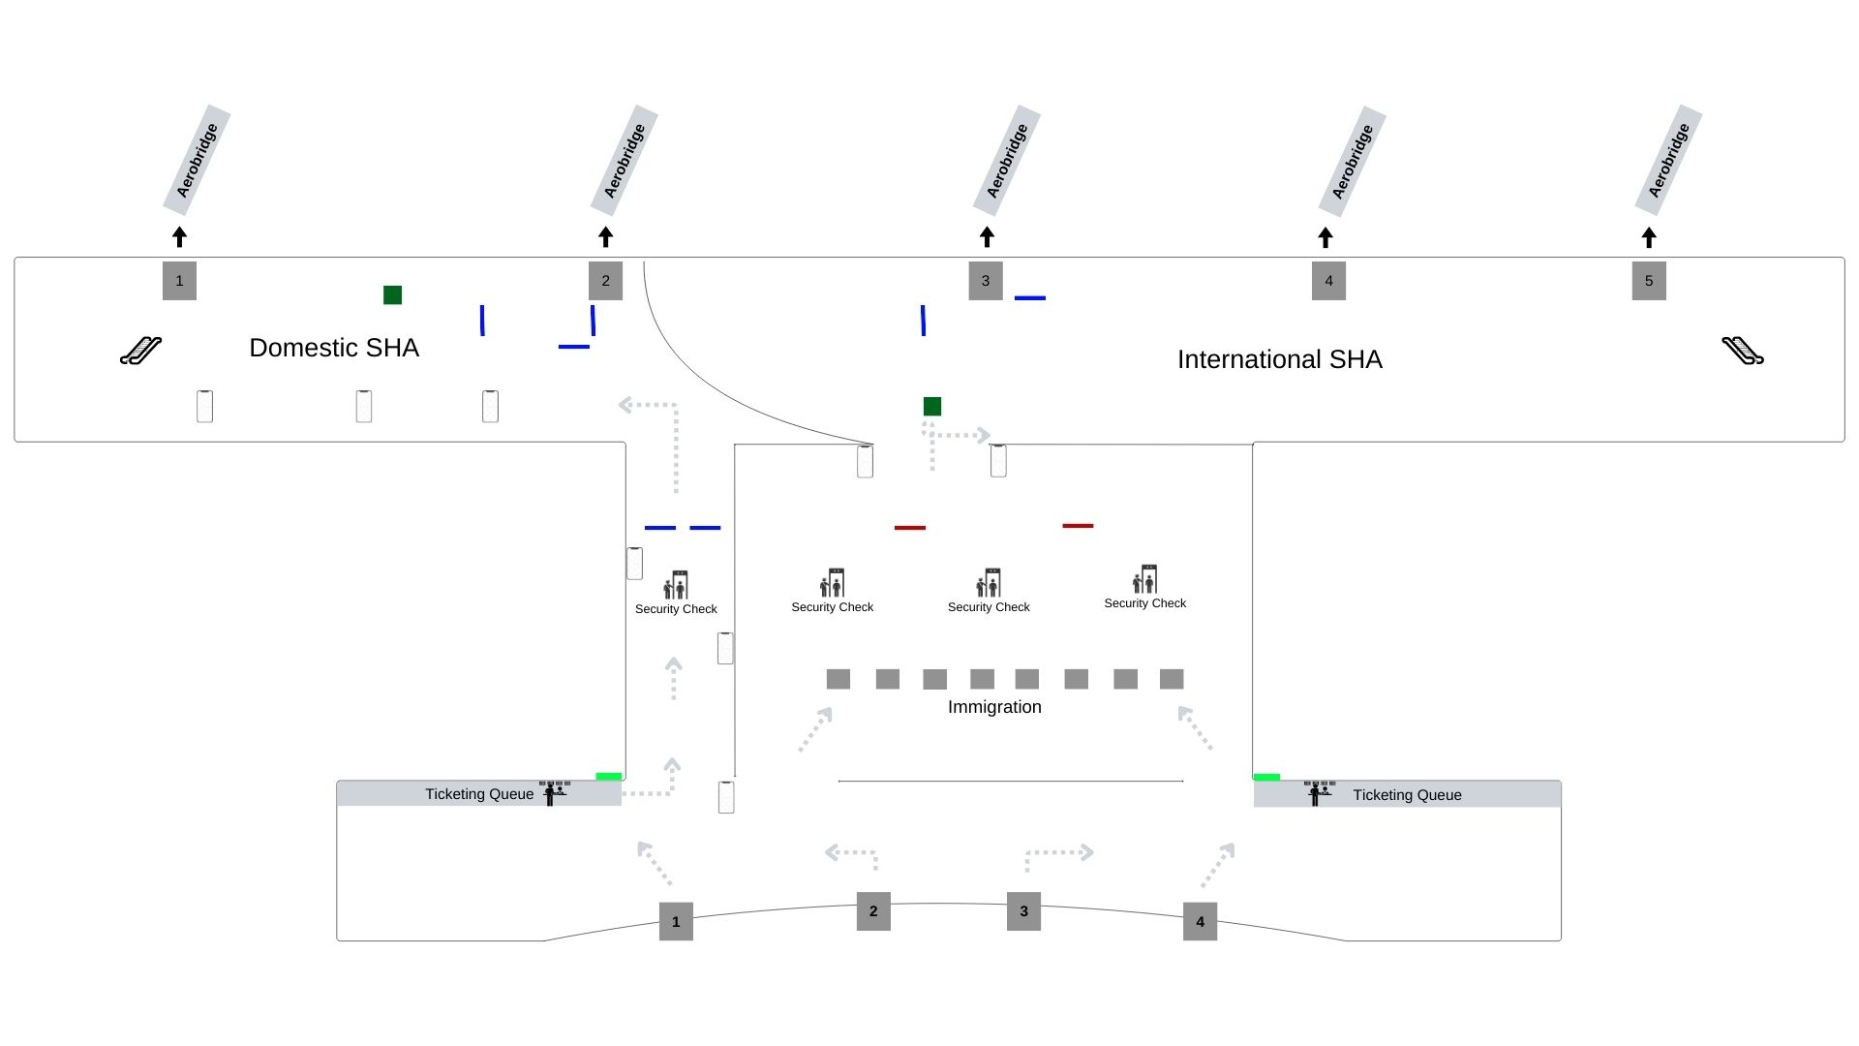
T1- DOMESTIC
Departure | Check In To Boarding Gate | 2.5 W X 5 H ft (Package Of 10 Units) | 15 Sec In Every 2.5 Min
www.themediaant.com
Notes:
‹#›

Slide 4
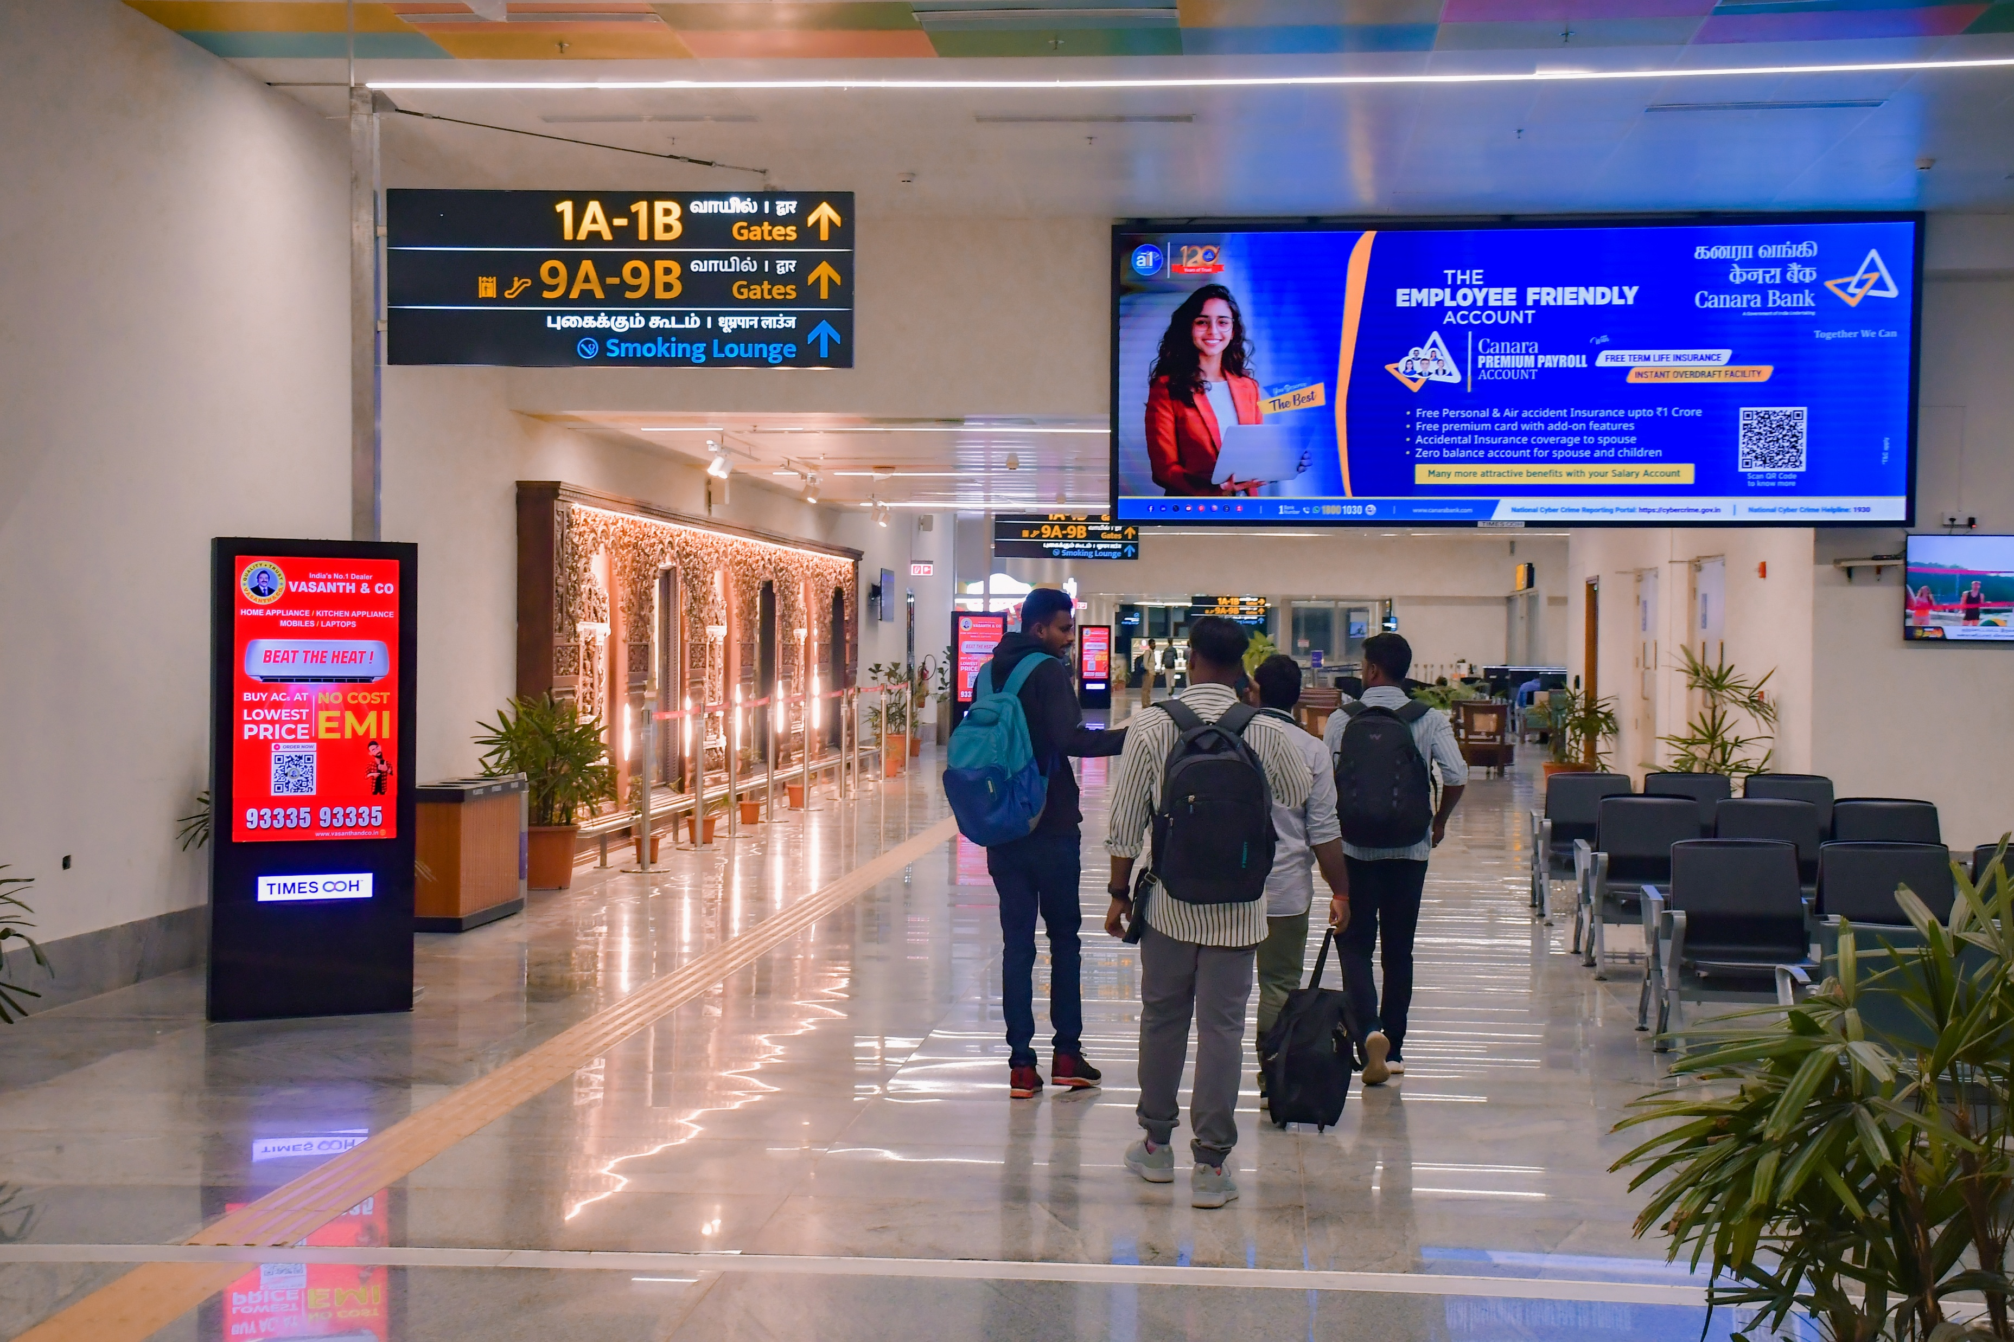
T1- DOMESTIC
Departure | Inside Security Hold Area | 18 W X 6 H ft (Only 1 Unit) | 15 Sec In Every 1.5 Min
Digital Wall
www.themediaant.com
Notes:
‹#›

Slide 5
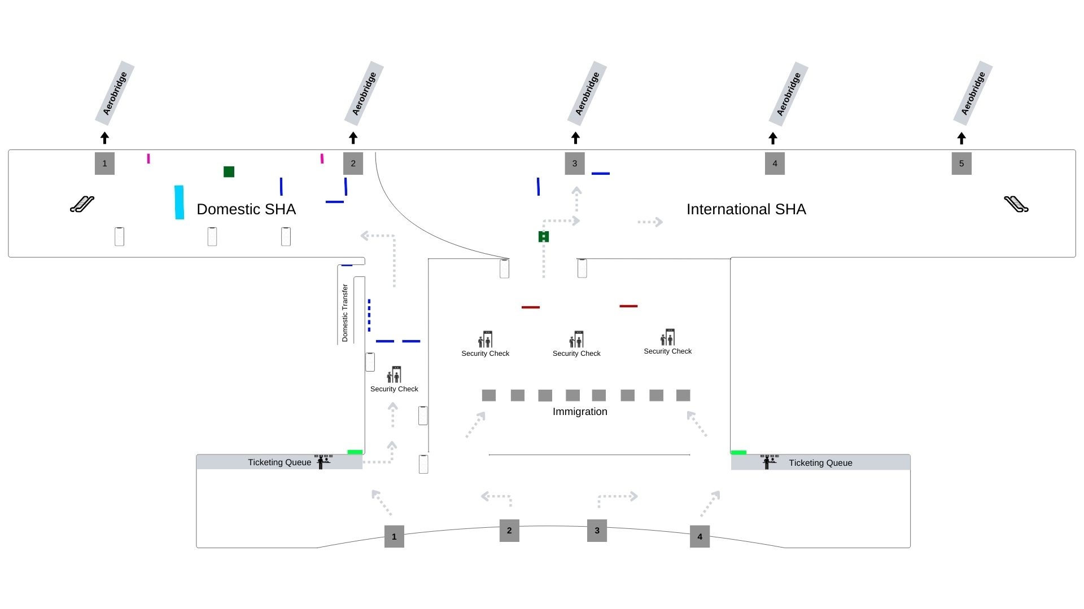
T1- DOMESTIC
Departure | Inside Security Hold Area | 18 W X 6 H ft (Only 1 Unit) | 15 Sec In Every 1.5 Min
www.themediaant.com
Notes:
‹#›

Slide 6
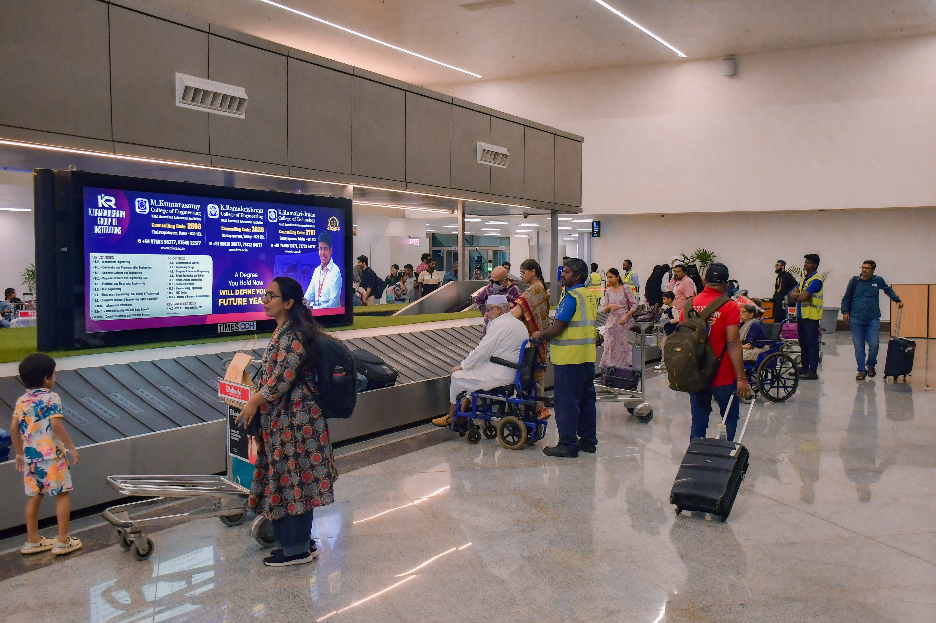
T1- DOMESTIC
Arrival | Baggage Reclaim Area | 12 W X 4 H ft (Package Of 2 Units) | 15 Sec In Every 1.5 Min
Digital Scroller
www.themediaant.com
Notes:
‹#›

Slide 7
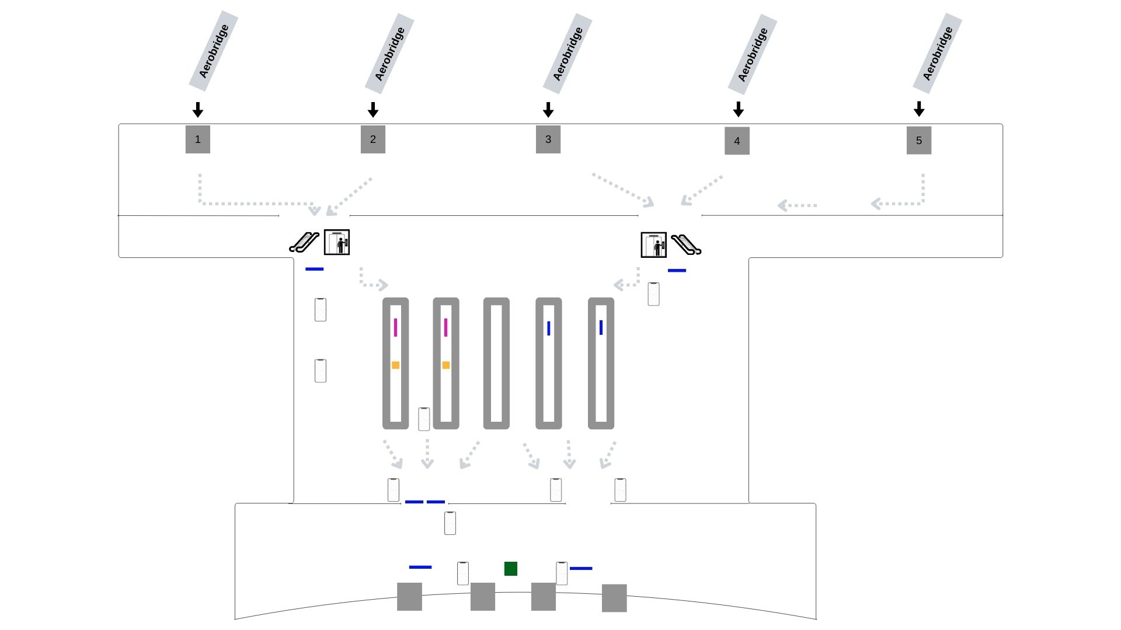
T1- DOMESTIC
Arrival | Baggage Reclaim Area | 12 W X 4 H ft (Package Of 2 Units) | 15 Sec In Every 1.5 Min
www.themediaant.com
Notes:
‹#›

Slide 8
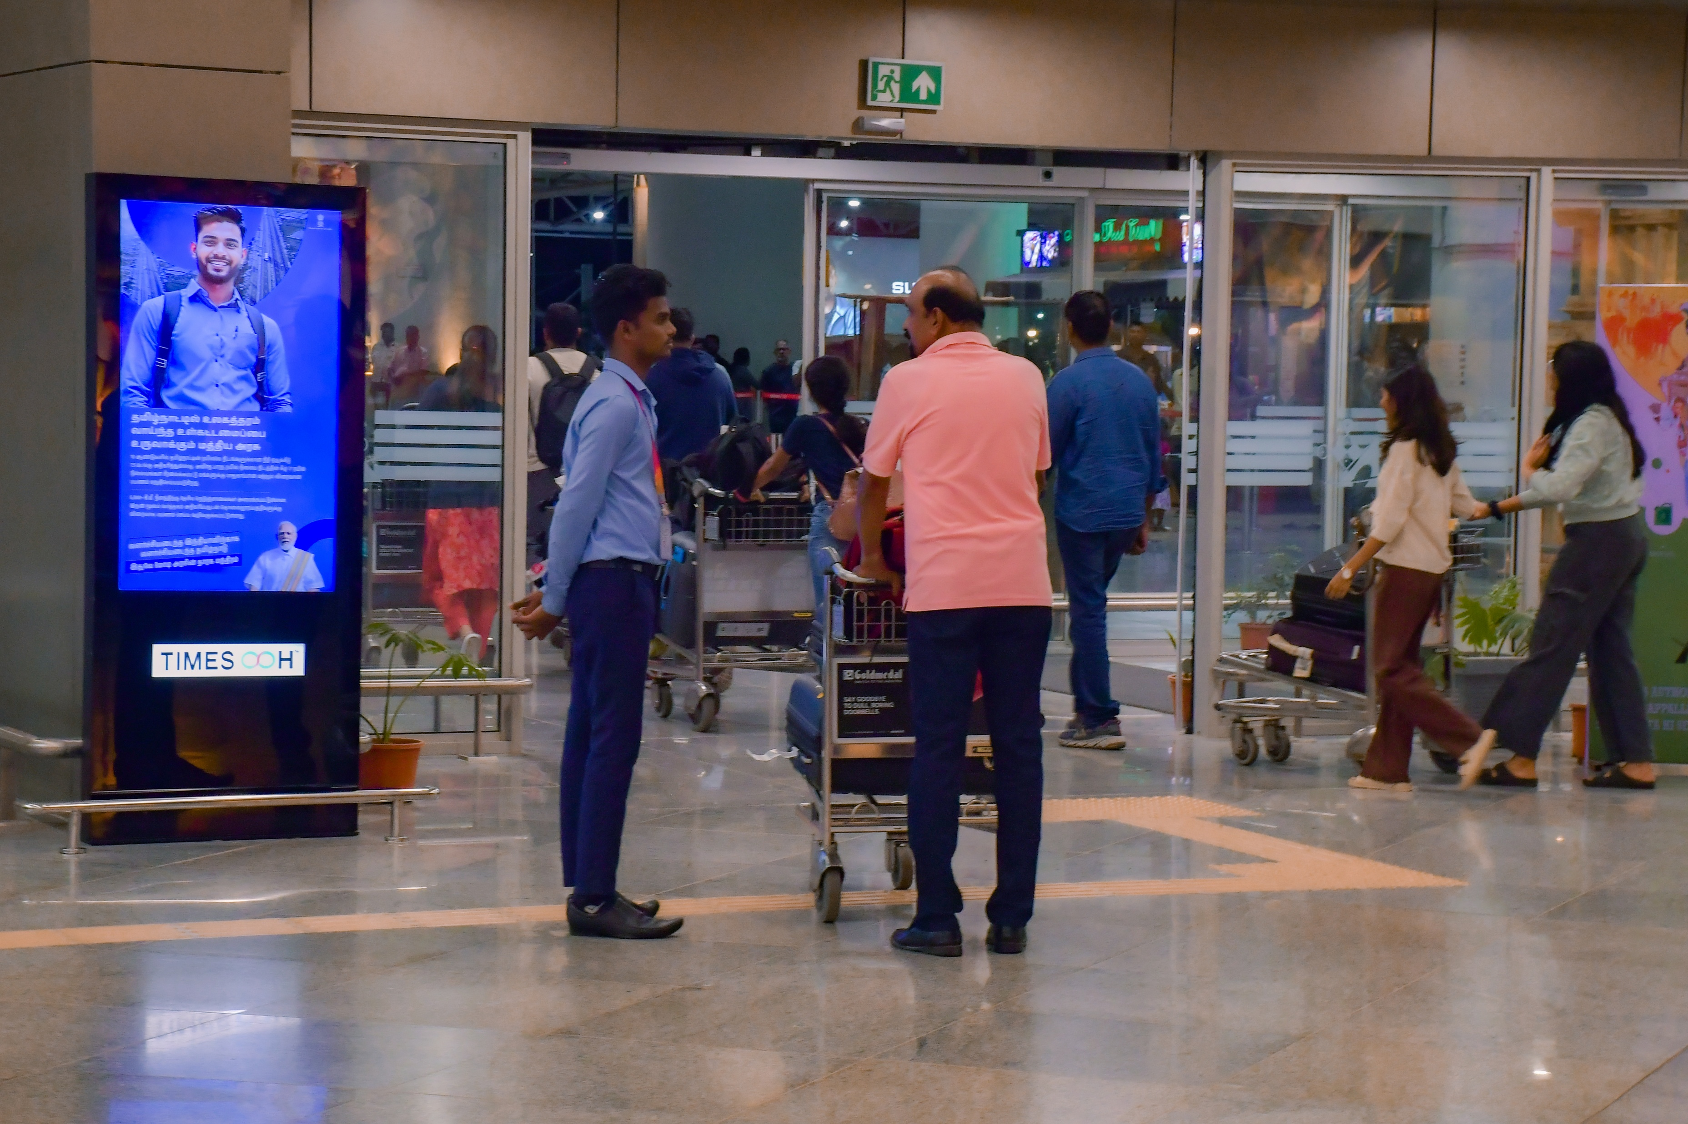
T1- DOMESTIC
Arrival | Baggage Belt To Exit Gate | 2.5 W X 5 H ft (Package Of 10 Units) | 15 Sec In Every 2 Min
Digital Pod
www.themediaant.com
Notes:
‹#›

Slide 9
T1- DOMESTIC
Arrival | Baggage Belt To Exit Gate | 2.5 W X 5 H ft (Package Of 10 Units) | 15 Sec In Every 2 Min
www.themediaant.com
Notes:
‹#›

Slide 10




www.themediaant.com
ad@themediaant.com
Thank You
080-067415510
Empowering All To Advertise
Notes:
‹#›

