Slide 1















Empowering All To Advertise
Tiruchirappalli
Airport
Media Kit
Notes:
‹#›

Slide 2
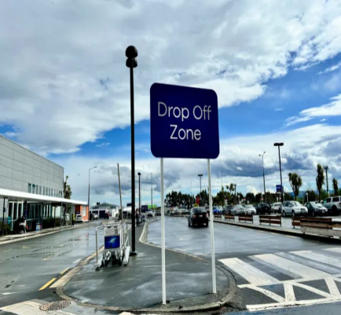
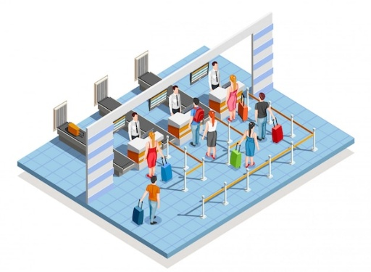
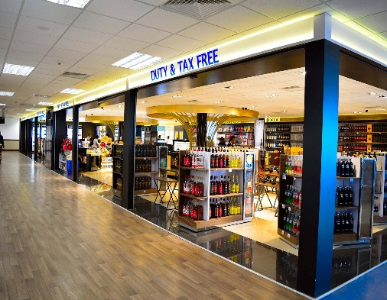
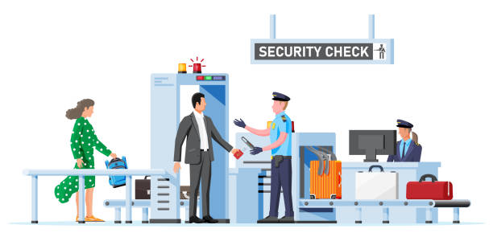
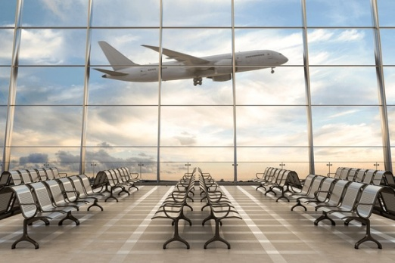
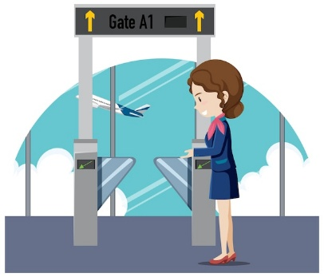

Drop Off
Check In Area
Target travelers and Waiting area Meeters & Greeters.
High Traffic Areas for Impactful advertising.
AIRPORT LAYOUT DEPARTURE
Retail Area
Security check Area
Opportunities for ads in shopping & Dinning Zone.
Captive Audience for targeted advertising
Boarding Area/ Lounge
Boarding Gate
High Dwell time area for awareness-based campaign.
Waiting Areas ideal for engagement.
www.themediaant.com

Slide 3
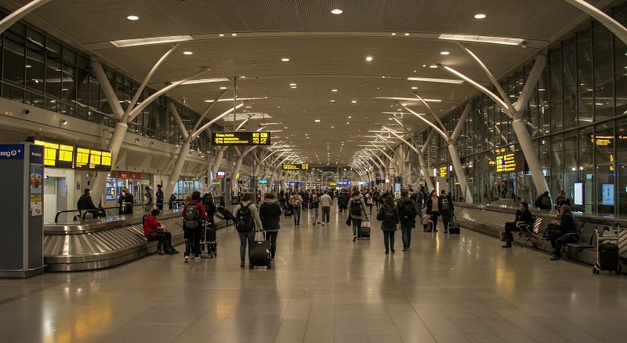
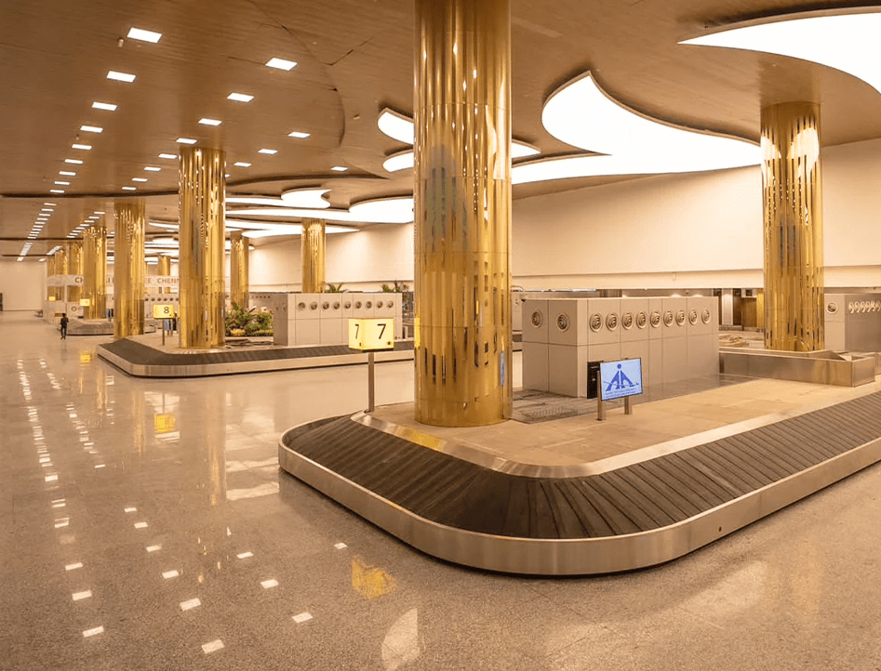
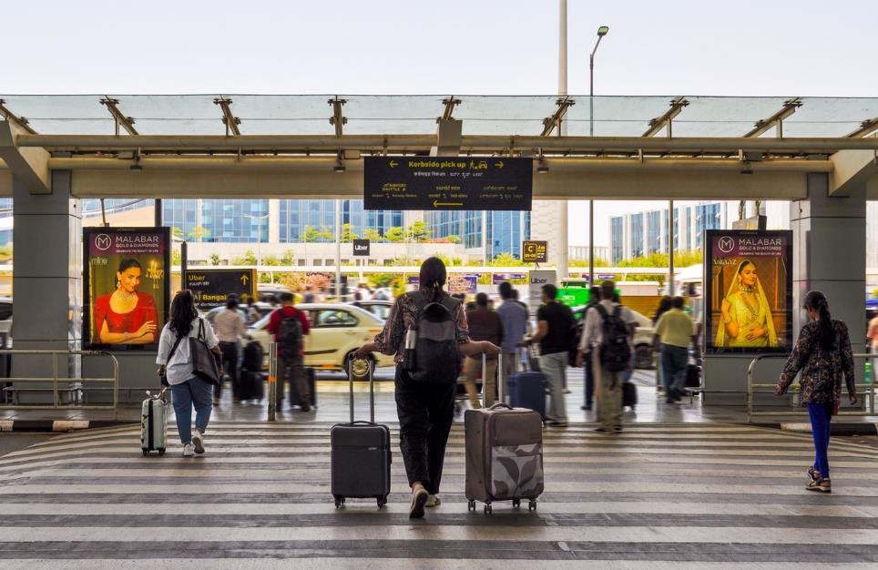
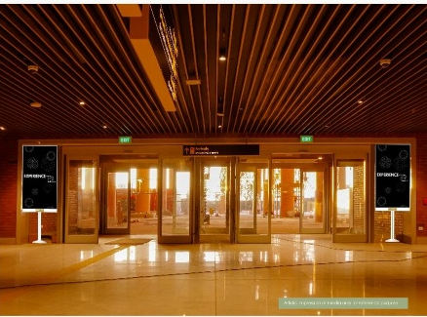
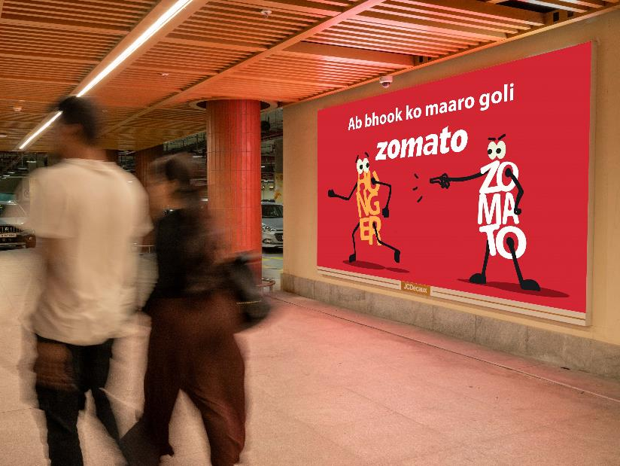
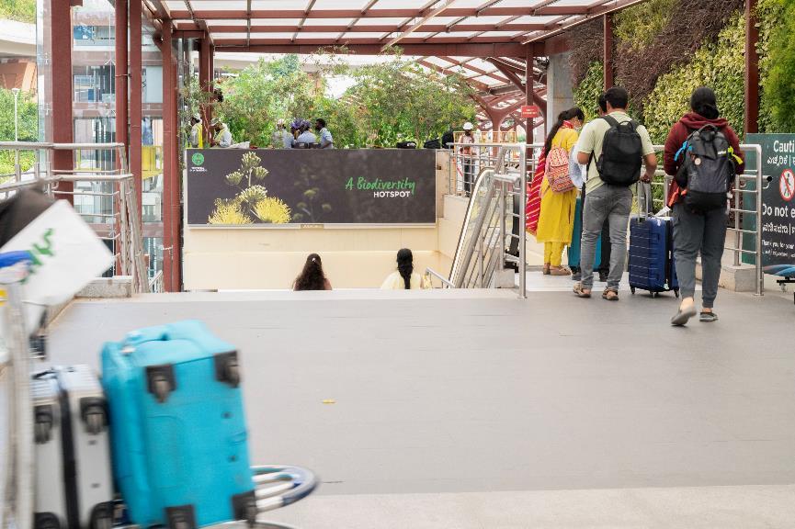
Arrival Hall
Baggage Belt
Welcoming spaces for arrival focused advertisement .
High Traffic & High Dwell time area for awareness-based campaign.
AIRPORT LAYOUT ARRIVAL
Meet & Greet Area
Exit Gate
Unique and large screen brand placement
100 % Arriving passenger coverage – Impact placement
Parking
Bus / Taxi Pick Up
www.themediaant.com

Slide 4

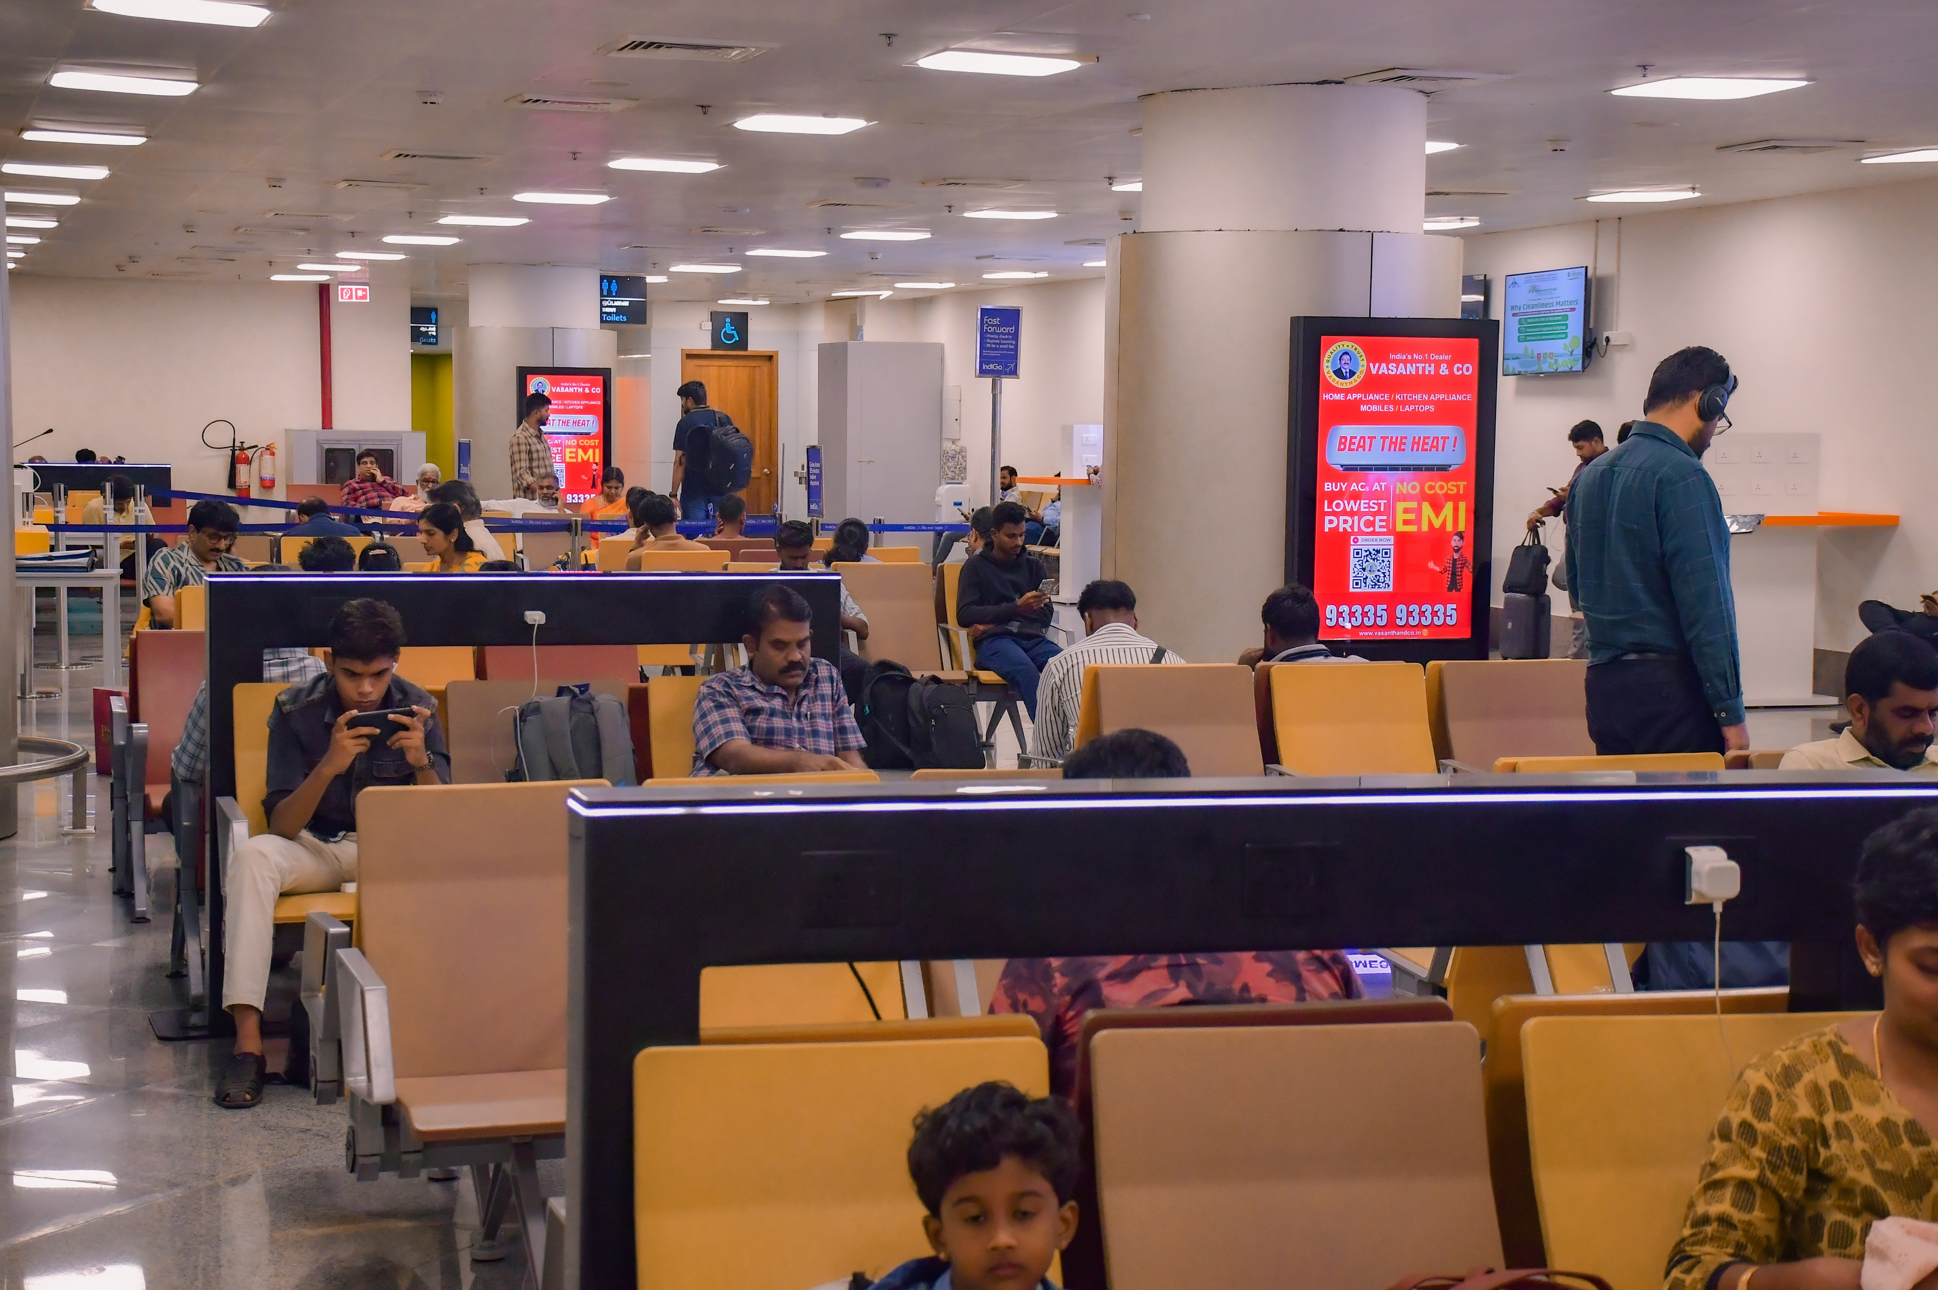
T1- DOMESTIC
Departure | Check In To Boarding Gate | 2.5 W X 5 H ft (Package Of 10 Units) | 15 Sec In Every 2.5 Min
Digital Pod
Rental Cost | 1,75,000/- P/M Per Slot
Production Cost | As Per Actual Cost
www.themediaant.com
Notes:
‹#›

Slide 5
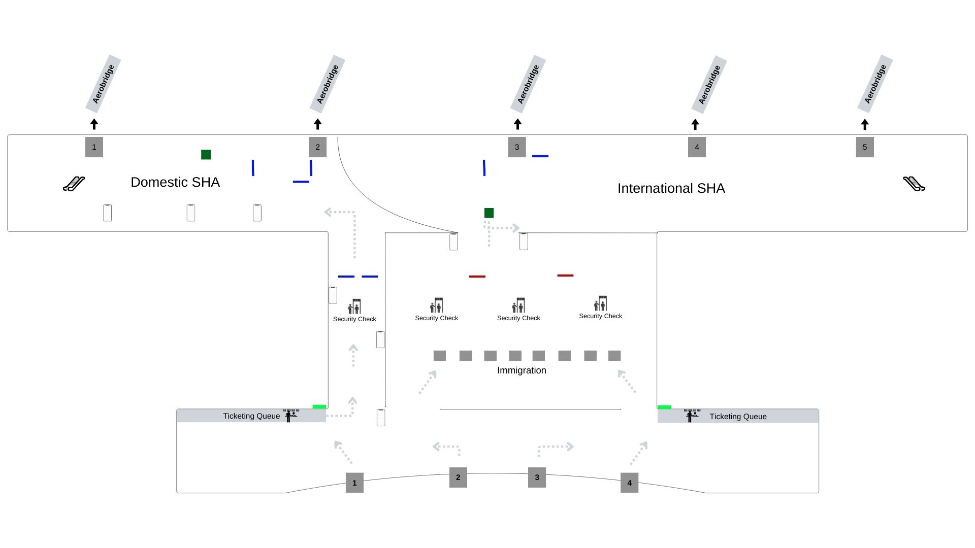
T1- DOMESTIC
Departure | Check In To Boarding Gate | 2.5 W X 5 H ft (Package Of 10 Units) | 15 Sec In Every 2.5 Min
www.themediaant.com
Notes:
‹#›

Slide 6
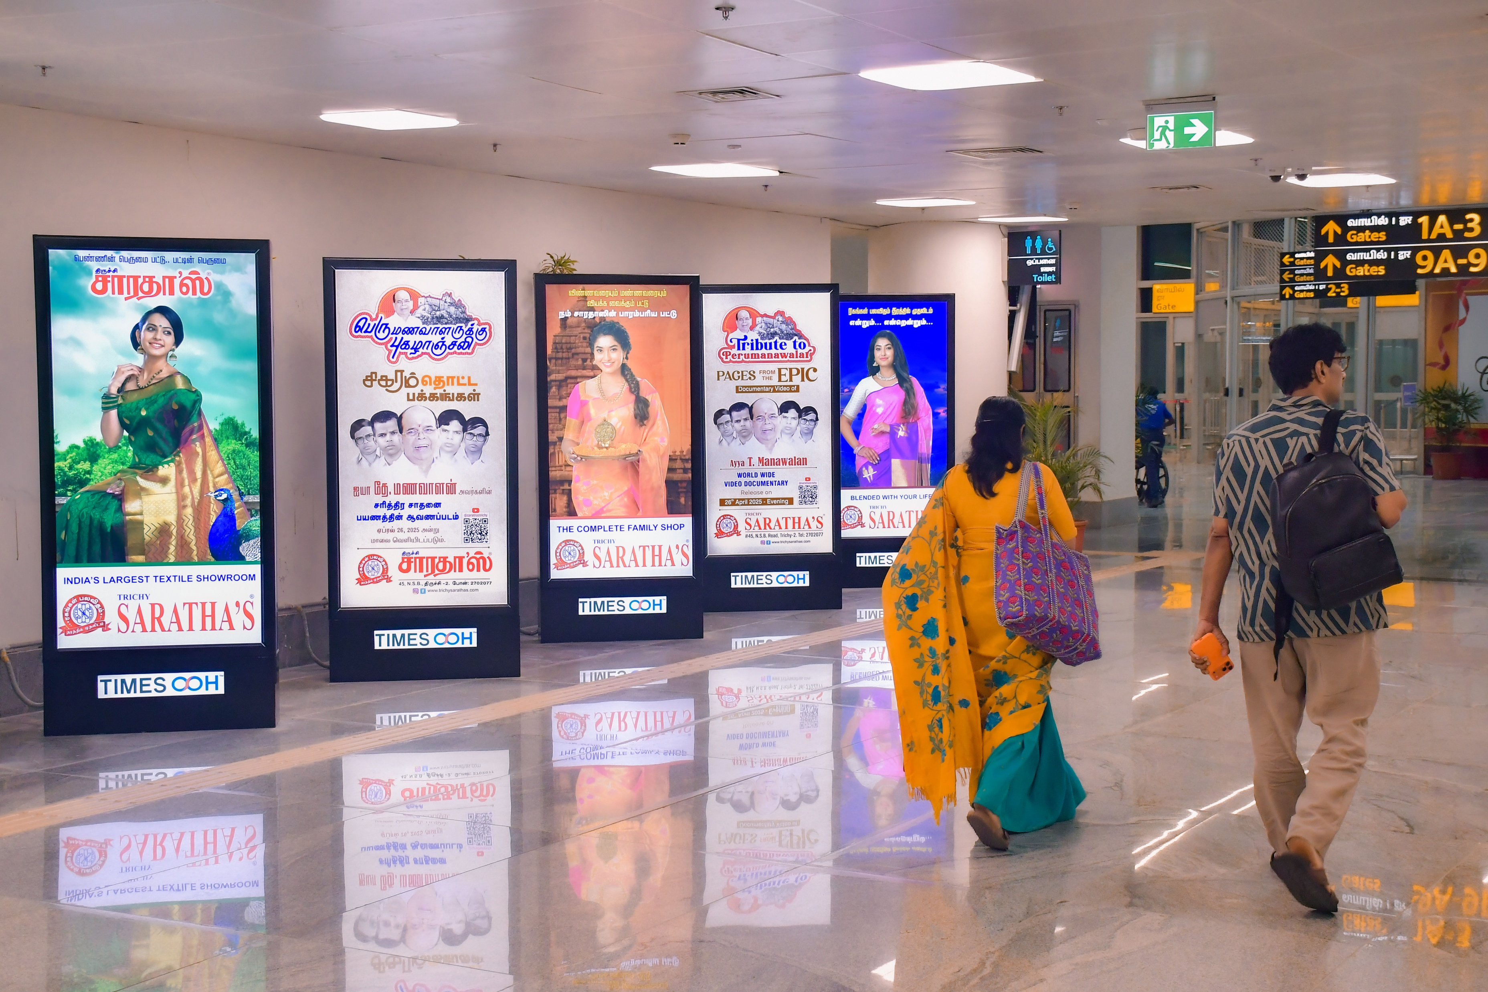
T1- DOMESTIC
Departure | Passage To Security Hold Area | 3 W X 6 H ft (Package Of 5 Units) | Back Lit
Static Lightbox Single Sided
Rental Cost | 6,00,000/- P/M
Production Cost | As Per Actual Cost
www.themediaant.com
Notes:
‹#›

Slide 7
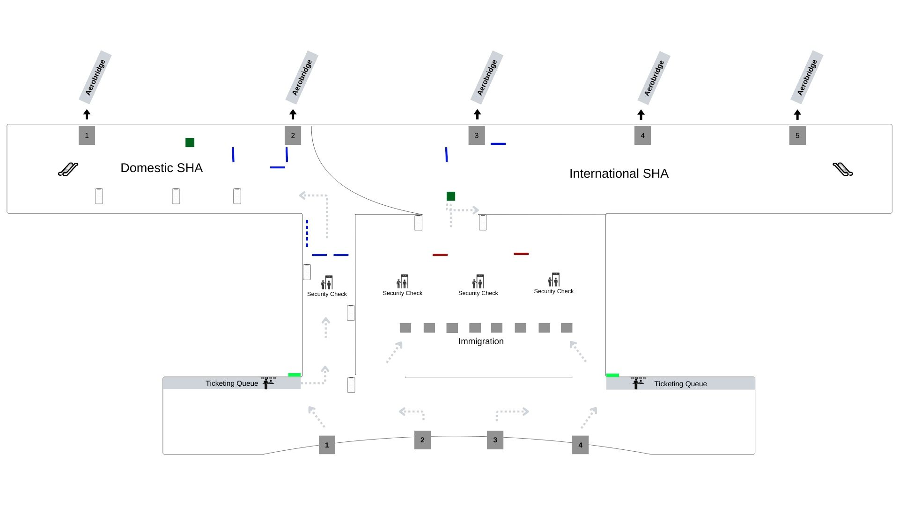
T1- DOMESTIC
Departure | Passage To Security Hold Area | 3 W X 6 H ft (Package Of 5 Units) | Back Lit
www.themediaant.com
Notes:
‹#›

Slide 8
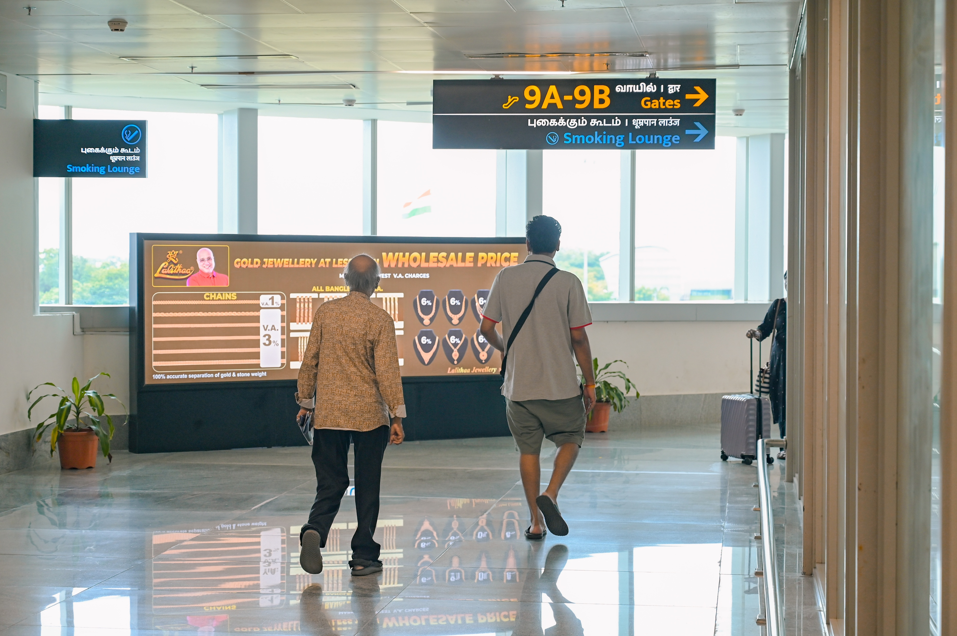
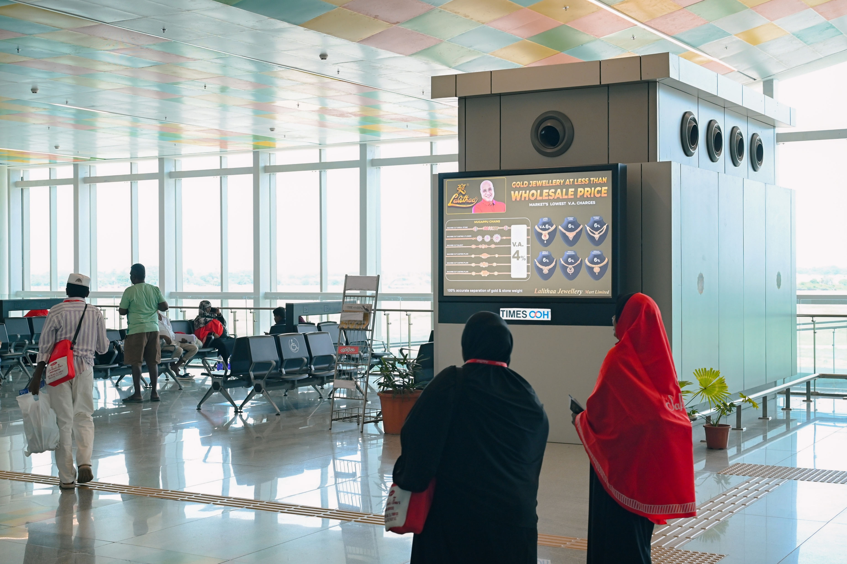
T1- DOMESTIC
Departure | Security Hold Area | 6 W X 4 H ft & 12 W X 4 H ft (Package Of 2 Units) | Back Lit
Static Lightbox Single Sided
Rental Cost | 2,85,000/- P/M
Production Cost | As Per Actual Cost
www.themediaant.com
Notes:
‹#›

Slide 9
T1- DOMESTIC
Departure | Security Hold Area | 6 W X 4 H ft & 12 W X 4 H ft (Package Of 2 Units) | Back Lit
www.themediaant.com
Notes:
‹#›

Slide 10
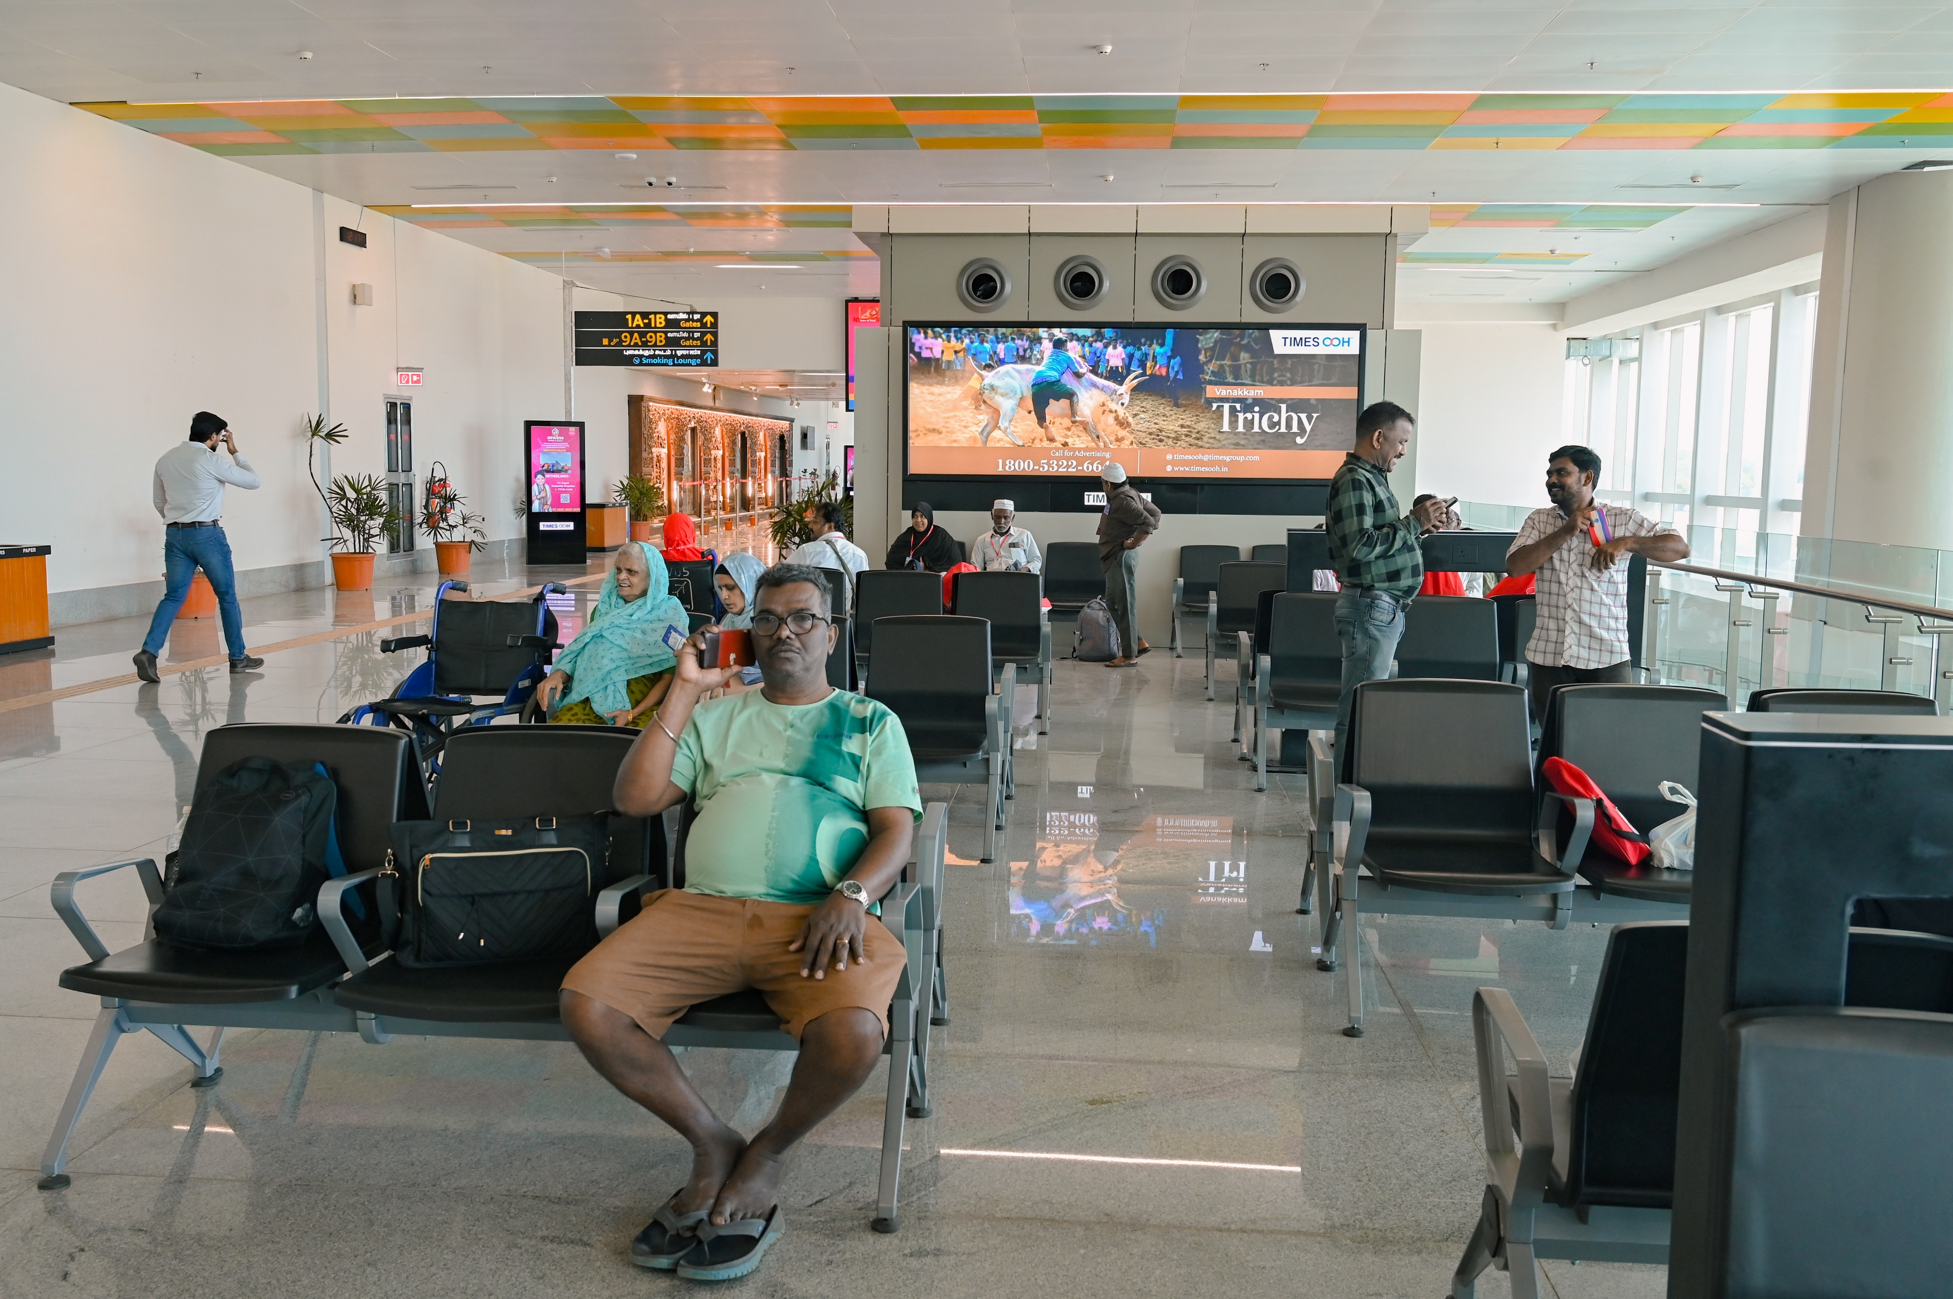
T1- DOMESTIC
Departure | Security Hold Area | 12 W X 4 H ft (Only 1 Unit) | Back Lit
Static Lightbox Single Sided
Rental Cost | 4,00,000/- P/M
Production Cost | As Per Actual Cost
www.themediaant.com
Notes:
‹#›

Slide 11
T1- DOMESTIC
Departure | Security Hold Area | 12 W X 4 H ft (Only 1 Unit) | Back Lit
www.themediaant.com
Notes:
‹#›

Slide 12
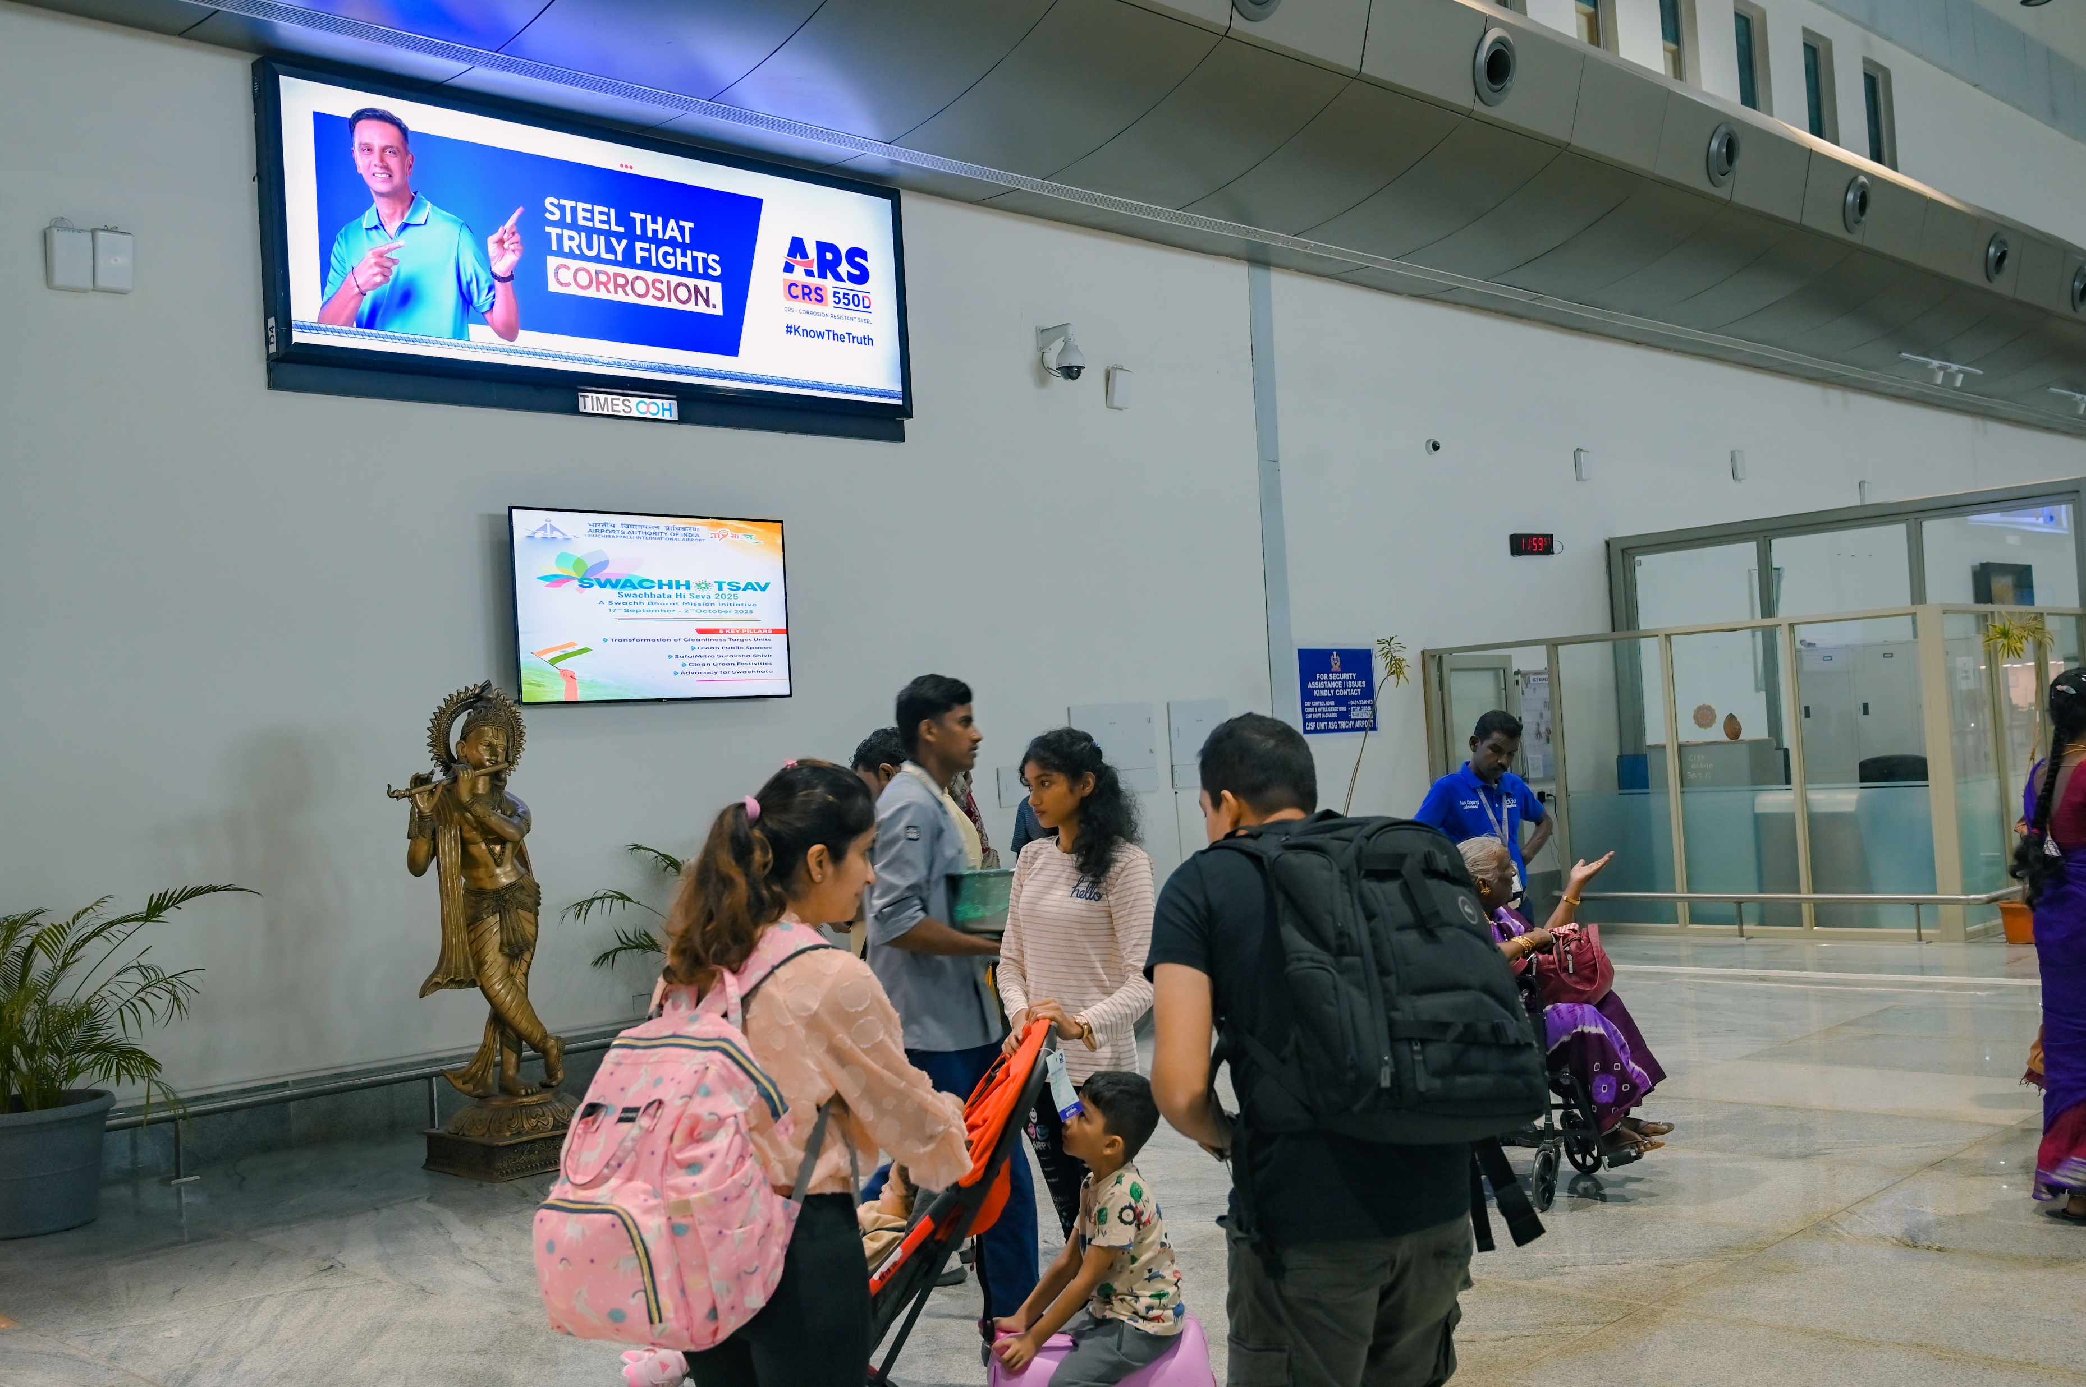
T1- DOMESTIC
Departure | After Frisking Area | 12 W X 4 H ft (Only 1 Unit) | Back Lit
Static Lightbox Single Sided
Rental Cost | 4,50,000/- P/M
Production Cost | As Per Actual Cost
www.themediaant.com
Notes:
‹#›

Slide 13
T1- DOMESTIC
Departure | After Frisking Area | 12 W X 4 H ft (Only 1 Unit) | Back Lit
www.themediaant.com
Notes:
‹#›

Slide 14
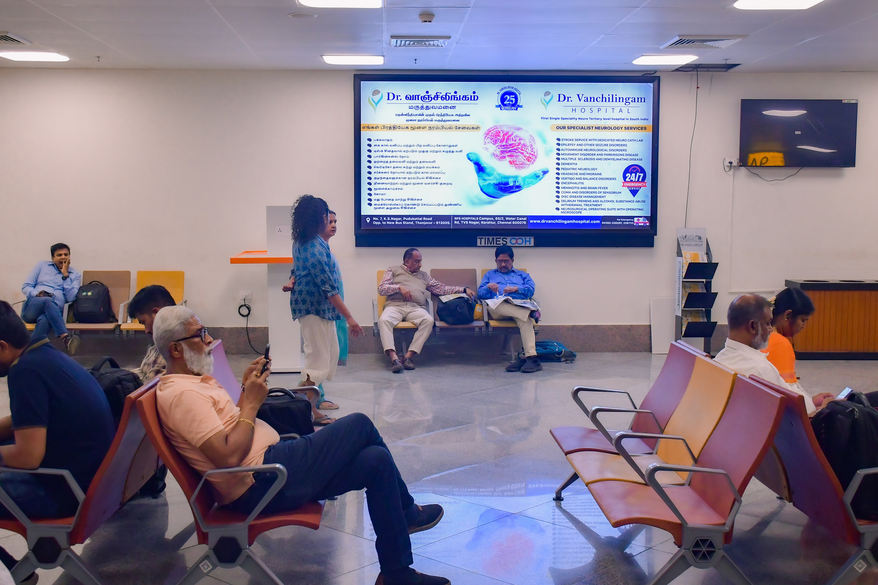
T1- DOMESTIC
Departure | Inside Security Hold Area | 10 W X 5 H ft (Only 1 Unit) | Back Lit
Static Lightbox Single Sided
Rental Cost | 3,50,000/- P/M
Production Cost | As Per Actual Cost
www.themediaant.com
Notes:
‹#›

Slide 15
T1- DOMESTIC
Departure | Inside Security Hold Area | 10 W X 5 H ft (Only 1 Unit) | Back Lit
www.themediaant.com
Notes:
‹#›

Slide 16
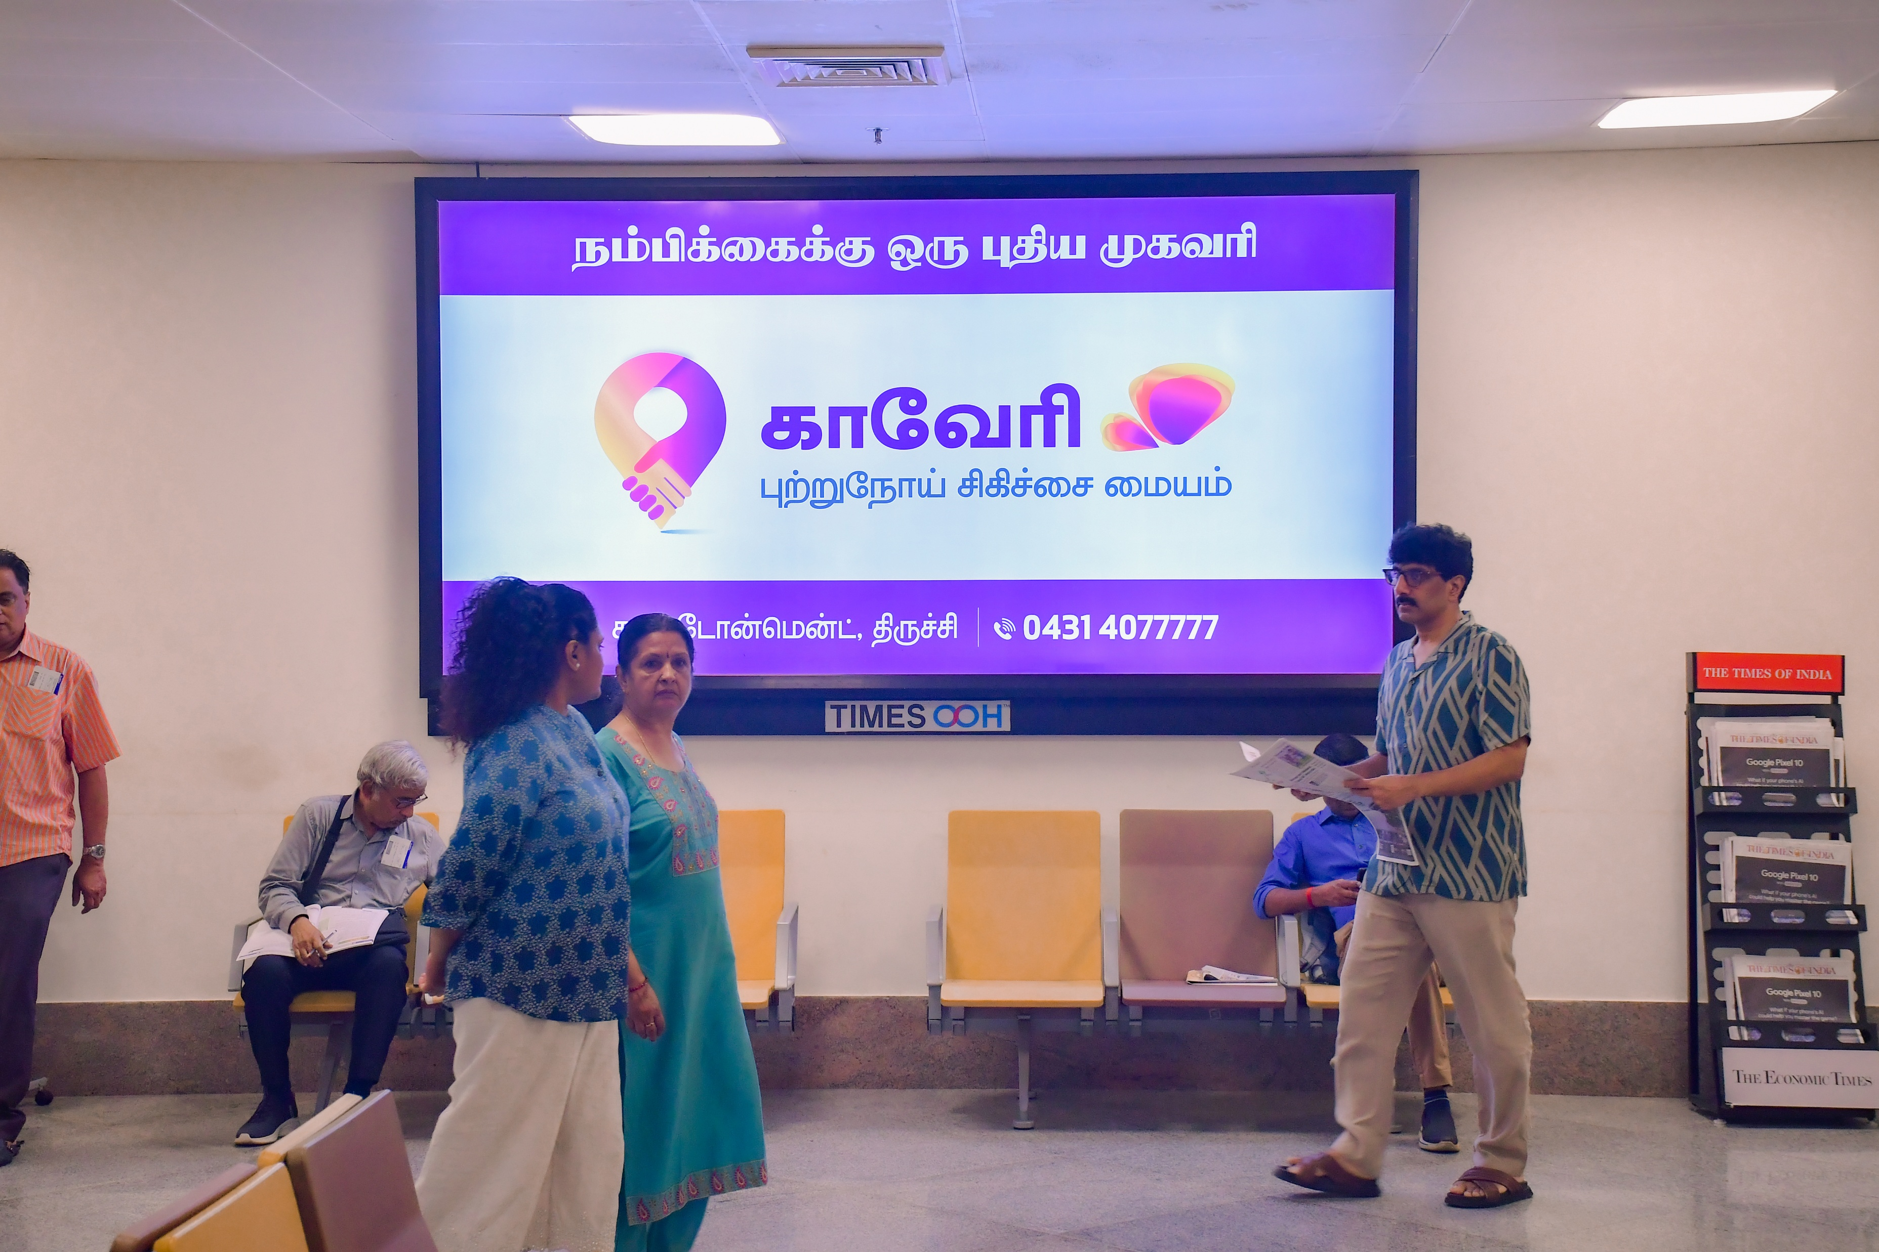
T1- DOMESTIC
Departure | Inside Security Hold Area | 10 W X 5 H ft (Only 1 Unit) | Back Lit
Static Lightbox Single Sided
Rental Cost | 3,50,000/- P/M
Production Cost | As Per Actual Cost
www.themediaant.com
Notes:
‹#›

Slide 17
T1- DOMESTIC
Departure | Inside Security Hold Area | 10 W X 5 H ft (Only 1 Unit) | Back Lit
www.themediaant.com
Notes:
‹#›

Slide 18
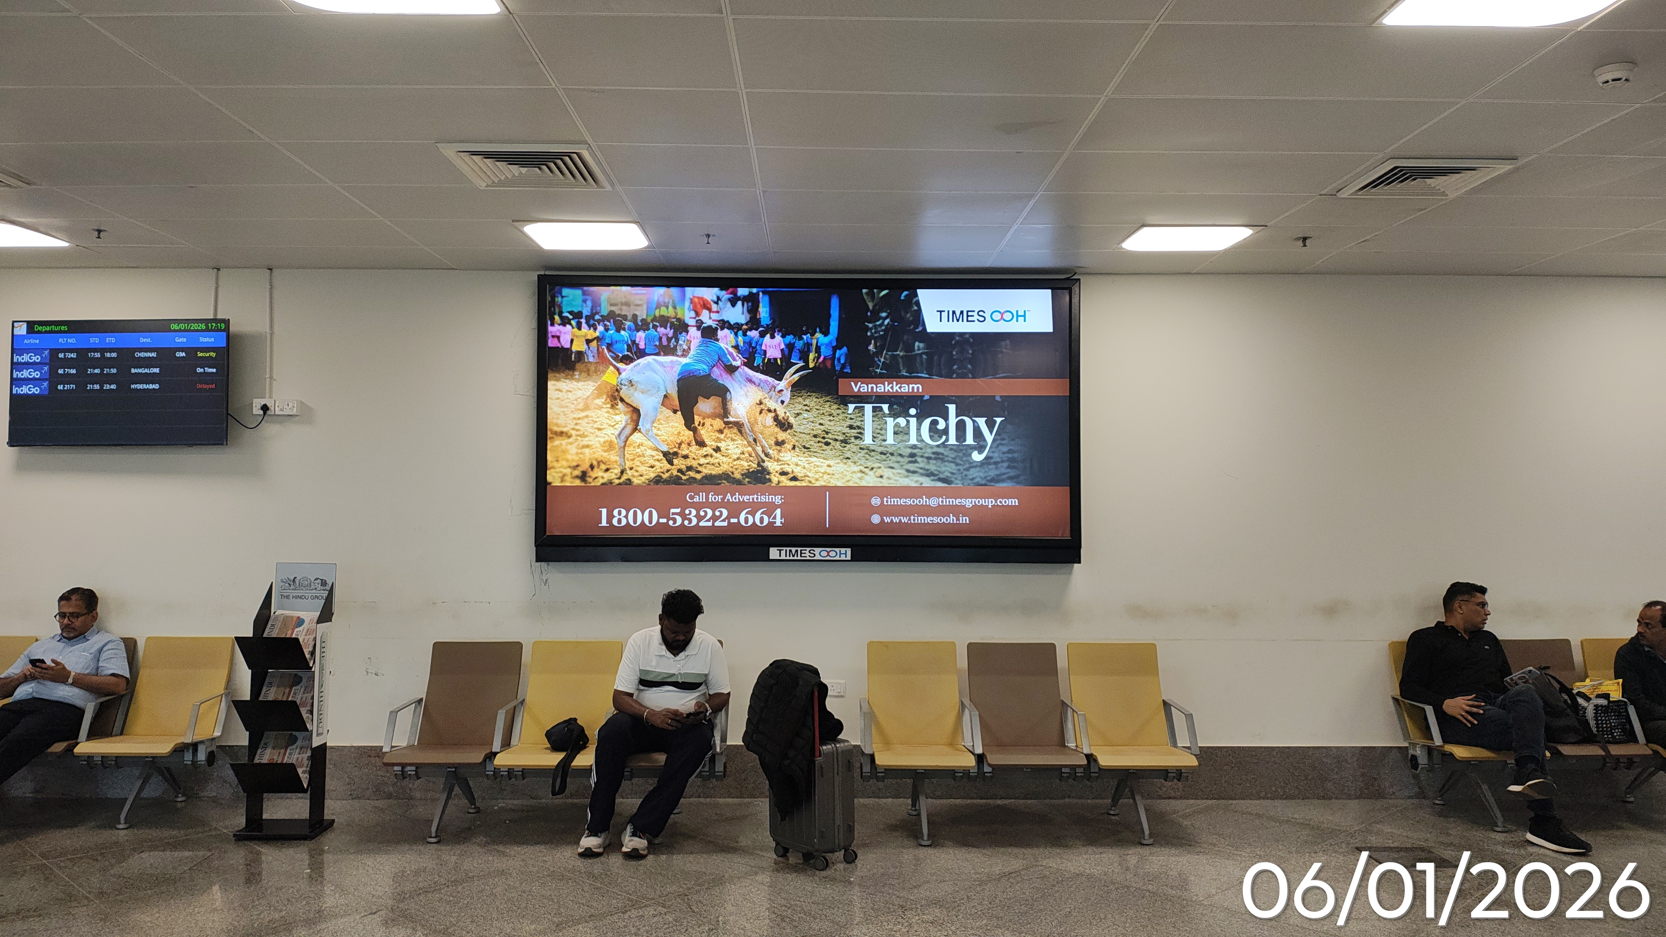
T1- DOMESTIC
Departure | Inside Security Hold Area | 10 W X 5 H ft (Only 1 Unit) | Back Lit
Static Lightbox Single Sided
Rental Cost | 3,00,000/- P/M
Production Cost | As Per Actual Cost
www.themediaant.com
Notes:
‹#›

Slide 19
T1- DOMESTIC
Departure | Inside Security Hold Area | 10 W X 5 H ft (Only 1 Unit) | Back Lit
www.themediaant.com
Notes:
‹#›

Slide 20
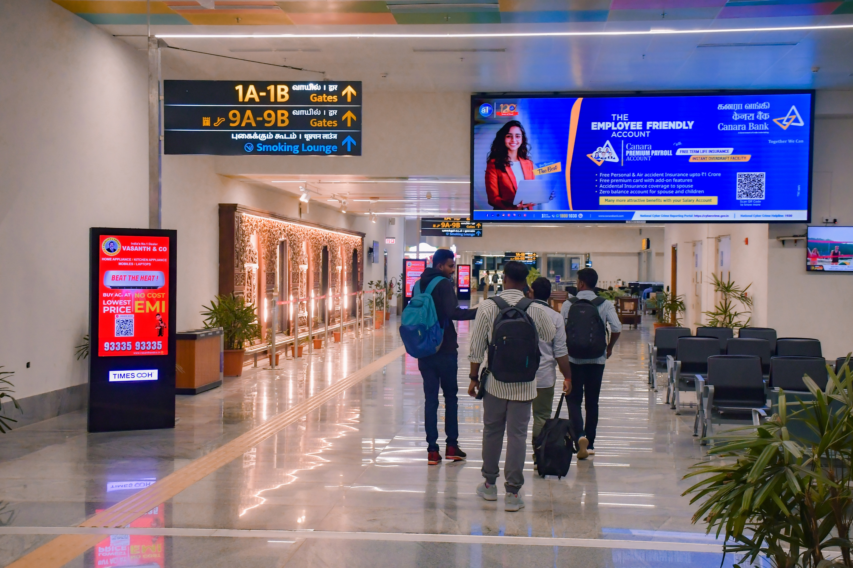
T1- DOMESTIC
Departure | Inside Security Hold Area | 18 W X 6 H ft (Only 1 Unit) | 15 Sec In Every 1.5 Min
Digital Wall
Rental Cost | 1,75,000/- P/M Per Slot
Production Cost | As Per Actual Cost
www.themediaant.com
Notes:
‹#›

Slide 21
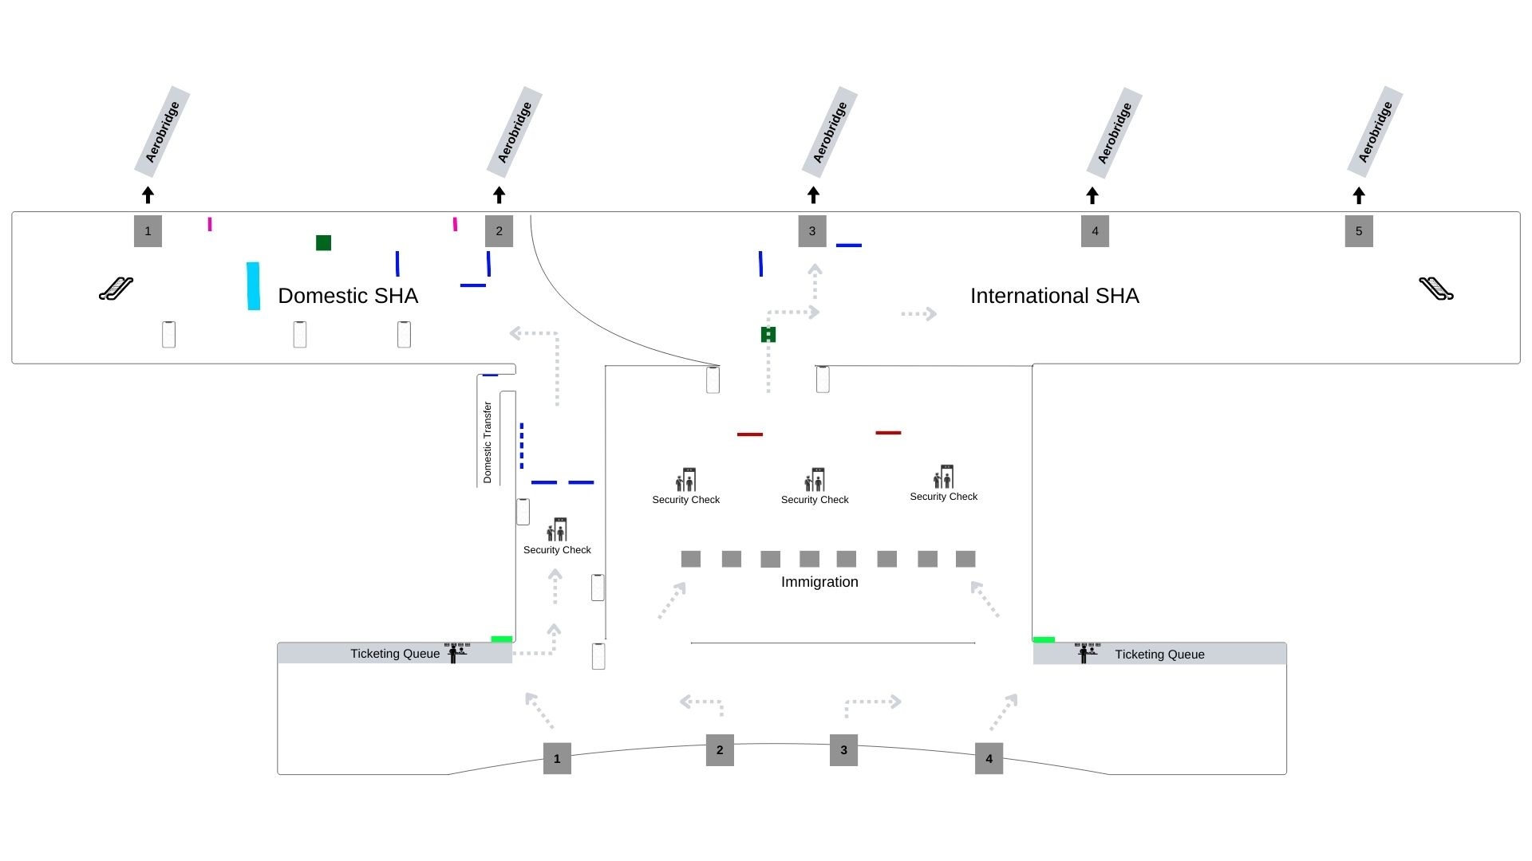
T1- DOMESTIC
Departure | Inside Security Hold Area | 18 W X 6 H ft (Only 1 Unit) | 15 Sec In Every 1.5 Min
www.themediaant.com
Notes:
‹#›

Slide 22
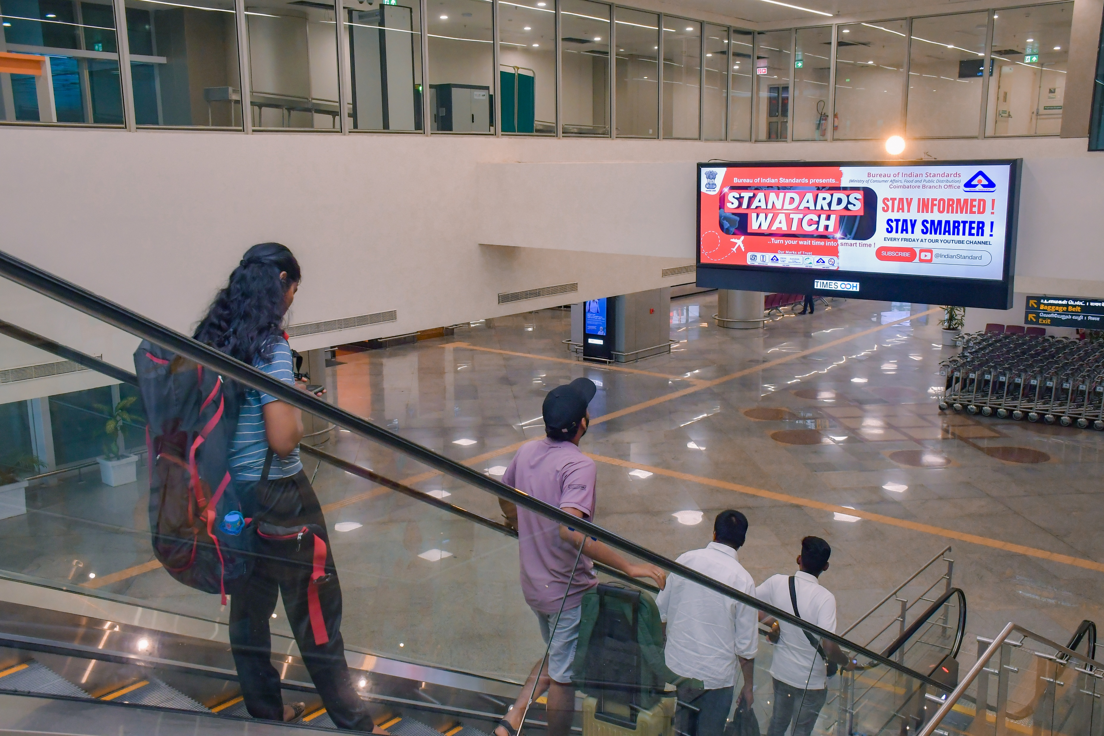
T1- DOMESTIC
Arrival | Arrival Corridor | 12 W X 4 H ft (Only 1 Unit) | Back Lit
Static Lightbox Single Sided
Rental Cost | 2,85,000/- P/M
Production Cost | As Per Actual Cost
www.themediaant.com
Notes:
‹#›

Slide 23
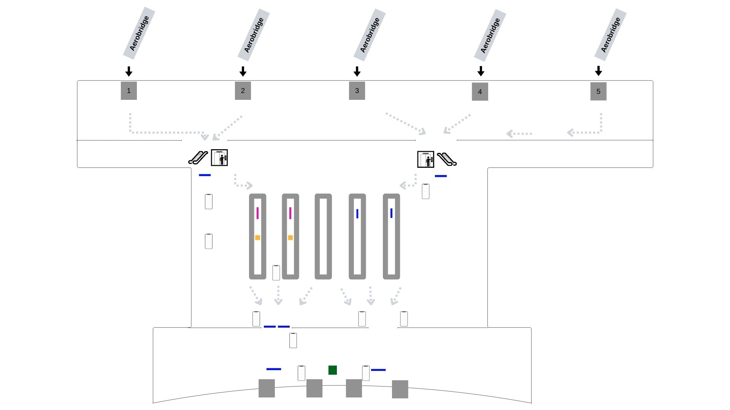
T1- DOMESTIC
Arrival | Arrival Corridor | 12 W X 4 H ft (Only 1 Unit) | Back Lit
www.themediaant.com
Notes:
‹#›

Slide 24
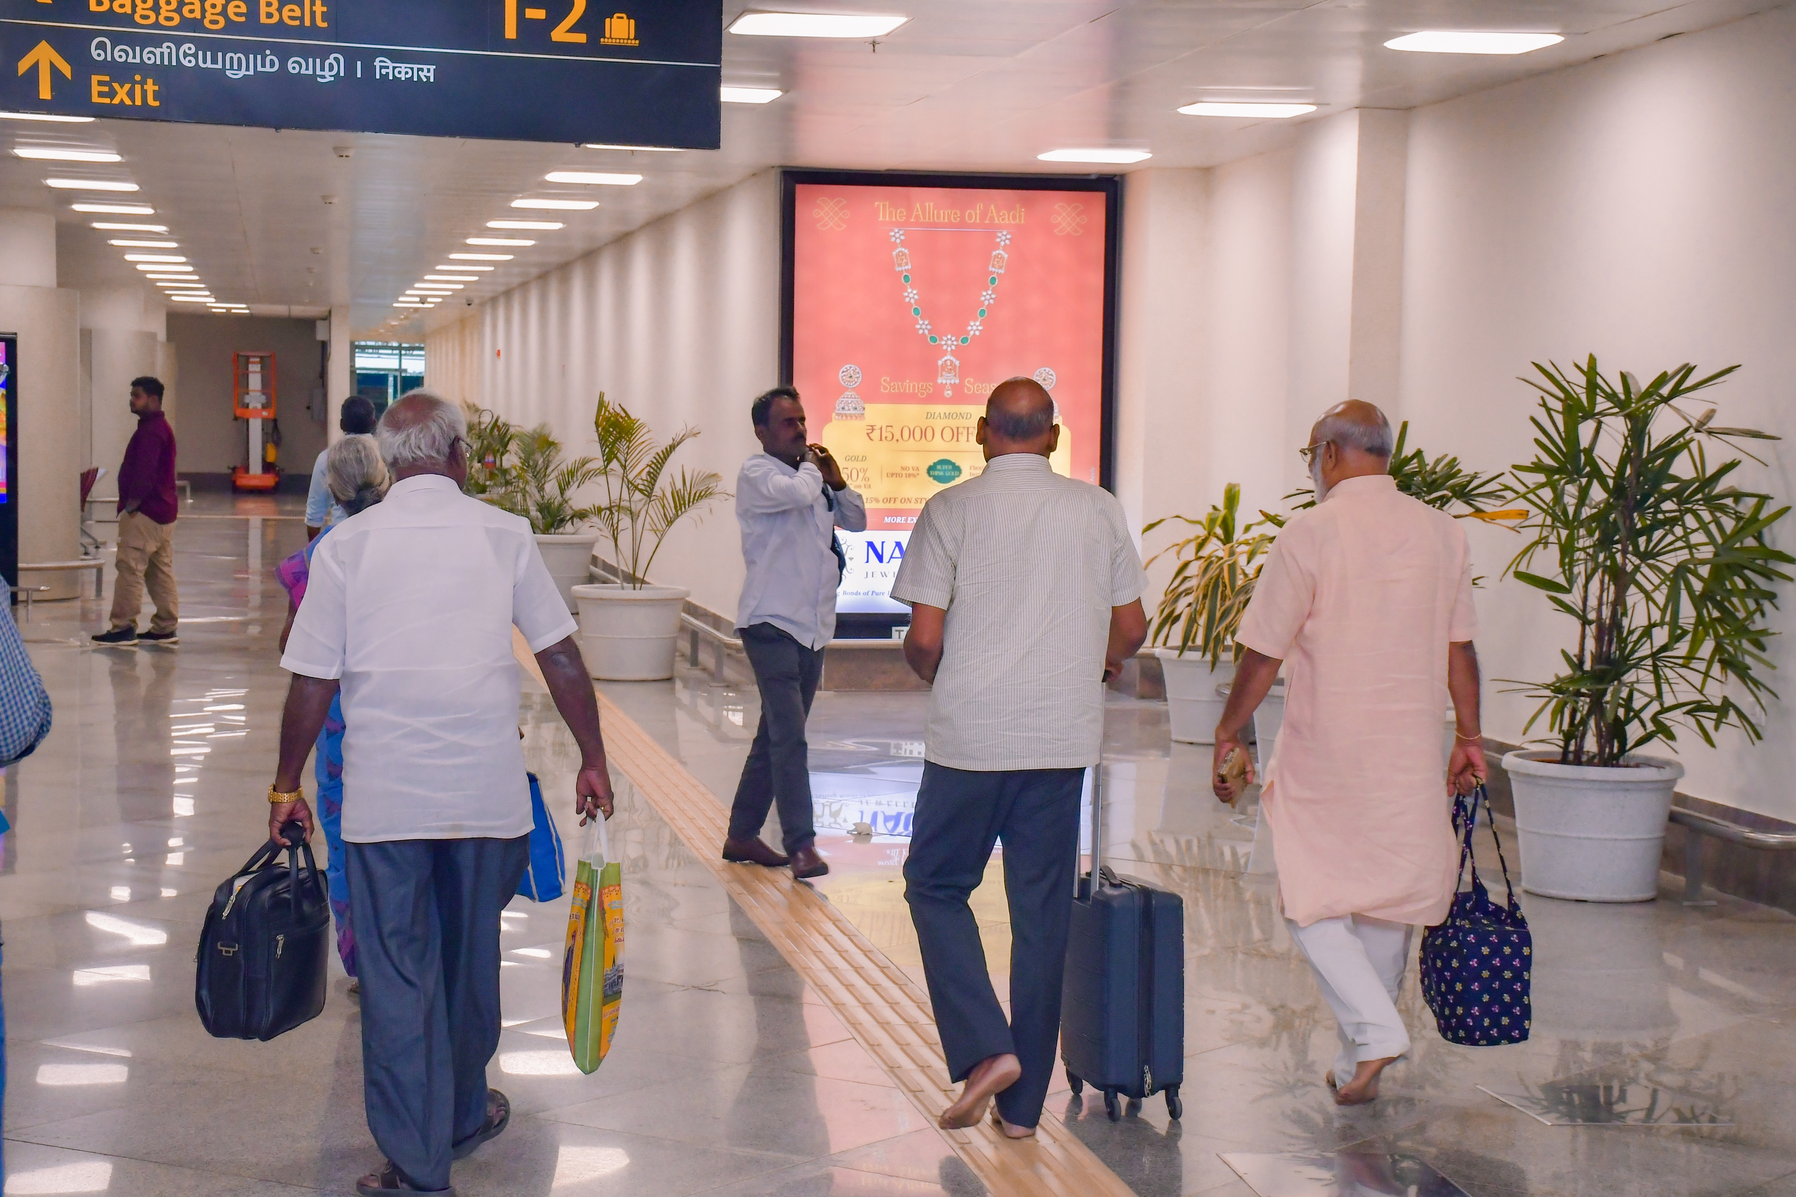
T1- DOMESTIC
Arrival | Arrival Corridor | 6 W X 8 H ft (Only 1 Unit) | Back Lit
Static Lightbox Single Sided
Rental Cost | 4,50,000/- P/M
Production Cost | As Per Actual Cost
www.themediaant.com
Notes:
‹#›

Slide 25
T1- DOMESTIC
Arrival | Arrival Corridor | 6 W X 8 H ft (Only 1 Unit) | Back Lit
www.themediaant.com
Notes:
‹#›

Slide 26
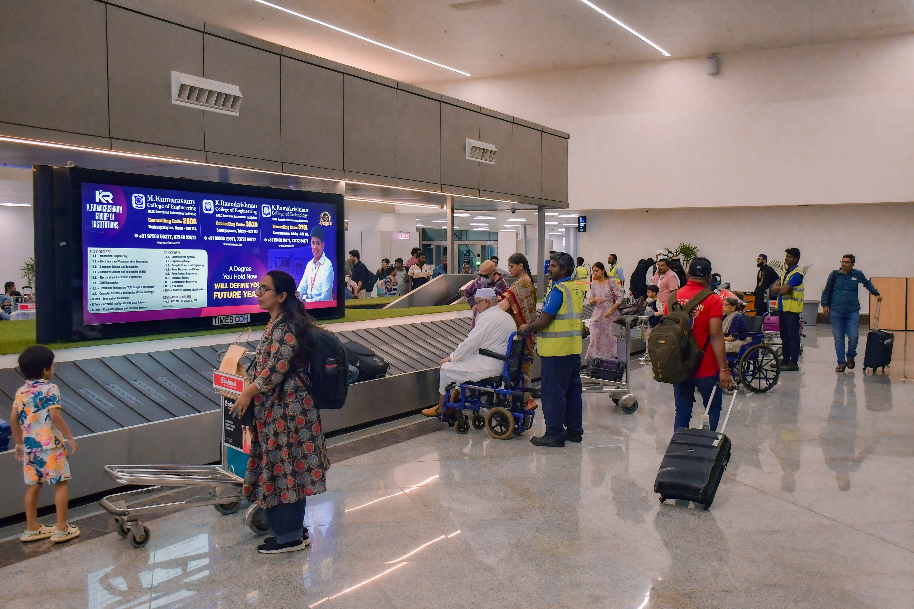
T1- DOMESTIC
Arrival | Baggage Reclaim Area | 12 W X 4 H ft (Package Of 2 Units) | 15 Sec In Every 1.5 Min
Digital Scroller
Rental Cost | 1,15,000/- P/M
Production Cost | As Per Actual Cost
www.themediaant.com
Notes:
‹#›

Slide 27
T1- DOMESTIC
Arrival | Baggage Reclaim Area | 12 W X 4 H ft (Package Of 2 Units) | 15 Sec In Every 1.5 Min
www.themediaant.com
Notes:
‹#›

Slide 28
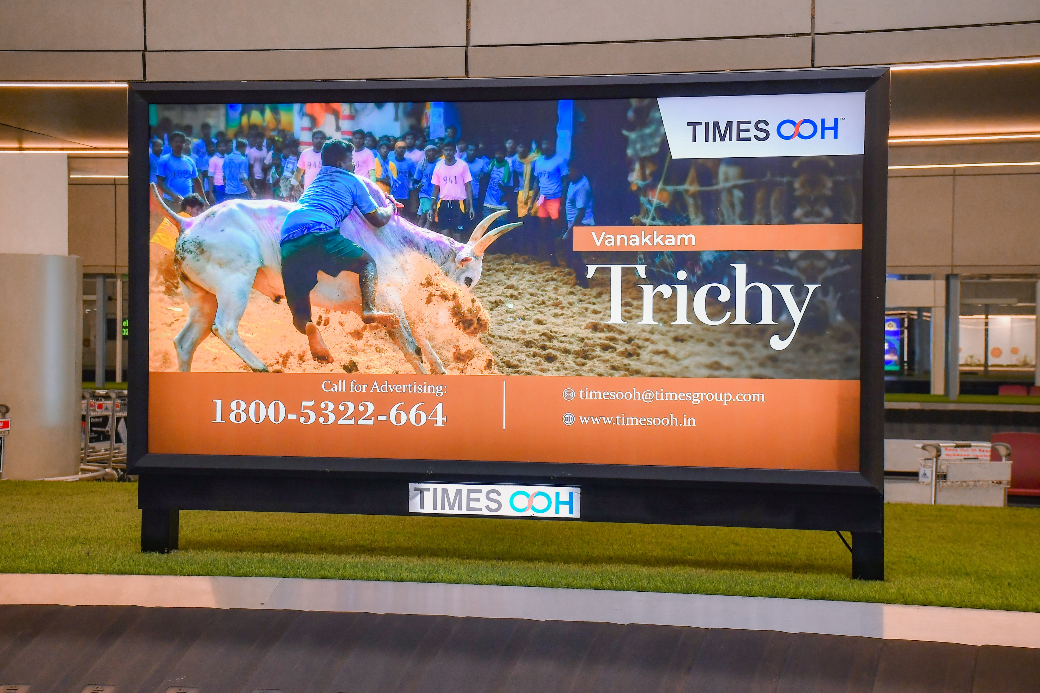
T1- DOMESTIC
Arrival | Baggage Reclaim Area | 8 W X 4 H ft (Package Of 2 Units) | Back Lit
Static Lightbox Single Sided
Rental Cost | 3,00,000/- P/M
Production Cost | As Per Actual Cost
www.themediaant.com
Notes:
‹#›

Slide 29
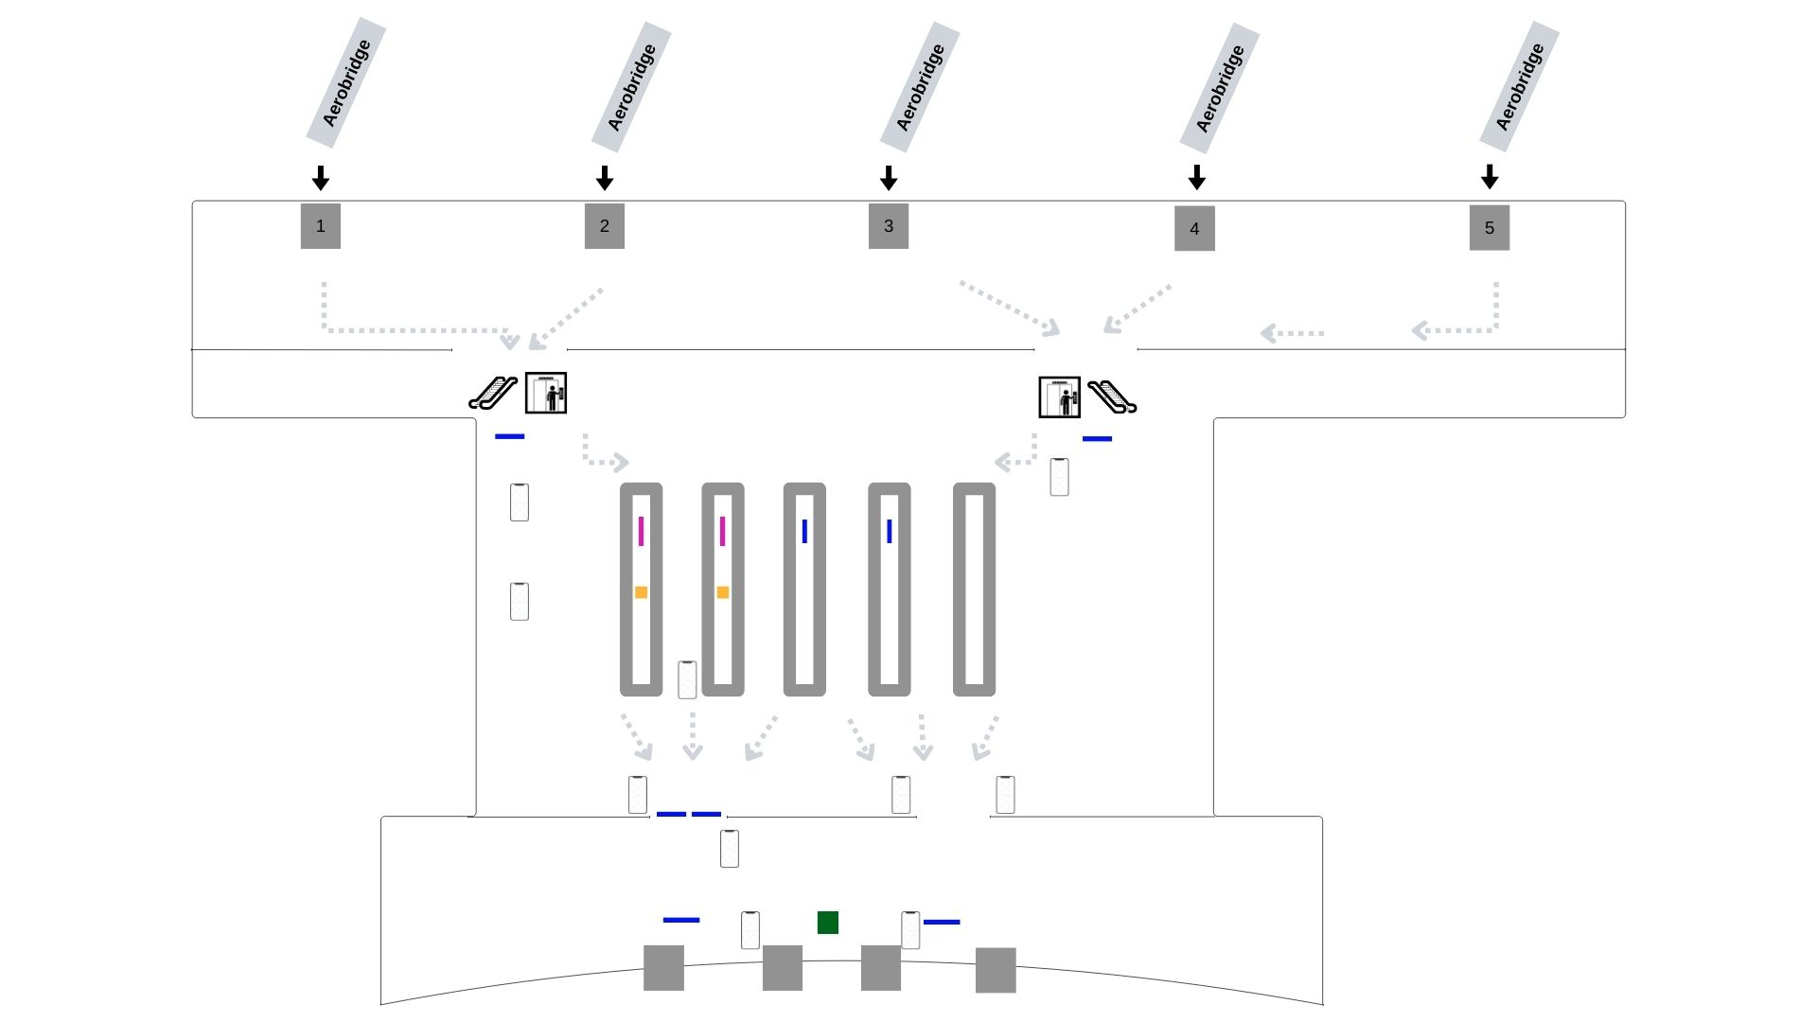
T1- DOMESTIC
Arrival | Baggage Reclaim Area | 8 W X 4 H ft (Package Of 2 Units) | Back Lit
www.themediaant.com
Notes:
‹#›

Slide 30
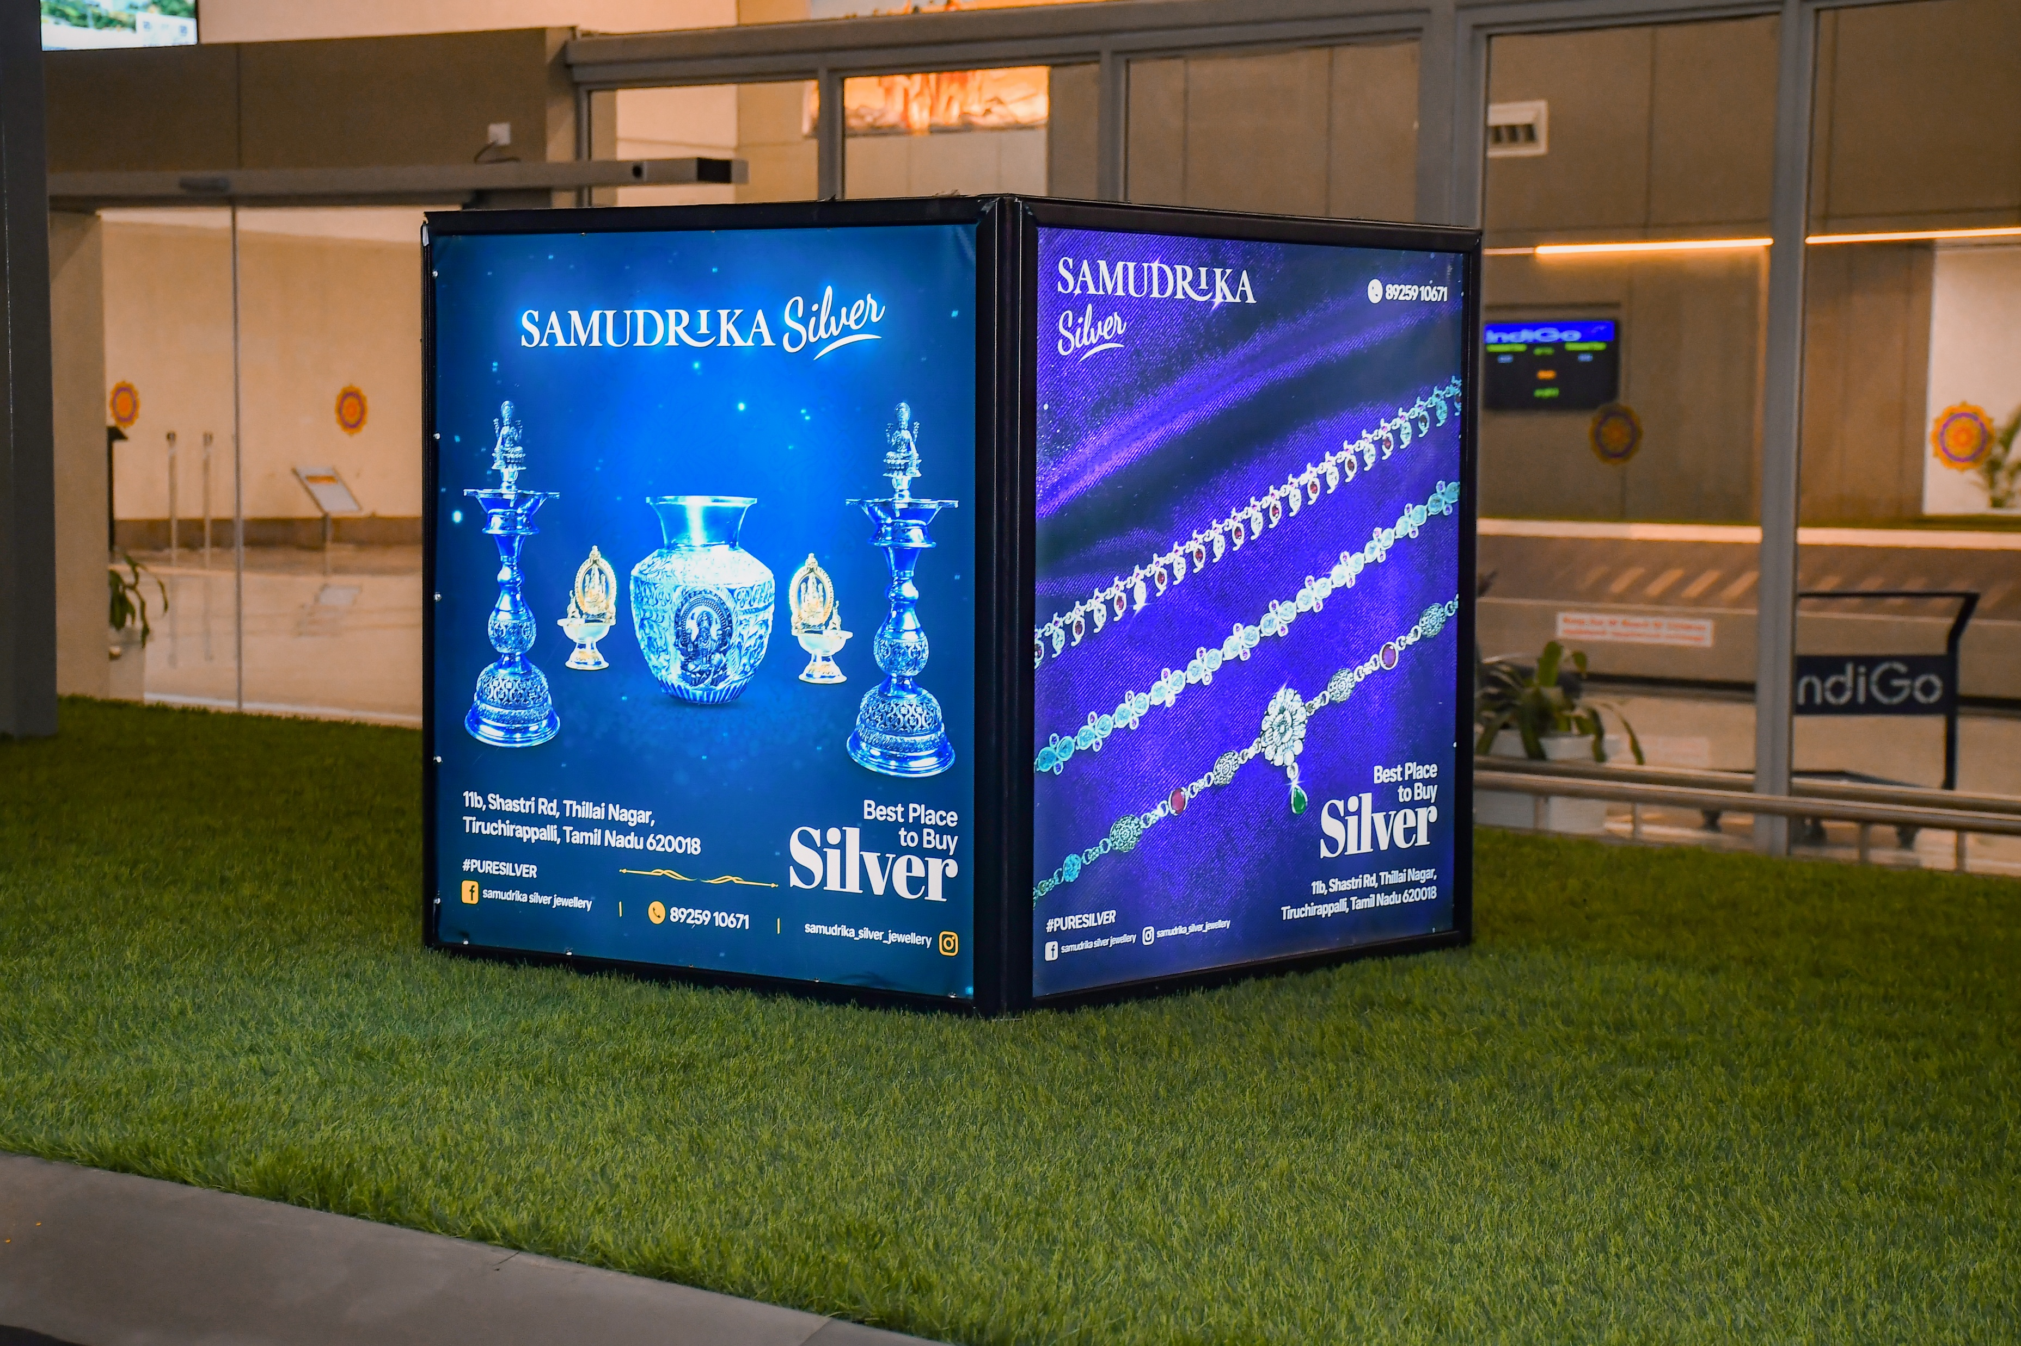
T1- DOMESTIC
Arrival | Baggage Reclaim Area | 3 W X 3 H ft (Package Of 2 Units) | Back Lit
Static Lightbox 4 Sided
Rental Cost | 1,00,000/- P/M
Production Cost | As Per Actual Cost
www.themediaant.com
Notes:
‹#›

Slide 31
T1- DOMESTIC
Arrival | Baggage Reclaim Area | 3 W X 3 H ft (Package Of 2 Units) | Back Lit
www.themediaant.com
Notes:
‹#›

Slide 32
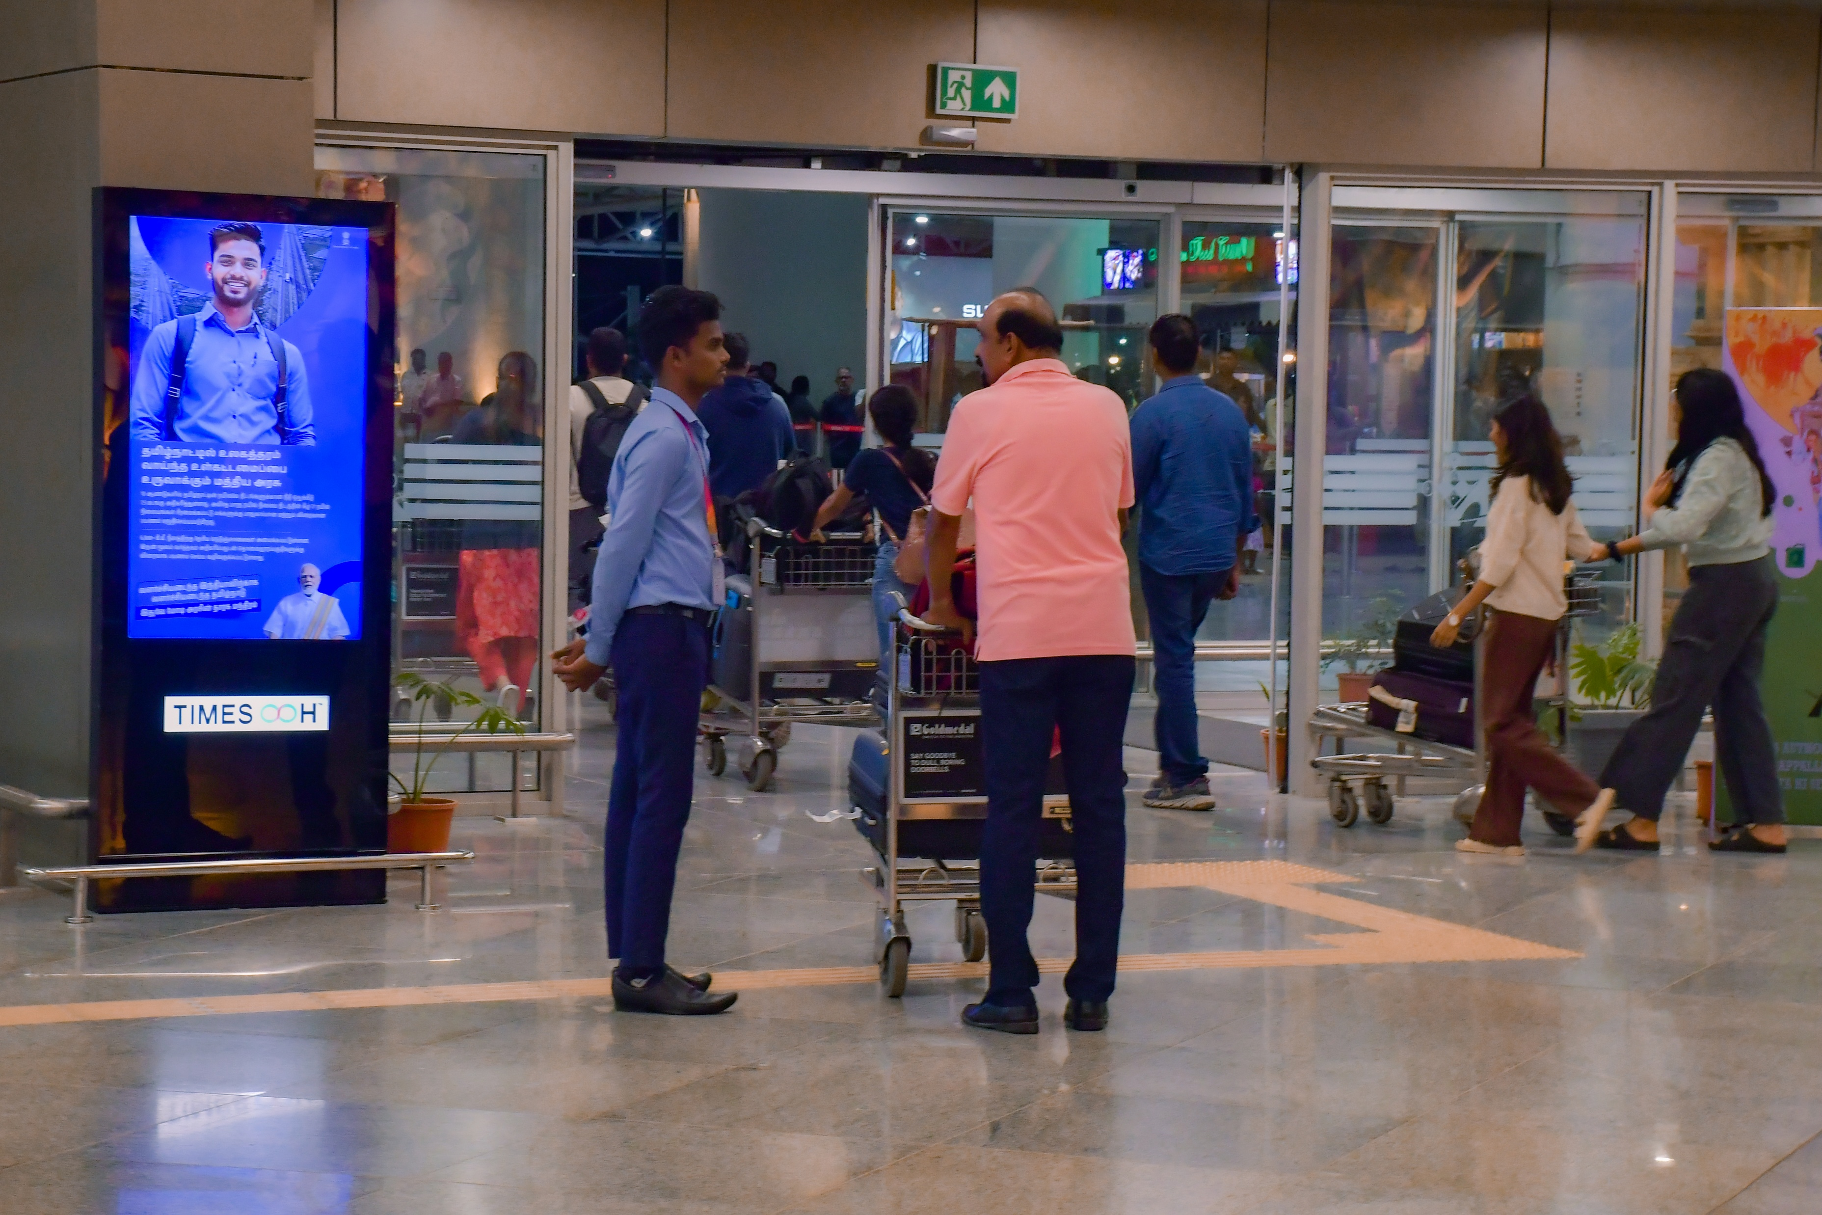
T1- DOMESTIC
Arrival | Baggage Belt To Exit Gate | 2.5 W X 5 H ft (Package Of 10 Units) | 15 Sec In Every 2 Min
Digital Pod
Rental Cost | 1,80,000/- P/M Per Slot
Production Cost | As Per Actual Cost
www.themediaant.com
Notes:
‹#›

Slide 33
T1- DOMESTIC
Arrival | Baggage Belt To Exit Gate | 2.5 W X 5 H ft (Package Of 10 Units) | 15 Sec In Every 2 Min
www.themediaant.com
Notes:
‹#›

Slide 34
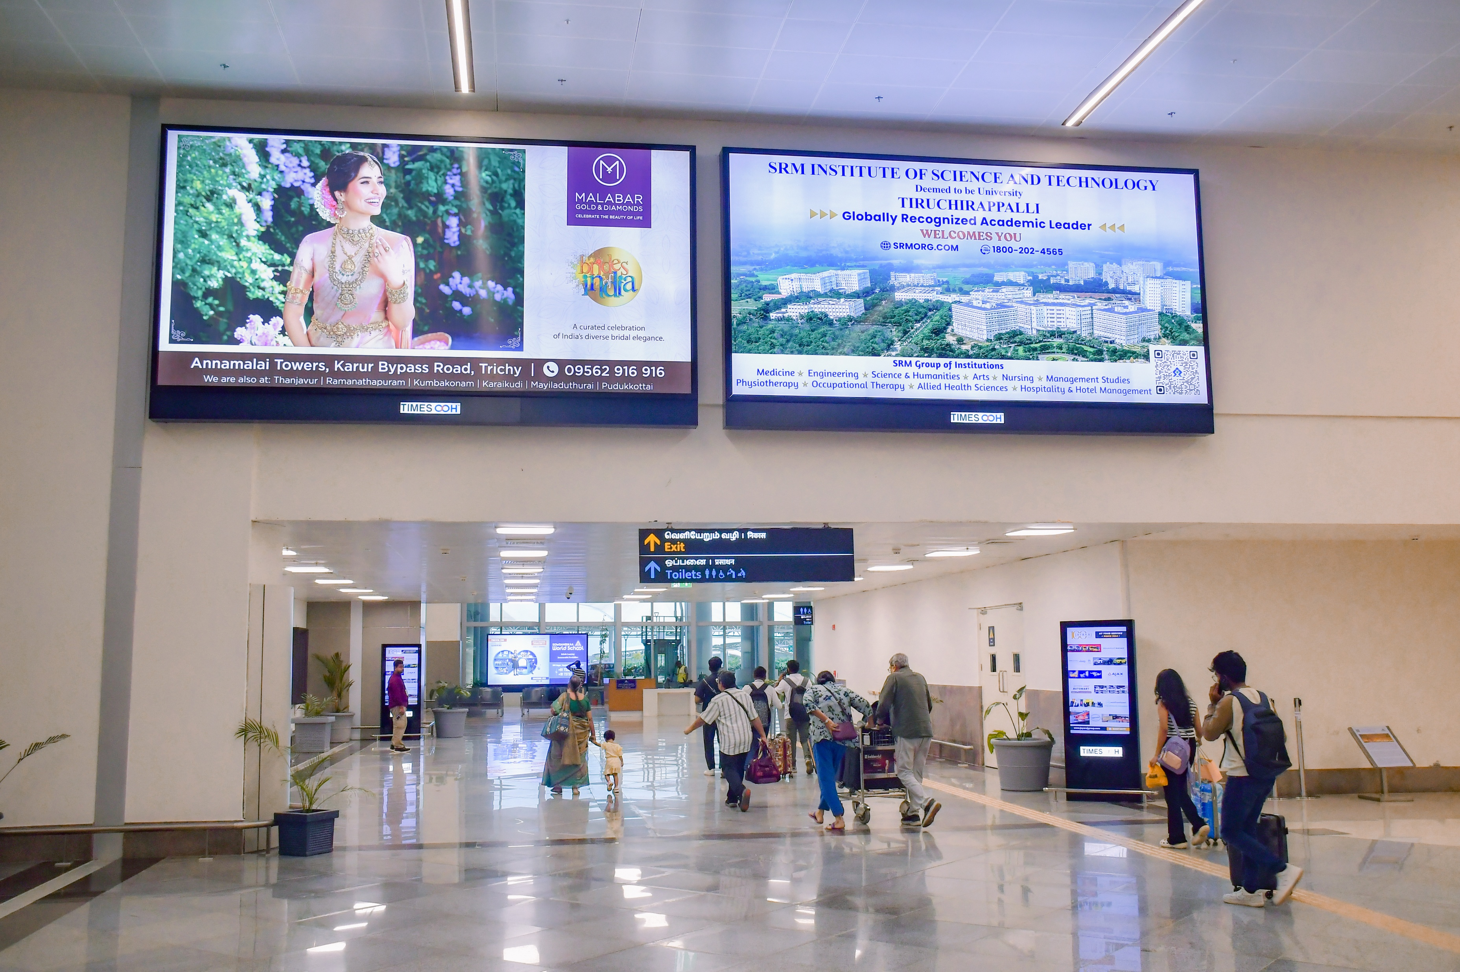
T1- DOMESTIC
Arrival | Exit Passage | 16 W X 8 H ft (Package Of 2 Units) | Back Lit
Static Lightbox Single Sided
Rental Cost | 4,50,000/- P/M
Production Cost | As Per Actual Cost
www.themediaant.com
Notes:
‹#›

Slide 35
T1- DOMESTIC
Arrival | Exit Passage | 16 W X 8 H ft (Package Of 2 Units) | Back Lit
www.themediaant.com
Notes:
‹#›

Slide 36
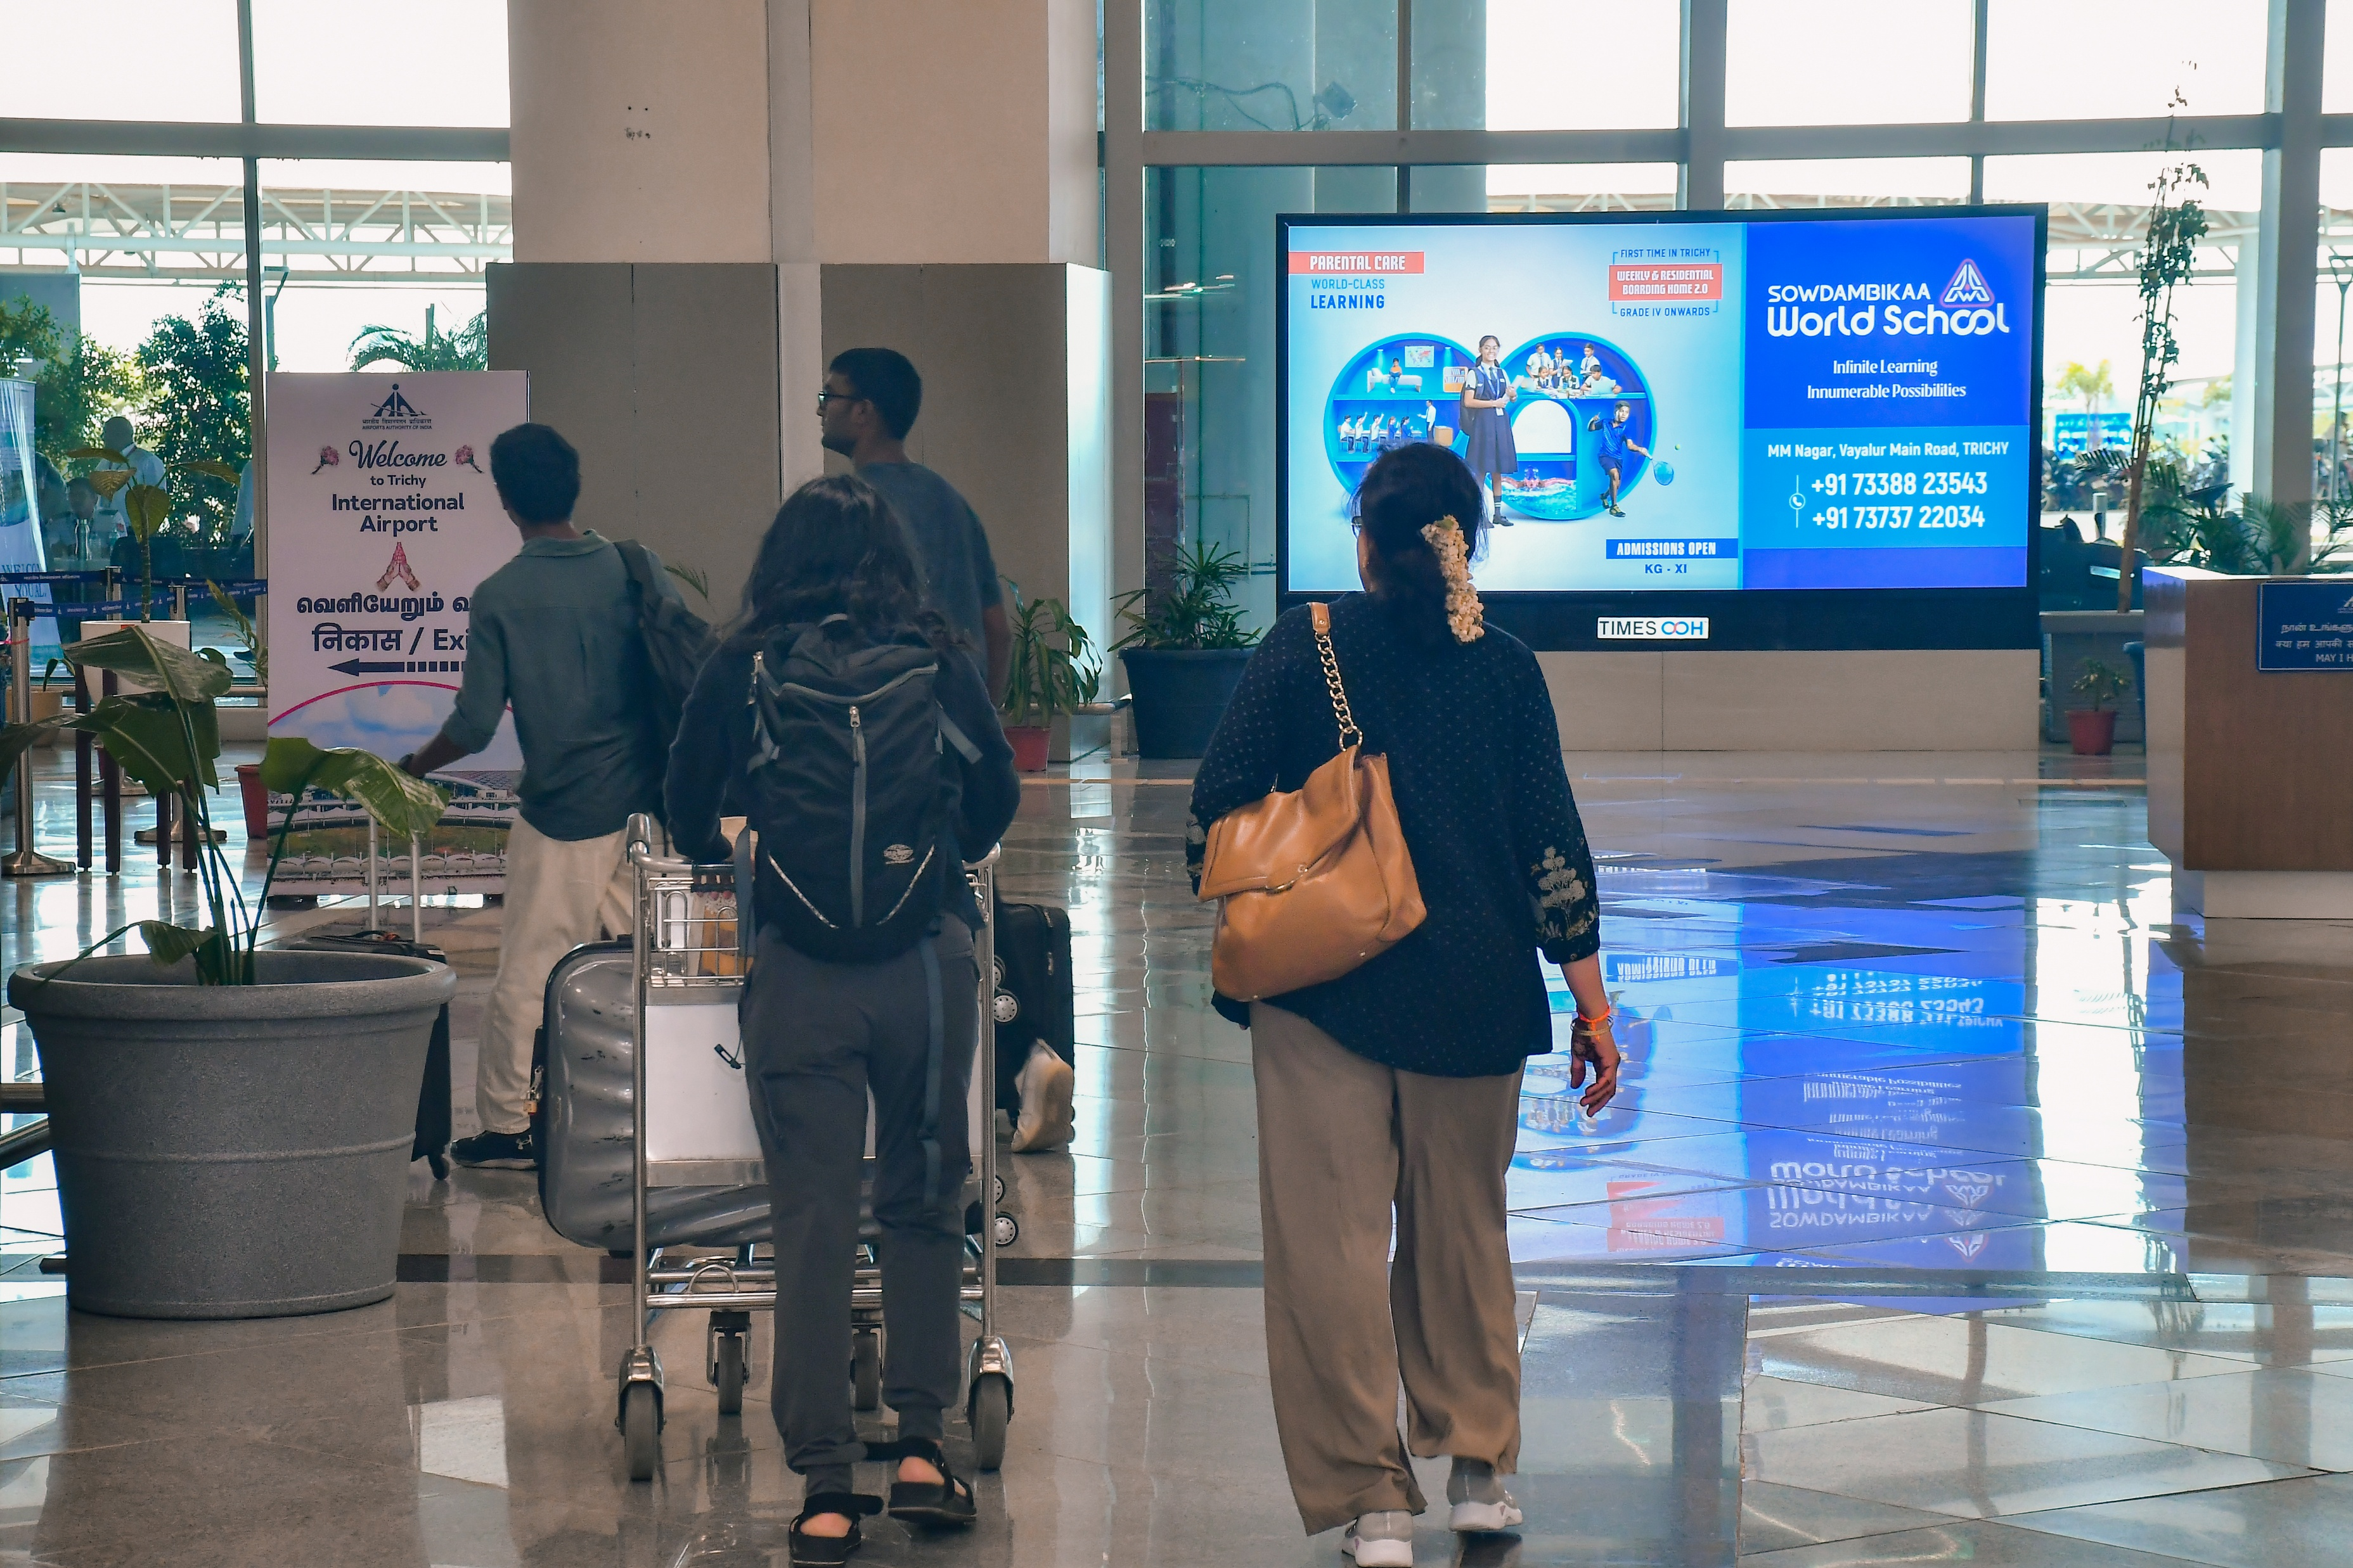
T1- DOMESTIC
Arrival | Exit Passage | 12 W X 6 H ft (Only 1 Unit) | Back Lit
Static Lightbox Single Sided
Rental Cost | 4,50,000/- P/M
Production Cost | As Per Actual Cost
www.themediaant.com
Notes:
‹#›

Slide 37
T1- DOMESTIC
Arrival | Exit Passage | 12 W X 6 H ft (Only 1 Unit) | Back Lit
www.themediaant.com
Notes:
‹#›

Slide 38
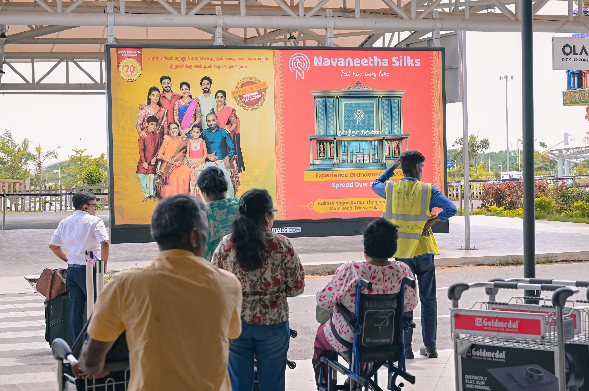
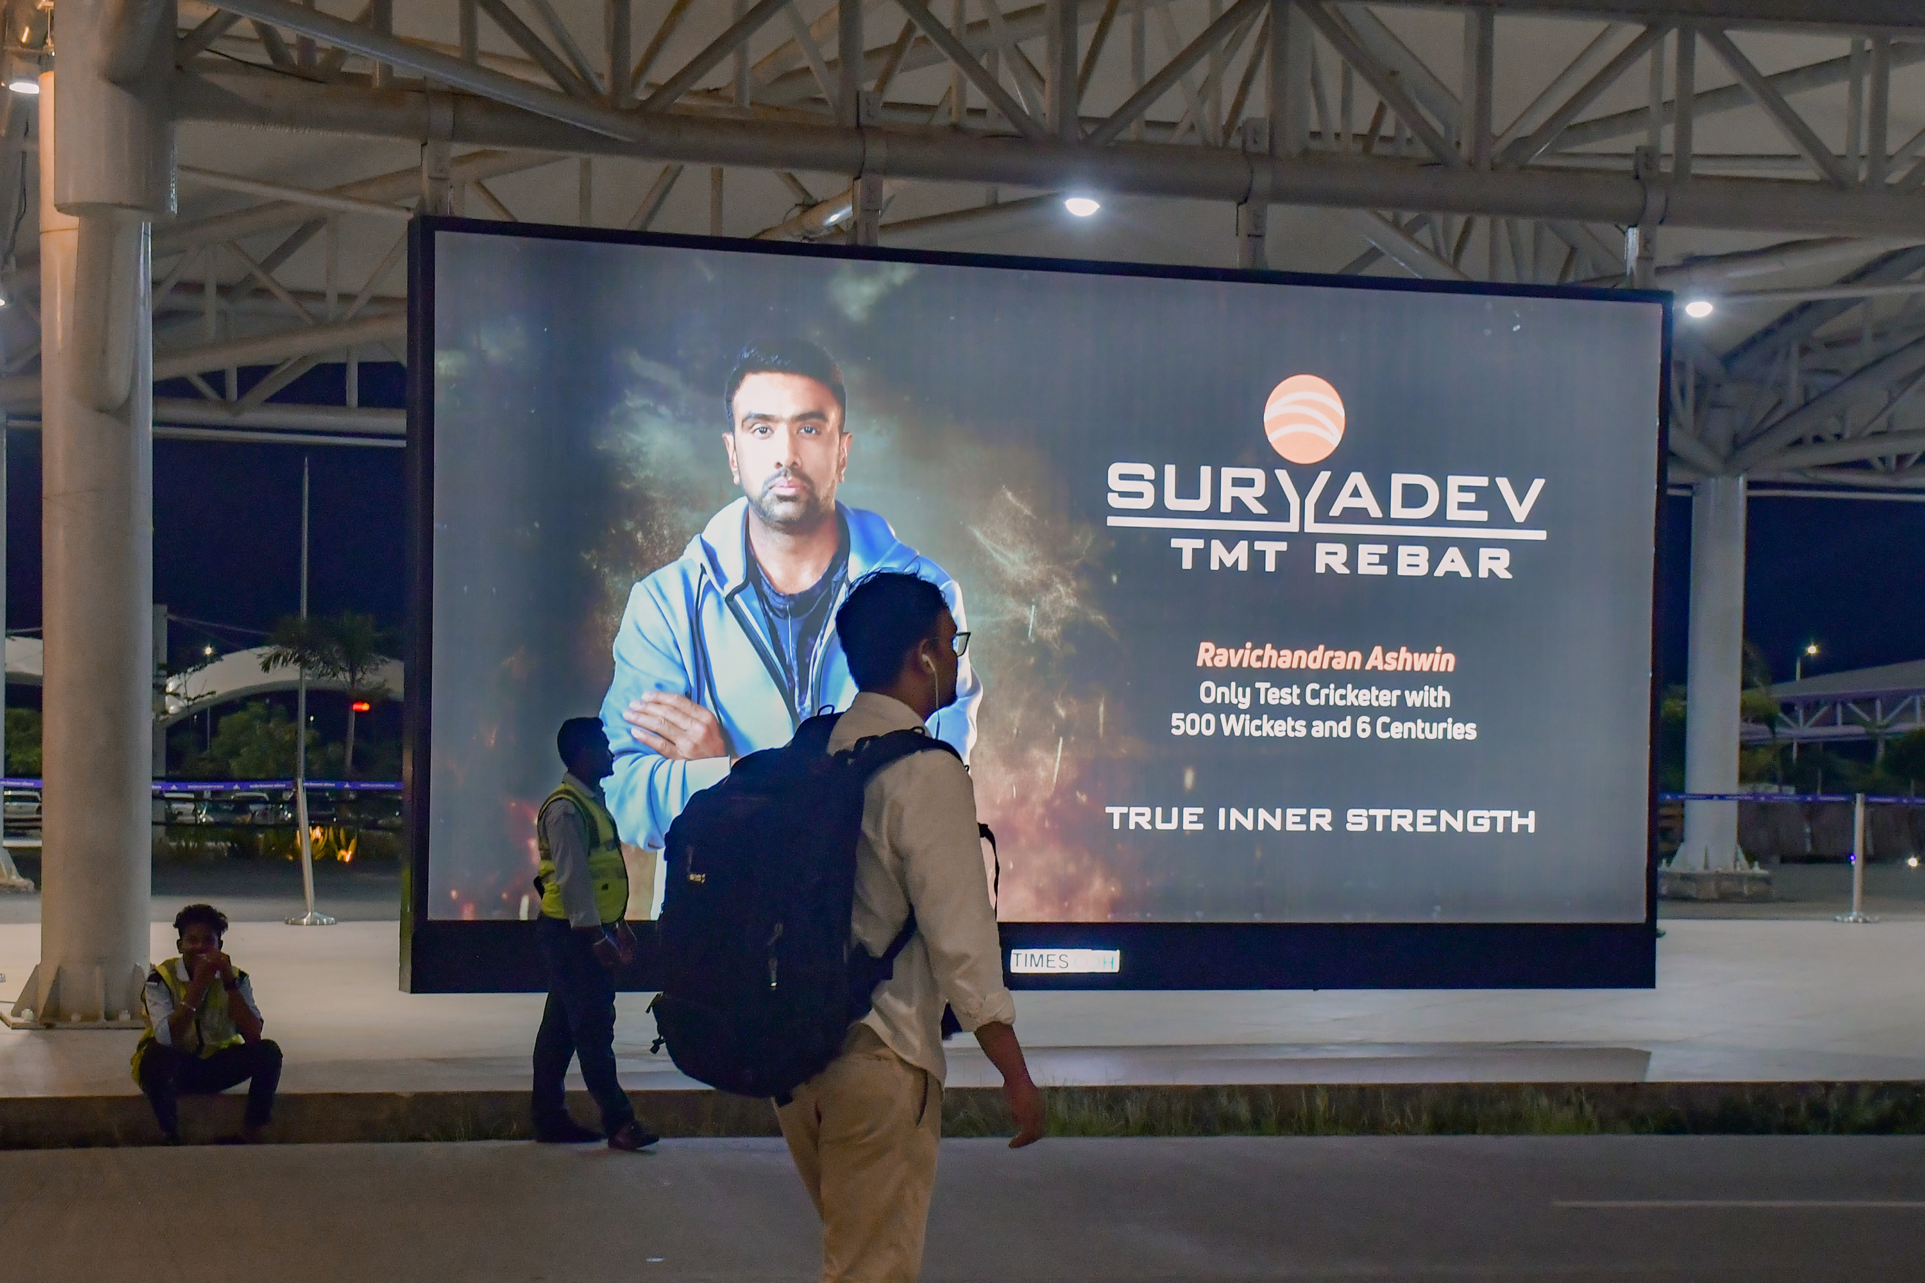
T1- DOMESTIC
Arrival | Pick Up Road | 20 W X 10 H ft (Max 2 Units) | Back Lit
Hoarding
Rental Cost | 4,00,000/- P/M Per Unit
Production Cost | As Per Actual Cost
www.themediaant.com
Notes:
‹#›

Slide 39




www.themediaant.com
ad@themediaant.com
Thank You
080-067415510
Empowering All To Advertise
Notes:
‹#›

