Slide 1

Lucknow Airport
Digital Screen

Slide 2

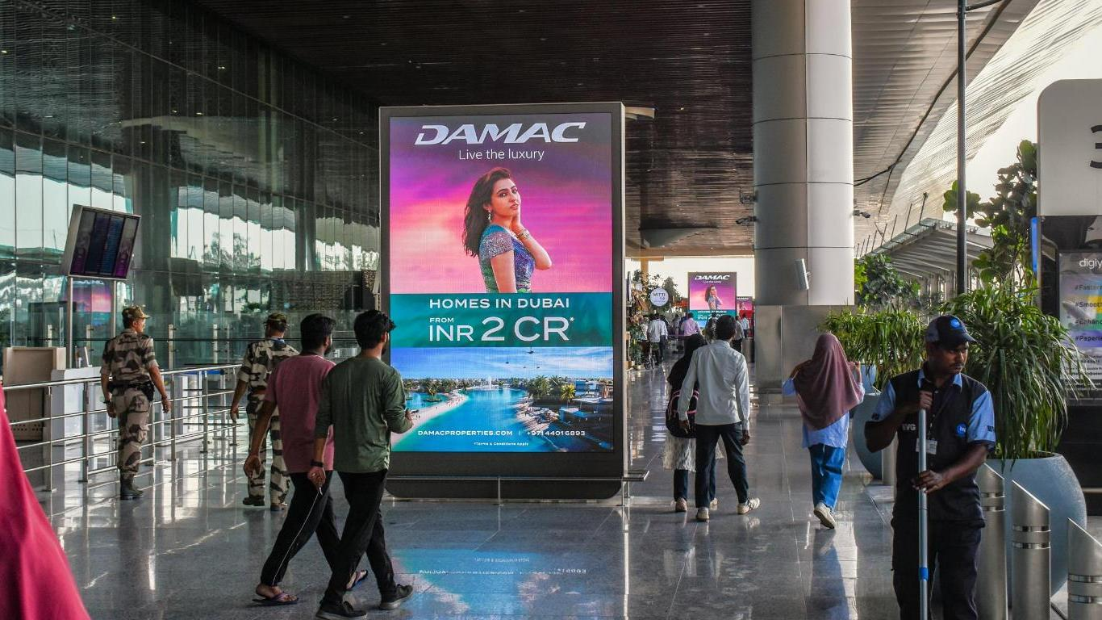

T1- DOMESTIC
Departure | Departure Approach | 6 W X 11 H ft (Package Of 3 Units) | 10 Sec In Every 1 Min
Digital Totem Double Sided
www.themediaant.com
Notes:
‹#›

Slide 3
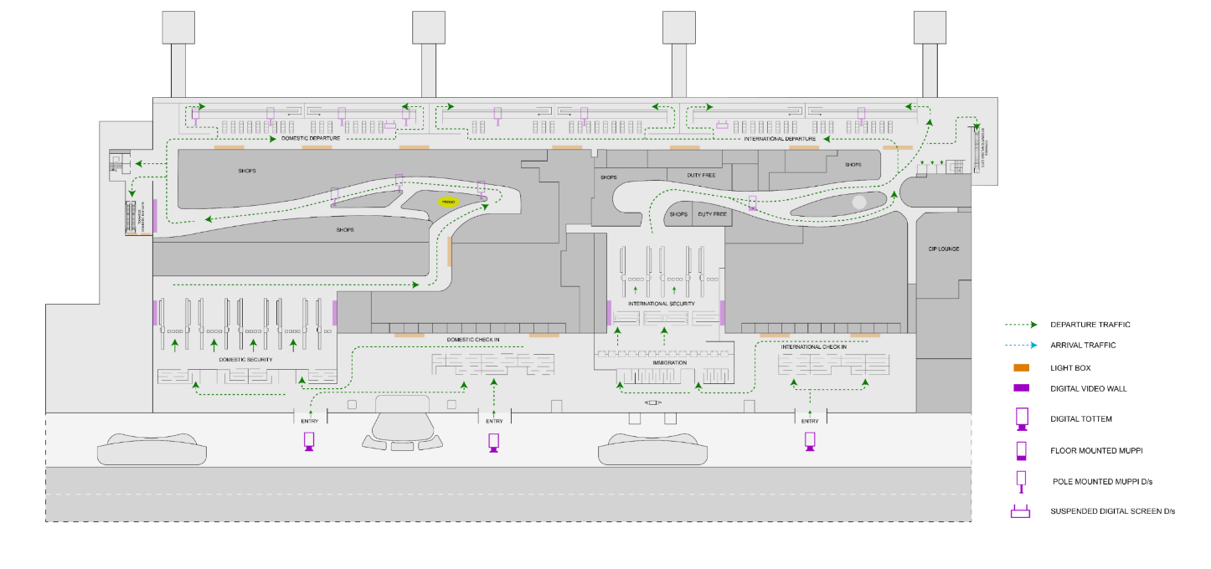
T1- DOMESTIC
Departure | Departure Approach | 6 W X 11 H ft (Package Of 3 Units) | 10 Sec In Every 1 Min
www.themediaant.com
Notes:
‹#›

Slide 4
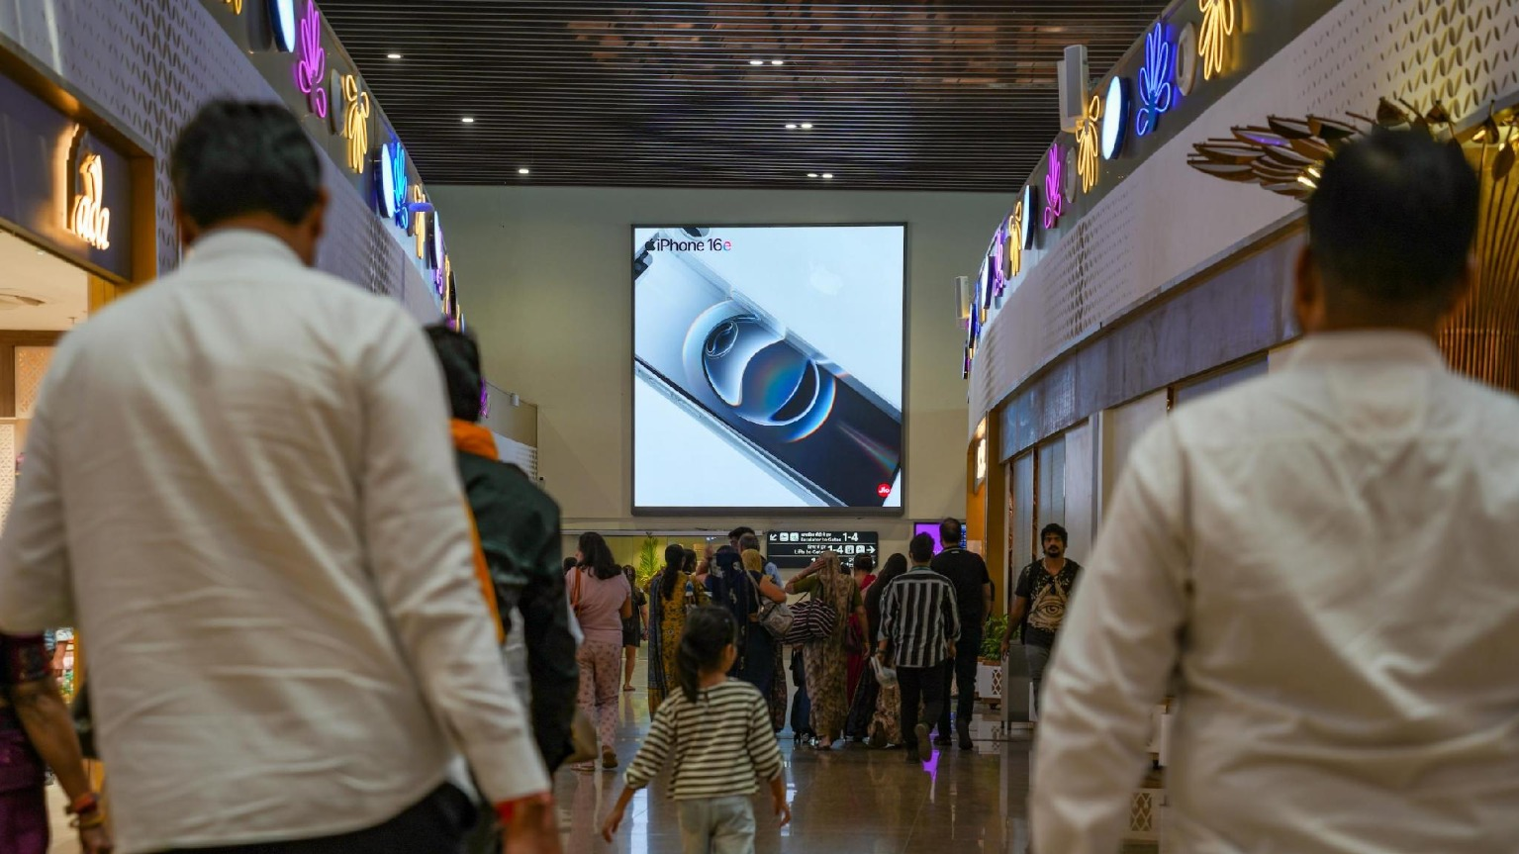

T1- DOMESTIC
Departure | Post Retail Area | 20 W X 20 H ft (Only 1 Unit) | 10 Sec In Every 30 Sec
Digital Wall
www.themediaant.com
Notes:
‹#›

Slide 5
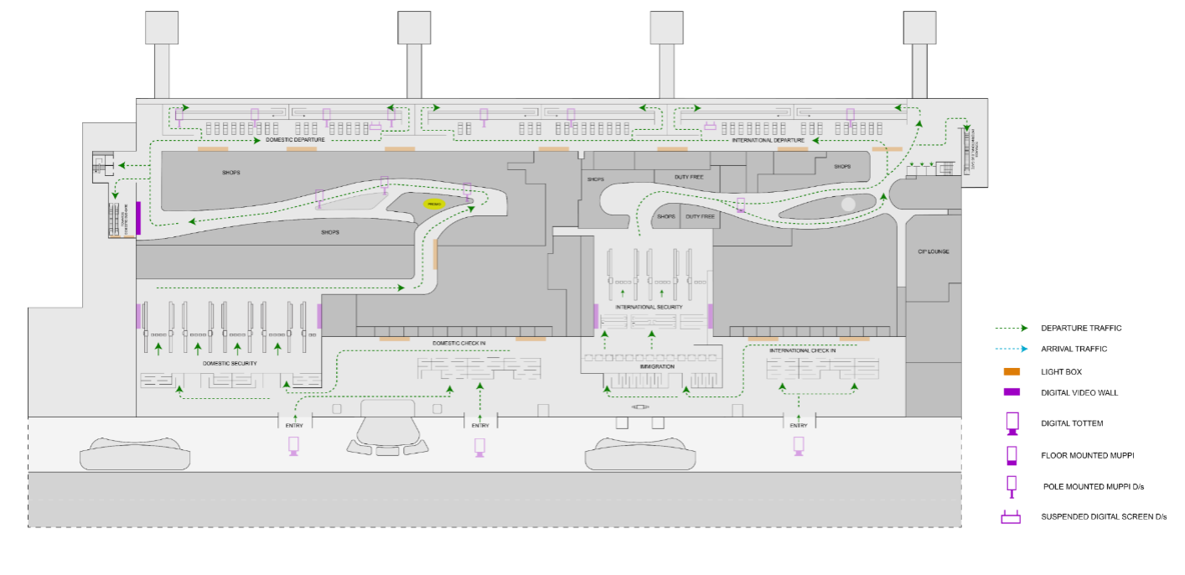
T1- DOMESTIC
Departure | Post Retail Area | 20 W X 20 H ft (Only 1 Unit) | 10 Sec In Every 30 Sec
www.themediaant.com
Notes:
‹#›

Slide 6
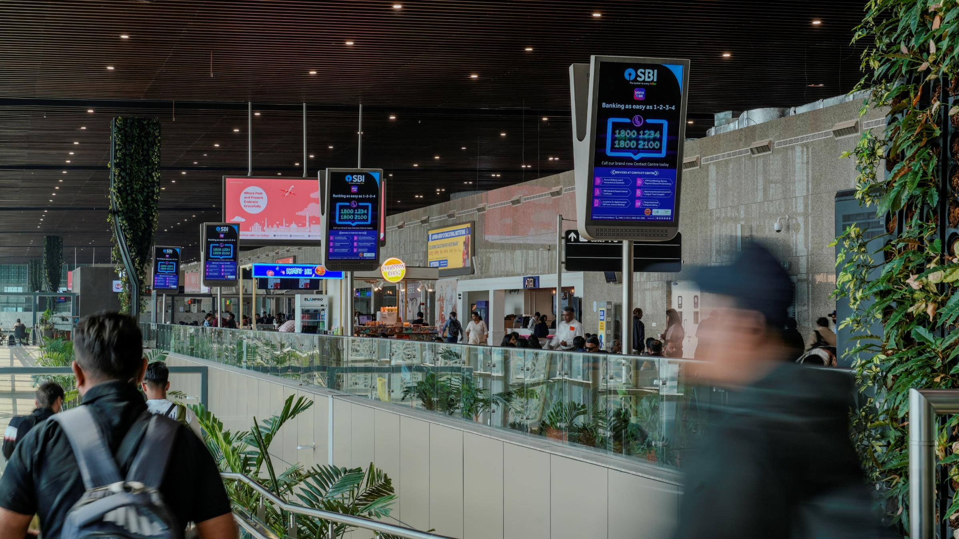
T1- DOMESTIC
Departure | Boarding Gate Area | 3 W X 5.5 H ft (Package Of 22 Units) 2160 W X 3840 H px | 10 Sec In Every 120 Sec
Digital Pole
www.themediaant.com
Notes:
‹#›

Slide 7
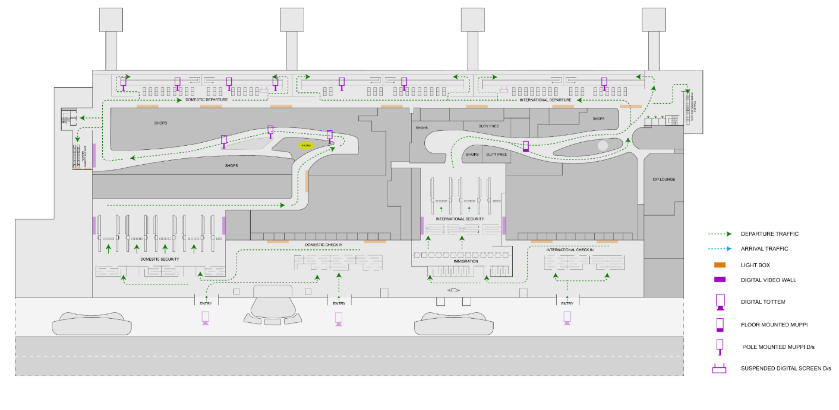
T1- DOMESTIC
Departure | Boarding Gate Area | 3 W X 5.5 H ft (Package Of 22 Units) 2160 W X 3840 H px | 10 Sec In Every 120 Sec
www.themediaant.com
Notes:
‹#›

Slide 8
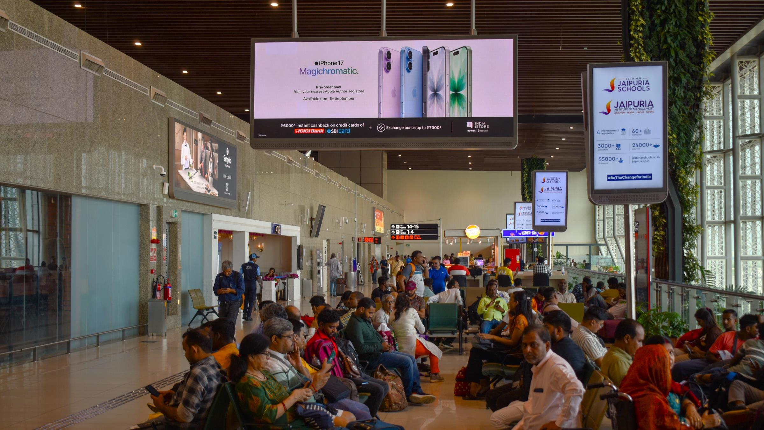
T1- DOMESTIC
Departure | Boarding Gate Area | 20 W X 8 H ft (Package Of 2 Units) 2304 W X 864 H px | 10 Sec In Every 60 Sec
Digital Wall Double Sided
www.themediaant.com
Notes:
‹#›

Slide 9
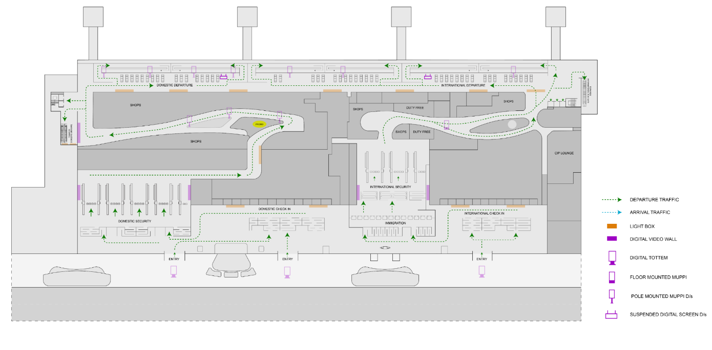
T1- DOMESTIC
Departure | Boarding Gate Area | 20 W X 8 H ft (Package Of 2 Units) 2304 W X 864 H px | 10 Sec In Every 60 Sec
www.themediaant.com
Notes:
‹#›

Slide 10
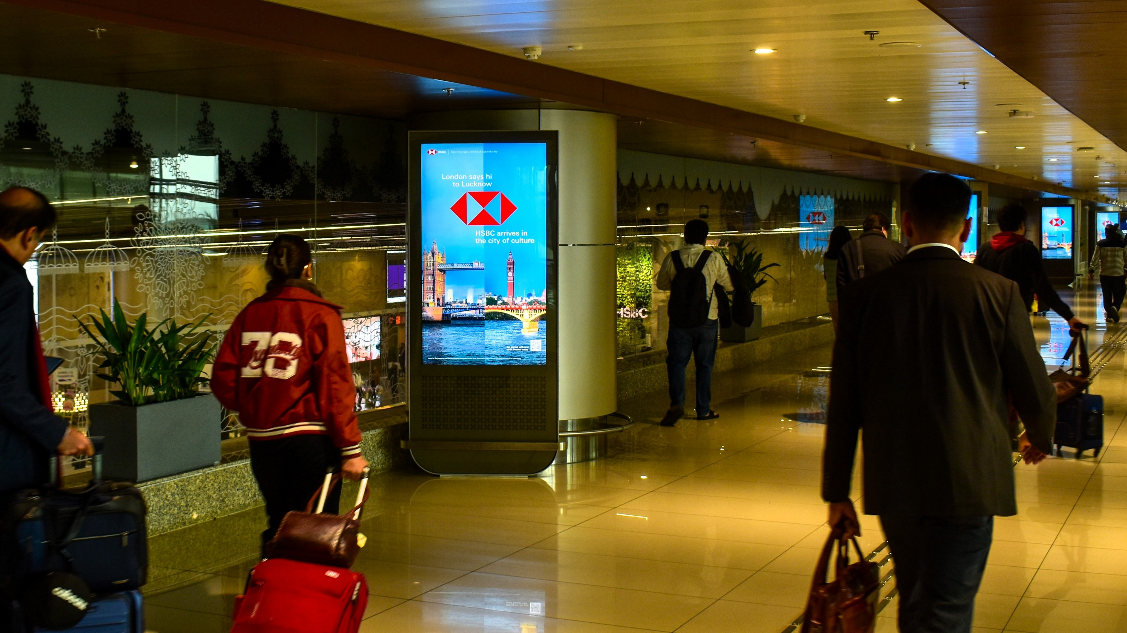
T1- DOMESTIC
Arrival | Arrival Area | 3 W X 5.5 H ft (Package Of 12 Units) 2160 W X 3840 H px | 10 Sec In Every 60 Sec
Digital Pod
www.themediaant.com
Notes:
‹#›

Slide 11
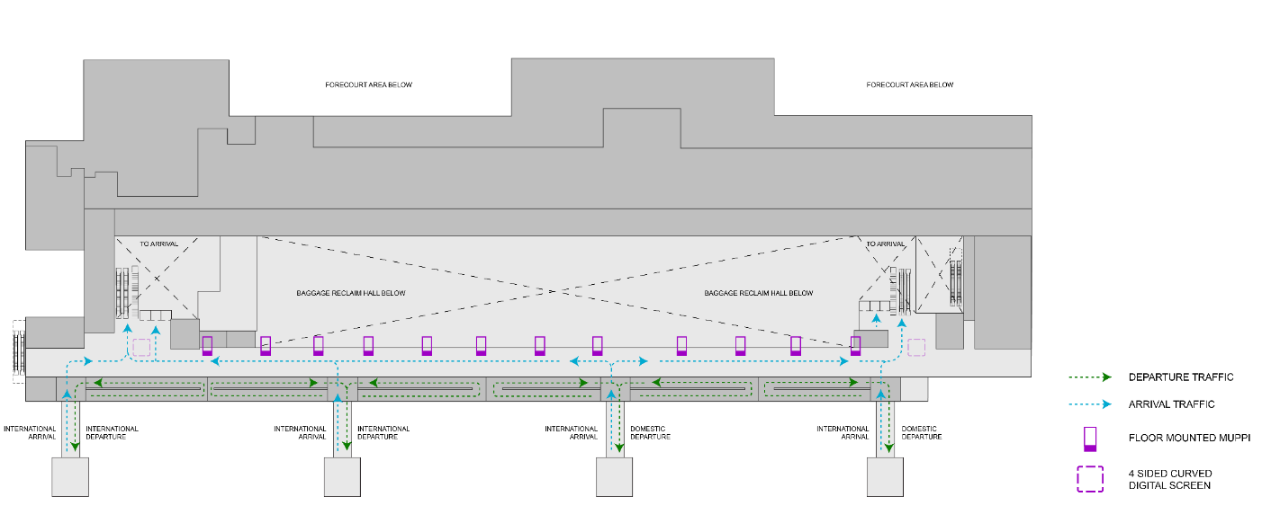
T1- DOMESTIC
Arrival | Arrival Area | 3 W X 5.5 H ft (Package Of 12 Units) 2160 W X 3840 H px | 10 Sec In Every 60 Sec
www.themediaant.com
Notes:
‹#›

Slide 12
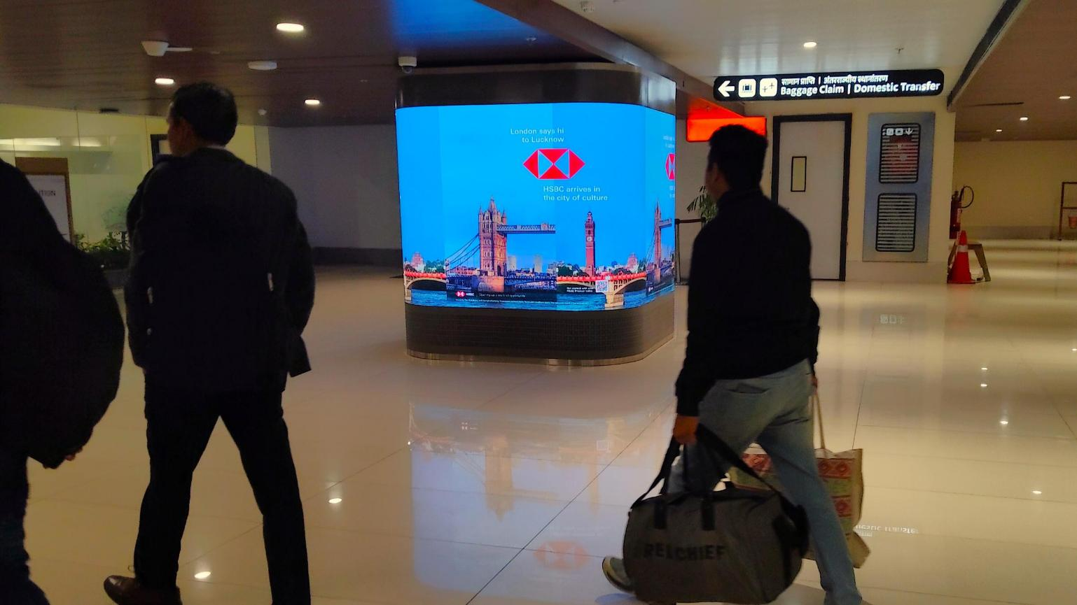
T1- DOMESTIC
Arrival | Arrival Area | 6 W X 6 H ft (Package Of 2 Units) | Exclusive
Digital Wall Quad Sided
Note: This is an exclusive media placement dedicated to a single advertiser and runs continuously throughout the operating hours. There is no fixed minimum or maximum creative duration; the advertiser can determine the creative duration based on their requirements.
www.themediaant.com
Notes:
‹#›

Slide 13
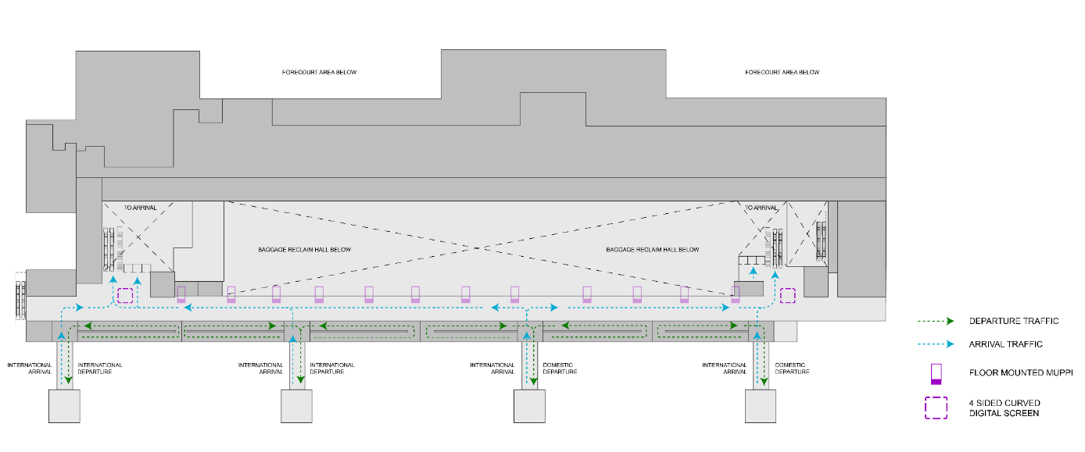
T1- DOMESTIC
Arrival | Arrival Area | 6 W X 6 H ft (Package Of 2 Units) | Exclusive
www.themediaant.com
Notes:
‹#›

Slide 14
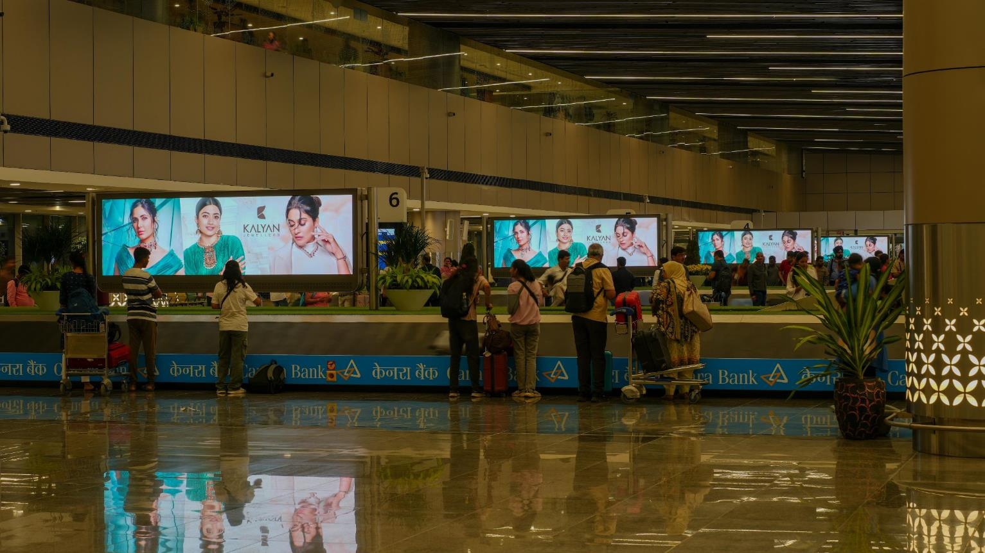
T1- DOMESTIC
Arrival | Baggage Claim | 12 W X 4 H ft (Package Of 7 Units) 1536 W X 432 H px | 10 Sec In Every 120 Sec
Digital Wall Double Sided
www.themediaant.com
Notes:
‹#›

Slide 15
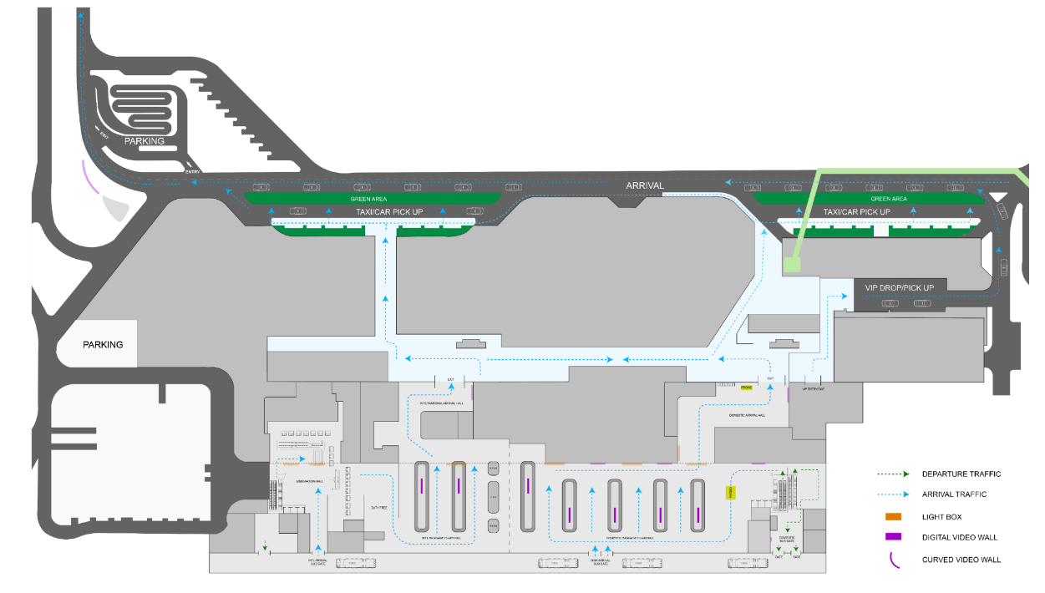
T1- DOMESTIC
Arrival | Baggage Claim | 12 W X 4 H ft (Package Of 7 Units) 1536 W X 432 H px | 10 Sec In Every 120 Sec
www.themediaant.com
Notes:
‹#›

Slide 16





www.themediaant.com
ad@themediaant.com
Thank You
080-067415510
Empowering All To Advertise
Notes:
‹#›

